Slide 1

November 19th, 2019
Duluth Airport Authority
2019 3rd Quarter Financial Update

Slide 2
Duluth Airport Authority UNAUDITED
Budget VS Actual
Duluth Airport Authority
DAA Board Packet Budget vs. Actual Summary
From Jan 2019 to Sep 2019
Unaudited
Financial Row | Prior Year Actual (Jan 2018 - Sep 2018) | Current Year Actual (Jan 2019 - Sep 2019) | Budget Amount (Jan 2019 - Sep 2019) | Variance from Prior Year | Variance From Budget | Total Budget (Jan 2019 - Adjust 2019 )
Ordinary Income/Expense
Income
Non-Aeronautical Revenue | 2,242,976 | 2,543,139 | 2,091,290 | 300,162 | 451,849 | 2,651,808
Non-Passenger Aeronautical Revenue | 1,205,065 | 1,196,105 | 1,143,589 | (8,960) | 52,516 | 1,510,738
Passenger Airline Aeronautical Revenue | 931,478 | 1,095,691 | 1,055,840 | 164,212 | 39,851 | 1,407,786
Total - Income | 4,379,519 | 4,834,934 | 4,290,719 | 455,415 | 544,216 | 5,570,332
Gross Profit | 4,379,519 | 4,834,934 | 4,290,719 | 455,415 | 544,216 | 5,570,332
Expense
Miscellaneous Expenses | 20,450 | 25,808 | 21,491 | 5,358 | 4,317 | 29,625
Personnel Compensation & Benefits | 1,413,359 | 1,543,282 | 1,590,873 | 129,923 | (47,591) | 2,210,849
Services and Charges | 1,203,477 | 1,240,241 | 1,210,718 | 36,764 | 29,523 | 1,614,373
Supplies | 331,680 | 464,527 | 348,180 | 132,847 | 116,347 | 461,435
Total - Expense | 2,968,966 | 3,273,858 | 3,171,262 | 304,892 | 102,596 | 4,316,282
Net Ordinary Income | 1,410,553 | 1,561,077 | 1,119,457 | 150,523 | 441,620 | 1,254,050
Other Income and Expenses
Other Income
Non-Operating Revenue | 460,147 | 521,091 | 416,000 | 60,944 | 105,091 | 524,000
Total - Other Income | 460,147 | 521,091 | 416,000 | 60,944 | 105,091 | 524,000
Other Expense
Non-Operating Expense | 248,758 | 228,533 | 285,273 | (20,225) | (56,740) | 379,834
Total - Other Expense | 248,758 | 228,533 | 285,273 | (20,225) | (56,740) | 379,834
Net Other Income | 211,389 | 292,558 | 130,727 | 81,168 | 161,831 | 144,166
Net Income Exclusive of Project Expenses, Depreciation & Amortization | 1,621,943 | 1,853,634 | 1,250,184 | 231,692 | 603,450 | 1,398,216
Projects/Grants | 2,871,919 | 2,240,922 | 13,682,929 | (630,997) | (11,442,007) | 18,243,905
Depreciation & Amortization | (7,703,378) | (21,229) | (7,196,914) | 7,682,149 | 7,175,685 | (9,588,809)
Net Income | (3,209,516) | 4,073,327 | 7,736,199 | 7,282,843 | (3,662,872) | 10,053,312
* This report is based on an allocated budget, which is seasonally adjusted. At this time the DAA is at a positive variance of over 600k.
* The results of this report are expected to change slightly with adjustments as delays in receipt of invoices occurs from time to time.
* The largest variance from budget in revenues comes from concession revenue specifically parking and car rental concessions. Revenue is over 544k over budget.
* The largest variance from budget in expenses comes from increased fuel and sand costs due to the harsh winter conditions and increased per gallon price of fuel as well as an unbudgeted heavy equipment repair. Fortunately personnel compensation and benefits is under budget, which leave us with an expense total of just over $100k over budget.
* Non-operating income is up due to increased PFC collections while expenses are down in budgeted interest expenses on the line of credit since it has not yet been used much this year.

Slide 3
8% under the three year average and 8.5% under 2018
Totals
62,729 42,589
Notes:
1998 - 64,235
1999 - 61,434
2000 - 61,641
2001 - 68,060
2002 - 74,832
2003 - 75,668
2004 - 70,943
2004 Jan-Aug 49,638
2005 Jan-Aug 46,864
(11.6% is military)
decrease of 2,774

Slide 4
18.7% above the 3 year average and 12% more than 2018.
Included green trend line for when Allegiant operated for comparison – only 3% under 2013-2014 passenger count through Sept.
Total
261,537
237,152
315,416

Slide 5
Revenues

Slide 6
18% over the 3 yr average & 19% over budget
Totals 366,666 329,245 366,085
Notes:
Landing Fees 2000 $349,596
Landing Fees 2001 $317,565
Landing Fees 2002 $348,551
Landing Fees 2003 $320,749
Landing Fees 2004 $337,389
January 2003 - changed computation method to reflect actual
Landings instead of projected based on scheduled flights
plus or minus additions and cancellations
July 2002 NW rate increased from $.82 to $.84 per 1,000 lbs
March 2004 NW rate increased from $.84 to $.86 per 1,000 lbs
March 2005 NW rate increased from $.86 to $.88 per 1,000 lbs
July 2005 FEDEX rate will increase to $.92 per 1,000 lbs

Slide 7
26% over 3 year average, 25% over budget & 17% over 2018
Totals 504,826 497,703 498,500

Slide 8
17% over 3yr avg., 19% over budget & 14% over 2018 actual
Total
1,100,064
942,198
1,060,000

Slide 9
90.36% over 2018 & 126% over budget
Total
10,808
15,115
8,275

Slide 10
32% over 3 yr. average, 34% over budget & 19% over 2018
Totals
468,491
494,159 461,000
Notes:
1998 - $2,576,701 gross sales $257,670 DAA earned
1999 - $3,336,872 gross sales $333,687 DAA earned
2000 - $3,439,426 gross sales $343,942 DAA earned
2001 - $3,455,663 gross sales $345,566 DAA earned
2002 - $3,618,900 gross sales $379,113 DAA earned
2003 - $3,063,003 gross sales $306,300 DAA earned
2004 - $3,537,023 gross sales $353,702 DAA earned
Duluth Airport Authority earns 10%
2004 Jan-Aug $2,500,582
2005 Jan-Aug $2,512,757
$12,175 increase or .5% over 2004

Slide 11
33% over the 3 yr avg., 31% over budget & 19% over 2018
Totals
69,917
67,780 68,000
Notes:
1998 - $2,576,701 gross sales $257,670 DAA earned
1999 - $3,336,872 gross sales $333,687 DAA earned
2000 - $3,439,426 gross sales $343,942 DAA earned
2001 - $3,455,663 gross sales $345,566 DAA earned
2002 - $3,618,900 gross sales $379,113 DAA earned
2003 - $3,063,003 gross sales $306,300 DAA earned
2004 - $3,537,023 gross sales $353,702 DAA earned
Duluth Airport Authority earns 10%
2004 Jan-Aug $2,500,582
2005 Jan-Aug $2,512,757
$12,175 increase or .5% over 2004

Slide 12
20% over the 3yr avg., 22.5% over budget & 12% over 2018
Totals
275,504
257,860
268,000

Slide 13
Cost Per Enplaned Passenger (CPE)
The average passenger airline payments per enplaned passenger at an airport.
Cost to an airline for operating out of an airport.
Varies based on costs included as well as reported enplanements.
Key metric to evaluate the financial operations of an airport.
Provides only partial information about the financial operations of an airport and must be considered with other metrics.

Slide 14
2018 Rank: 180/290
Using 2018 comparable this puts us at: 210/290
In 2015 DWU Consulting online the average CPE for small hub airports was $11.53
Goal is to remain under $10

Slide 15
Operating Expenditures

Slide 16
11% over 3 year average, 3% under budget & 9% over 2018
Totals
2,033,153
1,543,282
2,210,849

Slide 17
28% over 3 year average, 20% over budget, 26% over 2018
Totals
481,965
419,222
461,435

Slide 18
7% under 3 year average, 6% under budget & 10% under 2018
Received nearly 17k credit. Excluding the credit we are within 1% of budget.
Totals
468,390
315,182
466,643

Slide 19

Q3 2019 Financials
Financial Row | Prior Year Actual (Jan 2018 - Sep 2018) | Current Year Actual (Jan 2019 - Sep 2019) | Budget Amount (Jan 2019 - Sep 2019) | Variance from Prior Year | Variance From Budget | Total Budget (Jan 2019 - Adjust 2019 )
Ordinary Income/Expense
Income
Non-Aeronautical Revenue | 10,404 | 11,722 | 10,489 | 1,318 | 1,234 | 22,450
Non-Passenger Aeronautical Revenue | 103,079 | 105,122 | 94,855 | 2,043 | 10,267 | 112,444
Total - Income | 113,483 | 116,844 | 105,344 | 3,361 | 11,500 | 134,894
Gross Profit | 113,483 | 116,844 | 105,344 | 3,361 | 11,500 | 134,894
Expense
Miscellaneous Expenses | 1,243 | 737 | 1,930 | (506) | (1,193) | 2,350
Personnel Compensation & Benefits | 44,543 | 46,359 | 59,398 | 1,816 | (13,039) | 79,198
Services and Charges | 13,346 | 14,768 | 17,829 | 1,421 | (3,061) | 23,560
Supplies | 74,576 | 60,142 | 64,177 | (14,433) | (4,035) | 65,845
Total - Expense | 133,709 | 122,007 | 143,335 | (11,702) | (21,328) | 170,953
Net Ordinary Income | (20,225) | (5,162) | (37,990) | 15,063 | 32,828 | (36,059)
Other Income and Expenses | (85) | 0 | 0 | 85 | 0 | 0
Net Income Exclusive of Project Expenses, Depreciation & Amortization | (20,310) | (5,162) | (37,990) | 15,148 | 32,828 | (36,059)
Projects/Grants | 2,527,708 | 487,586 | 3,118,353 | (2,040,122) | (2,630,767) | 4,157,804
Depreciation & Amortization | (488,905) | 0 | 0 | 488,905 | 0 | 0
Net Income | 2,018,493 | 482,424 | 3,080,362 | (1,536,069) | (2,597,939) | 4,121,745
Sky Harbor is operating with a positive variance vs budget of nearly $33k.
Revenues are 11.5k over budget and expenses are over 21k under budget. Personnel costs and aviation gas purchases are down substantially as well as reduced spending across nearly all accounts.

Slide 20
Long-Term Liabilities
 | City Loan 1 (Bonding) |  |  |  | City Loan 2 (Bonding) | DEDA Amort | NCA Loan | City Loan 3 (Bonding) | Total Annual Long-Term Liability
Fund Source | CFC | PFC | DAA OPERATING | Total | PARKING REVENUES | 0% | 8.85% | LSC RENT
2012 | 192,681.26 | 321,781.26 | 107,518.76 | 621,981.28 | - | 26,666.64 | 75,000.00 |  | 723,647.92
2013 | 189,981.26 | 322,281.26 | 111,018.76 | 623,281.28 | - | 26,666.64 | 75,000.00 |  | 724,947.92
2014 | 192,281.26 | 322,681.26 | 109,418.76 | 624,381.28 | 115,718.04 | 26,666.64 | 75,000.00 |  | 841,765.96
2015 | 194,481.26 | 322,981.26 | 107,818.76 | 625,281.28 | 338,981.26 | 26,666.64 | 75,000.00 |  | 1,065,929.18
2016 | 191,581.26 | 323,181.26 | 106,218.76 | 620,981.28 | 340,571.26 | 26,666.64 | 75,000.00 | 242,752.33 | 1,305,971.51
2017 | 193,681.26 | 323,281.26 | 109,618.76 | 626,581.28 | 336,071.26 | 26,666.64 | 75,000.00 | 247,137.50 | 1,311,456.68
2018 | 190,681.26 | 323,281.26 | 107,918.76 | 621,881.28 | 335,446.26 | 26,666.64 | 75,000.00 | 247,337.50 | 1,306,331.68
2019 | 192,681.26 | 323,181.26 | 106,218.76 | 622,081.28 | 338,776.26 | 26,666.64 | 37,500.00 | 247,387.50 | 1,272,411.68
2020 | 194,193.76 | 322,331.26 | 109,306.26 | 625,831.28 | 336,336.26 | 26,666.64 | - | 247,287.50 | 1,236,121.68
2021 | 195,393.76 | 326,037.50 | 107,168.76 | 628,600.02 | 338,006.26 | 2,222.62 | - | 247,037.50 | 1,215,866.40
2022 | 191,268.76 | 324,162.50 | 109,918.76 | 625,350.02 | 338,443.76 | - | - | 246,637.50 | 1,210,431.28
2023 | 191,937.50 | 321,812.50 | 107,425.00 | 621,175.00 | 338,108.76 | - | - | 246,087.50 | 1,205,371.26
2024 | 192,050.00 | 323,618.76 | 109,693.76 | 625,362.52 | 336,971.26 | - | - | 245,387.50 | 1,207,721.28
2025 | 191,800.00 | 324,768.76 | 111,693.76 | 628,262.52 | 340,143.76 | - | - | 244,537.50 | 1,212,943.78
2026 | 196,175.00 | 325,237.50 | 108,412.50 | 629,825.00 | 337,393.76 | - | - | 243,437.50 | 1,210,656.26
2027 |  |  |  |  | 339,218.76 |  |  | 246,877.50 | 586,096.26
2028 |  |  |  |  |  |  |  | 244,675.00 | 244,675.00
2029 |  |  |  |  |  |  |  | 246,975.00 | 246,975.00
2030 |  |  |  |  |  |  |  | 243,695.00 | 243,695.00

Slide 21
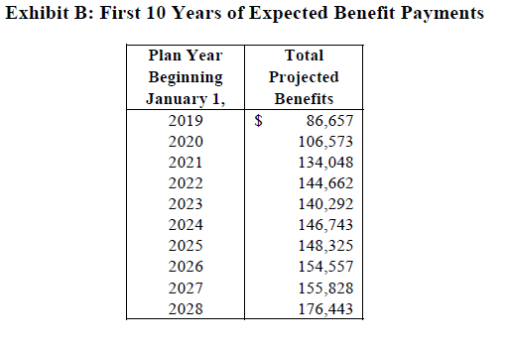
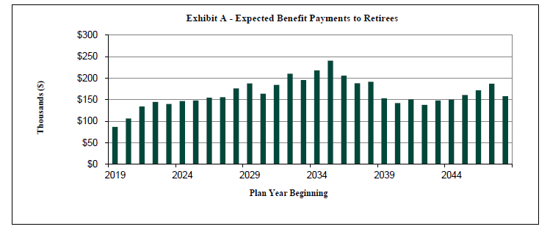
Other Post-Employment Benefits
Retiree Benefit Expenses
2019 expenses are budgeted for $66,360.
The DAA is on a pay as you go plan
OPEB Liability at YE 2018 was $2,865,609.
Those hired after Jan. 1, 2007 and working a minimum of 15yrs receive $250 monthly contribution for single/$500 monthly for family.

Slide 22
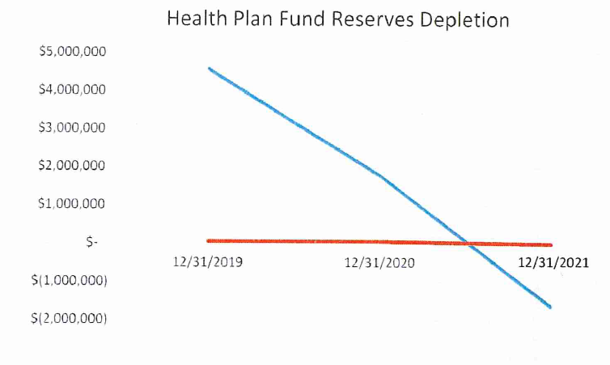
JPE – Health Insurance Pool
Health Insurance Premiums have been increasing by 10% or double digits annually for multiple years, which is not expected to change.
The Joint Powers Board has recognized this as an issue for sustainability of the plan in to the future.
The Joint Powers Board has been working on education of employees, wellness initiatives and is researching options available to help control costs.

Slide 23
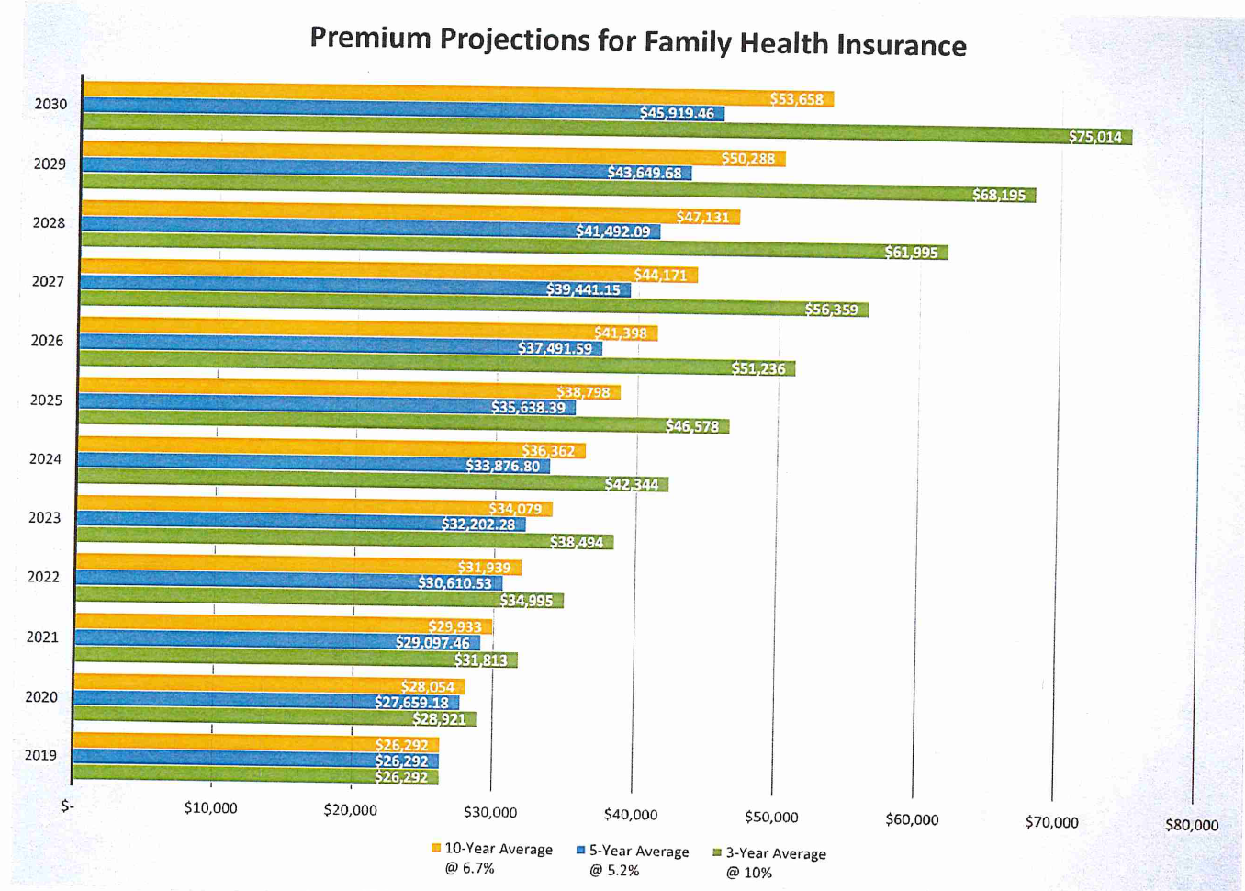

Slide 24
Questions ...

Slide 25
Gross Revenues are 3% above the 3 year average.
Total
1,263,759
989,848
Notes:
1998 $464,009 gross sales DAA earned $350,582
1999 $597,704 gross sales DAA earned $478,752
2000 $627,853 gross sales DAA earned $499,347
2001 $635,082 gross sales DAA earned $513,457
2002 $697,848 gross sales DAA earned $565,148
2003 $640,000 gross sales DAA earned $513,000
2004 $796,757 gross sales DAA earned $641,548
Income Calculation
$0 - $110,000 0%
$110,000 - $210,000 100%
$210,000 - $400,000 95%
excess of $400,000 91%
2004 Jan-Aug $509,269
2005 Jan-Aug $514,224
$4,955 increase 1% increase over 2004

Slide 26
A 7.3% Decrease in Gross Receipts compared to 4 year average Sept.
Totals
4,739,876
3,395,792
Notes:
1998 - $2,576,701 gross sales $257,670 DAA earned
1999 - $3,336,872 gross sales $333,687 DAA earned
2000 - $3,439,426 gross sales $343,942 DAA earned
2001 - $3,455,663 gross sales $345,566 DAA earned
2002 - $3,618,900 gross sales $379,113 DAA earned
2003 - $3,063,003 gross sales $306,300 DAA earned
2004 - $3,537,023 gross sales $353,702 DAA earned
Duluth Airport Authority earns 10%
2004 Jan-Aug $2,500,582
2005 Jan-Aug $2,512,757
$12,175 increase or .5% over 2004

