Slide 1
Operations/Construction/Planning
AFTIL Siting Study Update – September 20th – 22^{nd,}
Air Traffic Control Project Timeline
Hangar 101 Demolition Update
Runway 3/21 Lighting and Signage Update
Taxiway A – Phase 1 Construction Update
TSA Inspection
Parking Technology System Upgrade RFP

Slide 2
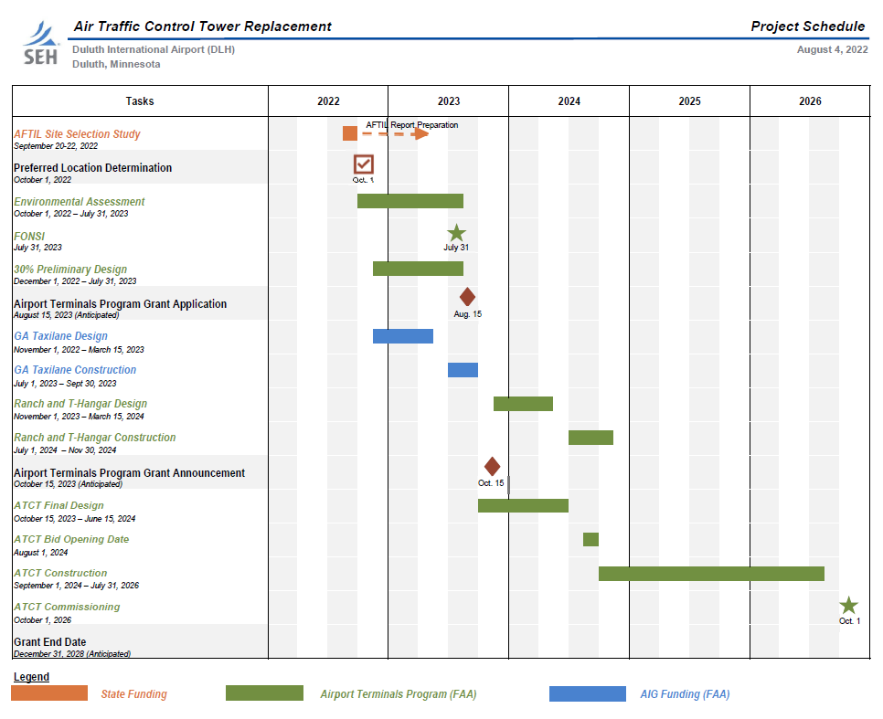


Slide 3
Operations/Construction/Planning
AFTIL Siting Study Update
Air Traffic Control Project Timeline
Hangar 101 Demolition Update
Runway 3/21 Lighting and Signage Update
Taxiway A – Phase 1 Construction Update
TSA Inspection
Parking Technology System Upgrade RFP

Slide 4
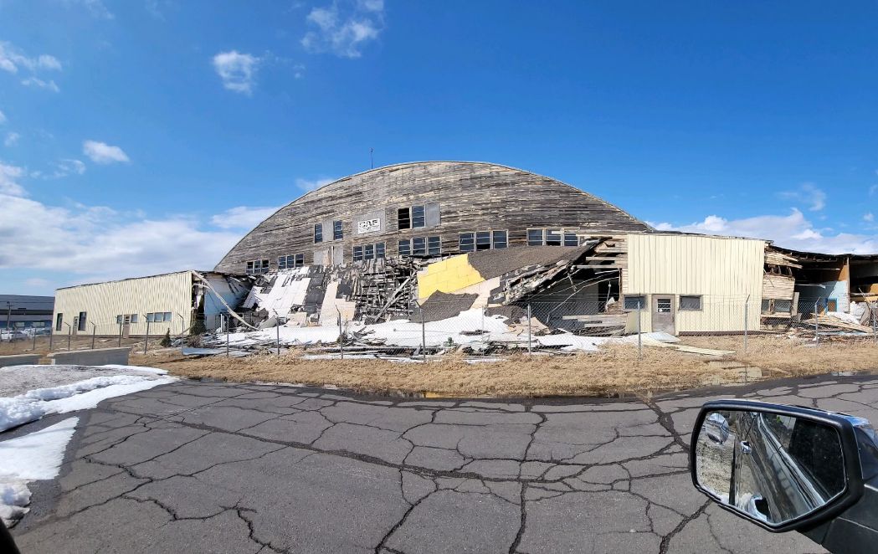
Hangar 101 Demolition Update
(Before)

Slide 5
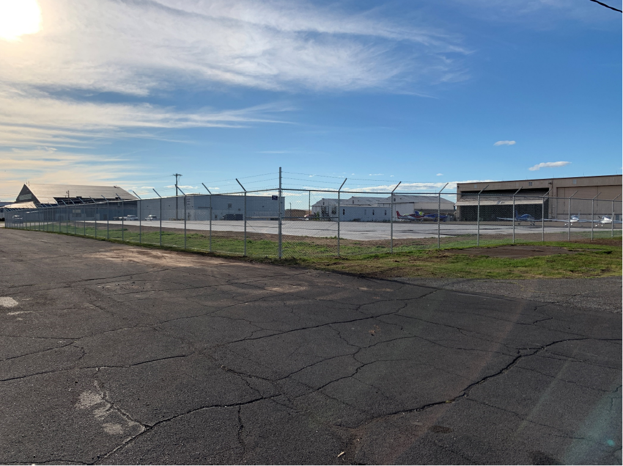
Hangar 101 Demolition Update
(After)

Slide 6
Operations/Construction/Planning
AFTIL Siting Study Update
Air Traffic Control Project Timeline
Hangar 101 Demolition Update
Runway 3/21 Lighting and Signage Update
Taxiway A – Phase 1 Construction Update
TSA Inspection
Parking Technology System Upgrade RFP

Slide 7
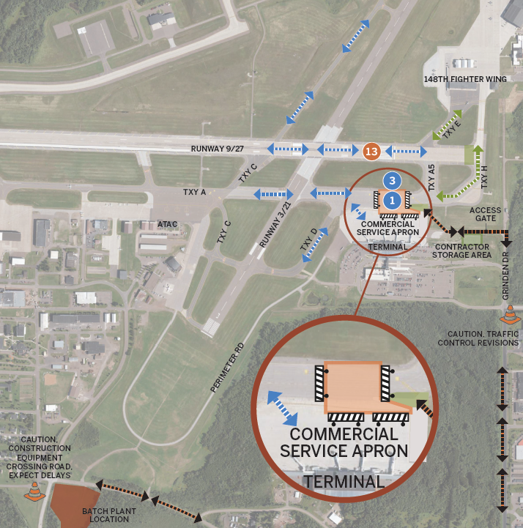
Taxiway A
Phase 1B

Slide 8
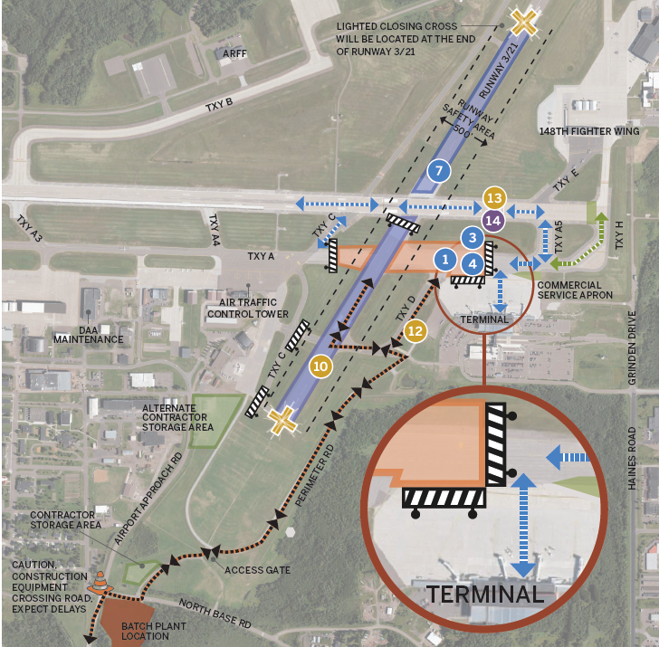
Taxiway A
Phase 1A

Slide 9
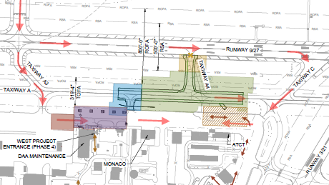
A. Resolution to Accept and Award Contract between the DAA and Shafer Contracting Co, Inc. for the Construction of Taxiway A Phase 2 & 4, and Phase 1 of the Midfield Ramp.
Total Contract Award: $11,335,917.12
                $9,975,500 of the total is FAA eligible and will be funded at 90% by FAA ($8,977,950), 5% by MnDOT ($498,775) and 5% by DAA ($ 498,775).
                $484,725 is FAA ineligible and is funded by the 148th Fighter Wing at 100%.
                $875,692 is MnDOT eligible and will be funded at 70% by MnDOT ($612,985), and 30% by DAA ( $ 262,707).

Slide 10
A. Resolution to Accept and Award Contract between the DAA and Shafer Contracting Co, Inc. for the Construction of Taxiway A Phase 2 & 4, and Phase 1 of the Midfield Ramp.

Slide 11
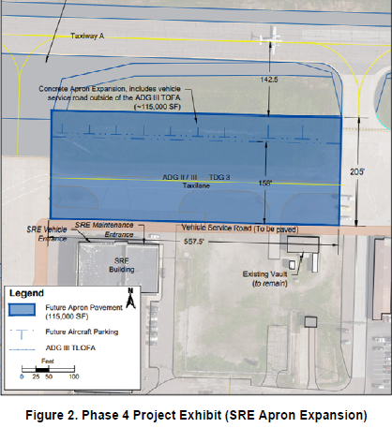
B. Resolution to Approve Work Order 2022–14 Between the Duluth Airport Authority and SEH, Inc. for the Construction Administration of Midfield Ramp Reconstruction – Phase 1.
              Total Cost is $124,300.00
              The project is funded by MnDOT at 70% (87,010) and 30% by DAA ($37,290).

