Slide 1
Operations/Construction/Planning
AFTIL Siting Study Update
Runway 3/21 Lighting and Signage Update
Taxiway A – Phase 1 Construction Update
Taxiway A – Phase 2+4 +Midfield Ramp Phase 1 Funding and Construction Update
DYT – Apron Rehab
DYT – Building Area Master Plan
DYT – Terminal Building Study

Slide 2
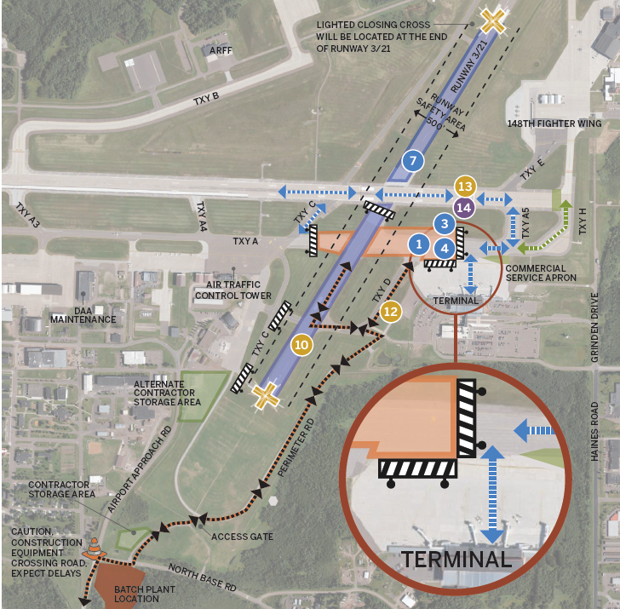
Taxiway A
Phase 1A

Slide 3
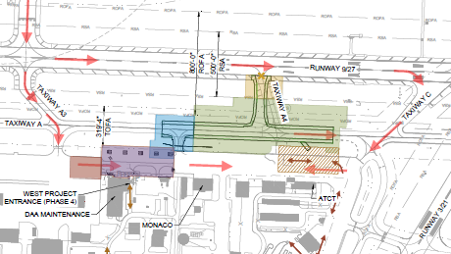
Taxiway A – Phase 2+4 +Midfield Ramp Phase 1 Funding and Construction Update
Grant Received - $12,058,696.00

Slide 4
A. Resolution to Approve an Agreement Between the Duluth Airport Authority and Hub Parking Technology USA, Inc for a Parking Technology System Upgrade

Slide 5
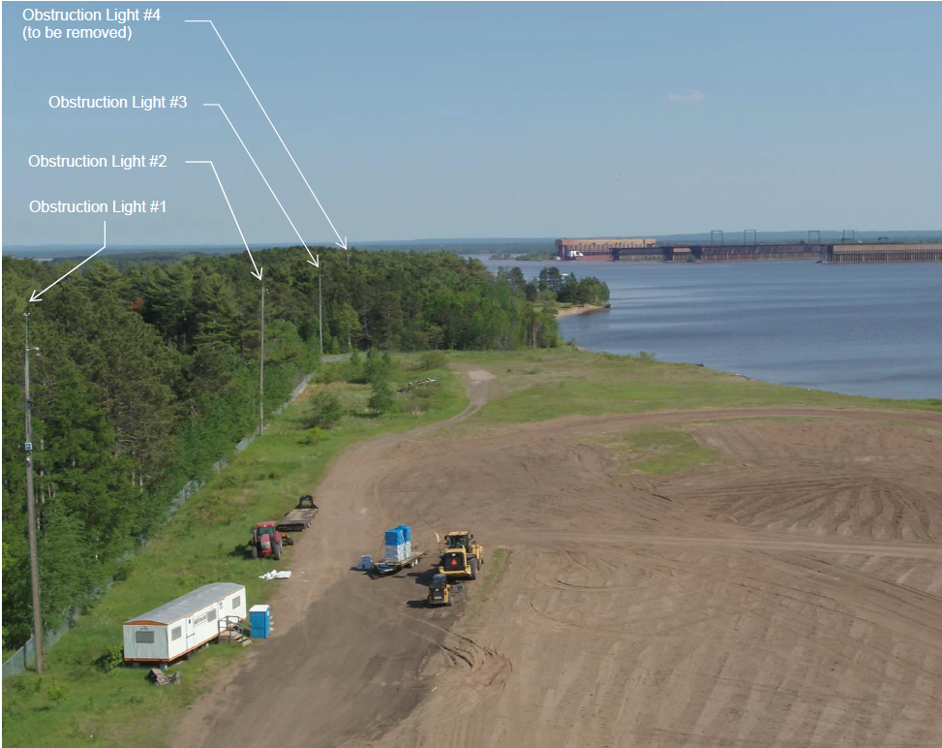

B. Resolution to Approve Work Order 2022-15 Between the Duluth Airport Authority and Short Elliott Hendrickson, Inc., for the Removal of the Obstruction Light at Sky Harbor (DYT) Airport
              Project Description - As part of the Runway 14/32 relocation project, obstruction light modifications are required as outlined in the environmental permit conditions. The project will include analysis of the need to raise the lights to accommodate future tree growth.
              The proposal amount is $21,600.00
              The project is funded by FAA at 90%, MnDOT at 5%, and the DAA at 5%.

Slide 6
C. Resolution to Approve Work Order 2022-13 Between the Duluth Airport Authority and Short Elliott Hendrickson, Inc., for Air Traffic Control Tower and General Aviation Hangar Road Repairs
Project Description – Pavements along the Air Traffic Control Tower (ATCT) access road are in poor or failed condition. The DAA, as part of the pavement management plan and the Master Plan Study, has indicated specified areas to receive pavement maintenance. Two roadway networks were analyzed and recommended for repair.
The proposal amount is $16,800.00
The project is funded by MnDOT at 70%, and the DAA at 30%.

Slide 7
D. Resolution to Approve an Agreement Between the Duluth Airport Authority and Northland Companies for the Air Traffic Control Tower Road Repair Project, in the Amount of $143,624.00
                The project included a base bid and three alternates to matching funding availability with the most critical road repair needs. Staff recommends awarding base bid and alternates 1 and 2 to complete necessary road repairs and replace two drainage structures in poor condition. Four bids were received.
                The project will be funded by MnDOT at 70% by MnDOT ($100,537), and 30% by DAA ( $43,087).

