Slide 1
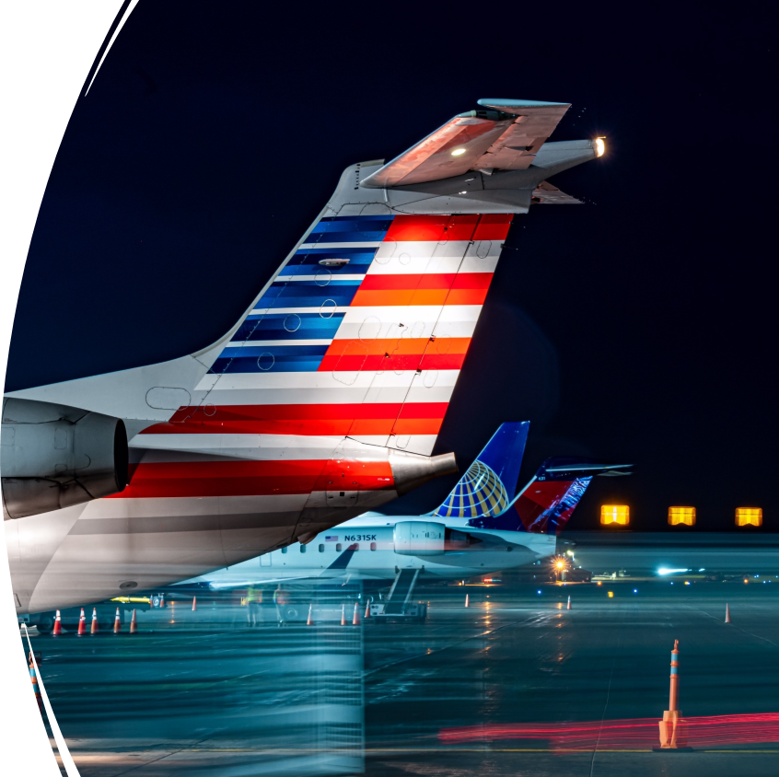
Duluth International Airport Air Service Update
DAA Board Meeting
20DEC22

Slide 2
YTD enplanements -20% (2019)
YTD enplanements
26% (2021)
November enplanements
1% (NOV21)
DL passengers
-32% (NOV21)
UA passengers
182% (NOV21)
*Does not include Landline
%

Slide 3
DL -31% (NOV21)
UA 205% (NOV21)
LL -62% (NOV21)
*Incomplete 2020 Landline data

Slide 4
DLH Future Scheduled Capacity: December-April

Slide 5
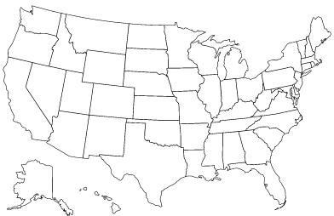
Air Service News and Notes
National Notes
DL preliminary agreement with pilots’ union
30%+ wage increases
clause guaranteeing that they’re the highest paid in the industry
UA and AA likely to follow suit
Sun Country adjusted RSW schedules for January through April
Suspending and/or tagging several
Markets include DLH, MSN, RST, and GRB
SkyWest indicates that pilot attrition peaked in October and has been improving since; they hope to see steady improvement in the availability of pilots going forward
AA capacity will be up over 50% in aggregate in ORD markets under 500 miles
Appears to target market where DL has pulled back
Could bode well for AA’s return to DLH???
Local Notes
SY’s RSW route is still planned for the upcoming winter season
RSW marketing is active
Route Map
MSP Daily
ORD Daily
RSW, PHX Seasonally, IFP Charters

Slide 6
DLH Advanced Bookings

Slide 7
DLH Leakage
*Source: ArcCorp

Slide 8
Top 30 U.S. Airports seat capacity change: November 2022 vs 2019

Slide 9
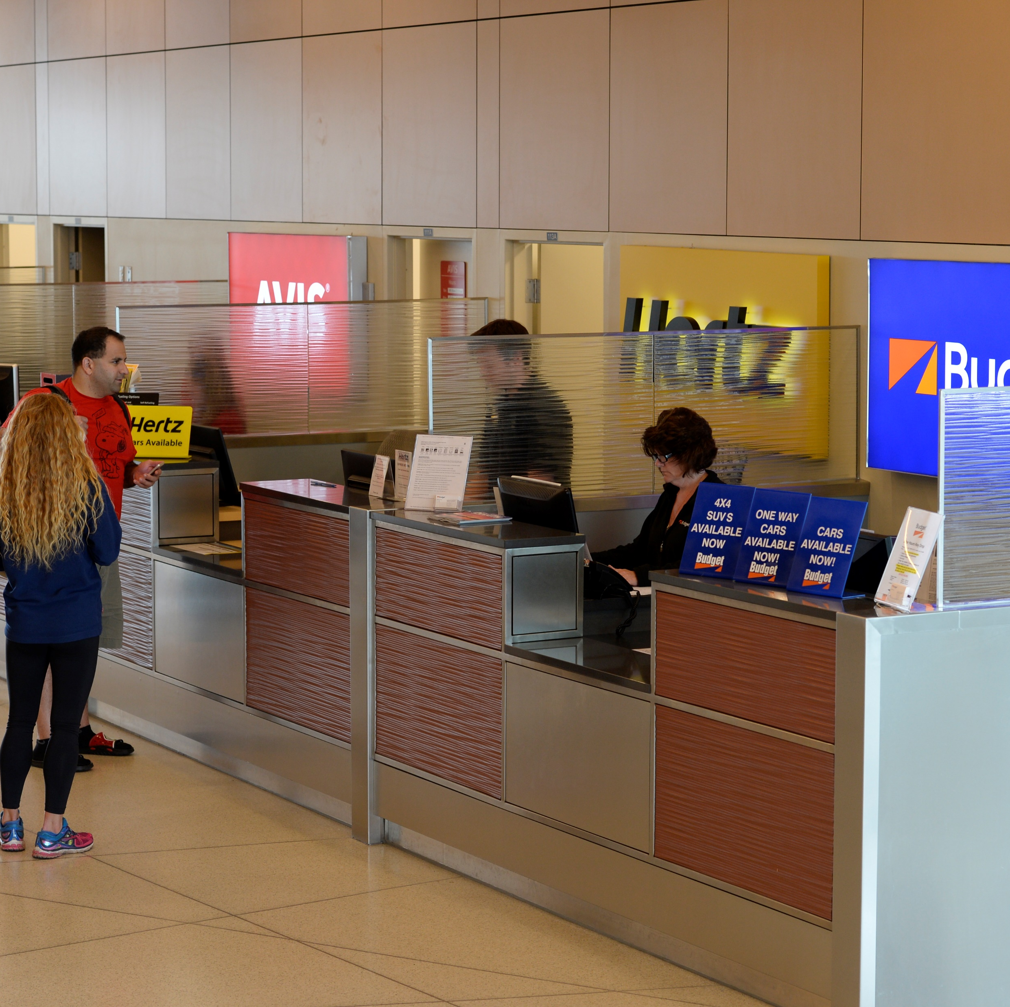
Duluth International Airport Key Activity Metrics Global Pandemic Recovery
12/19/2022
9

Slide 10
Air Cargo
Freight-in volume has softened the last 4 months compared to the same period 2021 and 2022
Freight-out has also softened the last 4 months compared to the same period 2021 and 2020

Slide 11
Fuel Sales
-16% YTD Fuel Sales (2019)
20% YTD Fuel Sales (2021)
May 2022
-19% (MAY19)
26% (MAY21)

Slide 12
Rental Car
YTD Gross Receipts -4% (2019)
May 2022
-12% (MAY19)
18% (MAY21)

Slide 13
Parking Lot
YTD Gross Receipts 9% (2019)
May 2022
0% (MAY19)
30% (MAY21)

Slide 14
Restaurant
YTD Gross Receipts 17% (2019)
Jun 2022
-33% (JUN19)
17% (JUN21)

