Slide 1
Operations/Construction/Planning
Duluth International Airport
ATCT Architecture and Engineering Request for Qualification Solicitation
Taxiway C North Reconstruction - MnDOT
Parking Technology Installation Update
February 24th, 2023 - Aircraft Accident
Sky Harbor Airport
Airport Terminal Program – Sky Harbor Airport Terminal Result
Sky Harbor Manager Staffing Update

Slide 2
A. Resolution to Approve Master Service Agreement between the Duluth Airport Authority and Short Elliott Hendrickson Inc. for Planning, Engineering, Environmental, and Design Services
Project Description - In accordance with FAA Advisory Circular 150/5100-14E, FAA grant assurances, and the policies and procedures of the Duluth Airport Authority, airports seeking FAA funding support are required to have selected an airport consultant within the previous five years for selected projects.
Upon completion of the open solicitation the DAA received one submission from Short Elliott Hendrickson (SEH). The selection committee completed an independent review of the submitted proposal and declared that SEH’s submission was complete and fully qualified. DAA staff recommends selecting SEH as the airport consultant for the next five-year period.

Slide 3
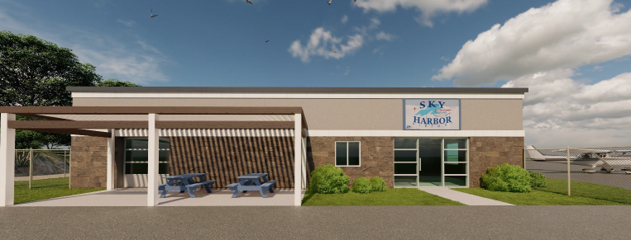
B. Resolution to Approve Work Order 2023 – 3 between the Duluth Airport Authority and Short Elliott Hendrickson Inc. for the Design of the new General Aviation Terminal at Sky Harbor Airport (DYT)
Project Description – The project consists of designing a new terminal building at the Sky Harbor Airport (DYT). This project replaces the 40-year-old, 2-story terminal with a new single-story terminal. The proposed terminal will include a pilot-planning room, waiting room, restrooms, and general office space.
The proposal amount is $163,900.00
Eligible portions of the project are anticipated to be funded by FAA at 95%, and the DAA at 5%. The FAA portion is funded with competitive Airport Terminal Program (ATP) funding through the Infrastructure Investment and Jobs Act (IIJA).

Slide 4
C. Resolution to Approve Reimbursable Agreement between the Duluth Airport Authority and the Federal Aviation Administration for the Preliminary Design support of the Air Traffic Control Tower Replacement Project
Description – The existing ATCT facility at DLH is over 70 years old and is in poor condition. The ATCT cab height does not provide adequate site lines for the entire airfield, causing safety concerns. The ATCT condition, existing location and proposed replacement was studied as part of the recently completed comprehensive Airport Master Plan. The DAA received state funding to complete a site visit to the Airport Facilities Terminal Integration Laboratory (AFTIL). The reimbursable agreement (RA) will allow FAA staff to provide preliminary design and coordination services to the DAA and the ATCT design team.
The cost of the preliminary study conducted by FAA is $59,940.00.
The RA costs will be included in future grant and bonding applications for funding.

