Slide 1
Operations/Construction/Planning
Duluth International Airport
ATCT Architecture and Engineering RFQ Update
ATCT Construction Delivery Method
2023 Construction Season Update
VMS Software Change Over
Duluth Sky Harbor Airport
Airport Terminal Program – Sky Harbor Airport Terminal Design

Slide 2
Design - Build
A single entity who controls all aspects of design and construction.
Pros:
Faster overall timeline to completion
Design -> Construction Autonomy
Efficient Communication
Can see cost savings
Construction can start before final design is complete
Cons:
Longer design time
Cannot have a separate construction company oversee construction
Greater risk of change orders
Less control once a GMP has been agreed too
Too many unknowns with the FAA
Overall new to airport industry

Slide 3
Construction Manager at Risk (CMAR)
A construction manager hired by the owner to complete design and construction under a Guaranteed Maximum Price (GMP)
Pros:
Most of the time accompanied by a GMP
Can see cost savings
Transfer of risk from owner to CM
Cons:
Longer design time
Too many unknowns with the FAA
Less control once a GMP has been agreed too
Potential conflicts as CM is also the GC.

Slide 4
Design - Bid - Build
Firm that designs a project, puts it out for bid, and then hires GC/CMA to complete construction.
Pros:
Traditional and familiar to the DAA
Greatest speed during design phase
Greatest flexibility during design phase
Designer will oversee construction through completion
Cons:
A longer process overall
No contractor input in design

Slide 5
Why Did the DAA Choose Design-Bid-Build?
Too many unknowns at this point
Speed needed during the design phase
Most flexible to respond to guidance changes
Familiar to the DAA/FAA

Slide 6
Operations/Construction/Planning
Duluth International Airport
ATCT Architecture and Engineering RFQ Update
ATCT Construction Delivery Method
2023 Construction Season Update
VMS Software Change Over
Duluth Sky Harbor Airport
Airport Terminal Program – Sky Harbor Airport Terminal Design

Slide 7
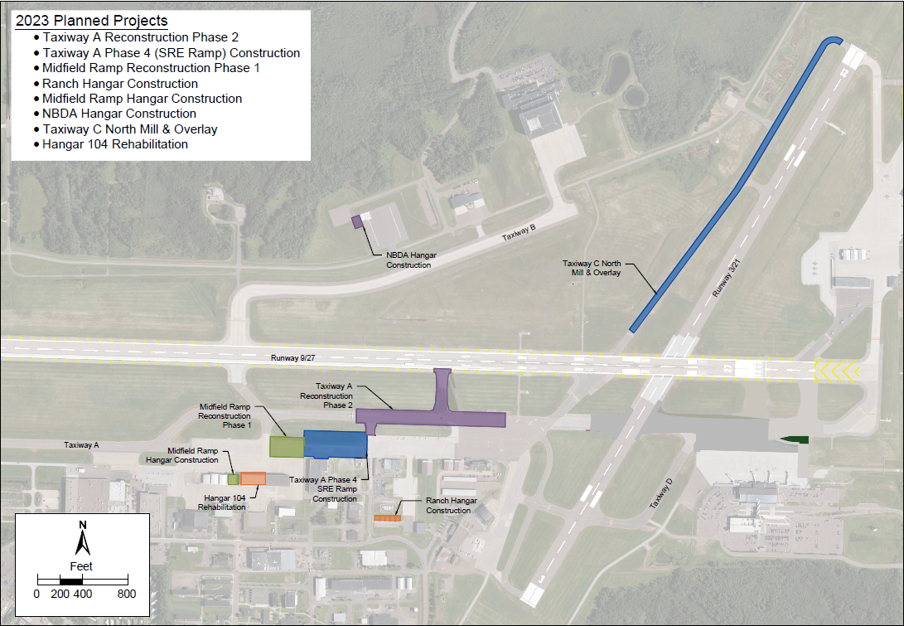

Slide 8
Operations/Construction/Planning
Duluth International Airport
ATCT Architecture and Engineering RFQ Update
ATCT Construction Delivery Method
2023 Construction Season Update
VMS Software Change Over
Duluth Sky Harbor Airport
Airport Terminal Program – Sky Harbor Airport Terminal Design

