Slide 1
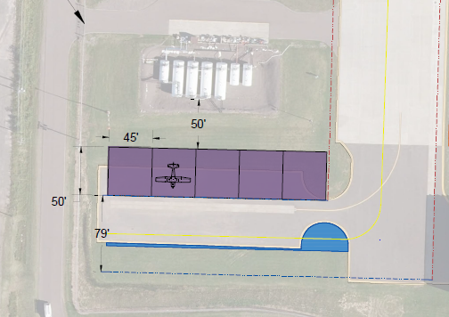
D. Resolution to Approve Work Order 2023 - 1 between the Duluth Airport Authority and Kraus Anderson Construction Company for Construction Phase Services as part of the Ranch Hangar project at Duluth International Airport (DLH)
Project Description: Construction Management Services for oversight of Ranch Unit Hangars
The scope of Construction-Phase Services includes administrative management of awarded Contractors, schedule management, construction meetings, submittals, construction phasing, budget tracking, cash flow reporting, pay applications, request for information processing, and additional services.
The proposal amount is $190,084.00.

Slide 2
E. Resolution to Award the Following Contracts for the Ranch Hangar Construction Project, Bid Package 1 of 1
Project Description – The bidding for construction of the 5-bay Ranch Hangar was completed on March 2, 2023.
9 Work Scopes for Construction were bid, for a total construction amount of $1,763,352.50.
The project is funded at 90 percent from the Infrastructure Bill
WS 01A – WSB and Associates $15,852.50
WS 03A – Northland Constructors $281,600.00
WS 08D – Nordpal Corp $115,950.00
WS 10B – Duluth Electrical $16,203.00
WS 13G – Radotich, Inc $421,729.00
WS 13H – Radotich, Inc $270,850.00
WS 23-B – A.G. O’Brien Plumb $63,745.00
WS 26A – Duluth Electrical $103,243.00
WS 31A – Ulland Brothers $474,180.00
Total $1,763,352.50

Slide 3
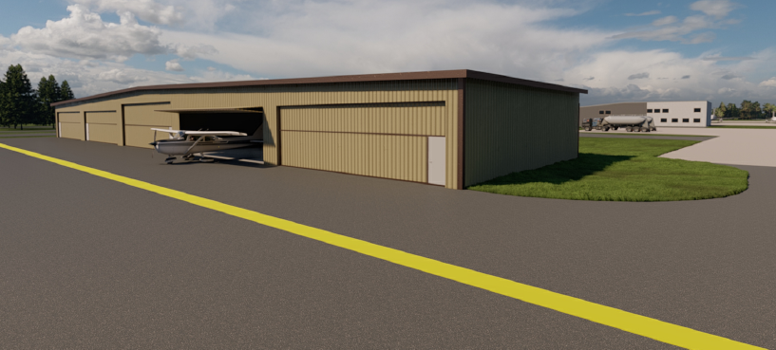
F. Resolution to Approve Work Order 2023 – 2 between the Duluth Airport Authority and Short Elliot Hendrickson, Inc. for Construction Support of the Ranch Hangar project at Duluth International Airport (DLH).
Project Description – The project consists of design support, grant management, as-built drawings, and closeout.
The proposal amount is $53,200.00
Eligible portions of the project are anticipated to be funded by FAA at 90%, and the DAA at 10% as part of the Infrastructure Bill.

Slide 4
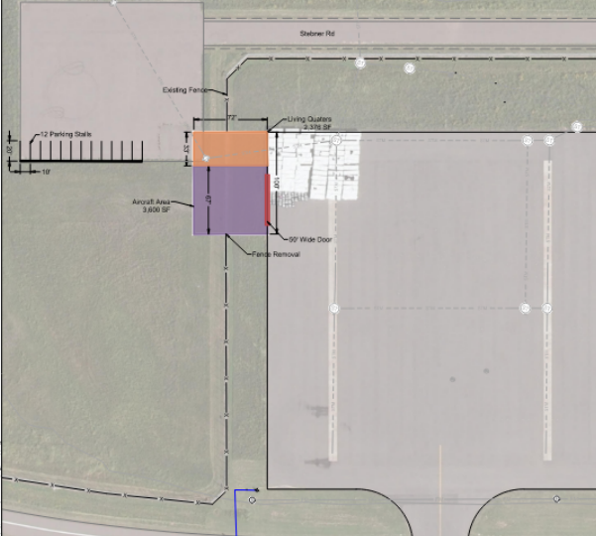
G. Resolution to Approve Work Order 2023 – 5 between the Duluth Airport Authority and Short Elliot Hendrickson, Inc. for the Design of North Business Development Hangar Construction Project at Duluth International Airport (DLH)
Project Description – The project consists of designing a new revenue generating 7,200 square foot hangar and crew quarters in the North Business Development Area.
The proposal amount is $229,300.00
Eligible portions of the project are anticipated to be funded by FAA at 90%, and the DAA at 10% as part of the Infrastructure Bill. Ineligible portions will be 100% DAA.

Slide 5
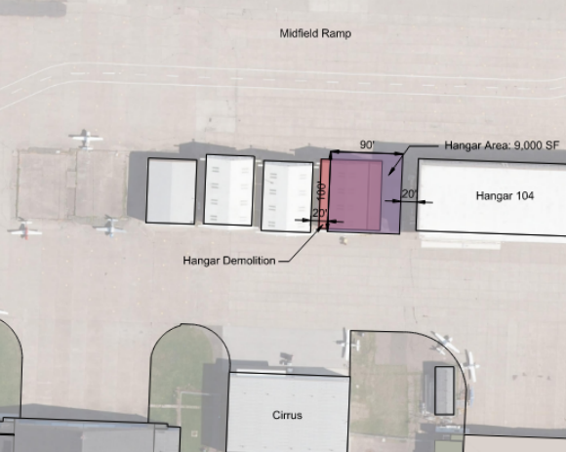
H. Resolution to Approve Work Order 2023 – 4 between the Duluth Airport Authority and Short Elliot Hendrickson, Inc. for the Design of Midfield Ramp Hangar 105 Redevelopment Construction Project at Duluth International Airport (DLH)
Project Description – The project consists of designing a new revenue generating 9,000 square foot (approx.) hangar used for aircraft storage and tenant use on the Midfield Ramp Area.
The proposal amount is $169,500.00
Eligible portions of the project are anticipated to be funded by FAA at 90%, and the DAA at 10% as part of the Infrastructure Bill.

