Slide 1
Operations/Construction/Planning
Introductions:
Tristan Durfee – Sky Harbor Manager
Matt Francois – Airport Management Intern
Duluth International Airport
ATCT Architecture and Engineering RFQ Update
AFTIL Site #6 Impacts to Approaches to Runway 3/21
Taxiway A Phase 2 + 4 Update
Duluth Sky Harbor Airport
Airport Terminal Program – Sky Harbor Airport Terminal Update
Airport Snow Removal Equipment (SRE) Building Update

Slide 2
ATCT Architecture and Engineering RFQ Update
RFQ Issued | March 14, 2023
*Mandatory (In-person or Virtual) Pre-Bid + Optional Tour of Future DLH ATCT Site | March 28th, 2023
RFQ Questions Due | March 30th, 2023
RFQ Due Date | April 21st, 2023
RFQ Presentation/Interview | May 8th, 2023
RFQ Approval - Authority Board | June 20th, 2023
Agreement - Effective | June 20th, 2023

Slide 3
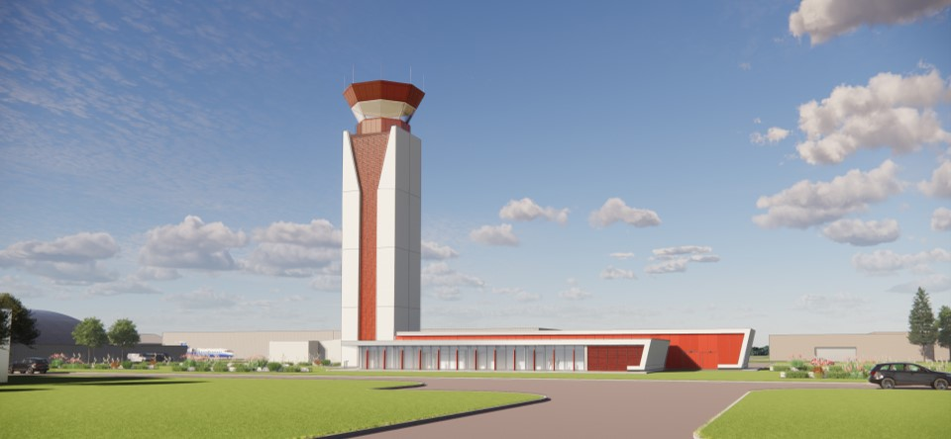
Welcome EXP!

Slide 4
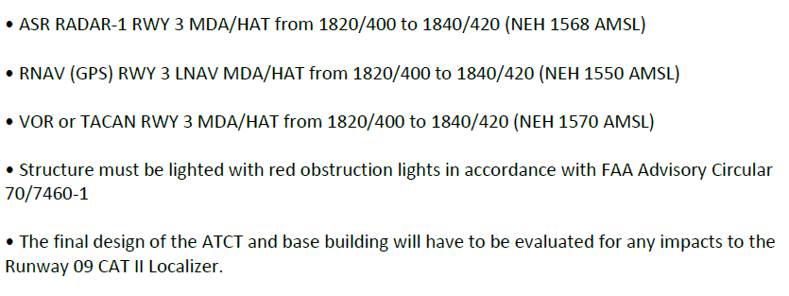
AFTIL Site #6 Impacts to Approaches to Runway 3/21

Slide 5
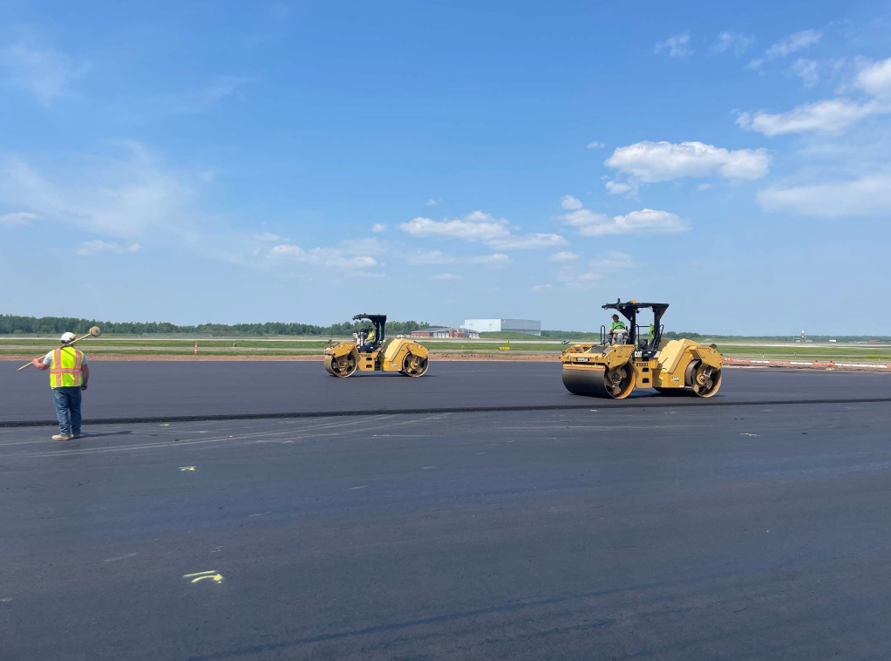
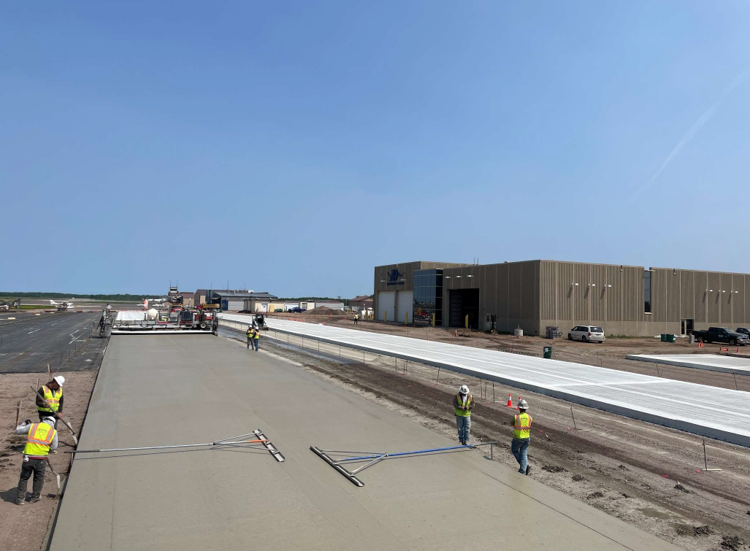
Taxiway Phase 2 + 4 Update

Slide 6
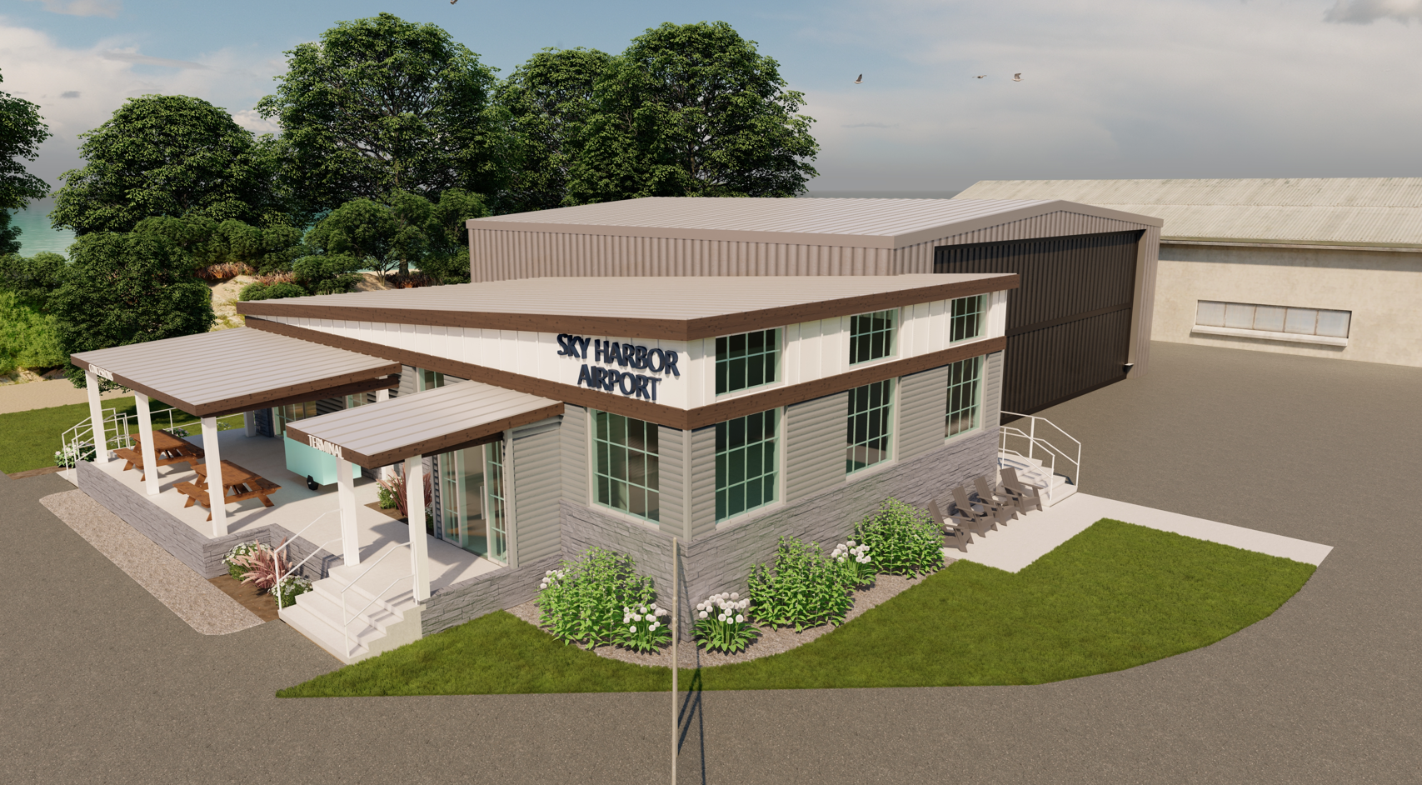
Sky Harbor Airport Terminal Update

Slide 7
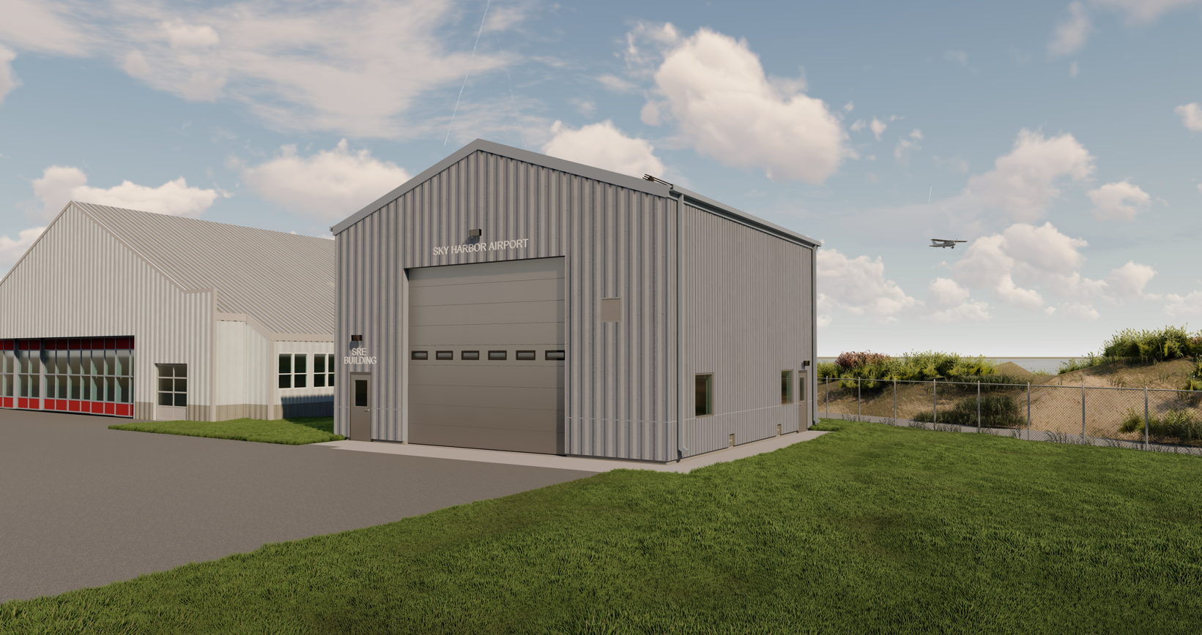
Sky Harbor Airport SRE Update

Slide 8
DYT Rates and Charges
All invoiced aircraft parking fees shall be paid within thirty (30) days of invoice date. In the event that aircraft parking fees are not paid within thirty (30) days of invoice date and such failure to pay continues for a period exceeding ninety (90) days after invoice date, the aircraft owner shall be in default. Upon default, the Duluth Airport Authority may exercise any one or more of the following remedies (in its sole discretion):
(i) utilize a collections agency and/or an attorney to recover said amount, including reasonable attorney’s fees, court costs, and collection costs,
(ii) enter the premises where the aircraft is located and take immediate possession of and remove (or disable in place) the aircraft by self-help, summary proceedings or otherwise without liability; and
(iii) eject and trespass the aircraft pilot and owner from Sky Harbor.

Slide 9

D. Resolution to Approve Incentive Award Payments of $1000 Each, for Outstanding Performance Per DAA Operating Policy #5 to the Following Employees: Mr. Ryan Welch, Mr. John Graves, Mr. Paul Sinnott, Mr. Dan Taylor, Mr. Wade Cossalter, Mr. Matt Johnson, Mr. Roger Engelmeier, Mr. Derek Anderson, Mr. Tristan Durfee, Mr. Justin
Tibodeau, Mr. John Orrey, and Mr. Mike Fellerson.

Slide 10
E. Resolution to approve Master Service Agreement between EXP and the Duluth Airport Authority

