Slide 1
Operations/Construction/Planning
Duluth International Airport
New Air Traffic Control Tower Update
Basis for Design
Requirements Workbook Update
Introduce EXP
Midfield Ramp – Phase 2 Concrete Replacement
Taxiway A Phase 2 + 4 Update
FAA Duct Bank
Overall Schedule
Duluth Sky Harbor Airport
Sky Harbor Airport Terminal
Sky Harbor Snow Removal Equipment Building Update

Slide 2
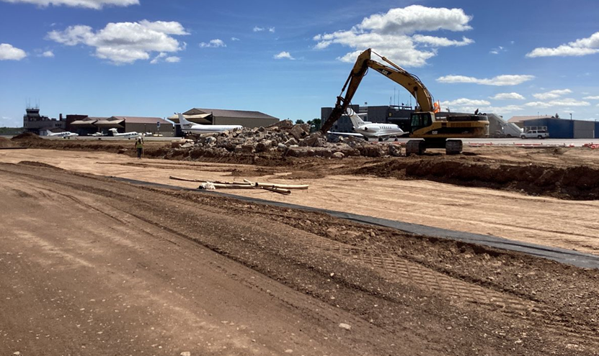
Taxiway A Reconstruction – Phase 2
Project Update
Progress: Work completed includes:
Existing pavement removal
Storm sewer and drain tile placement
Existing electrical conduit removal, including airport, FAA, and 148th ANG owned cables
Placement of geotextile fabric
Granular subbase material placement
New lighting and equipment conduit placement

Slide 3
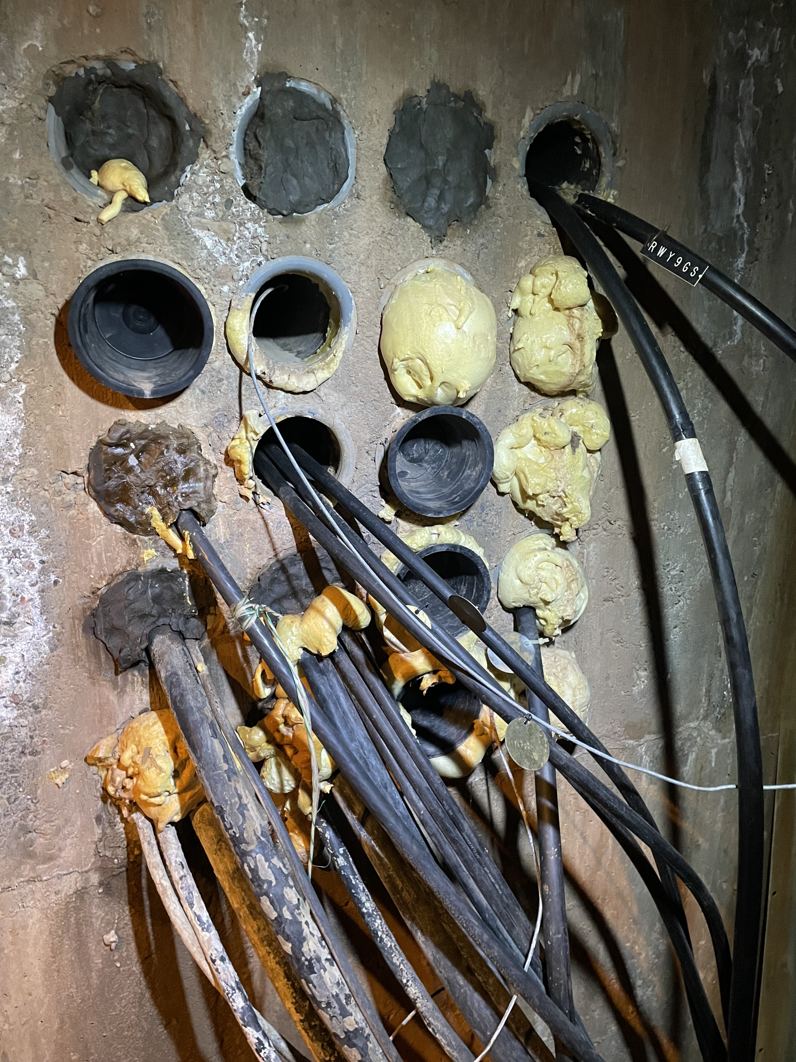
Project Challenges – Unforeseen Conditions
Pre Construction records provided by FAA indicated a simple layout of existing FAA-owned cables.
Actual conditions discovered a mixture of cables in un-planned location, many abandoned cables, and inaccurate FAA record drawings.
Through work with on-site FAA staff, contractor locating, and SEH design assistance, a plan was developed to relocate all cables in new conduit and cable with minimal impacts.
FAA funding is available for change conditions.

Slide 4
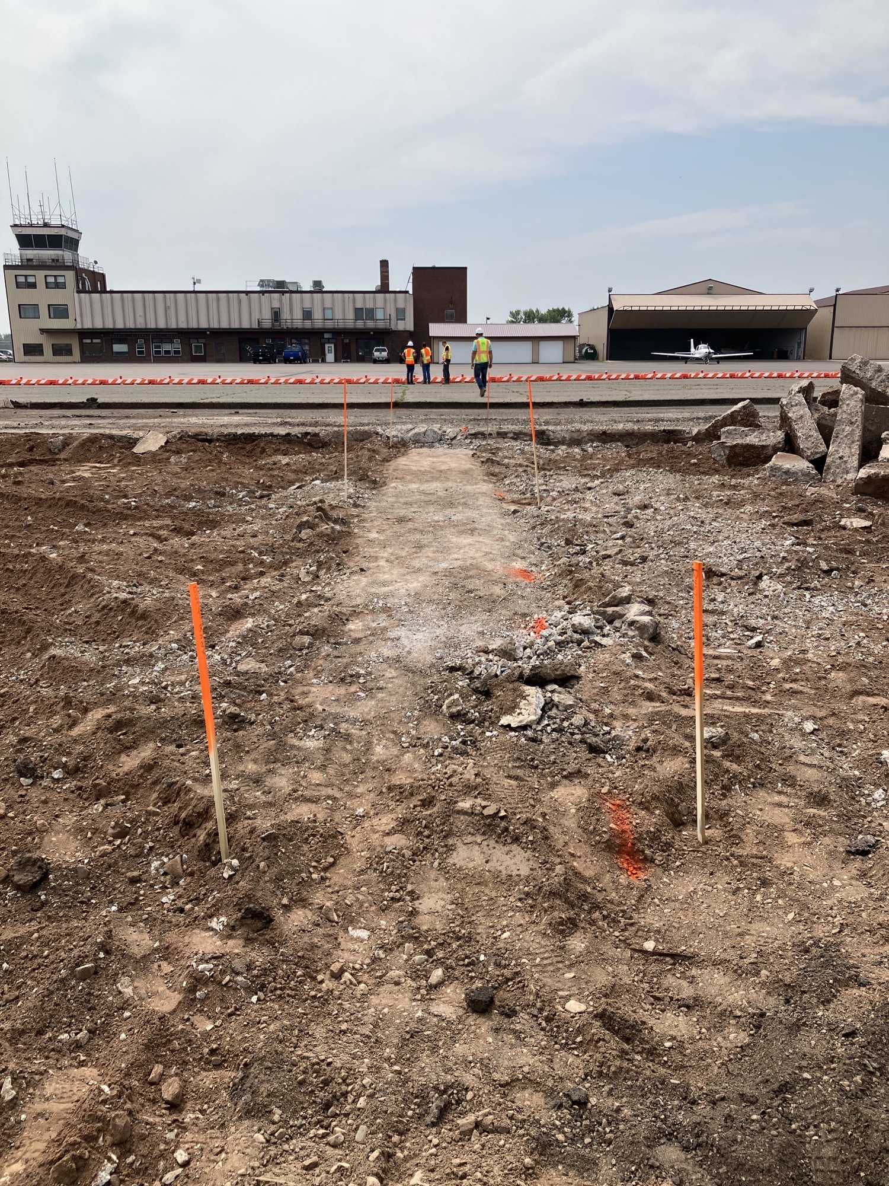
Project Impacts
Schedule Impacts
The impact to FAA-owned cables will impact airport facilitates, such as lighting, glideslope, radar control, and communications.
The project team is coordinating work to identify the least impactful impact, both financially and schedule.
Latest projects show at least an additional 30-45 days of overall construction and 10- night closures for facility relocation.
Additional costs are projected to be funded by FAA and MnDOT at 95 percent. The costs were required to correctly align the airfield circuitry in the best interest of the airport.

Slide 5
Operations/Construction/Planning
Duluth International Airport
New Air Traffic Control Tower Update
Basis for Design
Requirements Workbook Update
Introduce EXP
Taxiway A Phase 2 + 4 Update
FAA Duct Bank
Overall Schedule
Duluth Sky Harbor Airport
Sky Harbor Airport Terminal
Sky Harbor Snow Removal Equipment Building Update

Slide 6
A. Resolution to Approve Work Order 2023-1 between the Duluth Airport Authority and EXP for the Pre-design of the New Air Traffic Control Tower at Duluth International Airport (DLH)
Agreement Overview: This work order includes preliminary design for the New Air Traffic Control Tower (ATCT) – Phase 1 (preliminary design) project at Duluth International Airport (DLH). The contract provisions included in the Master Agreement (dated 7-05-2023) between the DAA and EXP remain in effect for this work order.
Compensation to Consultant: Compensation to the Consultant shall be a lump sum amount of $65,307.39

