Slide 1
Operations/Construction/Planning
Duluth International Airport
New Air Traffic Control Tower Update
Airshow 2023 Recap
Taxiway A Phase 2+4 Update
Sky Harbor Airport
New Sky Harbor Airport Terminal Update
New Snow Removal Equipment Building Update

Slide 2
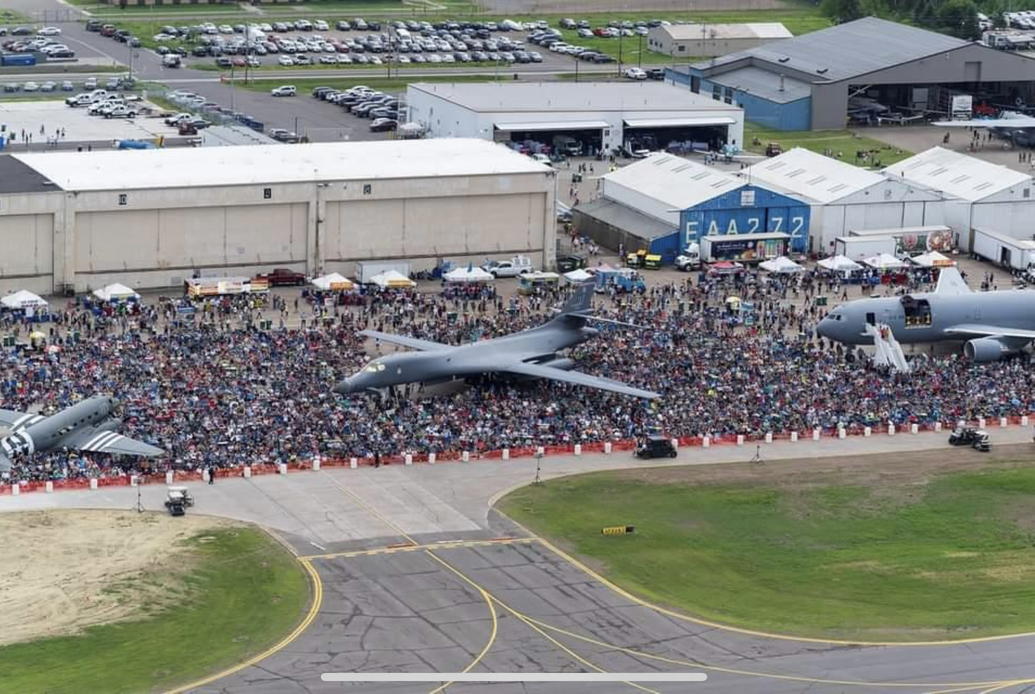
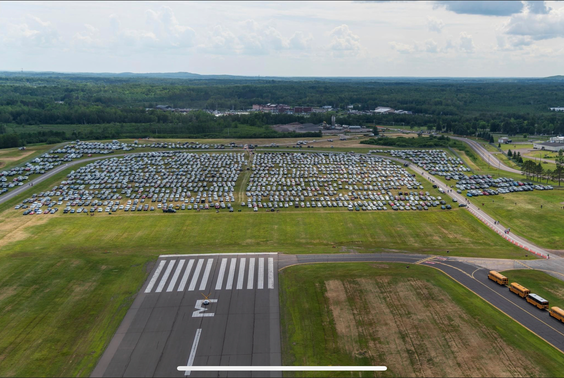
Airshow 2023 Recap

Slide 3
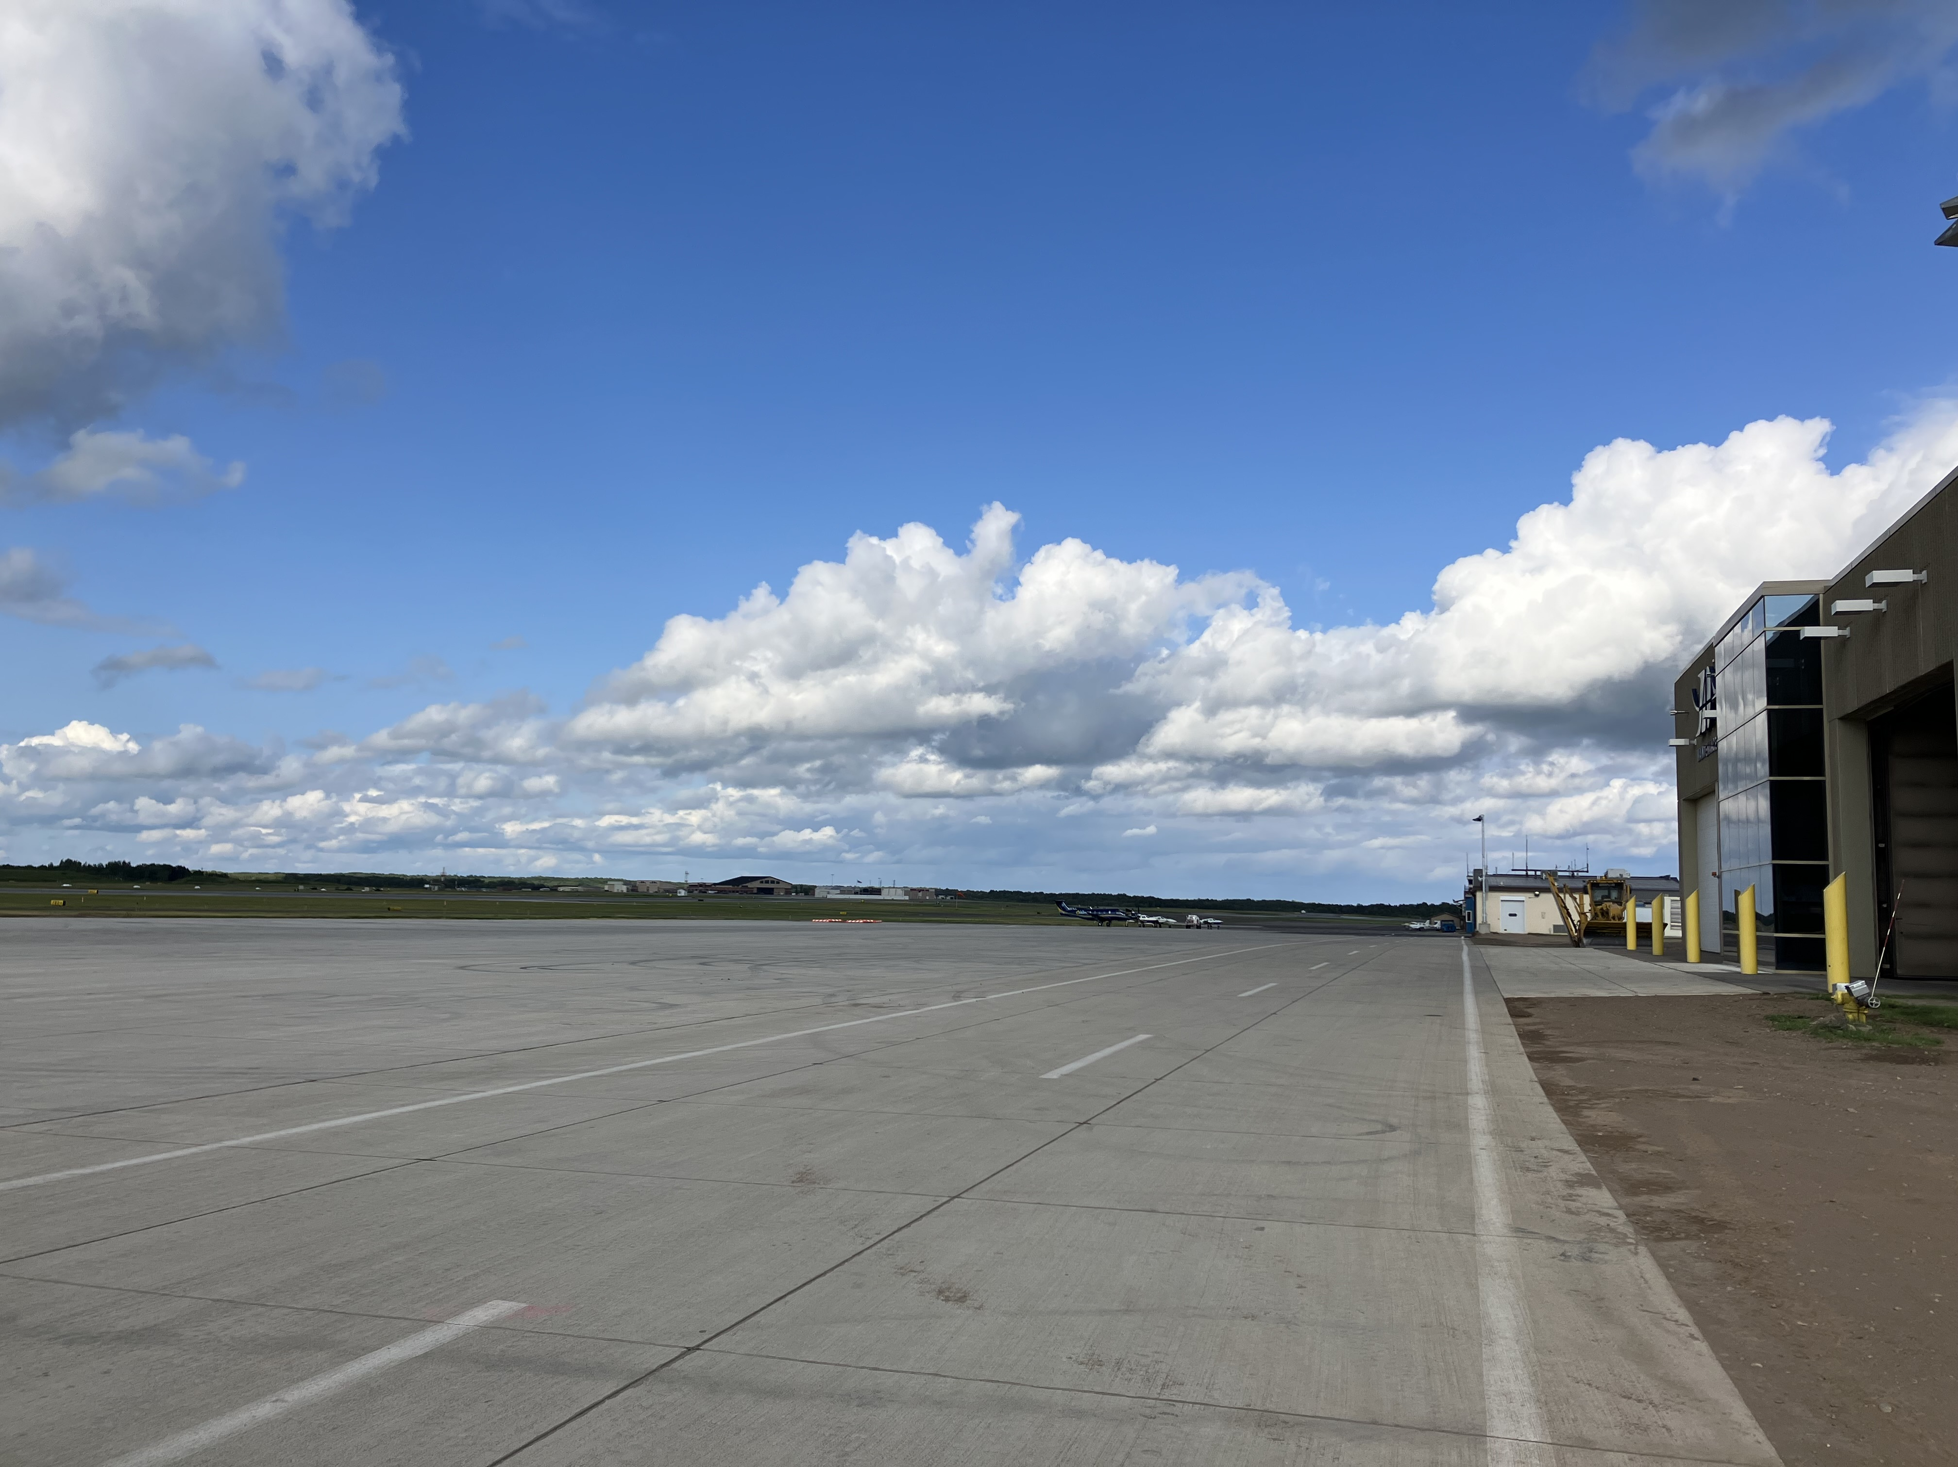
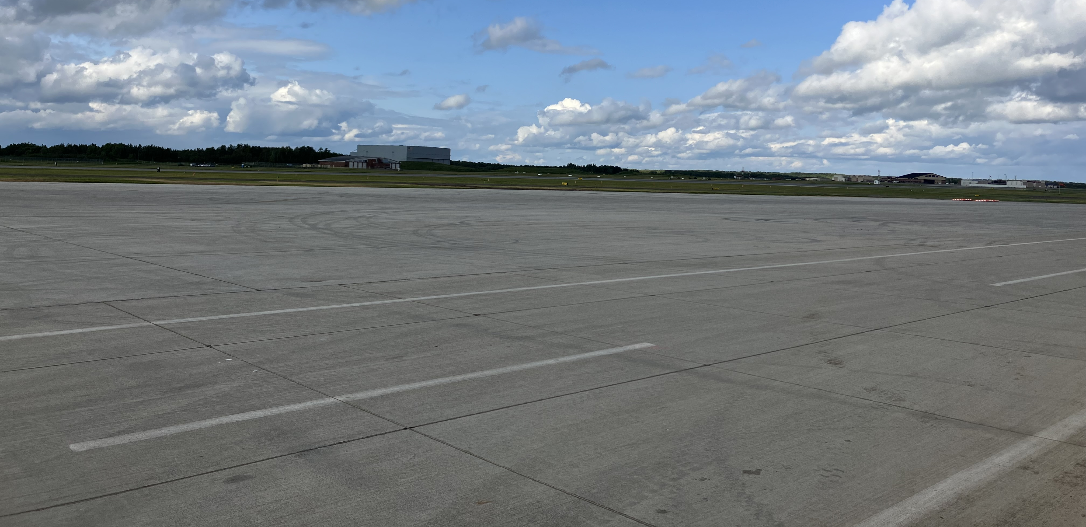
Phase 4 (SRE Ramp) and Midfield Ramp Project Update
Phase was substantially complete prior to the airshow and ahead of schedule.
Taxiway A Phase 2 reconstruction will start today

Slide 4
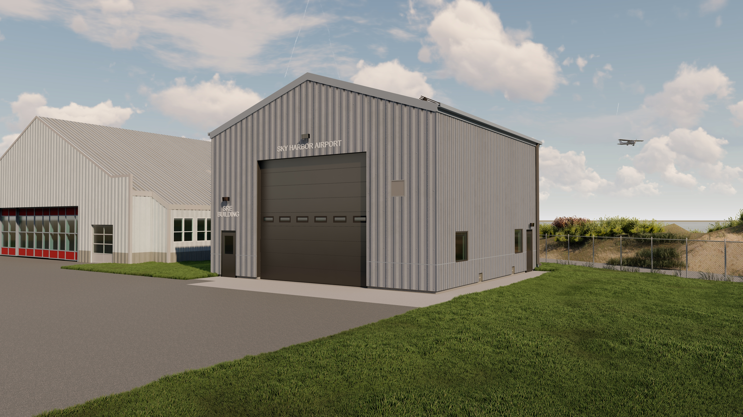

2023 Snow Removal Equipment (SRE) Building
              Project Description:
              40’ x 40’ Pre-Engineered Building
              1-HR Fire-Rated wall, adjacent to Hangar 11
              Flood vents installed to floodproof structure to meet floodplain regulations
              Oversized garage door to accommodate future DLH equipment
              Water/sewer capabilities for maintaining equipment
              Employee parking area
              Building will allow DAA equipment to be moved from Hangar 1 which will increase aircraft storage capacity and aeronautical revenue.

Slide 5
2023 Snow Removal Equipment (SRE) Building
Summary of Bids
Gardner Builders (low bid, also the terminal building low bidder)
  Schedule A – SRE Building: $980,428.00
  Schedule B – FAA Eligible Building Plumbing Fixtures: $40,840.00
  Schedule C – FAA Ineligible Watermain Extension: $74,411.00
  Total: $1,095,679.00
Lakehead Contractors
  Schedule A – SRE Building: $993,556.00
  Schedule B – Eligible Building Plumbing Fixtures: $125,117.00
  Schedule C – Ineligible Watermain Extension: $100,834.00
  Total: $1,219,507.00

Slide 6
2023 Snow Removal Equipment (SRE) Building
Overall Project Costs
Project Item | FAA | State | Local
FAA Eligible Components | $1,165,511.52 | $64,750.64 | $64,750.64
FAA Ineligible Components | -- | $58,181.34 | $24,934.86
Total | $1,165,511.52 | $122,931.98 | $89,685.50

Slide 7
2023 Snow Removal Equipment (SRE) Building
Funding Plan for FAA Eligible Components
Funding Sources | FAA | State | Local
2023 AIP Grant | $996,361.00 | $56,385.15 | $56,385.15
Future AIP or AIG Grant | $199,150.00 | $8,365.49 | $8,365.49

Slide 8
2023 Reconstruct Terminal Building
              Project Description:
              1,800 SF Terminal Building
              950 SF Exterior Covered Patio (Landside)
              96 SF Exterior Concrete Patio (Airside)
              ADA Accessibility
              Meets Regulatory Flood Protection Elevation (RFPE) – Raised building 2 FT above grade.
              Terminal Building includes:
                Administrative Office
                Concession Room
                Pilots Lounge & Pilot Briefing Rooms
                Two Family Restrooms
                Central Waiting Room
                Utility Support Room

Slide 9
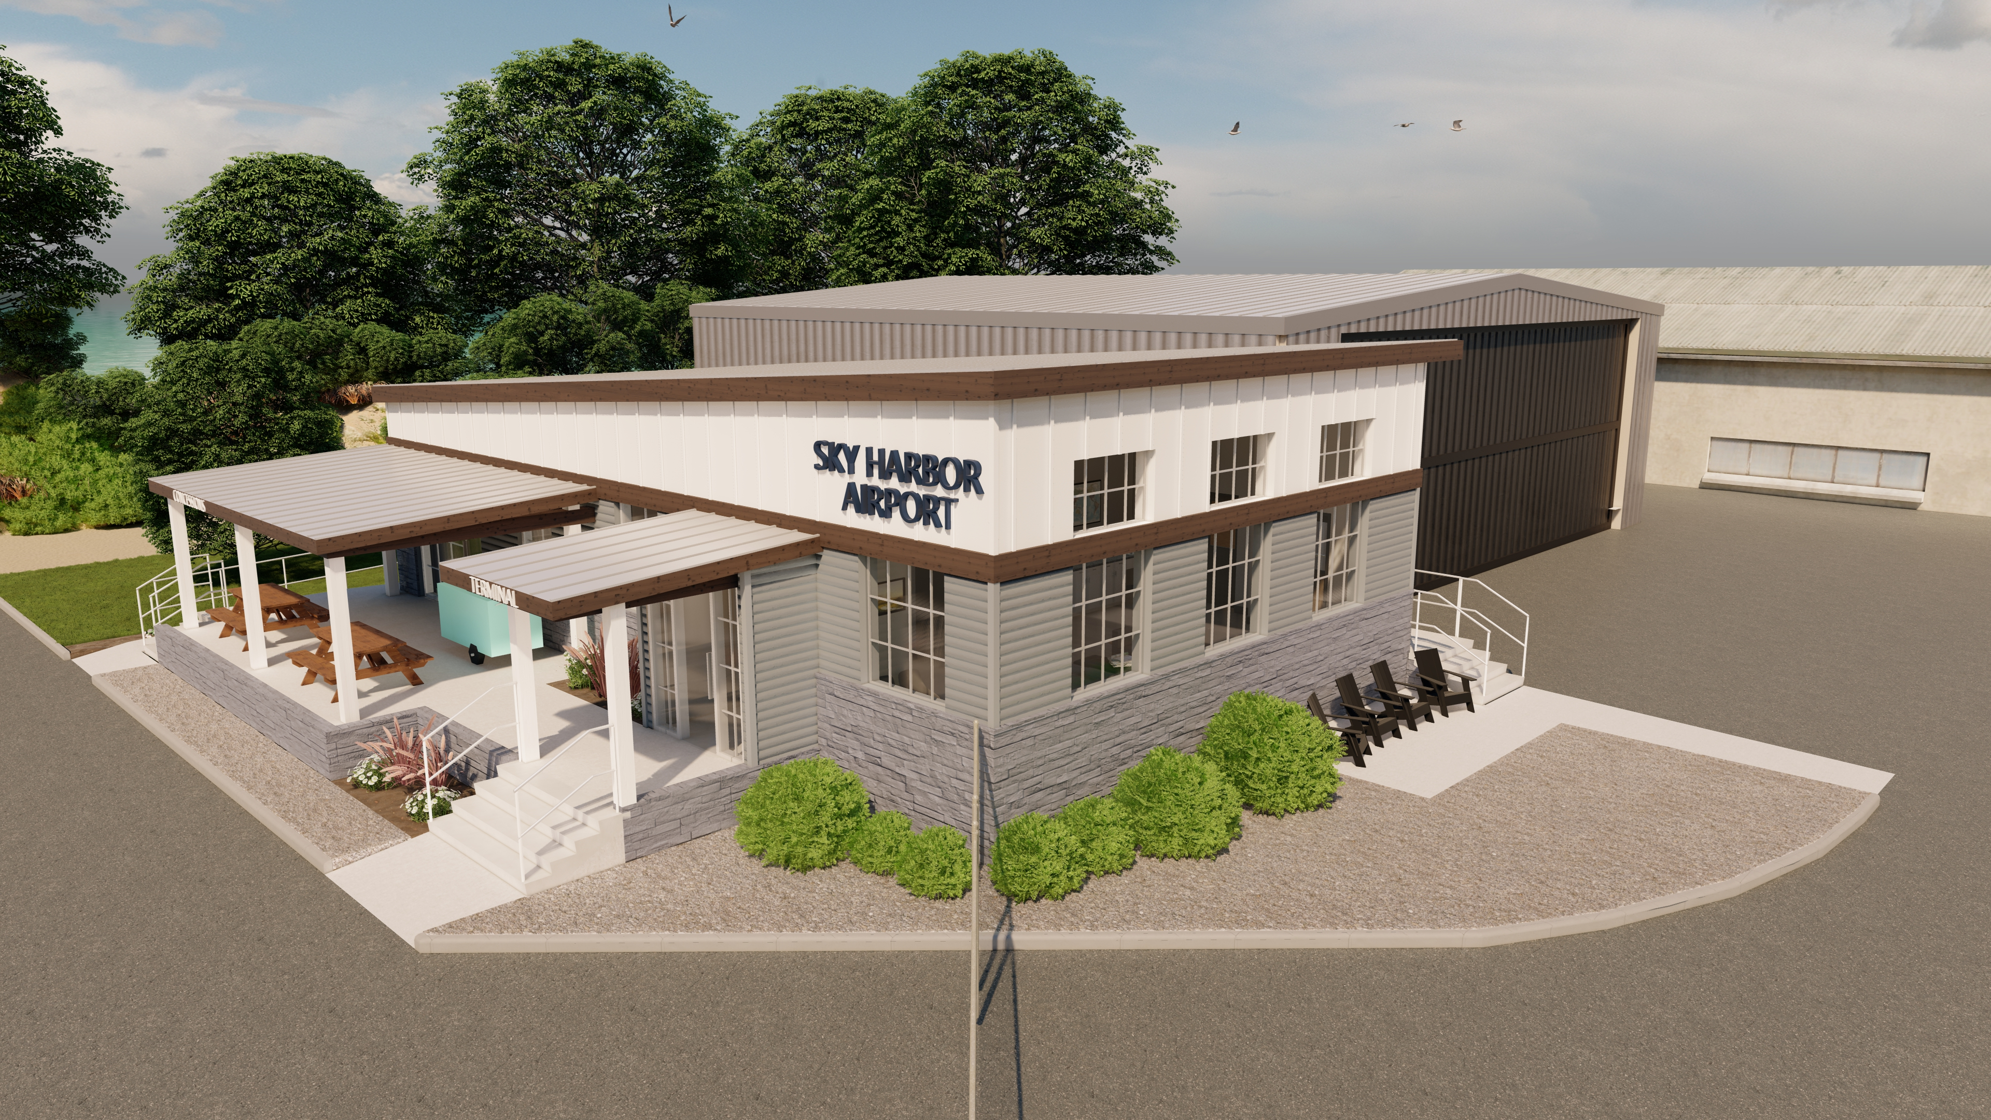
2023 Reconstruct Terminal Building

Slide 10

2023 Reconstruct Terminal Building

Slide 11
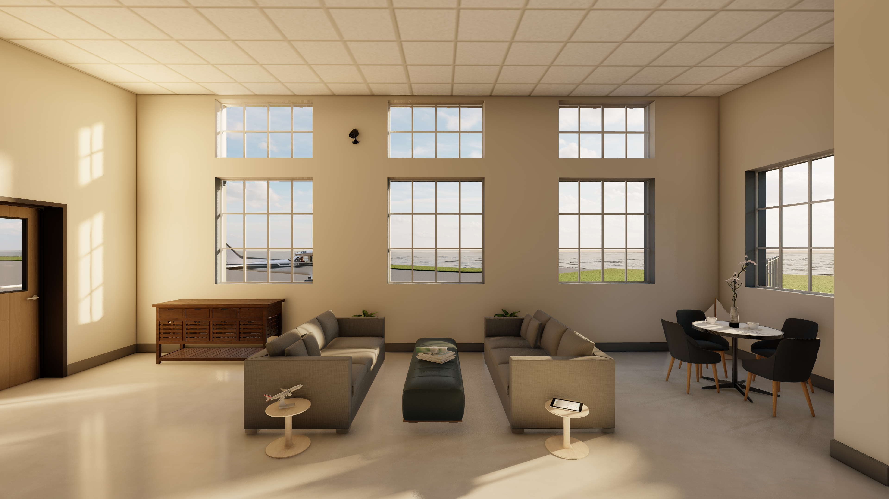
2023 Reconstruct Terminal Building

Slide 12
2023 Reconstruct Terminal Building
Summary of Bids – Negotiated Price
Gardner Builders (also the SRE building contractor)
Reconstruct Terminal Building: $1,858,012
Alternate – Reconstruct Auto Parking Area: $114,570 ** Not Awarding**
Alternate – Replace Existing Hangar Roofing & Siding: $171,780
Alternate – Provide Interim Facilities (Terminal & Restrooms): $37,420
Total of Award: $2,006,612.00

Slide 13
2023 Reconstruct Terminal Building
Overall Project Costs
Project Item | FAA | State | Local
FAA Eligible Components | $1,767,709.66 | $63,425.81 | $63,425.81
FAA Ineligible Components | -- | $257,649.51 | $119,321.22
Total | $1,767,709.66 | $321,075.32 | $182,747.02

Slide 14
2023 Reconstruct Terminal Building
Funding Plan for Eligible Components
Funding Sources | FAA | State | Local
2023 FAA ATP Grant | 1,187,000.00 | $31,236.84 | $31,236.84
2023 FAA AIG Grant | $88,000.00 | $4,400.00 | $4,400.00
2024 FAA AIP & AIG Grants | $285,000 ** | $14,250.00 | $14,250.00
2025 FAA AIP or AIG Grant | $123,820.00 ** | $7,500.00 | $7,500.00
**Funding amount for BIL/AIG may change based on FAA allocations

Slide 15
2023 Replace Hangar Roofing & Siding
Overall Project Costs
Project Item | FAA | State | Local
Eligible Components | $154,062.00 | $8,559.00 | $8,559.00
Funding Plan for Eligible Components
Funding Sources | FAA | State | Local
2025 FAA AIP and AIG Grants | $171,180.00** | $8,559.00 | $8,559.00
**Funding amount for BIL/AIG may change based on FAA allocations

Slide 16
D. Resolution to Award and Approve the Sky Harbor (DYT) General Aviation Terminal Building Construction Contract Between the Duluth Airport Authority and Gardner Builders in the Amount of $2,066,412
Project Description – The new terminal will be approximately 1,900 square feet with an 800 square foot outdoor covered patio area connecting to the structure. Bids were received on June 8, 2023.
The project is funded by various FAA funding programs, MnDOT Aeronautics, and the DAA. The total project costs are shown below:
Project Item | FAA | State | Local
FAA Eligible Components | $1,767,709.66 | $63,425.81 | $63,425.81
FAA Ineligible Components | -- | $257,649.51 | $119,321.22
Total | $1,767,709.66 | $321,075.32 | $182,747.02

Slide 17
E. Resolution to Approve Work Order 2023 – 10 between the Duluth Airport Authority and Short Elliott Hendrickson, Inc. for the Construction Administration of the new General Aviation Terminal Building at Sky Harbor Airport (DYT)
Project Description – The scope of engineering services includes construction administration, construction observation and project closeout, including shop drawings, quality control, tribal monitoring coordination, public outreach, and project management
The proposal amount is $177,300.00
FAA Eligible portions of the project are anticipated to be funded by FAA and MnDOT Aeronautics, with the remaining funded by MnDOT and DAA.

Slide 18
F. Resolution to Award and Approve the Sky Harbor (DYT) Snow Removal Equipment Building Construction Contract Between the Duluth Airport Authority and Gardner Builders in the amount of $1,095,679
Project Description – A new Snow Removal Equipment (SRE) Building is proposed to be constructed on the southeast portion of the apron area. The SRE will be 40’ x 40’ prefabricated metal engineered structure.
The project is funded by various FAA funding programs, MnDOT Aeronautics, and the DAA. The total project costs are shown below:
Project Item | FAA | State | Local
FAA Eligible Components | $1,165,511.52 | $64,750.64 | $64,750.64
FAA Ineligible Components | -- | $58,181.34 | $24,934.86
Total | $1,165,511.52 | $122,931.98 | $89,685.50

Slide 19
G. Resolution to Approve Work Order 2023 – 09 between the Duluth Airport Authority and Short Elliott Hendrickson, Inc. for the Construction Administration of the new Snow Removal Equipment Building at Sky Harbor Airport (DYT)
Project Description – The scope of engineering services includes construction administration, construction observation and project closeout, including shop drawings, quality control, tribal monitoring coordination, environmental mitigation, public outreach, and project management
The proposal amount is $158,300.00.
Eligible portions of the project are anticipated to be funded by FAA and MnDOT Aeronautics, with the remaining funded by the DAA.

Slide 20
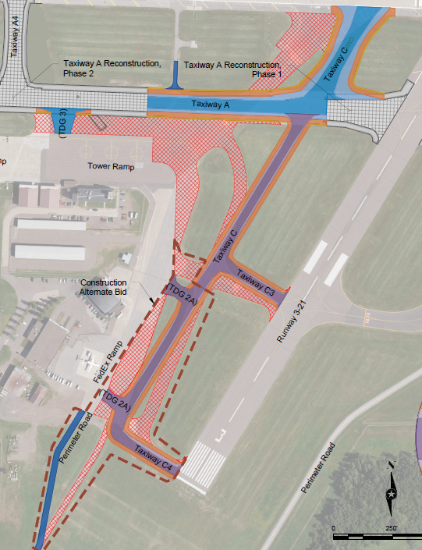
H. Resolution to Award and Approve the Duluth International Airport (DLH) Taxiway A – Phase 3 Construction Contract Between the Duluth Airport Authority and KGM Contractors Inc. in the amount of $11,197,150
Total Contract Award: $11,197,150.00
                $9,805,624 of the total is FAA eligible and will be funded at 90% by FAA ($8,825,062), 5% by MnDOT ($490,281) and 5% by DAA ($490,281).
                $1,068,345.50 is FAA ineligible but supports the Air National Guard and is funded by the 148th Fighter Wing at 100%.
                The remaining $323,180.50 will be funded by the DAA to support maintaining existing Taxiway C south infrastructure that is ineligible for FAA funding.

Slide 21
I. Resolution to Approve Work Order 2023 – 11 between the DAA and Short Elliot Hendrickson, Inc. for the Construction Administration of Taxiway A - Phase 3 and Taxiway C South
Project Description – The scope of engineering services includes construction administration, construction observation and project closeout, including shop drawings, quality control, public outreach, and project management
The proposal amount is $1,275,400.00.
FAA Eligible portions of the project are anticipated to be funded by FAA and MnDOT Aeronautics, with the remaining funded by the 148th FW and the DAA.

Slide 22
J. Resolution to Approve Work Order 2023 – 12 between the Duluth Airport Authority and Short Elliot Hendrickson, Inc. for the Design of Taxiway A Reconstruction - Phase 5
Total Cost: $696,000
              The federally eligible portion of the contract is funded at 90% by FAA ($582,300), 5% by MnDOT ($32,350) and 5% by DAA
              ($ 32,350).
              The remaining work is anticipated to be funded by the National Guard / 148th FW ($49,000).

