Slide 1

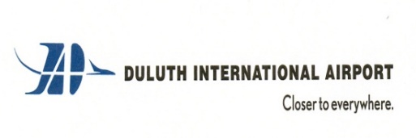
Duluth International Airport (DLH)
Airport Board Presentation | September 2023

Slide 2

Presentation
Key Industry Trends (Long-term, with focus upon Post-Pandemic Trends)
Air Service Trends in Upper Midwest markets
Essential Air Service (EAS) Program Changes & Potential DLH Impact
DLH Ground Shuttle Study
State of DLH Air Service

Slide 3
Cursory Look at Long-Term Industry Trends

Slide 4
Airline Industry 1978-2010
The U.S. airline industry lost over $40 billion in aggregate from 1978-2010
Yields (prices) fell over 50% after inflation during this time period
The primary issue was excess airline capacity and relatively high operating costs
When the U.S. financial crisis hit in 2008, almost every U.S. airline declared Chapter 11 Bankruptcy
This was actually a good time period for U.S. airports, but it wasn’t viable long-term

Slide 5
Airline Industry 2011-2019
The U.S. airline industry consolidated and right-sized capacity, while also sharply reducing operating costs
The result was a very profitable airline industry, with double-digit operating margins the norm later in the decade
Ultra-low-cost-carriers (ULCCs) far outpaced growth of network airlines, while also generating high operating margins
For the most part, the industry was in its strongest period ever during 2018 and 2019; then COVID hit…..

Slide 6
Post-Pandemic: Key Industry Trends

Slide 7
#1 Trend: Regional airline pilot shortages that mostly serve smaller markets are driving traffic declines

Slide 8
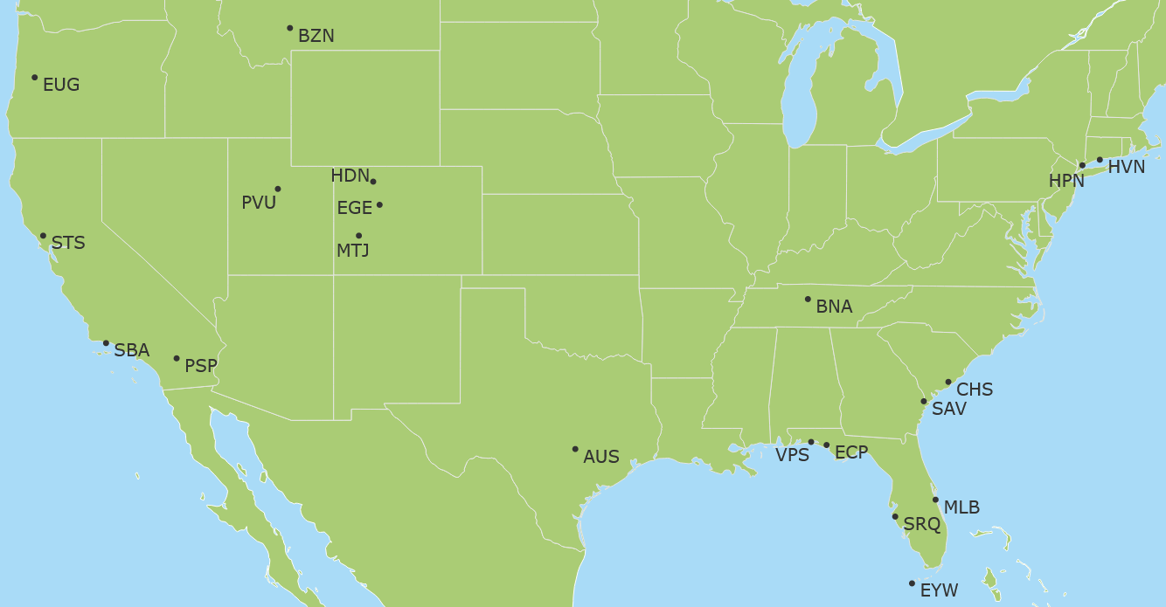
#2 Trend: Shifting of traffic to markets that are growing (migration) & generally leisure-oriented…
45%
IDA
62%
43%
237%
683%
297%
25 Fastest Growing U.S. Airports*
Departing Seats: 2Q23 vs 2Q19
COS
42%
38%
93%
41%
SGU
53%
BFL
32%
28%
48%
35%
31%
34%
37%
36%
27%
29%
87%
131%
43%
* Of top 200 airport (seats)

Slide 9
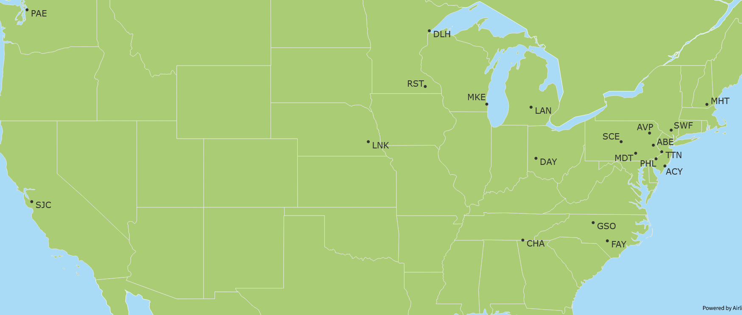
… away from airports that are typically more business-oriented
(36%)
BIS
(26%)
(25%)
(19%)
(36%)
(27%)
(42%)
(44%)
(56%)
(28%)
MLI
(24%)
(29%)
(19%)
BMI
(22%)
(19%)
(27%)
(38%)
(19%)
(21%)
(33%)
(19%)
25 Airports with the largest seat capacity declines*
Departing Seats: 2Q23 vs 2Q19
(20%)
(19%)
OAJ
(21%)
(20%)
(20%)
MOB
* Of top 200 airport (seats)

Slide 10
Largest airports are seeing similar trends, although carrier strategic plans also factoring in

Slide 11
#3 Trend: Leisure travel demand outpacing business travel
In general, while improving business travel is still 20% below 2019 levels
Large auto maker: Domestic back to 2019 levels, although international still down 20% (Europe) to 30%+ (Asia and Latin America)
Select high tech companies starting to travel again (Microsoft), while many others are still well below 2019 levels
In general, domestic travel weakening of late, although still above 2019 levels (thanks to strong leisure travel); Europe very strong of late with Asia still weak
Notes:
Auto maker (Ford); tech commentary function of Alaska comments

Slide 12
#4 Trend: ULCCs growing much faster than network airlines
ULCCs almost exclusively cater to leisure passengers
Notes:
#3 Industry Trend (which is tied to #2 trend and is the continuation of a longer-term trend): Relative growth of ULCCs as compared to network airlines. This likely continues.
#3A Industry Trend. Network airlines shift to larger aircraft
Fastest growing airports generally benefitted from ULCC growth and/or a start-up airlines (Breeze or Avelo).

Slide 13
#5 Trend: Significant airline operating cost increases
Pilot salaries: Roughly 40% growth
Oil prices also higher
It will also result in generally larger aircraft
Even larger RJ aircraft will be more challenged – bad for smaller markets
Air fares will have to go and stay higher
Notes:
Note that SY (ULCC) highest paid pilot made $750k last year.

Slide 14
#6 Trend: Shifting towards larger aircraft
Notes:
Flight capacity in the U.S. is at lowest levels since turn of the century. Seats are only up 14% over the past (almost) 20 years.
Average gauge went up by 15 seats post-COVID or about 12%. The longer-term trend of larger gauge has exploded post-COVID and will likely continue (due to retirements of 50-seat RJs, limit growth (pilot scope clauses) of larger RJs, ongoing pilot shortages of regional pilots and finally, significantly higher pilot labor costs will make larger aircraft more economical.

Slide 15
Where industry is headed over next 5+ years
Air fares will likely go materially higher due to much higher airline cost structures
Leisure travel continues to outpace business travel
ULCCs will likely continue to grow much faster relative to network airlines; also, mainline airlines will grow much faster than regional airlines
  Example 1: ULCC=Allegiant, Network Airline=Delta
  Example 2: Mainline=Delta, Regional=Delta Connection
  The result: Much larger aircraft than was experienced pre-COVID or even today
The result will be that relatively smaller communities will likely experience constrained/reduced air service (& relatively higher air fares)

Slide 16
Regional Air Service Trends

Slide 17
Regional Airports have experienced worsening capacity as compared to the U.S.
Notes:
Wisconsin, Michigan & Minnesota have seen worsening capacity trends as compared to other regional airports and the rest of the U.S. – particularly when compared to fast growing sunbelt markets (where ULCCs are more focused, too). This is somewhat tied to DL – when ranking top 30 airports, 3 of the worst in terms of capacity declines are MSP, DTW and to a lesser degree, ATL.

Slide 18
Relative capacity trends regionally are largely driven by relative ULCC changes
Notes:
ATW, DSM & GRR: Benefiting from G4 (ULCC) growth.

Slide 19
The relative share of low-cost carriers greatly impacts air service (and fares)

Slide 20
Essential Air Service
DLH Ground Shuttle Feeder Study

Slide 21
What is Essential Air Service (EAS)?
Federally subsidized program that subsidizes air service in what are deemed “Essential” markets
Subsidized through the U.S. Department of Transportation (DOT)
Guarantees 2 daily weekday trips
Carriers bid, with community input weighing heavily on DOT decision
Minnesota is one of largest EAS states, with service to 5 markets: BJI, BRD, HIB, INL and TVF

Slide 22
EAS is about to change, and it could be significant
SkyWest has/is the dominant EAS provider
  Considered by far the best regional airline in the industry
  But SkyWest will no longer bid on EAS contracts as a Part 121 airline (50-seaters)
  Instead, SkyWest will only consider flying EAS as a Part 135 carrier: 50-seat CRJ configured for 30-seats
It is far from certain that DOT will approve SkyWest flying as a Part 135 carrier
What this means for EAS regionally
  Best case: 40% less seat capacity and operating costs (subsidies) roughly doubling
  Even the best case will be a 40% reduction in seats (& it will likely be worse)
  If Part 135 airline is taken out of the equation, EAS markets will either be served by single engine, 8-seat turboprop aircraft or more likely via ground transportation (Landline)

Slide 23
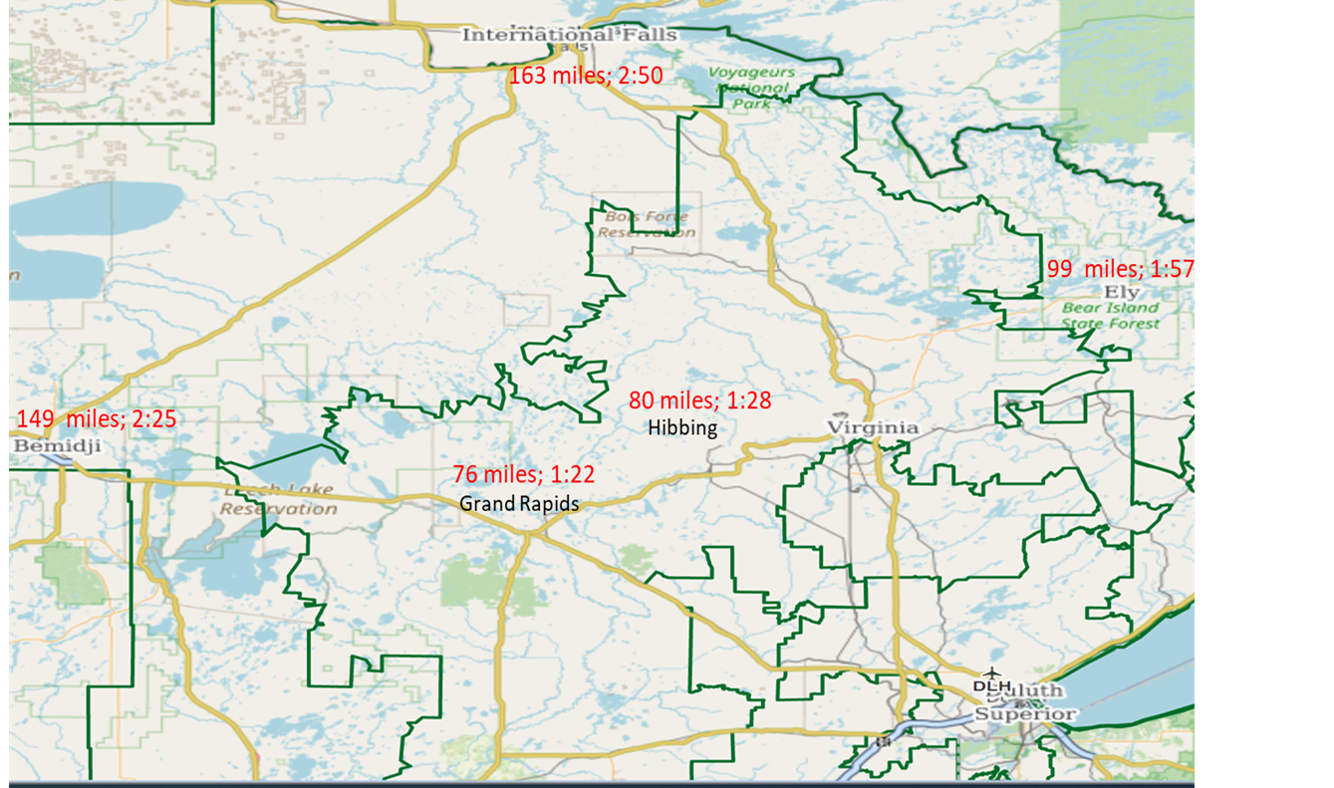
EAS is potentially important to DLH given DLH’s proximity to many of these airports
* Peak: 1998, 1999 or 2000; GPZ was not an EAS market

Slide 24
DLH already captures a decent share of these market’s traffic

Slide 25

Ground Shuttle Feeder: Concept
United: New DEN nonstop & added ORD capacity
Grand Rapids (GPZ)
  76 miles or a 1:22 drive to Duluth
  31,000 people within 30 miles
  Generated 20,000 annual enplanements in 1990s
Hibbing (HIB)
  80 miles or a 1:28 drive to Duluth
  30,000 people within 30 miles
  2x daily CRJ (DL) service today although with pilot shortages it has not been consistent
International Falls (INL)
  47,000 people (U.S.-side only) within 60 miles
  2x daily CRJ (DL) service today, although with pilot shortages that has been sporadic

Slide 26
Ground Shuttle Feeder Study: Findings To-Date
Estimated Ground Shuttle operating costs per route:
  Twin Harbors: $200
  GPZ/HIB: $300
  INL: $500
Estimated Fare: GPZ/HIB - $20, INL-$30
Breakeven Passenger Loads
  GPZ/HIB: 15
  INL: 16+
With DEN & ORD connectivity, should be ample traffic to cover this
Landline looking at minimizing risks
This equates to Capacity Purchase Agreements (CPA) with airlines
  Starting with AA and then UA
  Consistent with how regional airlines work with major airlines (DL, UA, AA)
Key Landline issues:
  “Secure-to-Secure” Passenger Processing
  Shuttle passengers being credited as an enplaned passenger – key for getting important buy in from EAS airports

Slide 27
The State of Air Service at DLH

Slide 28
Pre-COVID: DLH passenger volumes were up almost 26% from 2017 to 2019, with early 2020 up almost 50%

Slide 29
Post-COVID: DLH 2023 seat capacity will be about 26% below CY 2019 levels – with most of year down more

Slide 30
Declines have come primarily from AA and UA
AA exited DLH in late 2019 due to poor loads (66% LF)
SY capacity was 14,136 departing seats in 2022 (cuts due to RSW & related hurricane)
UA results mostly hampered by regional pilot shortages, although UA has also reduced ORD capacity overall
DL #’s were initially higher due to going all mainline aircraft in earlier summer schedule

Slide 31
DLH reductions are tied to pilot shortages, as revenues have been strong
DL: +13%
UA: +28%

Slide 32
United Airlines
UA has been the most impacted by pilot shortages; they’ve indicated that this is stabilizing and plans to bring some ORD capacity back in 2024
UA: Adding a lot of mainline aircraft over next few years which likely results in downstream impacts upon smaller aircraft (meaning more growth is possible)
DEN service
  Again, somewhat dependent upon pilot shortage situation
  SCASD/MRG helps support service
  The sharp increase in operating costs makes the economics of flying RJs (even larger RJs) much more challenging on longer haul routes like DLH-DEN

Slide 33
Delta Air Lines
Initial summer 2023 schedules had DL flying 3x daily A319 service; seasonally this is still a possibility
Since 2019, DL has seemed more committed to DLH and has generally backed that up with larger, multiple cabin aircraft – expect this to continue
Likely that service is exclusively over MSP; DTW or ATL service is a long-shot

Slide 34
Sun Country Airlines
Year one (2021-22) PHX and RSW service met SY expectations
SY had an interest in serving MCO and LAS after year one, although last year’s hurricane impacted results under-performed – including PHX
Right now it appears that SY will fly RSW 2x weekly during the winter season as before, but this still somewhat up in the air

Slide 35
Other Airlines
Avelo Airlines: Growing start-up airline who recently added CWA service in the upper Midwest; targeting markets that Allegiant is not in
Frontier Airlines: Given planned growth and their DEN hub, a secondary choice for DEN service (although a distant 2nd to what UA could provide)
American Airlines: Back-up for ORD service
Breeze Airways: Start-up airline who only recently begun flying; while they are targeting larger markets, relatively smaller A220 aircraft is a decent fit

Slide 36
Recent & Next Steps
Avelo Airlines: Late September/Early October
SkyWest Airlines: October 12 meeting at SkyWest HDQ in St. George, UT
Delta Air Lines: November meeting
United Airlines: November meeting
Planned:
  Sun Country meeting at MSP HDQ in 1st Quarter of 2024
  JumpStart Air Service Conference in June 2024 with multiple U.S. airlines

Slide 37
Recommended Air Service Goals
Increase annual network airline seat capacity by 50% over next 3 years
  DL to MSP
  UA to ORD
Seasonal ULCC service to Florida and another leisure destination
  Like what SY offered in 2021-22
  Stabilization is first step
Addition of other ULCC nonstop service to LAS and MCO; as a part of this, targeting of year-round service
Nonstop service to DEN on UA utilizing SCASD grant to support service
Notes:
In order of likelihood. 1st point gets us closer to 2019 levels and is quite achievable. Also, ties somewhat to industry trends (relative ULCC growth and tougher economics on longer haul CR9/E175 flying). While this is a last resort, ULCC service to DEN might be an option but I didn’t add it and won’t speak to it unless indicated otherwise.

Slide 38
Final Thought: Communities are getting much more aggressive recruiting air service
Almost all waive all airport fees for 2 years & include marketing support
Most have airline leases that are at a minimum neutral for carriers offering less-than-daily service (by route)
Selected regional communities* that incentivized carriers w/financial support packages
  GRR: $3.5 million for Southwest
  CMH: $1.7 million for Southwest
  IND: $5+ million for Delta & United
  CLE: $4 million for Aer Lingus
  CRW: $2.5 million for Breeze
  LAN: $1.5 million for Avelo
  SBN: $1.5 million for American
  PIT: $5+ million for Delta
  CAK: $x for Breeze
  TOL: $1-$3 million TBD
  YNG: $1-$3 million TBD
  PIA: $1 million TBD
  BMI: $1 million TBD
Notes:
Explain financial support packages (minimum revenue guarantees (MRG)). There are so many here that I can’t list them all.

Slide 39
THANK YOU!

