Slide 1
SEPTEMBER 14, 2023

Slide 2
AGENDA
Current State
Audiences
Personas
Key Takeaways
Questions

Slide 3
CURRENT STATE

Slide 4
AUDIENCES
Leisure
Business
Geography
Media

Slide 5
PERSONAS

Slide 6
YOUNG PROFESSIONALS
Who Are They?
Young professionals (25-35, men + women) that are deliberate about where they choose to live, work and travel. They believe that salary is merely one component that contributes to their quality of life.
While this group has less disposable income, they still value travel and experiences.
Persona Characteristics
Prioritizes an active lifestyle; includes hiking, biking, rock climbing
Rents their home or apartment
Owns a dog
Single
No children
Values experiences over material items

Slide 7
YOUNG PROFESSIONALS
Key Message
Whether you're traveling for fun or working remotely once you arrive, begin your adventure at DLH.
Tactics
Digital Ads
Paid Social Media
Travel Style/Needs
Make the most of every minute mentality
Less disposable income, more flexibility
Willing to pay a premium for convenience

Slide 8
BUDGET-CONSCIOUS FAMILIES
Who Are They?
Families with children 5+ years old planning their next vacation. Budget-conscious families do not fly regularly, due to cost. If they do, they may elect to fly out of MSP.
If this family is considering flying at all, it’s likely a very special trip—something that happens every 2-5 years.
Persona Characteristics
Matriarch of family typically plans vacations
Prioritize cost and convenience Interested in warmer weather vacations, often flying out of DLH for a Spring Break or similar occasion
Homeowners in dual-income household
At least two children
Travel schedule is inflexible

Slide 9
BUDGET-CONSCIOUS FAMILIES
Key Message
This trip is special for your family. Kick off your adventure
and avoid the drive by traveling from DLH.
Tactics
Billboards
Broadcast Television
Paid Social Media
Radio
Travel Style/Needs
Less disposable income
Willing to experience longer waits and layovers to save money
Not investing in expensive seats or upgrades, nor checking bags

Slide 10
HIGH-EARNING FAMILIES
Who Are They?
Families with children 5+ years old planning for their next vacation. These families are established with high-paying jobs and more disposable income.
They love vacationing and traveling for the holidays, and likely travel 1+ times each year together. They are more likely to travel internationally than other audiences.
Persona Characteristics
Matriarchs may work with a travel planning agency to save time
Homeowners in dual-income household
At least two children
Flexible travel schedule due to work from home and/or seniority at workplace
Cost of travel is not a hindrance nor investment; it is an expectation

Slide 11
HIGH-EARNING FAMILIES
Key Message
Whether your destination is domestic or international, kick off your adventure and avoid the drive by traveling from DLH.
Tactics
Billboards
Broadcast Television
Digital Ads
Paid Social Media
Print
UMD Athletics Sponsors
Travel Style/Needs
Willing to pay a premium for convenience
Not interested in long layovers or stressful travel experiences
Interested in flying from DLH due to closer proximity to home
Using DLH as a connecting airport

Slide 12
RETIREES
Who Are They?
The 65+ crowd appreciates that DLH is convenient and accessible. They’re the mostly likely to take mid-day flights, and they value short TSA times, caring staff and DLH’s smaller footprint.
With extra disposable income and time, retirees may fly multiple times per year to visit family and friends or take warm weather vacations.
Persona Characteristics
Seasoned travelers
Value convenience and accessibility
Prefer to avoid longer drives and commutes
Have children and grandchildren to visit

Slide 13
RETIREES
Key Message
No matter your final destination, let us help you connect. Kick off your trip by traveling from DLH.
Tactics
Billboards
Broadcast Television
Radio
Print
Travel Style/Needs
Prefers to save money but are willing to pay for convenience
Experienced travelers
Interested in flying from DLH if it saves time and money

Slide 14
BUSINESS TRAVELERS
Who Are They?
Established professionals (35+, men + women) who are dedicated, senior-level employees who value convenient travel and the ability to stay connected when they’re on the road.
This group is busy and highly scheduled; they’re likely taking early or late flights so they can maximize their time.
Persona Characteristics
Well-connected with technology and world news and trends
Hold a minimum of an undergraduate degree
Frequent travelers, likely utilize programs like SkyMiles, TSA Pre-Check, etc.
Traveling lightly and for short periods of time
Traveling for necessity rather than experience
Homeowners

Slide 15
BUSINESS TRAVELERS
Key Message
Your time is valuable. Traveling from DLH saves time and keeps you connected.
Tactics
Digital Ads
Paid Social Media
Print
Travel Style/Needs
Must be able to work from the airport
Employer willing to pay a premium for convenience
Traveler selects their own flights, airlines, etc.

Slide 16
REPORTING

Slide 17
KEY TAKEAWAYS

Slide 18
QUESTIONS?

Slide 19
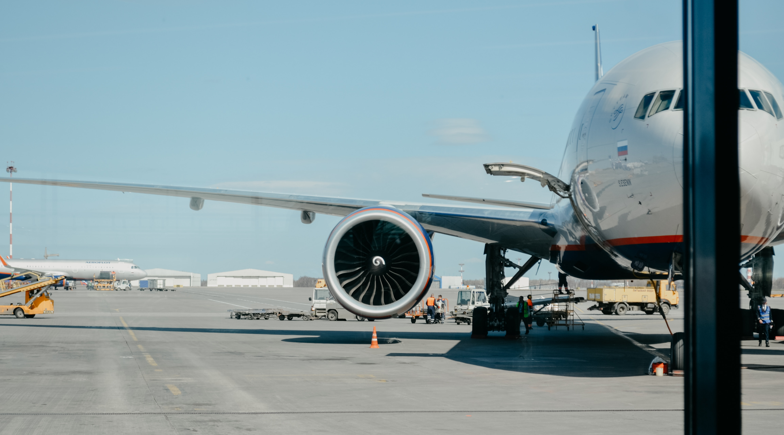
THANK YOU

