Slide 1
Duluth Airport Authority Capital Improvements Update
Tom Werner, C.M.
Executive Director
Duluth Airport Authority

Slide 2
Background
ADK Executive Search
Perform an Organizational Review of the Operations Department
Focus of the Study
Workload/staffing
Operations
Maintenance
Capital improvement projects
Project Scope
Meet w/ designated staff re: current organizational structure
Examine current organizational structure/staffing levels
Assess functional assignments, staffing levels required to perform the current duties and expected future duties
Compare organizational structure, services, and staffing levels w/ other similar airport systems
Review operational functions and workflow processes
Recommend opportunities for operational efficiencies, potential needs, or suggested organizational realignments

Slide 3
Background
Employee Survey
Airport Tours
Staff Interviews
Stakeholder Interviews

Slide 4
Case Study Airports (Benchmark)
6 Benchmark Airports Provided a Comparative Cross-Section Similar to DLH
Distinguishing Characteristics
Commercial service volume
Operational volume
Business parameters
Work-force makeup
Regional conditions
Governance structure
Financial and physical resources
Rochester Airport Company

Slide 5
Key Findings and Recommendations

Slide 6
Key Findings and Recommendations
“We found airport staff to be committed, hard-working, accommodating, and cooperative. It is an impressive operation. Of special note, we want to acknowledge the incredible culture that has been developed. Everyone is willing to do what it takes to get the project started, work done or help anyone who needs it. This is not always common at other airports and this strong collaborative culture has and will be the success of the Airport.”

Slide 7
Key Findings and Recommendations
Snow Removal Events
Inadequate personnel to work prolong snow season efficiently
Snow removal team has a great attitude
Recommendation: eliminate or reduce reliance on over-hires/temps/seasonal employees. Add full-time permanent operations and maintenance personnel trained on the Snow Removal Equipment (SRE) and assist during the construction season and the many other operations and maintenance issues.
Bargaining Unit
Staff highly motivated
Genuinely invested in completing the job
Excellent relationship between bargaining unit, unrepresented employees and management
Airport(s) I, II, III work outside their classification
Recommendation: create new titles and job descriptions for operations, maintenance, and facilities.

Slide 8
Key Findings and Recommendations
Over Hires – Temporary/Seasonal Employees
Long snow season has resulted in large amounts of overtime at current staffing levels
Use of part-time, temporary/seasonal employees no longer a viable solution at airport around the country
While cost-effective for the DAA, overhires:
Difficult to find in today’s job market
Skillset is difficult to find
Poses increased risk to the DAA due to lack of:
Heavy equipment experience
Airfield familiarity
Availability
Recommendation: reduce or eliminate the use of Over-Hires/Temporary Employees or adjust the pay range; explore a new employee signing bonus whereby the new employee receives a one-time cash bonus if they reach a to-be-determined employment milestone. Alternatively, explore other labor sources such as local firefighters that may have interest in assisting during their off days.

Slide 9
Key Findings and Recommendations
Salary Study
Salaries across the board from the Over-Hires/Temps to the Executive Director are not reflective of industry levels
Recommendation: engage a firm to conduct a salary study whereby comparing DAA to other airports of similar size in both staffing levels, workload, etc.
Overtime Alternative for Non-Represented Salaried Employees
Hourly employees that worked long shifts and more than 5 days a week during the snow events resulted in the employee making more money than the salaried employee working the same hours.
Recommendation: offer Compensation Time (Comp Time) that can be used for paid time or days off but has well-defined written parameters and restrictions on accumulation and use in a written agreement.

Slide 10
Key Findings and Recommendations
Use of Fleetio/Vicheo
Both software platforms are currently in use airside
Facilities currently uses tried and true notes. Best practice is to manage workorders using a software solution that would include historical database of past repairs/issues.
Recommendation: explored possible expansion for facilities/landside
Adjust Operations/Maintenance Workers Hours/Coverage
Operations/maintenance staff works a variety of shifts, 7 days per week to ensure the airport is operating within regulatory guidelines, is safe and efficient.
Majority of staff work M-F 6:30AM-3:00PM. 1 employee works 4:00AM-1:00PM. 1 employee works 2:30PM-11:00PM. No coverage 1:00PM-2:30PM S-S.
Current staffing/schedule makes it difficult to conduct repairs w/o calling someone in on overtime
Recommendation: add more staff to allow for efficient work to be performed during low flying density hours of the airlines and the military. The airport operations area (AOA) is highly regulated and requires a certain level of maintenance that can only be done when the flight schedules are minimized.

Slide 11
Key Findings and Recommendations
Use of Operations and Maintenance Staff to Escort
Common practice to use airport operations and/or maintenance staff for construction project escorting.
Recommendation: train contractors and consultants to move safely on the AOA. Operations personnel could then periodically observe to confirm continued compliance.
Use of Administrative Staff to Assist with Snow Events
Common way to augment staffing levels during snow events is to develop a voluntary program where airport administrative staff assist with various landside snow duties
Recommendation: establish a voluntary program that is mainly used landside. Employees would either get their normal pay, overtime pay, if applicable, or paid time-off through Comp Time.

Slide 12
Key Findings and Recommendations
Contract Maintenance for Passenger Bridges and Baggage Belts
Facilities personnel respond to non-work hours maintenance issues with both the passenger bridges and the baggage delivery system.
Airport could benefit from formally trained contract personnel to not only repair the equipment promptly, but who would also be responsible for on-going preventive maintenance as well.
Recommendation: Secure outside experienced vendors for preventive maintenance and “on-call” responses for repairs on passenger bridges and the baggage handling equipment.
Employee Recognition Program
Recognizing the hard work employees do is key to maintaining their happiness and longevity in the workplace.
Recommendation: continue use of incentive awards (OP #5) and recognitions as a part of the Above and Beyond Program.

Slide 13
Key Findings and Recommendations
Training for all Employees
During the staff interviews and comments made within the employee survey that there is a continuing need for enhanced training opportunities.
Recommendation: offer training for work groups as requested. The type of training is dependent upon the work group but would include leadership, operations, finance, maintenance, and facilities.

Slide 14
Organizational Recommendations

Slide 15
Proposed Organizational Changes
Proposed Title Changes
Facilities Tech II – This position’s title is currently Airport II. We believe the title (and subsequent job description) should be changed to properly reflect the job duties associated with Facilities.
Facilities Tech I – This position’s title is currently Airport I. We believe the title (and subsequent job description) should be changed to properly reflect the job duties associated with Facilities.
Senior Operations Specialist – This position’s title is currently Airport III. We believe the title (and subsequent job description) should be changed to properly reflect the job duties associated with Operations.
Operations Specialist II – This position’s title is currently Airport II. We believe the title (and subsequent job description) should be changed to properly reflect the job duties associated with Operations.
Operations Specialist I – This position’s title is currently Airport I. We believe the title (and subsequent job description) should be changed to properly reflect the job duties associated with Operations.
Mechanic – This position’s title is currently Airport III. The person in the role is truly a vehicle/equipment mechanic. We believe the title (and subsequent job description) should be changed to properly reflect the job duties of working on and maintaining the Airport’s fleet equipment.
Maintenance Tech II – This position’s title is currently Airport II. We believe the title change better reflects the We believe the title (and subsequent job description) should be changed to properly reflect the job duties associated with Maintenance.

Slide 16
Proposed Organizational Changes
Proposed New Positions
Deputy Executive Director – This position would be an alternative to our preferred alternation and the hiring of a Special projects Manager. We envision the Deputy Executive Director to have the primary responsibility of the Airport’s Capital Improvement Program and those responsibilities now handled by the Director of Operations.
Special Projects Manager – DLH has a tremendous list of planned capital projects. The demand for the Director of Operations is high to be the acting project manager too. We suggest creating a new position that would be responsible for the capital projects, coordinating with design consultants, inspectors and providing information back to the airport manager. Overseeing construction projects both privately and grant funded.
As an alternative to the previously mentioned positions consider contracting with a construction manager to perform these duties and report to the Director of Operations.

Slide 17
Proposed Organizational Changes
Proposed Additional New Positions
Operations Specialist II – The operations and snow team are understaffed. We suggest the hiring of this new position to assist in reducing the heavy overtime during the long snow season.
Operations Specialist I – The operations and snow team are understaffed. We suggest the hiring of this new position to assist in reducing the heavy overtime during the long snow season.
Operations Specialist I (Part-Time Permanent) – The operations and snow team are understaffed. We suggest the hiring of this new position to assist in reducing the heavy overtime during the long snow season.
Airport Maintenance I - There is maintenance work that is not getting done. We suggest adding an additional person to assist.
Operations Trainee – This would be an entry-level position with the goal of being promoted to Operations Specialist I, once fully-trained and when an opening is presented.
Facilities Technician Trainee – This would be an entry-level position with the goal of being promoted to Facilities Tech I, once fully-trained and when an opening is presented.
Purchasing Clerk & Parking & Procurement – The Airport recently took over the day-to-day airport parking operations from the previous vendor. Financially, it appears to be a smart and strategic move. Finance is responsible for the cash portion and Facilities is responsible for the parking lot and equipment repair as well as responding to customer inquiries, issues, and questions. We recommend adding this position, so the management of the parking operation lands primarily under Finance. The position would also be the primary procurement position for Airport acquisitions

Slide 18
Proposed Organizational Changes
Proposed Deleted Positions
Over-Hires (Temps) – In the event DAA moves forward with our recommendation to hire additional full-time permanent operations and maintenance staff, the need for an active Over-Hire/Temp employee program is no longer needed.

Slide 19
Proposed Organizational Changes – Timeline The priorities for our recommended title upgrades, new positions and the deleted position are as follows:
Phase 1 – Immediate action for 2023 - 2025.
Title Changes
Facilities Tech II (formally Airport II)
Facilities Tech I (formally Airport I)
Senior Operations Specialist (formally Airport III)
Operations Specialist II (formally Airport II)
Operations Specialist I (formally Airport I)
Mechanic (formally Airport III)
Maintenance Tech II (formally Airport II)
New Positions
Special Projects Manager
Operations Specialist II
Operations Specialist I
Operations Specialist I (Part-Time Permanent)
Maintenance Tech I
Deleted Positions
Over-Hires (Temps)

Slide 20
Proposed Organizational Changes - Timeline
Phase 2 – Timing to be determined for 2026 and beyond.
New Positions
Special Projects Manager
Purchasing Clerk – Parking & Procurement
Facilities Technician Trainee
Maintenance Tech I

Slide 23
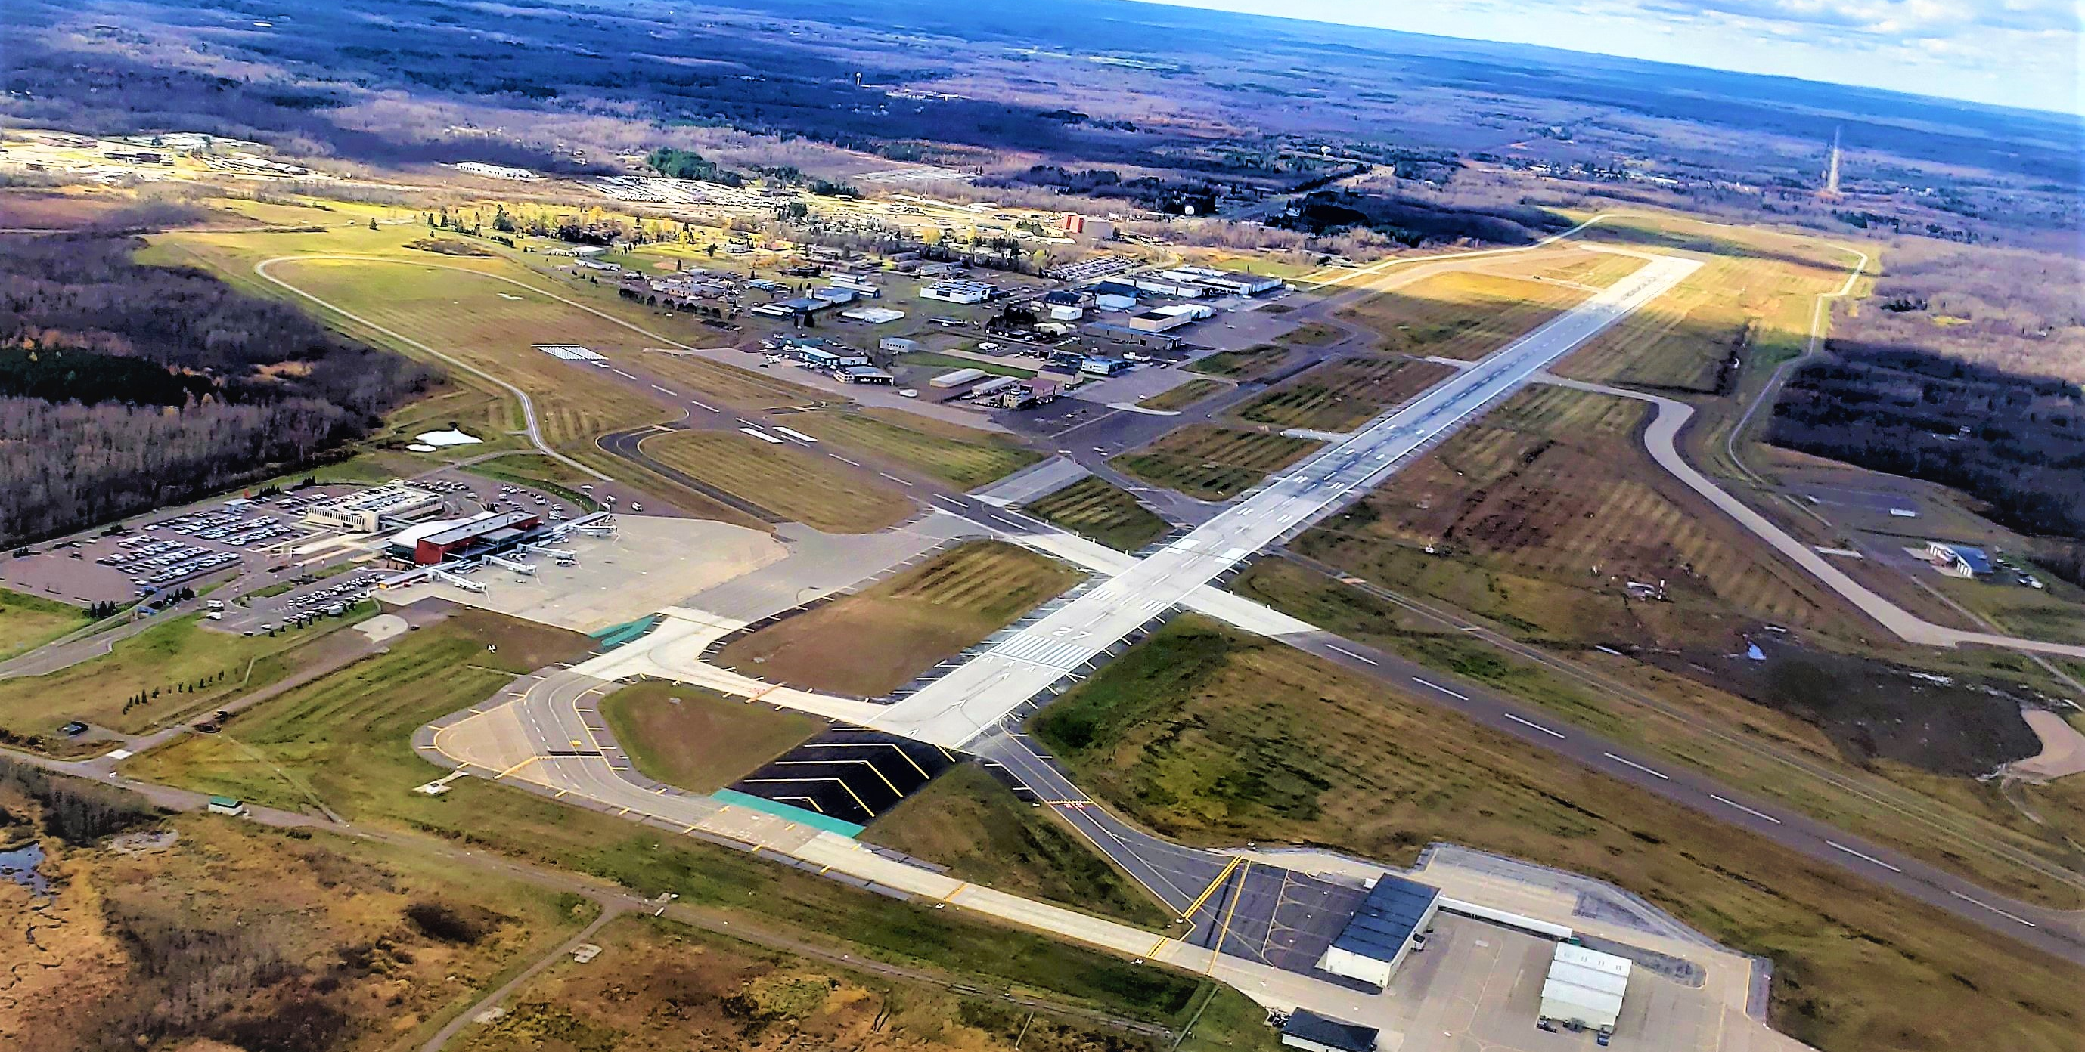
Questions

