Slide 1
Economic Development @ DLH
……more than just on our airfield
Mission
Our vision is to be a world-class aviation center that drives economic development and connects the region to the global economy.
Vision
The Duluth Airport Authority is committed to delivering a superior airport experience in a safe and secure environment, while enriching the region's economy.
Strategic Initiative #2
Support Economic Development

Slide 2
How does the DAA Participate in Economic Development in our Region?
APEX Partnership
Area Chamber Memberships
Engaging with Local Municipalities: City of Duluth, City of Hermantown, City of Rice Lake, Canosia Township, St. Louis County
Air Service Development
Non-Aeronautical Development
Engaging with and supporting our tenants:
Cirrus: collaborated with APEX on a regional housing initiative. Hosted a meeting at DLH with more than 50 attendees including regional municipalities, developers, and contractors.
148th: Support of the F35 airframe change

Slide 3
St. Louis County Engagement
Rice Lake Road Corridor Project
Victor Lund, St. Louis County Traffic Engineer reached out to DAA to discuss upcoming Rice Lake Road Corridor Project
Project Overview
Rice Lake Rd, beginning at Technology Dr and ending at ~2/3 mile north of Martin Rd
Martin Rd, beginning at Stebner Rd and ending at Stavenger Rd
West Calvary Rd, beginning at Rice Lake Rd and ending at ~1/3 mile east of Rice Lake Rd
Construction of a new city street connecting West Calvary Rd and Martin Rd

Slide 4
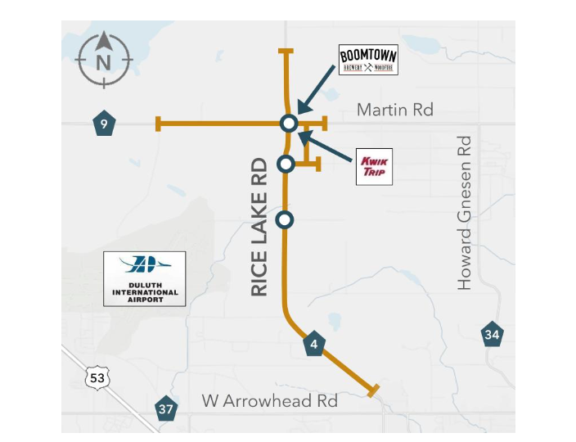
Rice Lake Road Corridor Project

Slide 5
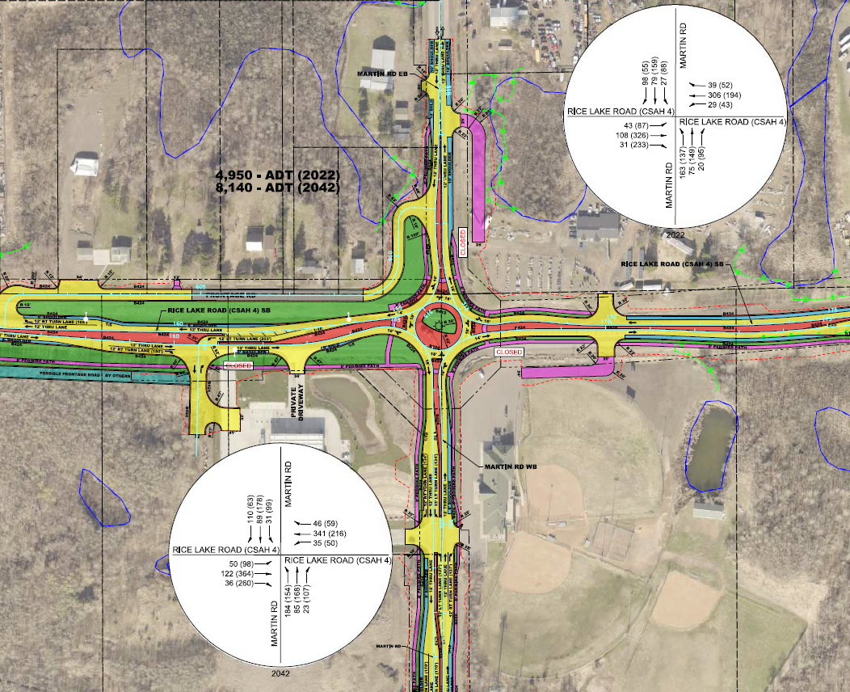
Rice Lake Road Corridor Project

Slide 6
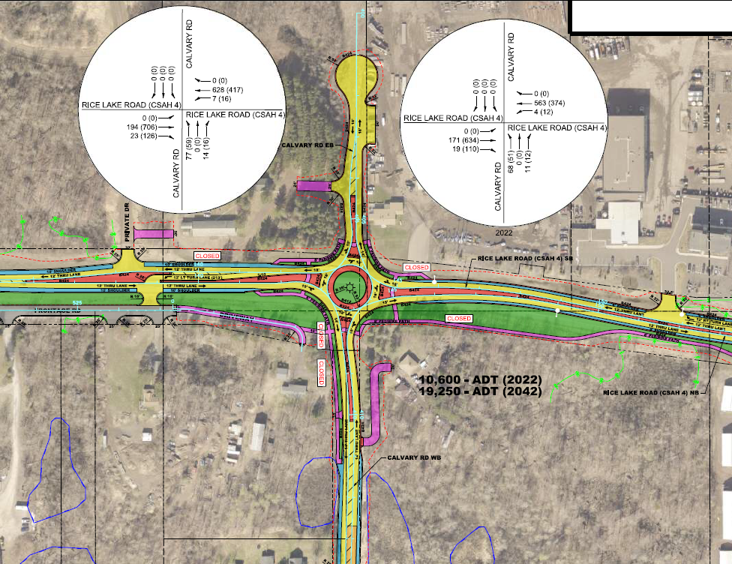
Rice Lake Road Corridor Project

Slide 7
Rice Lake Road Corridor Project Timeline & Funding

Slide 8
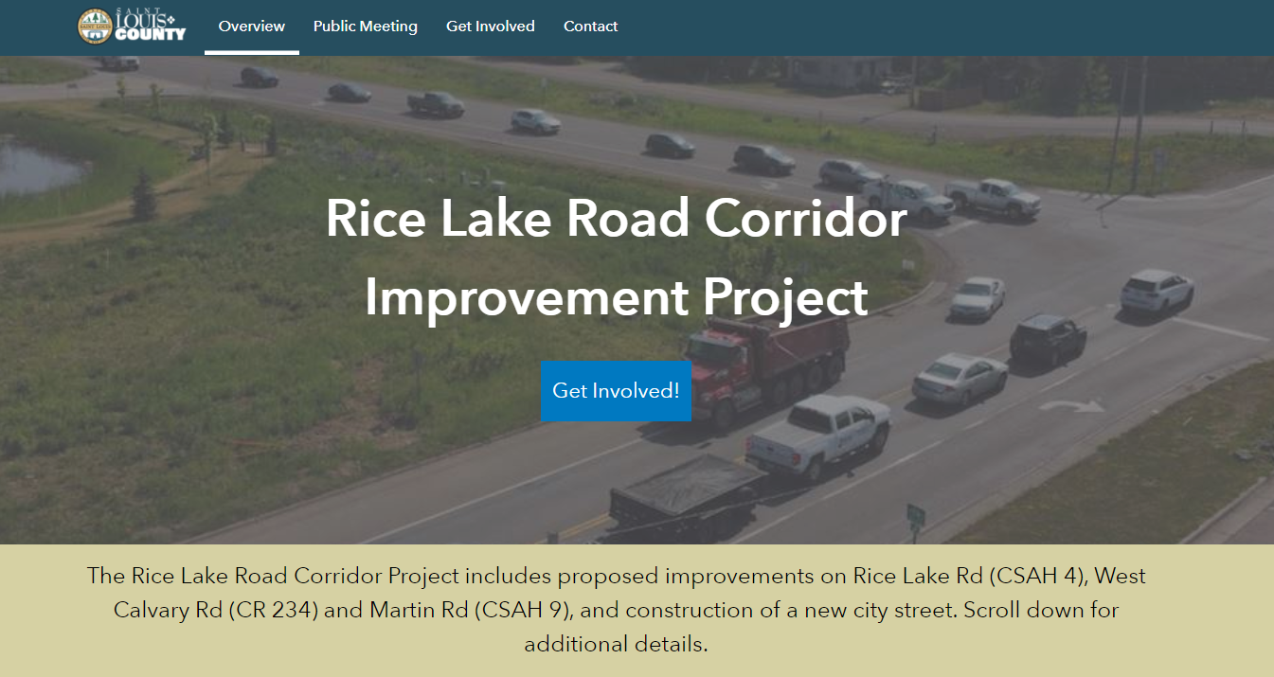
Rice Lake Road Corridor Project RAISE Grant
SLC was unsuccessful in their first application for a RAISE grant. As SLC began to research how to better prepare their next application it was very apparent that including economic development and housing into their application would increase their success rate.
That is where the DAA stepped in to assist SLC in collaborating with our tenants as well as APEX.
DAA facilitated meetings with:
Cirrus
148th
MN Power
APEX

Slide 9
Rice Lake Road Corridor Project Economic Development Engagement
Great discussion and collaboration came from the DAA coordinated meetings with SLC
Other projects such as the MN Power Service Center and Cirrus housing initiatives were brought to the table for SLC awareness.
Could the RAISE Grant provide funding for the infrastructure expansion for Stebner Road development?
Could the RL project provide access roads for housing projects located behind Boomtown?
Will businesses who plan to expand have easy access for customers?
Will oversized vehicles be able to navigate the roundabouts?
Trails? Where should trails be added?

Slide 10
Rice Lake Road Corridor Project Round Table
The DAA hosted and APEX coordinated a meeting for SLC to share the project with local business owners, DLH tenants & local developers.
The meeting was held to:
1. Bring awareness to the RLC Project
2. Stir up economic interest in the project area
3. Share any upcoming projects planned in the area
4. Create interest in the project
SLC shared project and funding overview
Business Roundtable discussed:
1. How the project could support private investment
2. Anything currently in the works that could bolster the grant application
Meeting created a great environment to get people talking

Slide 11
So, how does this further connect to DLH?
Projects Near Airport
MN Power Service Center on Stebner Rd
Project Update
Project site annexed by City of Rice Lake
County working to update proper ownership
Working with FAA on Section 163 land release for approval of non-aeronautical activity
Met with EDA MN representative on EDA Grant application qualification and application
City of Rice Lake will be applicant and will work with ARDC and DAA on application
Appraisal from FI Salter in next 15 days to establish market rate lease rate as required by FAA
Survey
MN Power has hired KLG as architect to design Stebner Rd and Eveleth facilities

Slide 12
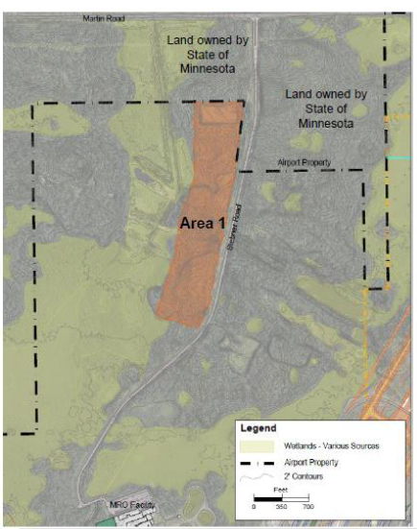
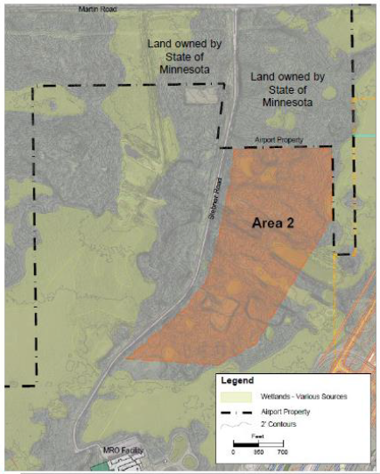
MN Power Project

Slide 13
Economic Development @ DLH ……more than just on our airfield
It is in our mission
It is in our vision
It is one of our strategic initiatives
It is how we engage
It is how we collaborate
It is the work we do!!

Slide 14
Questions?
Thank you!

