Slide 1
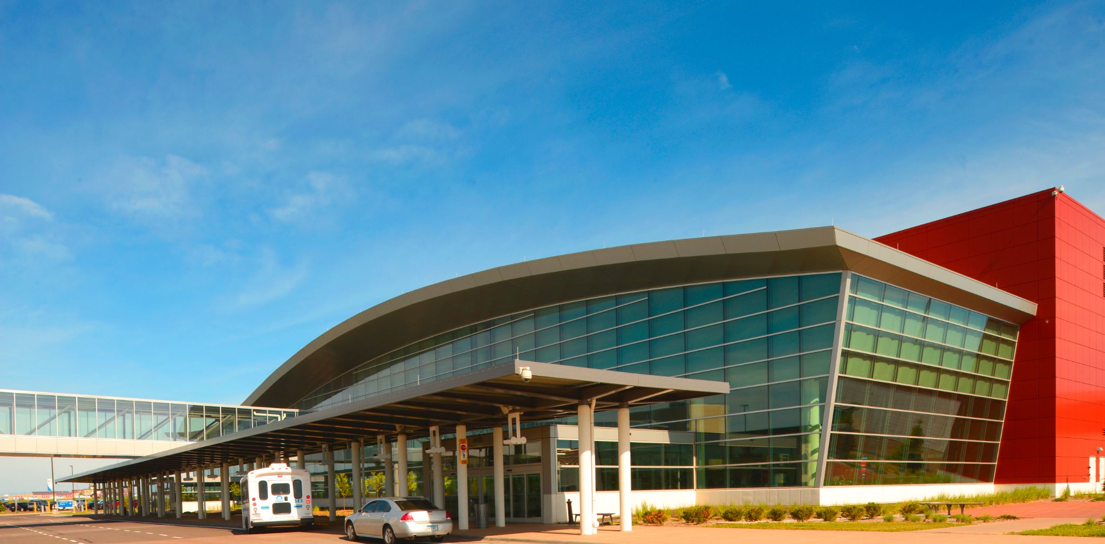

Finance Department Update
October 17, 2023

Slide 2
Updates
Concessionaire Audit Update
  Almost complete with Hangar 10 Aero
SCASD Semiannual Report Submission
  Tom updated the most recent efforts and secured an updated letter of support from SkyWest
2024 State Capital Budget Request Update
  $14M Request Remains Same, $66M Updated Construction Estimate from Requirements Workbook
2024 Draft DLH Rates & Charges Addendum
2024 Draft DYT Rates & Charges Addendum
2024 Draft Budget

Slide 3
DRAFT 2024 Budget and Rates & Charges

Slide 4
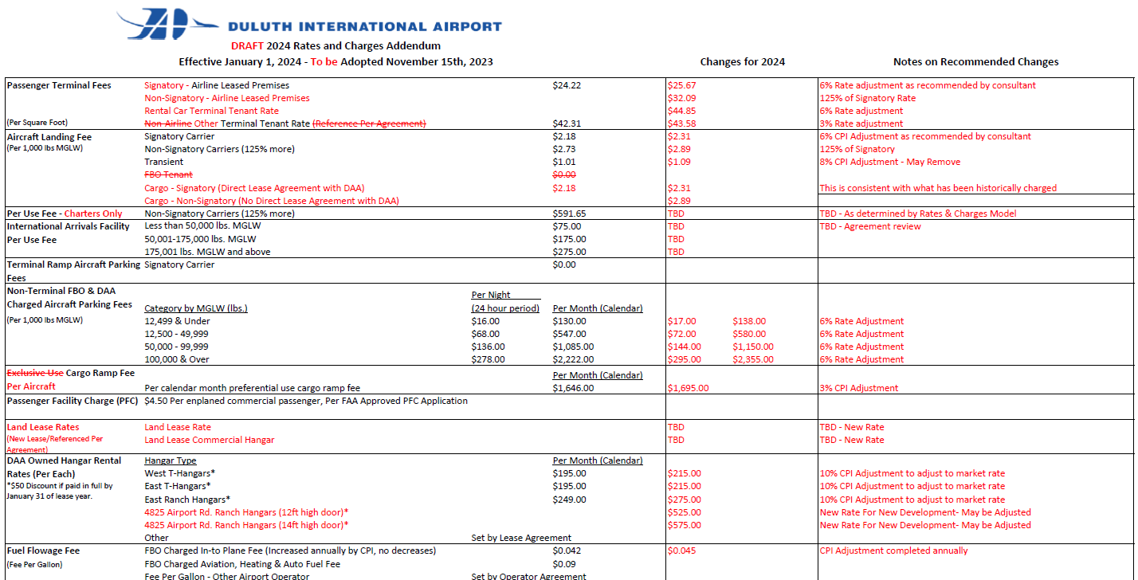
2024 DRAFT Rates & Charges

Slide 5
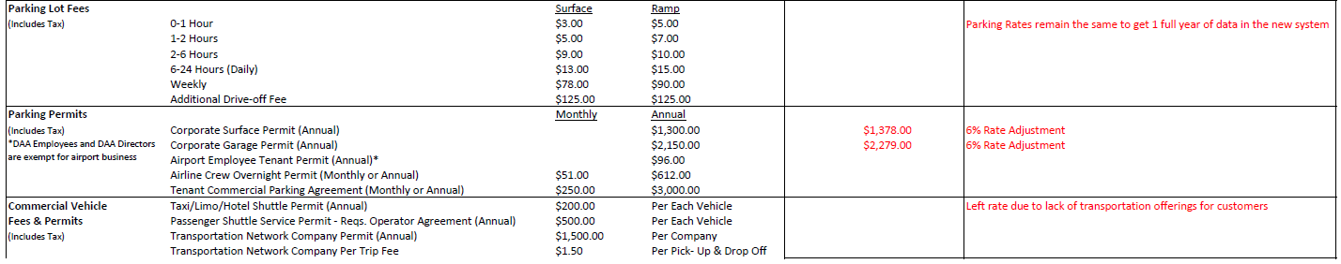
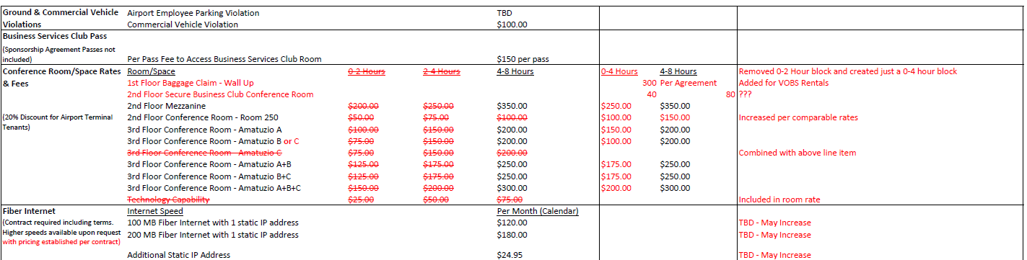
2024 DRAFT Rates & Charges Continued

Slide 6
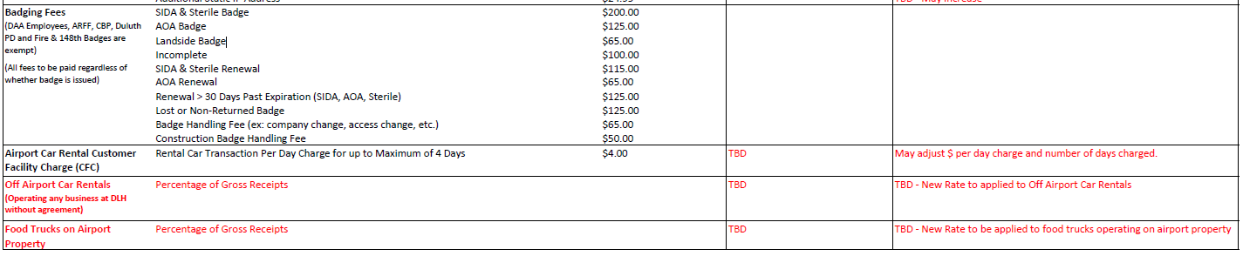
2024 DRAFT Rates & Charges Continued

Slide 7
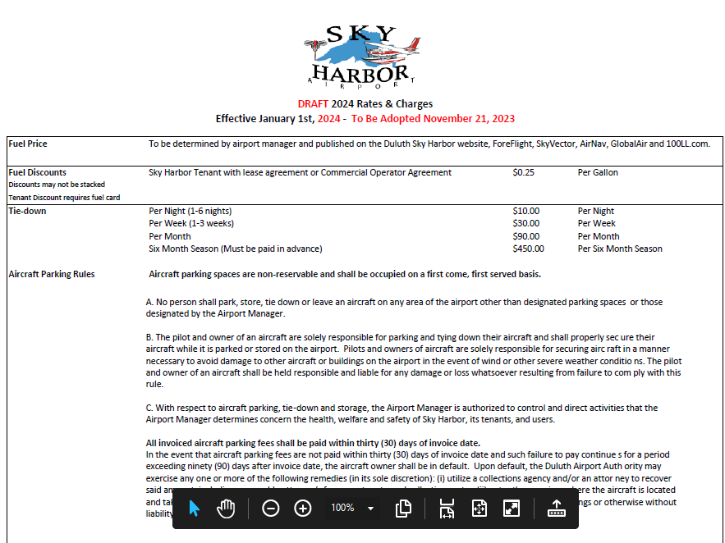

Slide 8
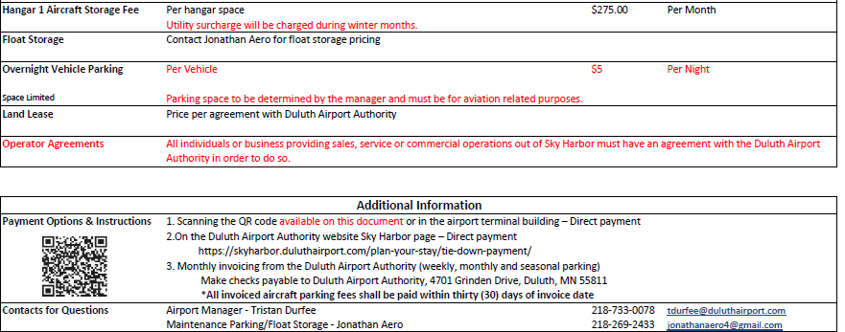

Slide 9
MAJOR TAKE AWAYS:
Operating revenue projections have surpassed pre pandemic levels. This is an 11% increase over 2023 budget.
Operating expenses are 5% over the 2023 budget. This is after budget cuts to reduce burden on cash.
We continue to work to support the master plan as well as our strategic plan initiatives.
6% rate increase to Signatory Airline rates has been proposed and nearly all other rates are being updated as well.
Passenger related concession revenue was estimated based on similar activity to 2023. Other revenues were determined based on current activity and contracted rates.
Our annual debt service in 2024 for all long-term debt is $1,076,174.
A strategy to utilize cash reserves has been identified to provide the local share of funding opportunities, pay debt service, and support operations in 2023.
Air service and expense projections continue to change as we receive more information. Airline negotiations with a new rate structure are anticipated as well, which may affect the final budget for November.

