Slide 1
Operations/Construction Update
New Air Traffic Control Tower Update
ATCT EA Update
Construction Delivery Method Update
2024 Capital Improvement Plan Update
Taxiway A Phase 2 + 4 Update
Sky Harbor Airport Terminal Update
Sky Harbor Airport Snow Removal Equipment Building Update

Slide 2
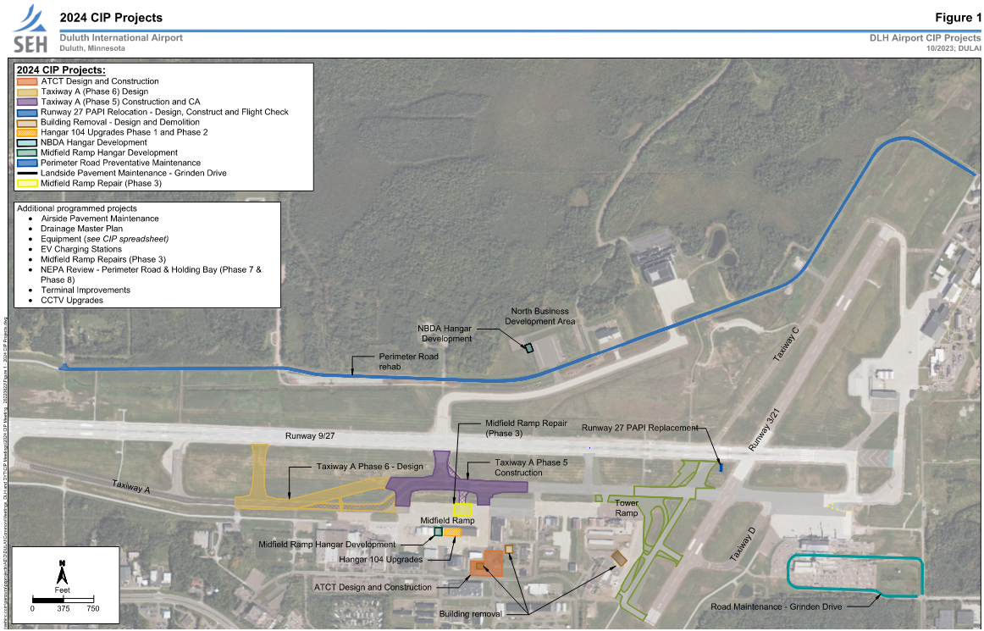

Slide 3
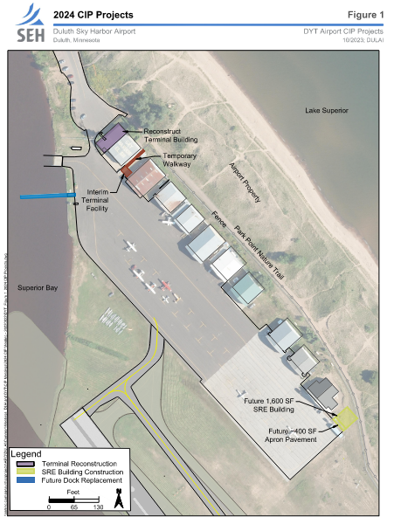
Sky Harbor 2024 CIP

Slide 5
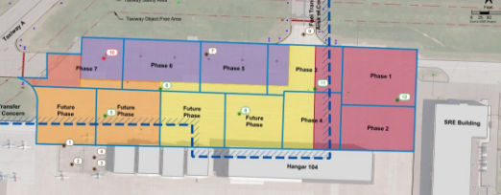
C. Resolution to Approve Work Order 2023-13 for the design of Midfield Ramp Phase 2 between Short Elliott Hendrickson, Inc. and the Duluth Airport Authority
Project Description – The project consists of designing repairs to the Midfield Ramp – Phase 2 area. The approximately 6,000 square yards of pavement is in poor condition and will be replaced with concrete.
The proposal amount is $125,500.00
The project is anticipated to be funded by MnDOT at 70% and the DAA at 30%, with the local share covered with passenger facility charge revenues.

Slide 6
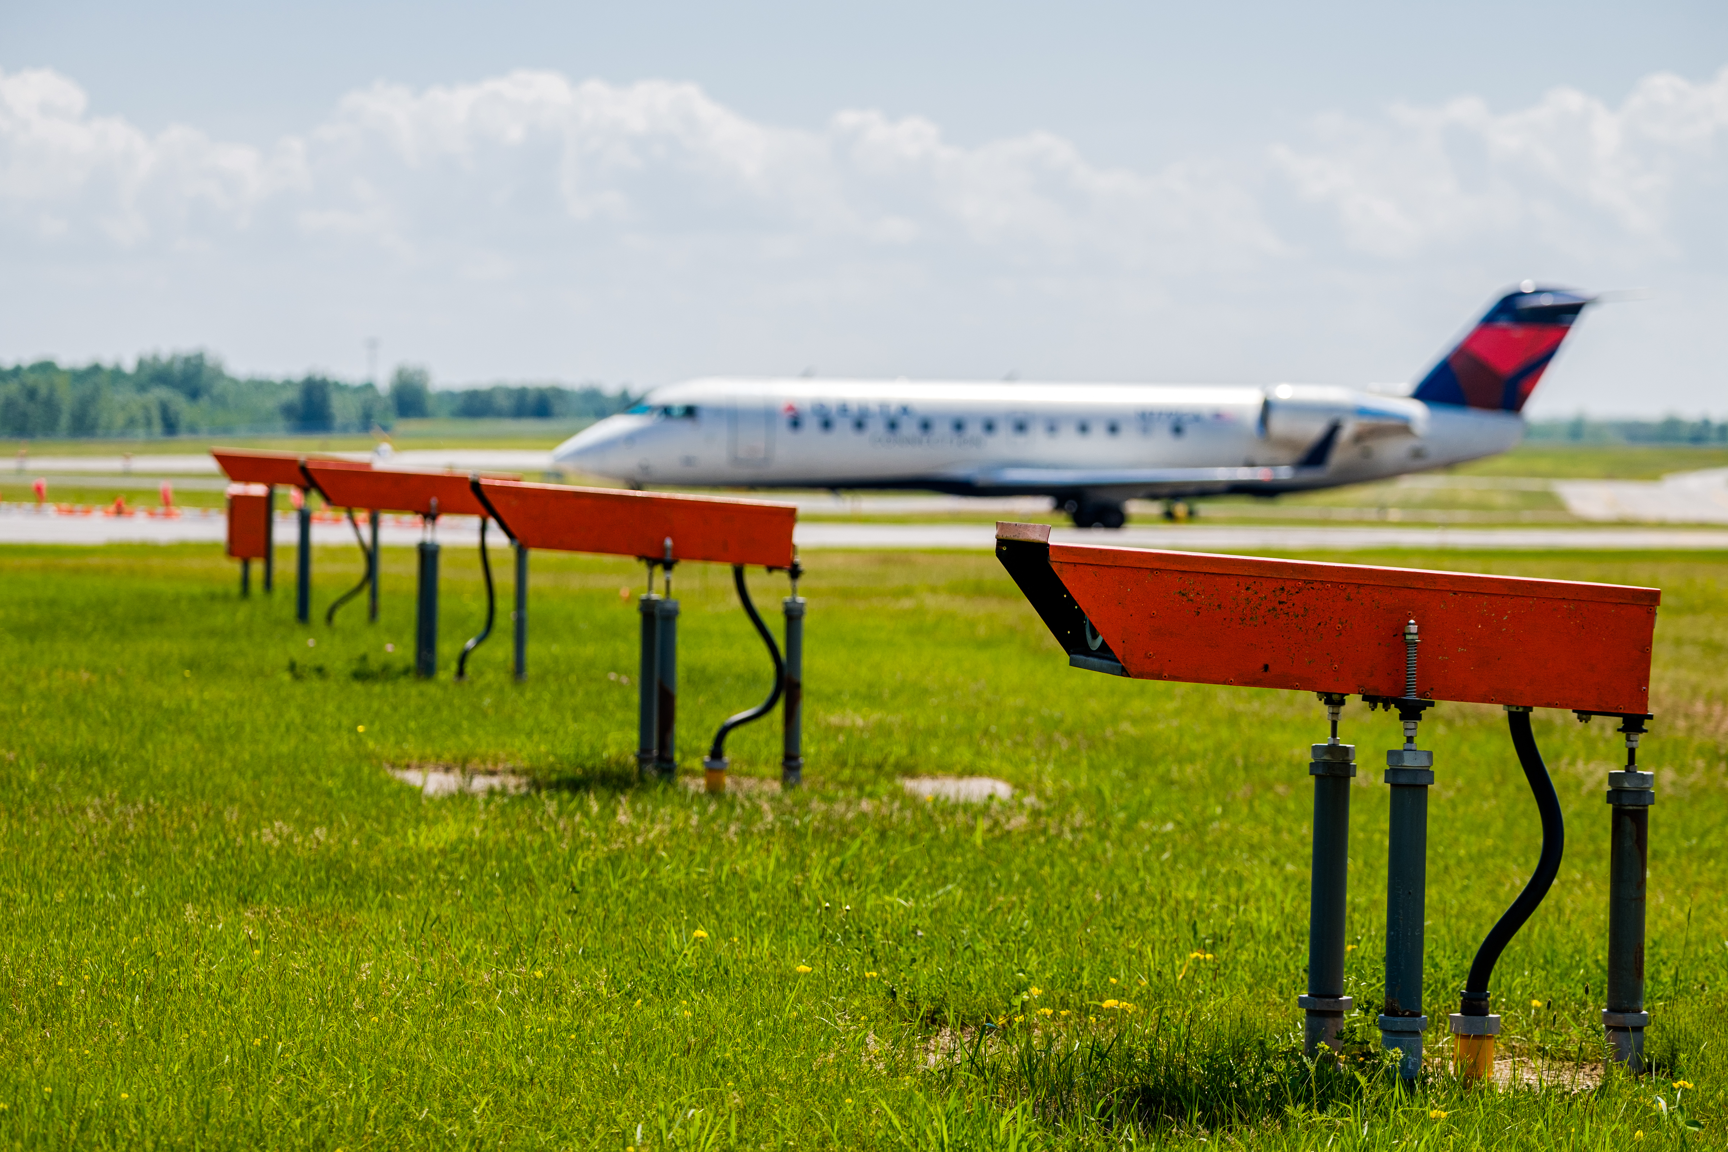
D. Resolution to Approve Work Order 2023-15 for the design of the Runway 27 PAPI’s between Short Elliott Hendrickson, Inc. and the Duluth Airport Authority Authority.
Project Description – The project consists of replacing the Runway 27 Precision Approach Path Indicator (PAPI) lighting system. The lights are beyond their useful life and in need of replacement.
The proposal amount is $57,900.
The project is anticipated to be funded by FAA at 90%, MnDOT at 5%, and the DAA at 5%.

