Slide 1
Operations/Construction/Projects/Planning Update
Duluth International Airport:
Joint Airport Zoning Board – Board of Adjustments DAA Nominee
Air Traffic Control Tower Update
Sky Harbor Airport:
New General Aviation Terminal Construction Update
New Snow Removal Equipment Building Construction Update

Slide 2
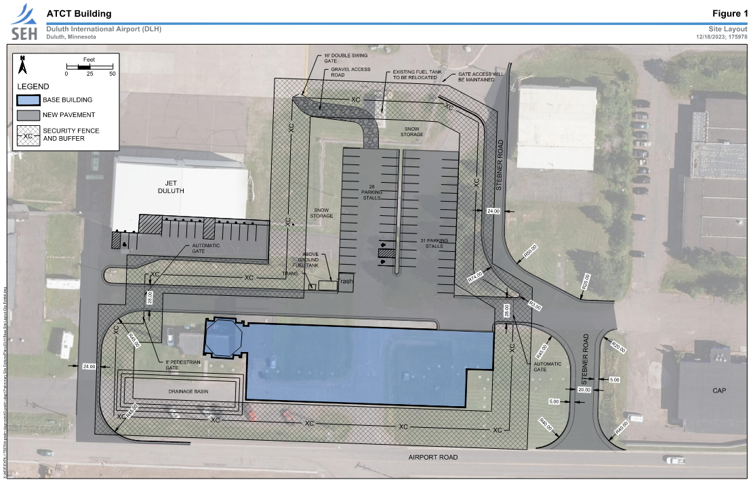
ATCT Preliminary Site Layout
Buildings to be removed prior to construction of new ATCT
Infrastructure to be relocated prior to construction of new ATCT
DHL Building
Hermantown Hydraulics

Slide 3
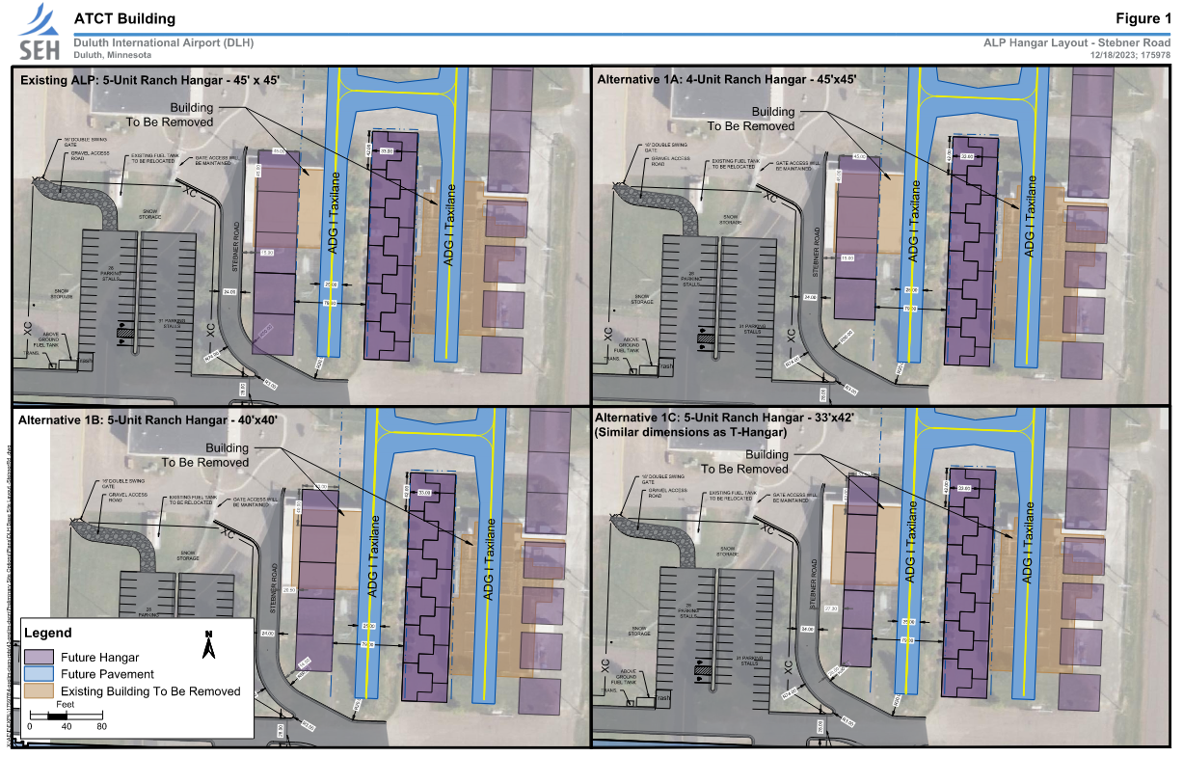
Impacts to Future Airport Development
Conflict Area

