Slide 1
Operations/Construction/Projects/Planning Update
Duluth International Airport:
Air Traffic Control Tower Update
FAA – Airport Terminal Program Funding – $10,000,000.00.
Construction Manager at Risk (CMaR) Request for Proposal Update
POTUS Visit Recap
Sky Harbor Airport:
New General Aviation Terminal Construction Update
New Snow Removal Equipment Building Construction Update

Slide 2
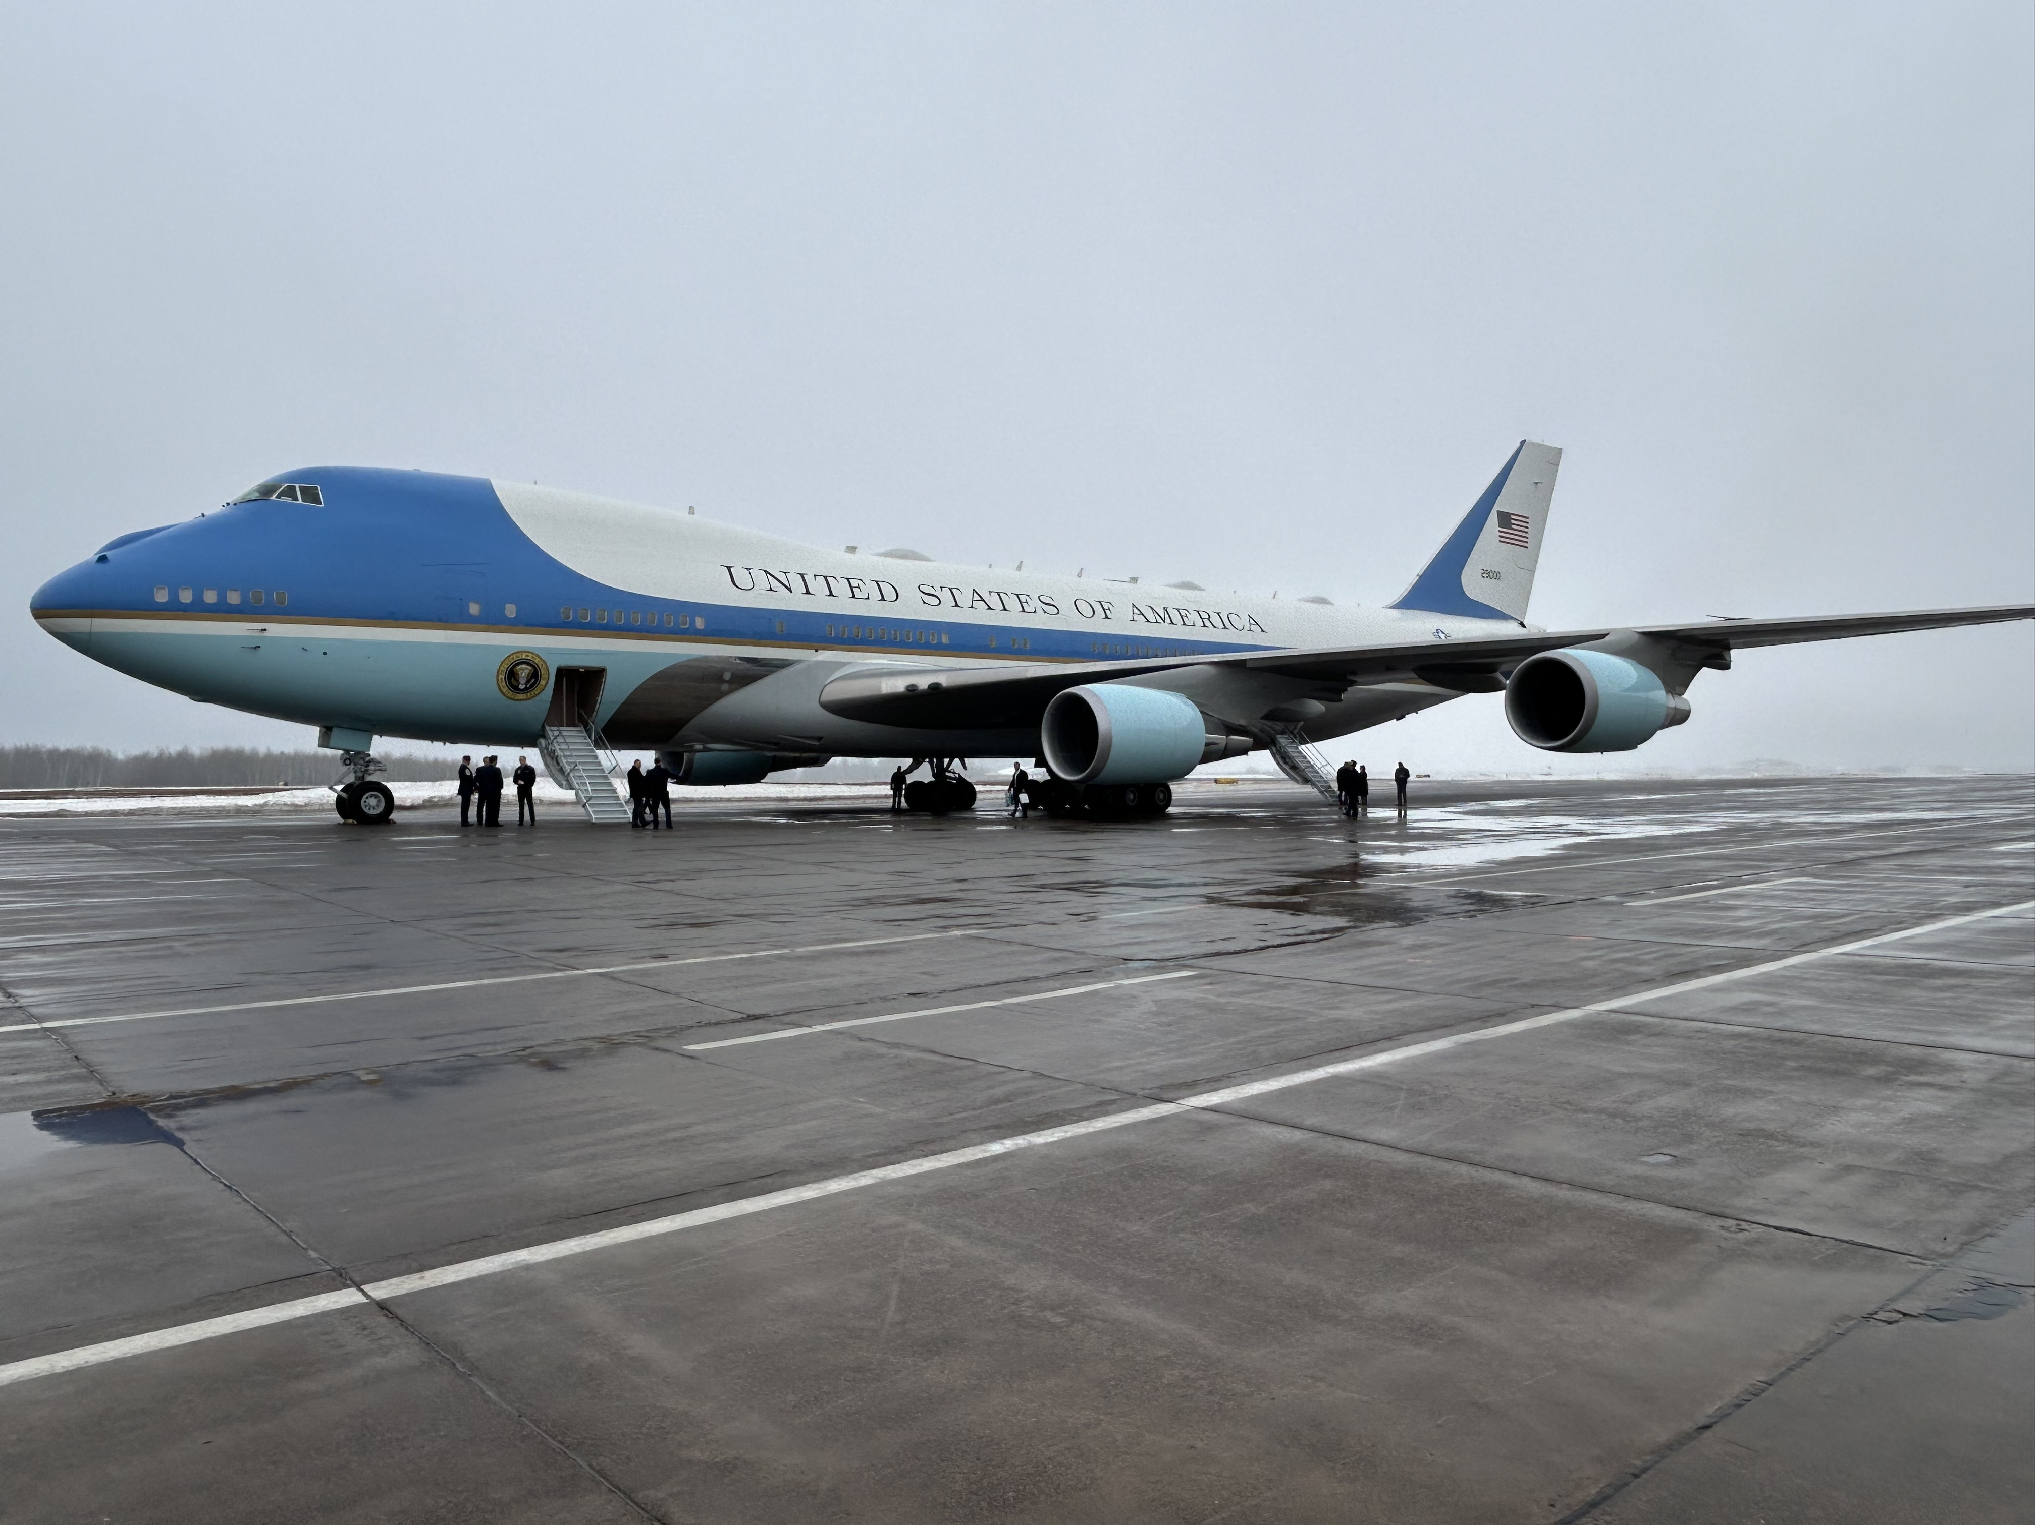
POTUS Visit

Slide 3
Operations/Construction/Projects/Planning Update
Duluth International Airport:
Air Traffic Control Tower Update
FAA – Airport Terminal Program Funding – $10,000,000.00.
Construction Manager at Risk (CMaR) Request for Proposal Update
POTUS Visit Recap
Sky Harbor Airport:
New General Aviation Terminal Construction Update
New Snow Removal Equipment Building Construction Update

Slide 4
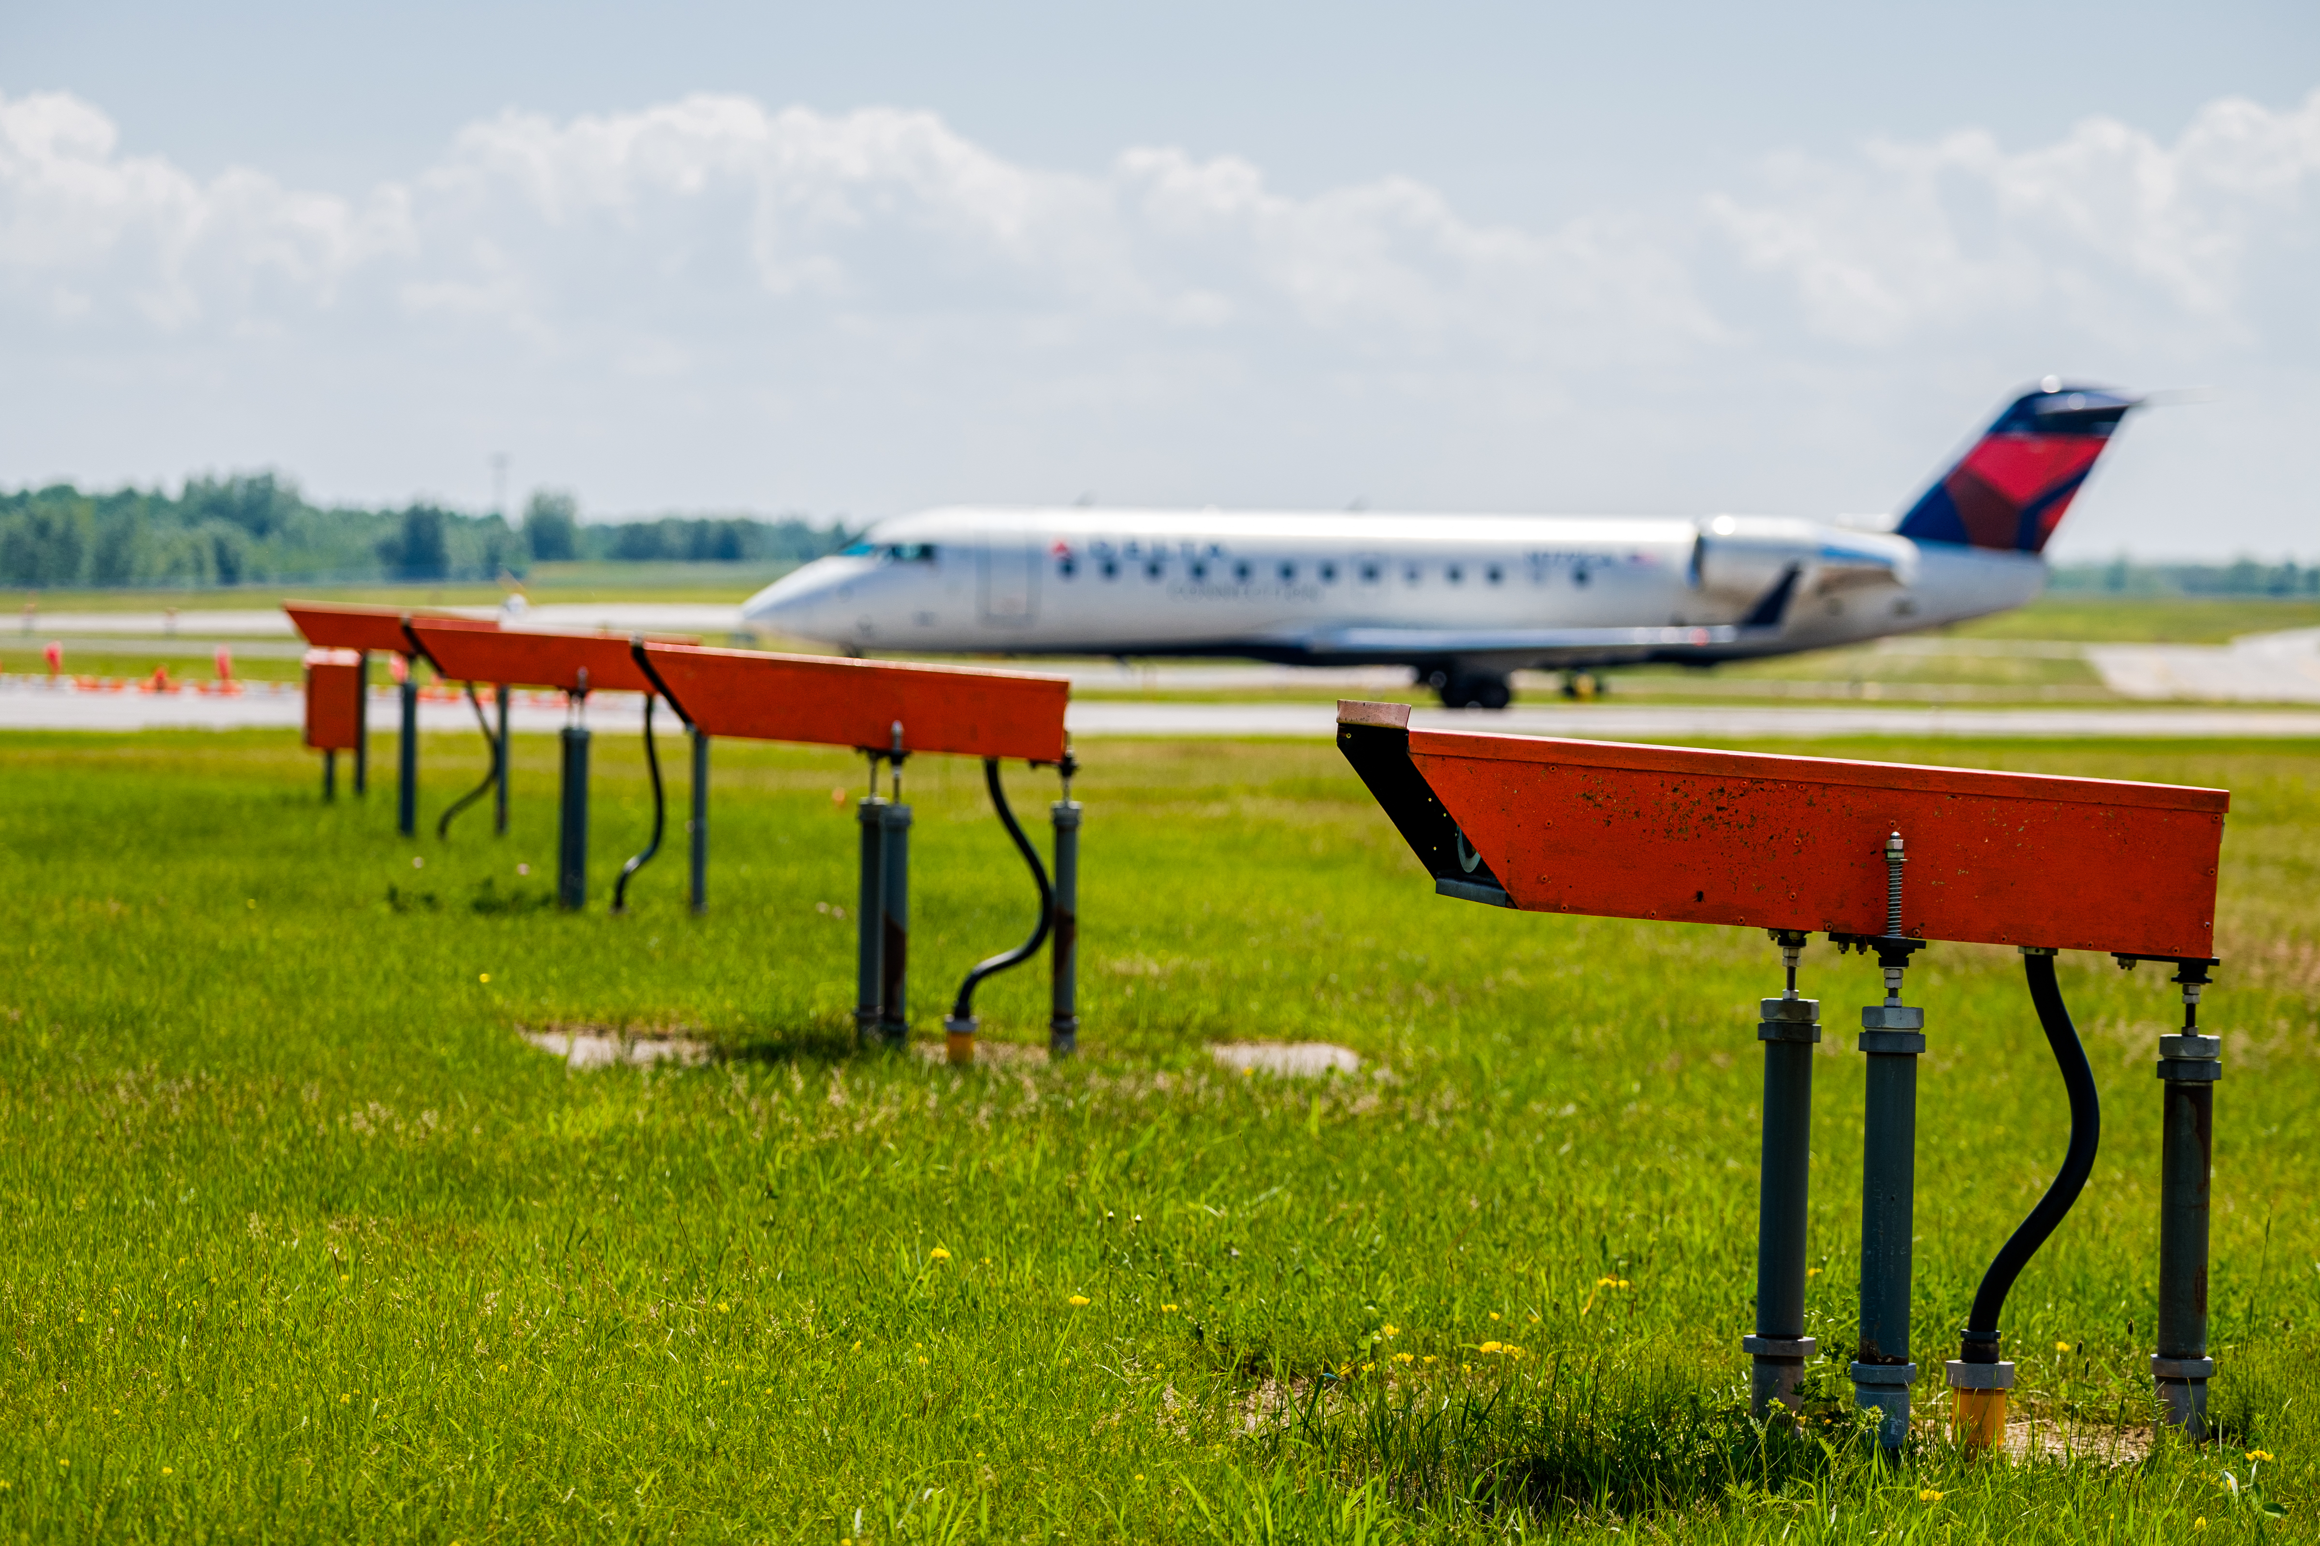
B. Resolution to Award Contract in the Amount of 83,624.00 to Parsons Electric for the Reconstruction of the Runway 27 Precision Approach Pathway Indicator (PAPI) Lights.
Project Description – The project consists of replacing the Runway 27 Precision Approach Path Indicator (PAPI) lighting system. The lights are beyond their useful life and in need of replacement.
The contract is for the Runway 27 Precision Approach Path Indicator (PAPI) replacement project in the amount received from PEC Solutions dba Parsons Electric from bids received on February 8, 2024.
The contract amount is $83,624.00
The project is anticipated to be funded by FAA at 90%, MnDOT Aeronautics at 5% and the DAA at 5% as part of the Airport Improvement Program.

Slide 5
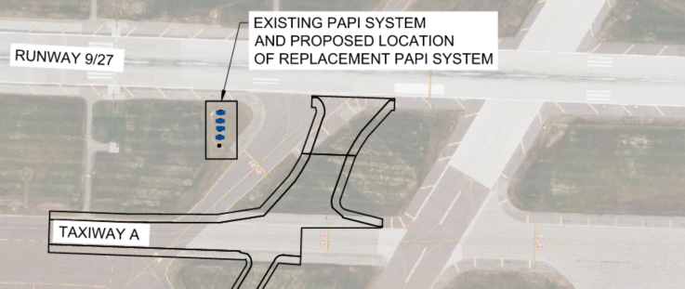
C. Resolution to Approve Work Order 2024-1 between Short Elliott Hendrickson, Inc. and the Duluth Airport Authority for the Construction Administration of the Runway 27 PAPI Replacement.
Project Description – The project consists of replacing the Runway 27 Precision Approach Path Indicator (PAPI) lighting system. The lights are beyond their useful life and in need of replacement.
The work order is for construction administration services, including preconstruction activities, shop drawing review, contractor oversight, FAA flight check coordination, and closeout.
The work order amount is $49,800.00
The project is anticipated to be funded by FAA at 90%, MnDOT Aeronautics at 5% and the DAA at 5% as part of the Airport Improvement Program.

Slide 6
G. Resolution to approve Renewal Agreement between iFIDS and the Duluth Airport Authority.

