Slide 1
Operations/Construction/Projects/Planning Update
Duluth International Airport:
Air Traffic Control Tower Update
Construction Manager at Risk (CMaR) Request for Proposal Update
Airshow 2024 – May 18-19, 2024
Sky Harbor Airport:
New General Aviation Terminal Construction Update
New Snow Removal Equipment Building Construction Update

Slide 2
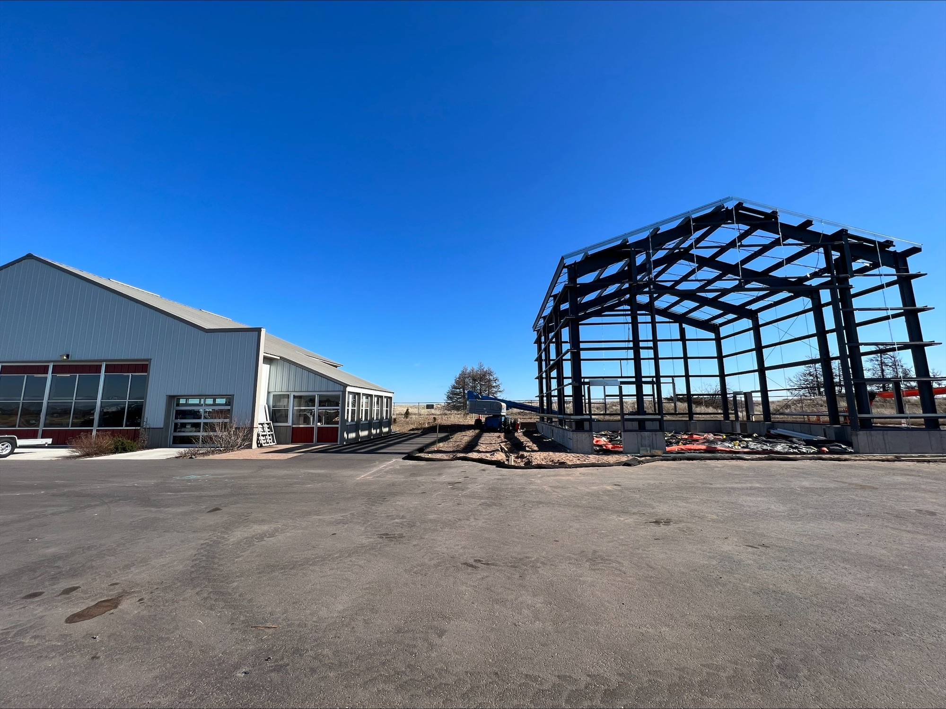
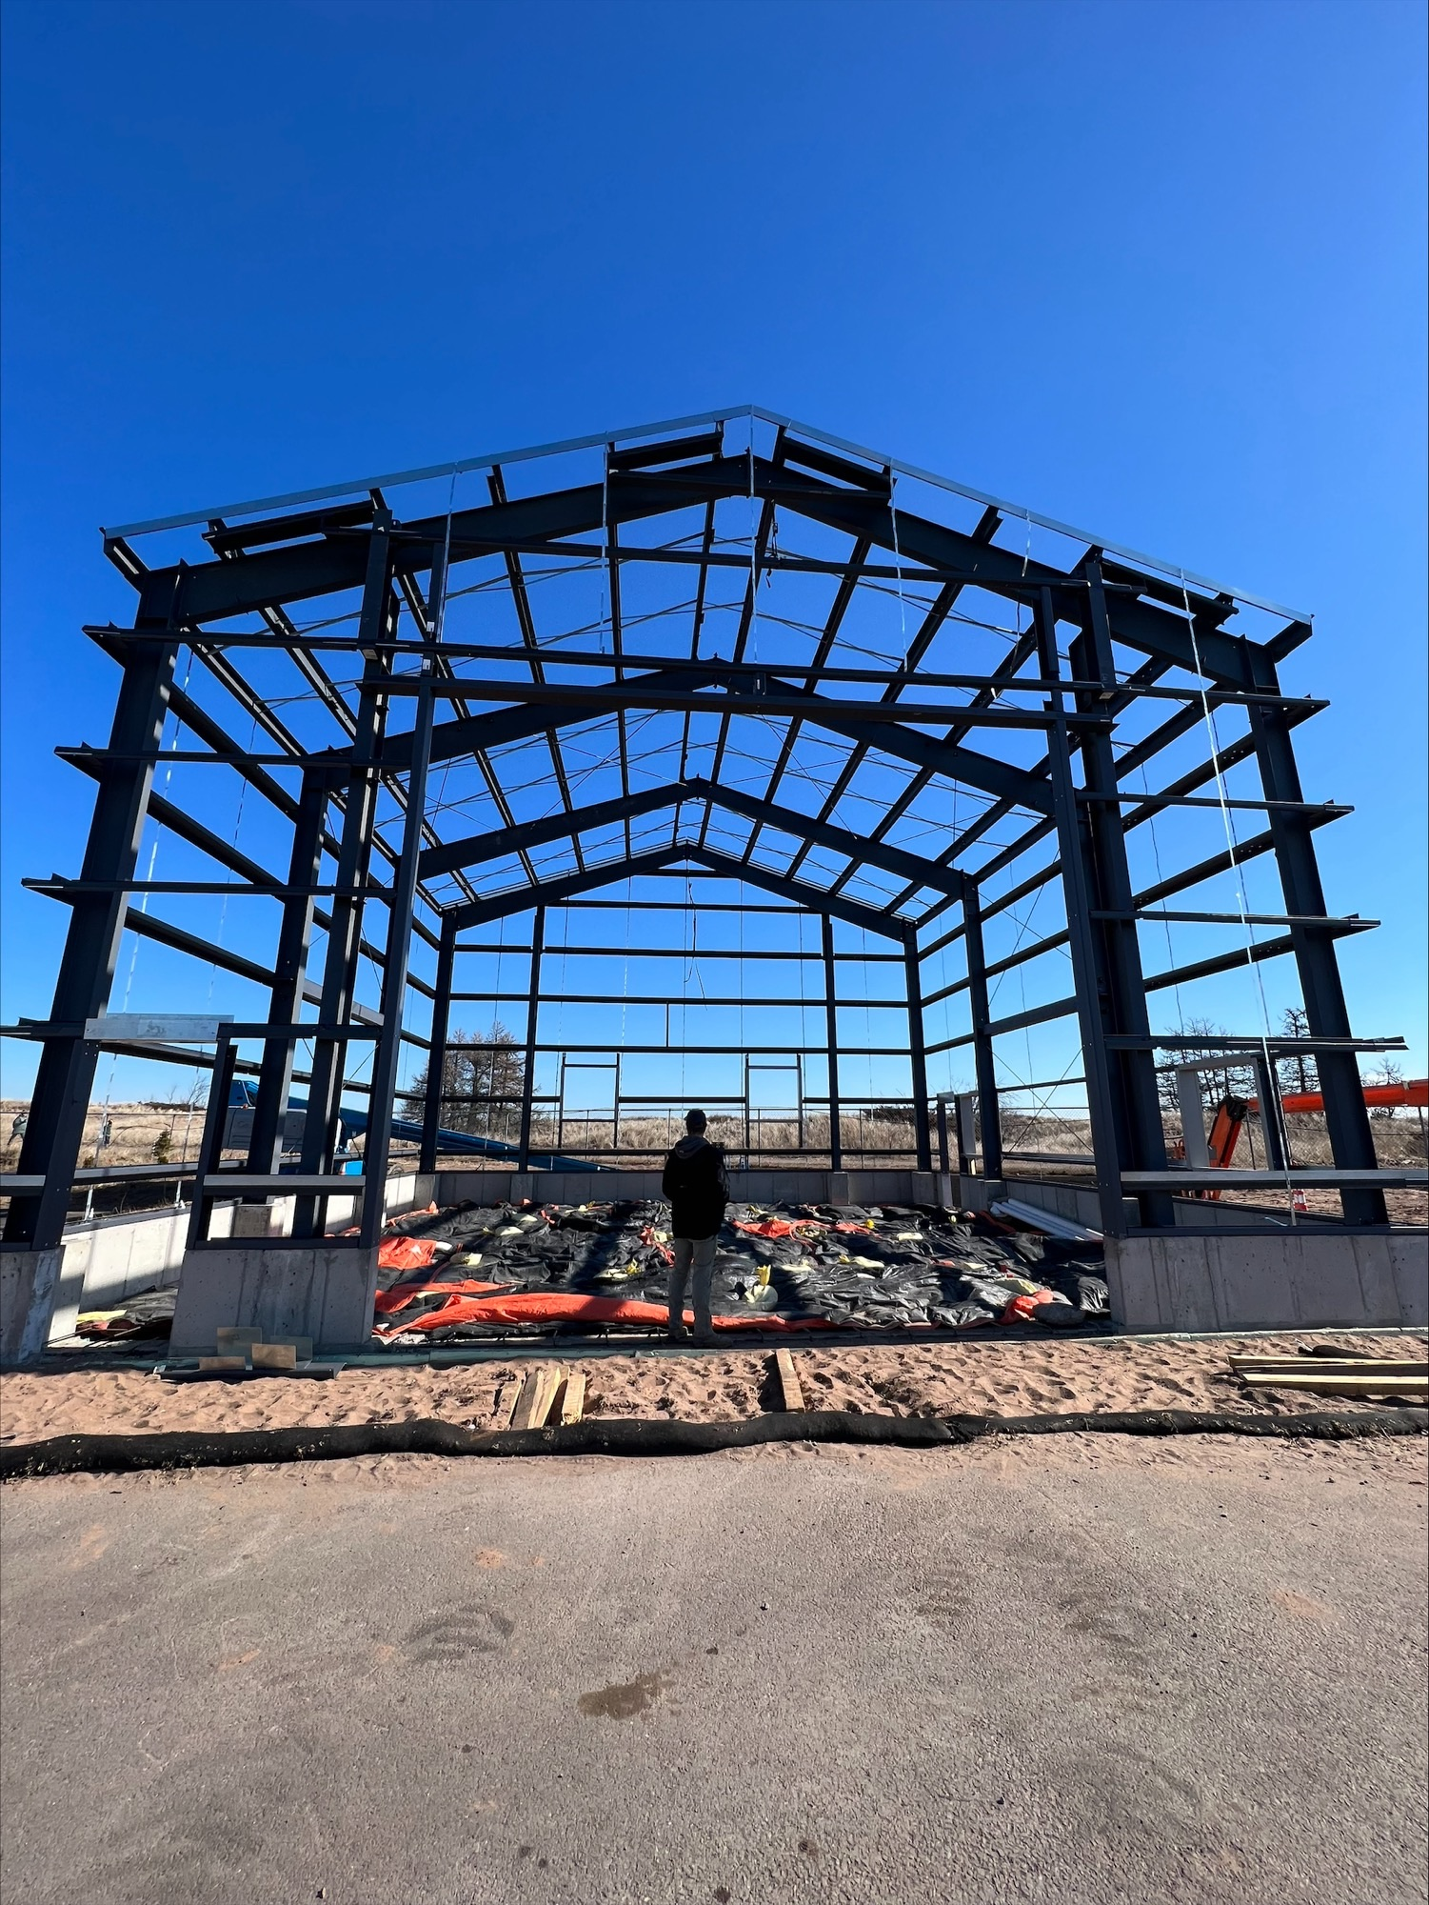

Slide 3
A. Resolution to approve Work Order 2024 – 03 between Short Elliott Hendrickson, Inc. and the Duluth Airport Authority for the coordination of Aquatic Mitigation at Sky Harbor Airport
Project Description –The Sky Harbor Runway Relocation project included several aquatic and terrestrial mitigation actions under the conditions of the permits issued by the USACE and MNDNR. Because the initial aquatic plantings completed as part of this project did not meet success criteria, a second round of plantings is required per permit commitments. This scope of services includes assisting DAA in obtaining quotes from qualified contractors for the planting efforts, permit coordination, contractor coordination and field monitoring during the replacement mitigation planting efforts. Monitoring of the mitigation planting is also included and will be completed as outlined in the environmental permits.
The work order amount is $13,000.00.
The project is anticipated to be funded by FAA at 90%, MnDOT Aeronautics at 5% and the DAA at 5% as part of the Airport Improvement Program.

