Slide 1
Operations/Construction/Projects/Planning Update
Duluth International Airport:
Air Traffic Control Tower Update
35% Design Review
ATCT Public Open House
Taxiway A Tenant Construction Communication
Storm Summary/Airfield Magnet
New ADA Coordinator Certification – DAA Facilities Manager – John Graves
Airshow 2024 – May 18-19, 2024
Sky Harbor Airport:
New General Aviation Terminal Construction Update
New Snow Removal Equipment Building Construction Update

Slide 2
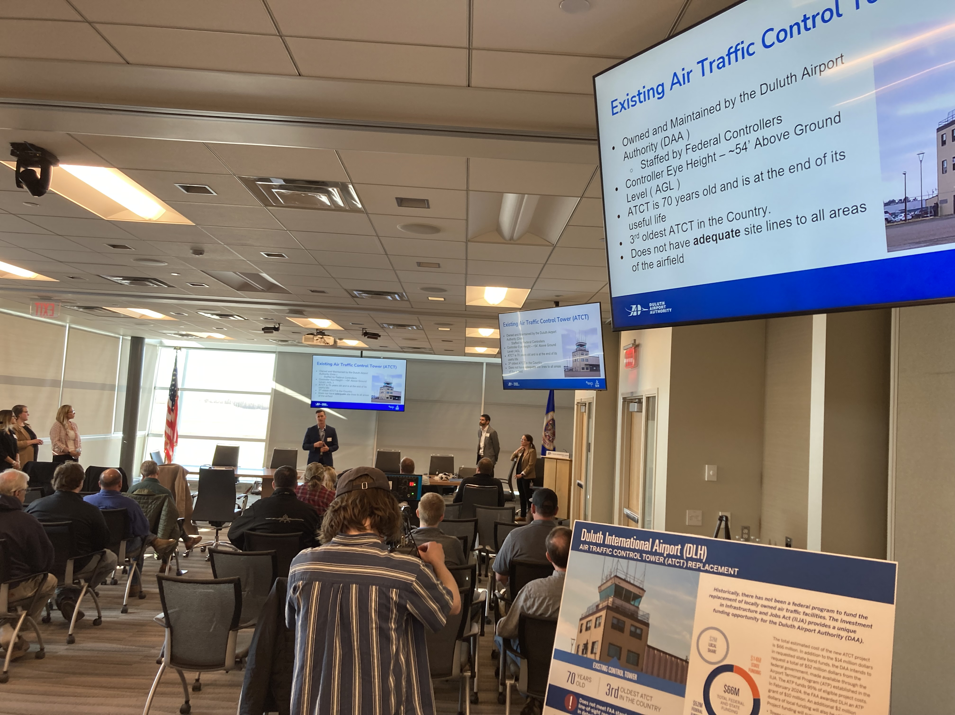
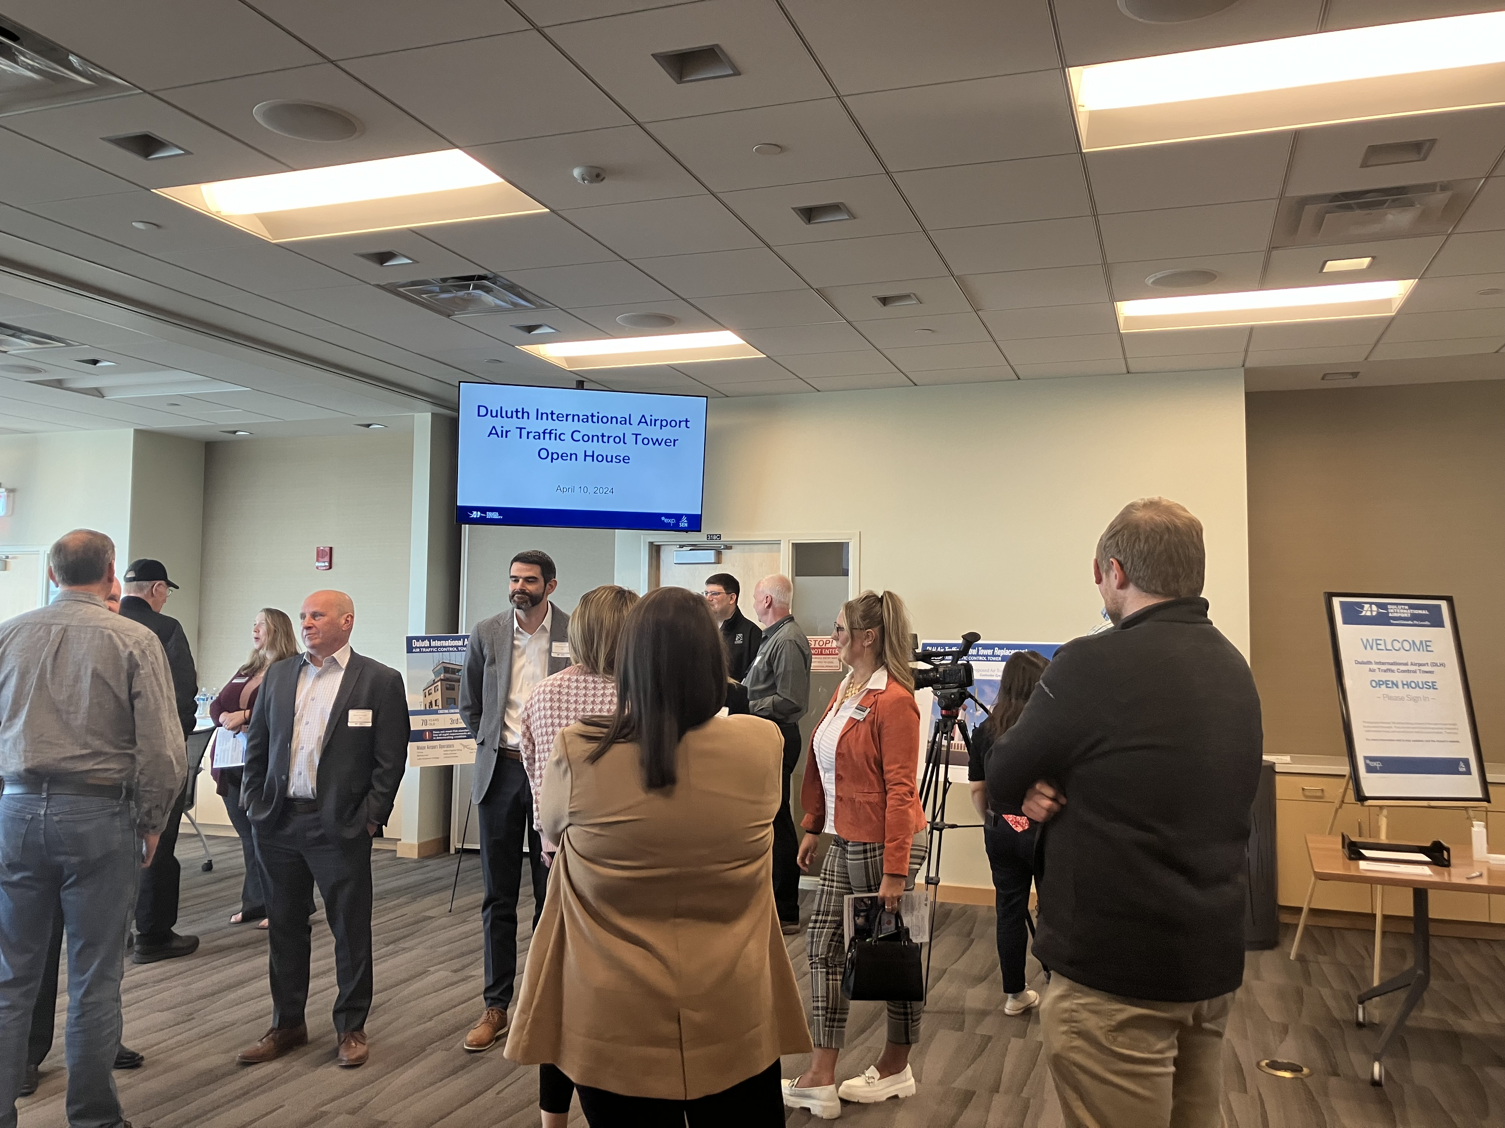
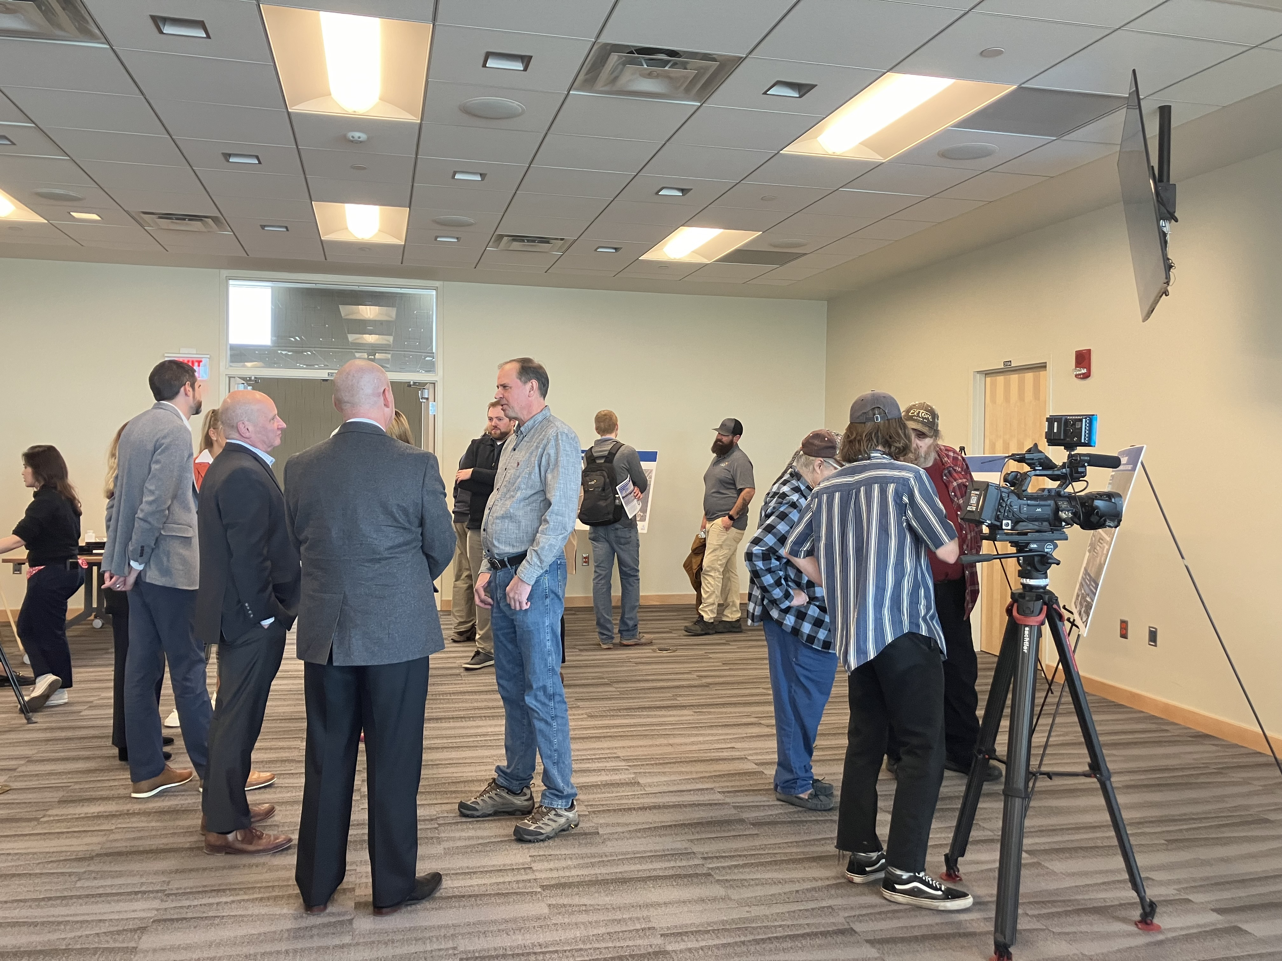
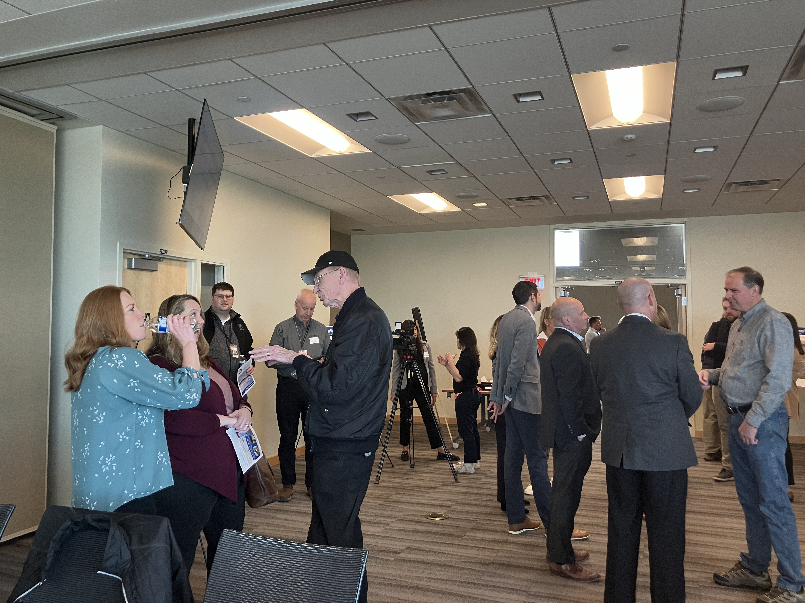
Air Traffic Control Tower Project Open House

Slide 3
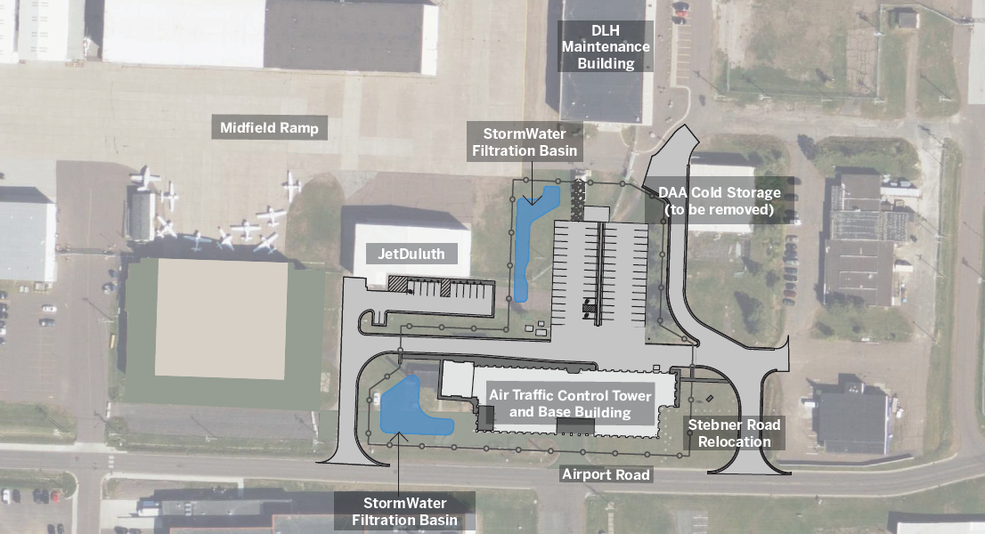
Proposed Site Layout
Notes:
SEH (Shawn/Kaci/Jessica)

Slide 4
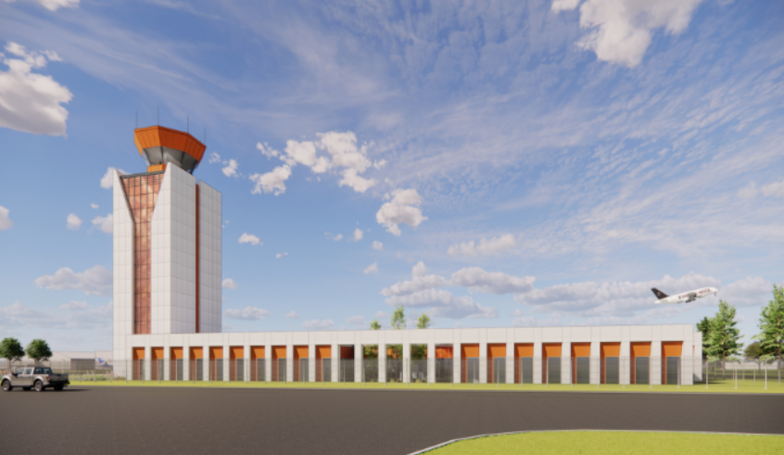
Proposed Air Traffic Control Tower
Notes:
SEH (Shawn/Kaci/Jessica)

Slide 5
Operations/Construction/Projects/Planning Update
Duluth International Airport:
Air Traffic Control Tower Update
35% Design Review
ATCT Public Open House
Taxiway A Tenant Construction Communication
Storm Summary/Airfield Magnet
New ADA Coordinator Certification – DAA Facilities Manager – John Graves
Airshow 2024 – May 18-19, 2024
Sky Harbor Airport:
New General Aviation Terminal Construction Update
New Snow Removal Equipment Building Construction Update

Slide 6
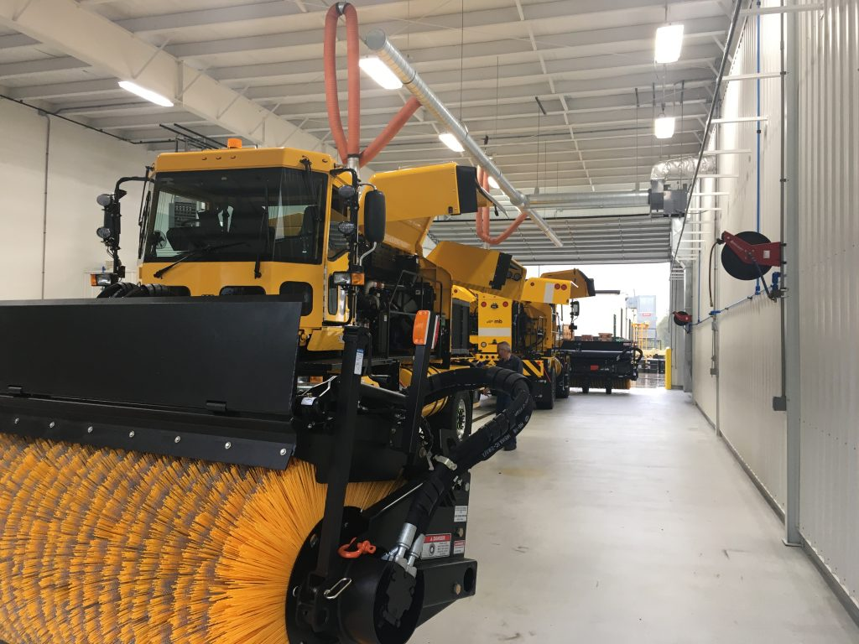
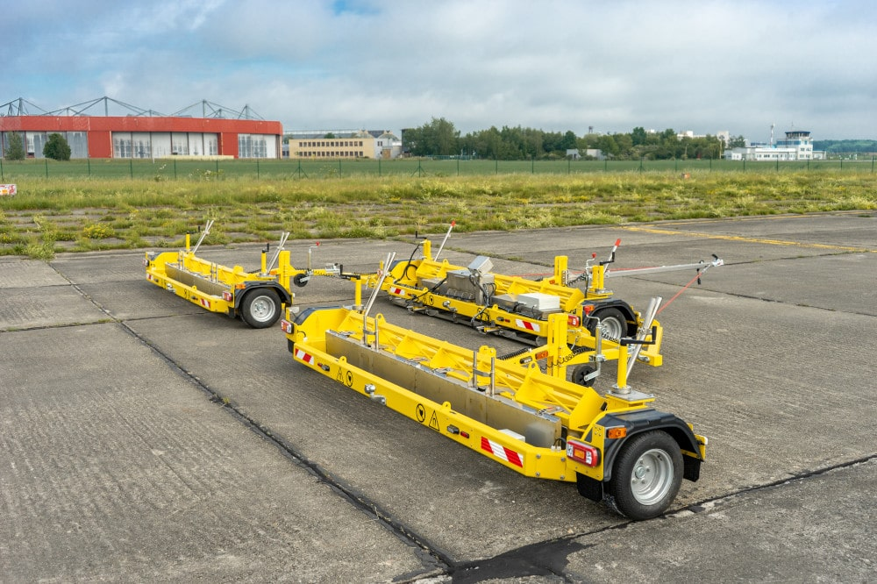
Operations/Construction/Projects/Planning Update

Slide 7
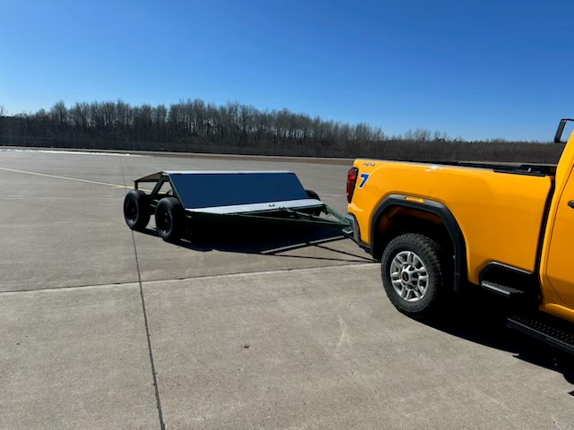
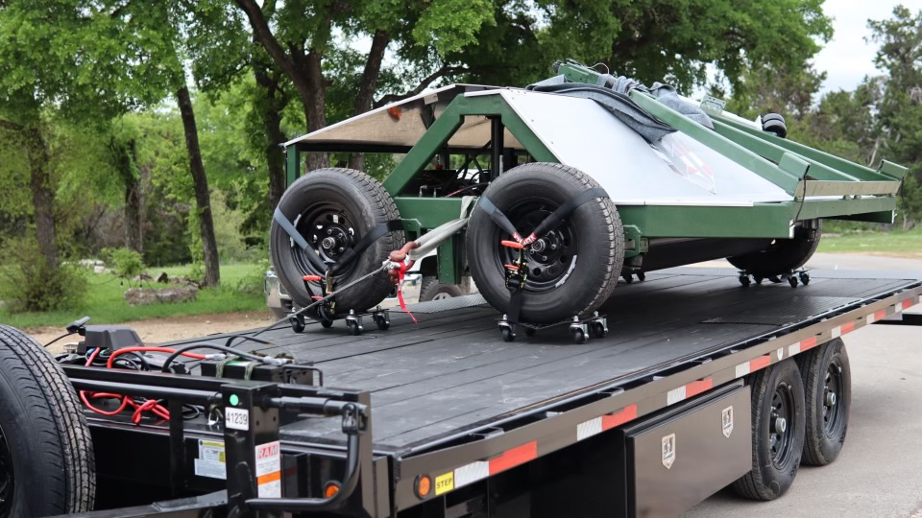
Operations/Construction/Projects/Planning Update

Slide 8
Operations/Construction/Projects/Planning Update
Duluth International Airport:
Air Traffic Control Tower Update
35% Design Review
ATCT Public Open House
Taxiway A Tenant Construction Communication
Storm Summary/Airfield Magnet
New ADA Coordinator Certification – DAA Facilities Manager – John Graves
Airshow 2024 – May 18-19, 2024
Sky Harbor Airport:
New General Aviation Terminal Construction Update
New Snow Removal Equipment Building Construction Update

Slide 9
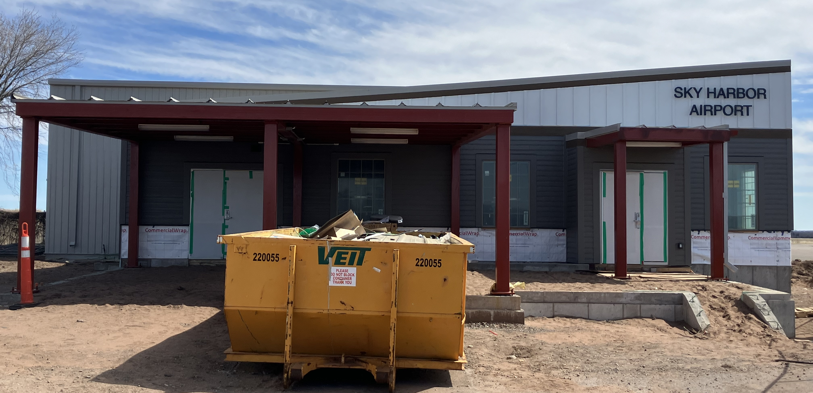
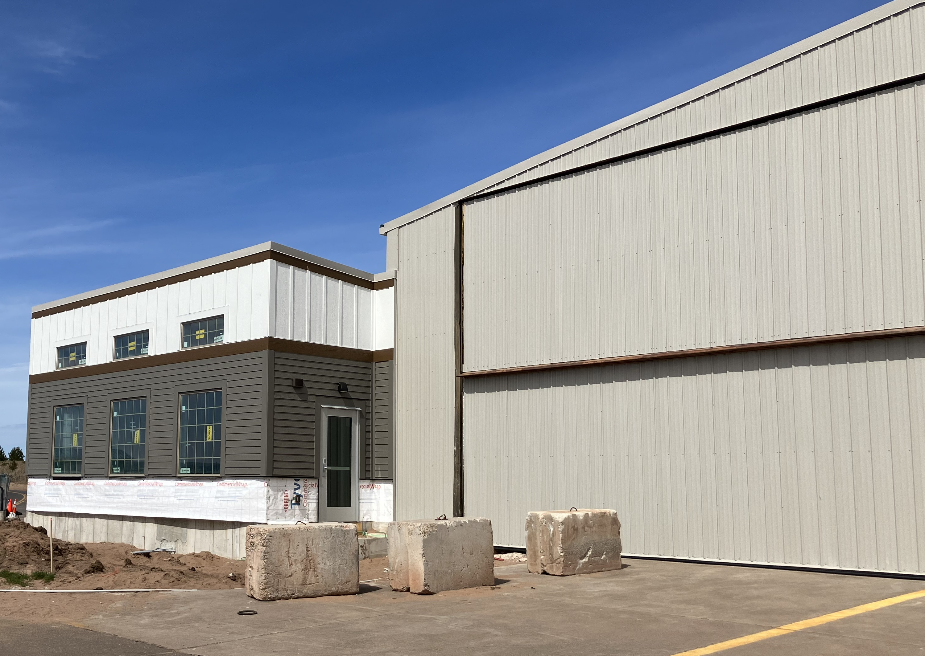
Sky Harbor Terminal Construction

Slide 10
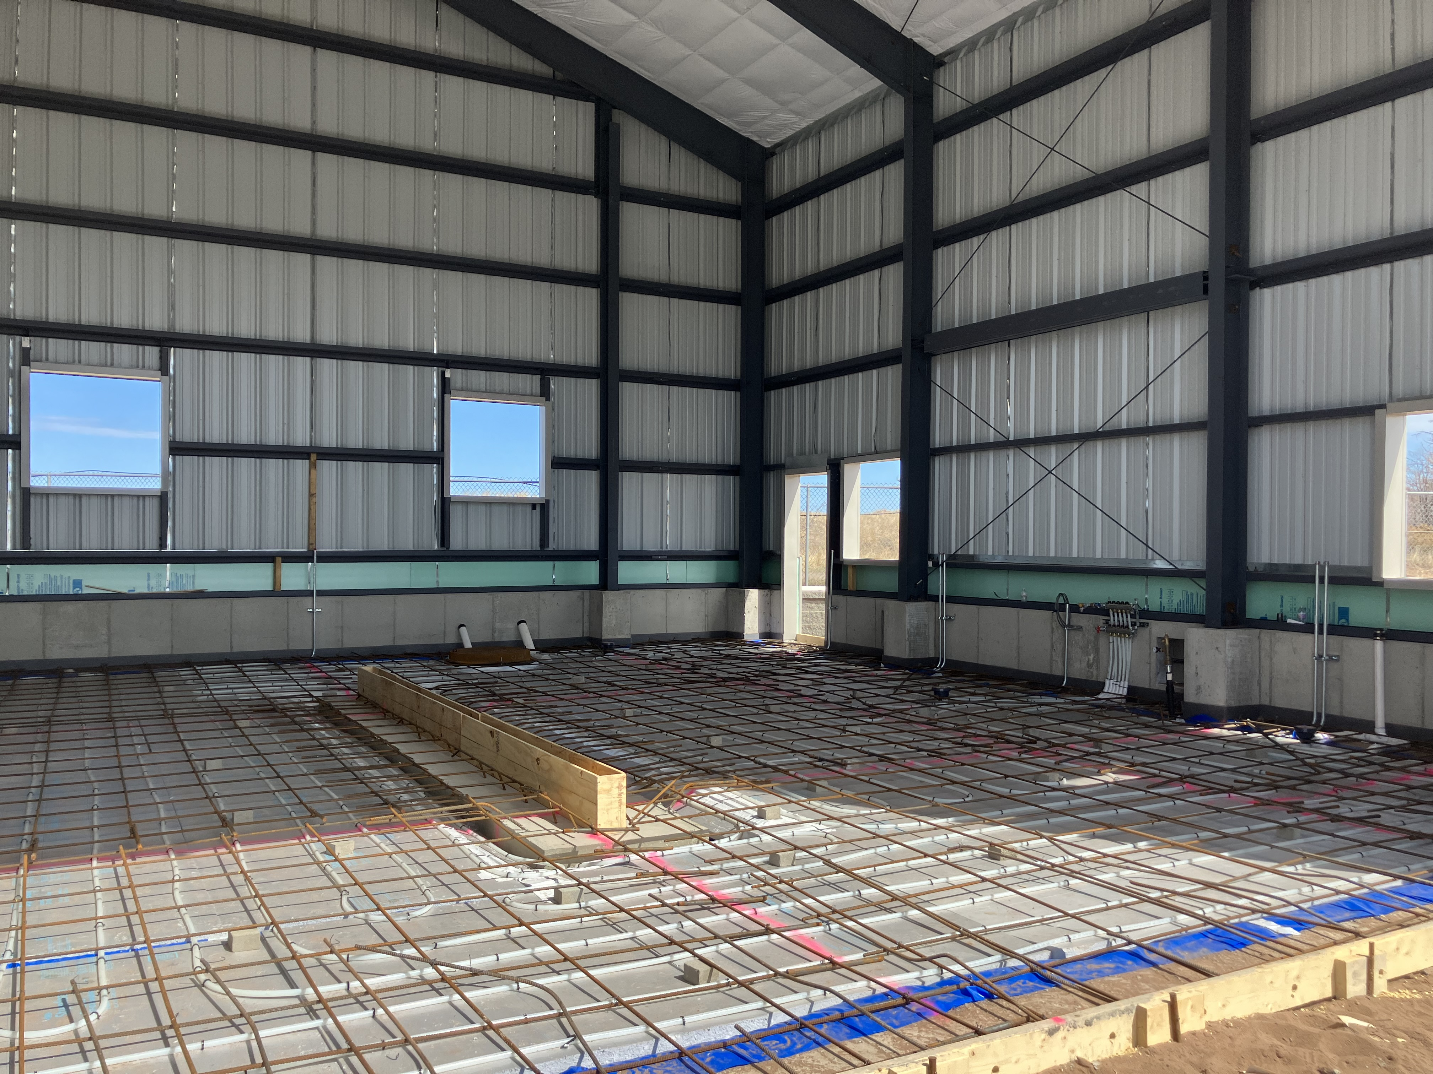
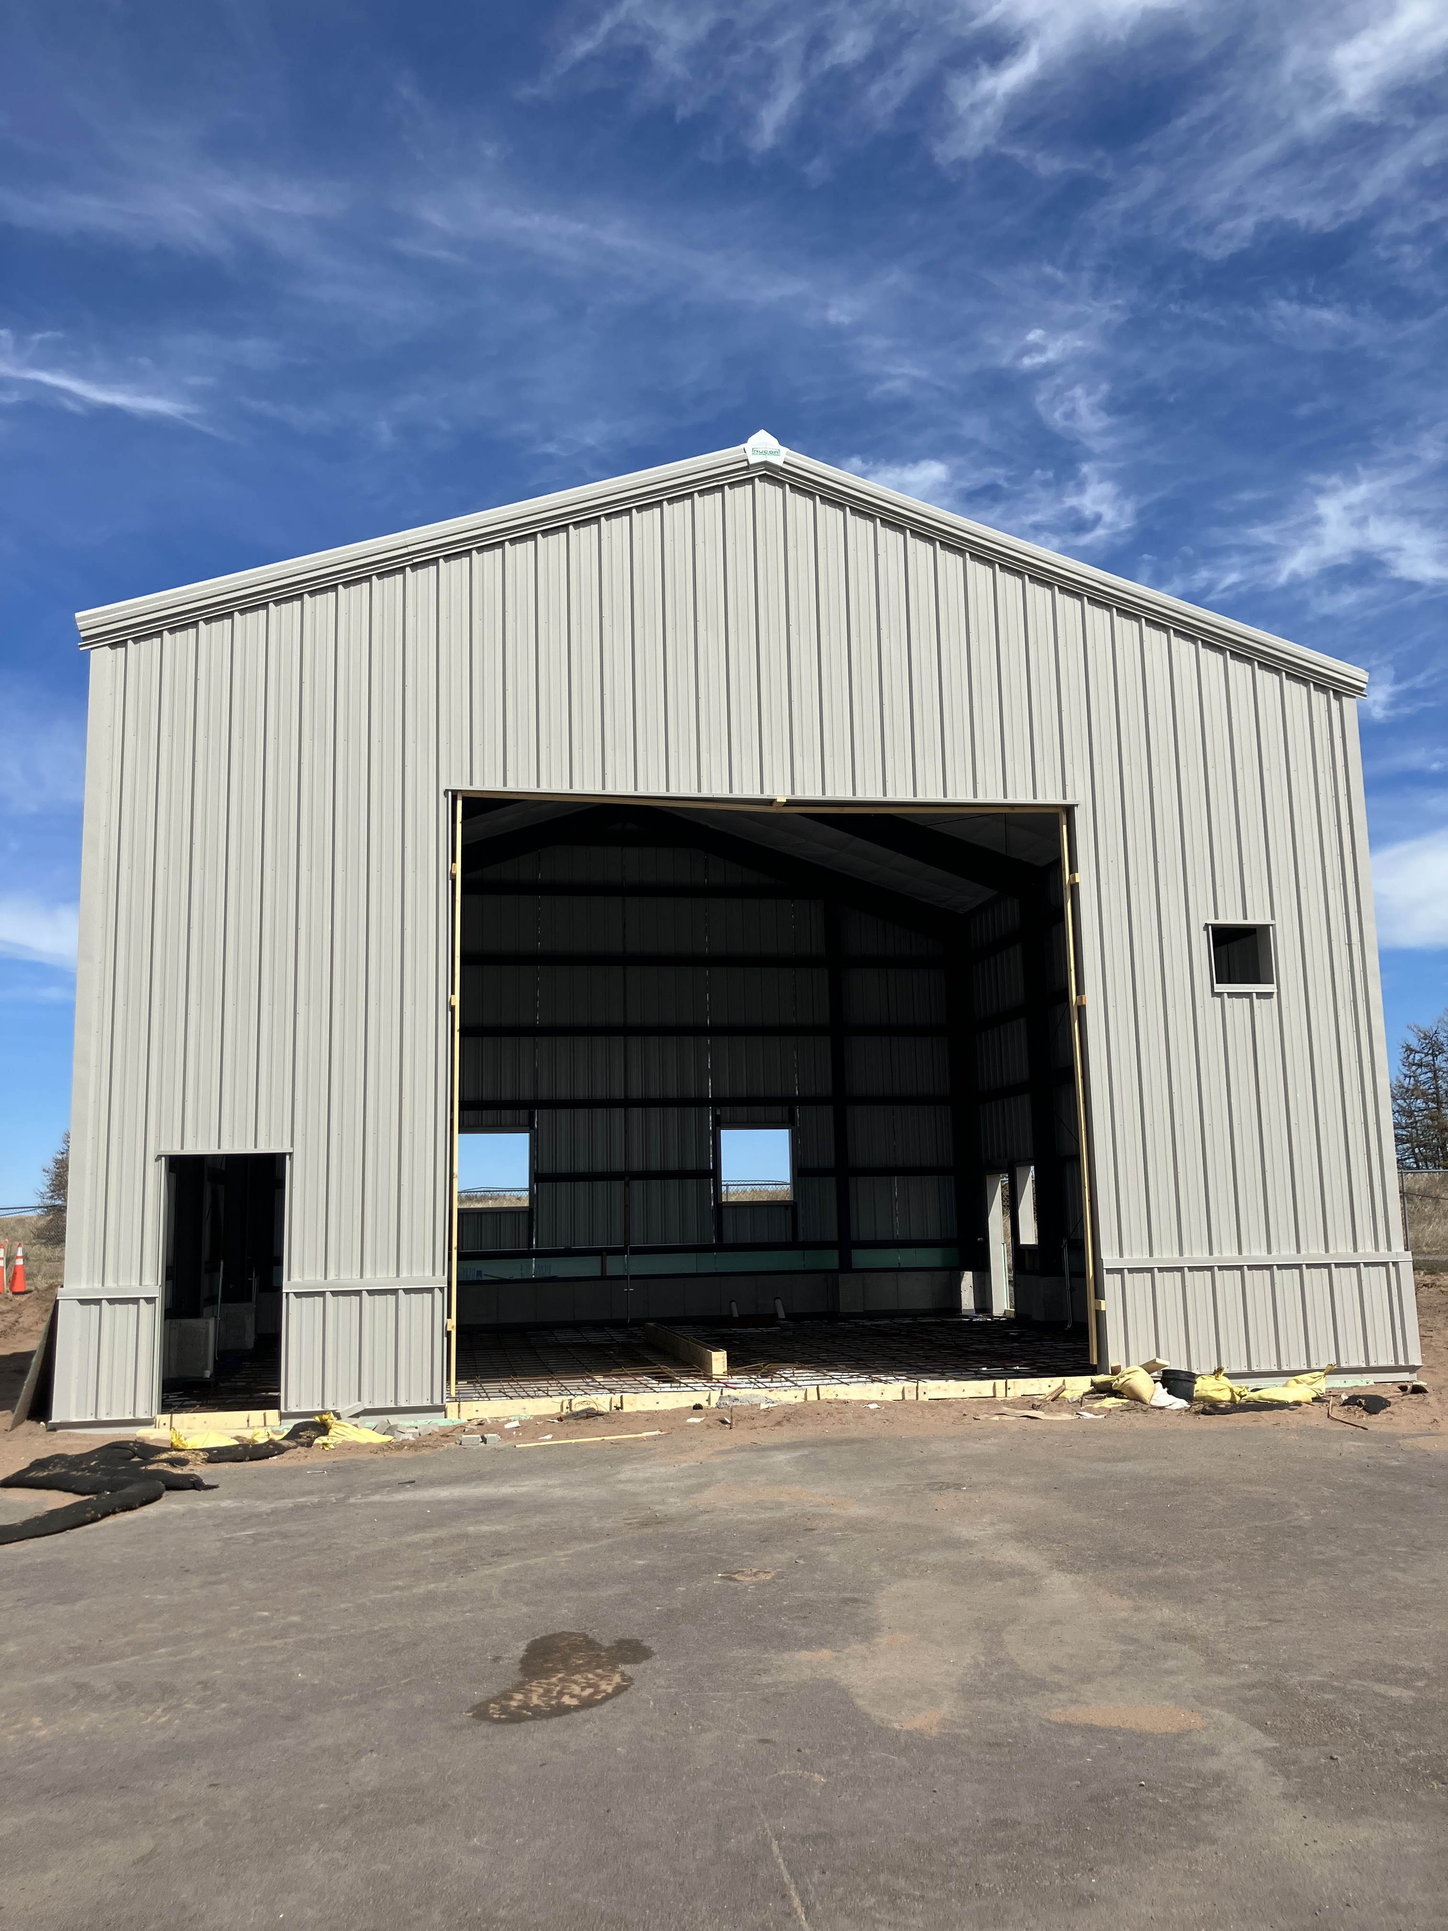
Sky Harbor Snow Removal Equipment (SRE) Building Construction

Slide 11
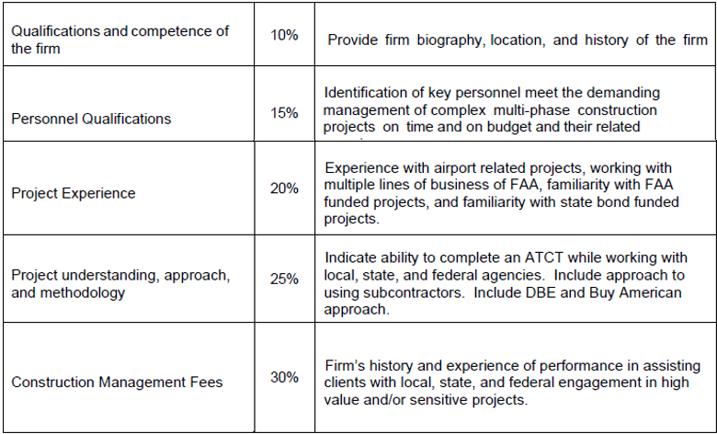
C. Resolution to Approve Master Agreement between the Duluth Airport Authority and H+U Construction for the Construction of a New Air Traffic Control Tower

Slide 12
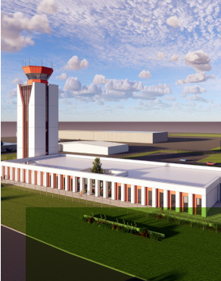
C. Resolution to Approve Master Agreement between the Duluth Airport Authority and H+U Construction for the Construction of a New Air Traffic Control Tower
Project Description –The Duluth Airport Authority completed a competitive request for proposals in accordance with current local regulations and requirements of the DAA and FAA. The specific scope of products and services requested include Construction Manager at Risk Services, including pre-construction services, construction services, post-construction services, and project closeout.
The project is anticipated to be funded by FAA at 95%, MnDOT Aeronautics at 5% and the DAA at 0% as part of the Airport Improvement Program Airports Terminal Program grant.

Slide 13
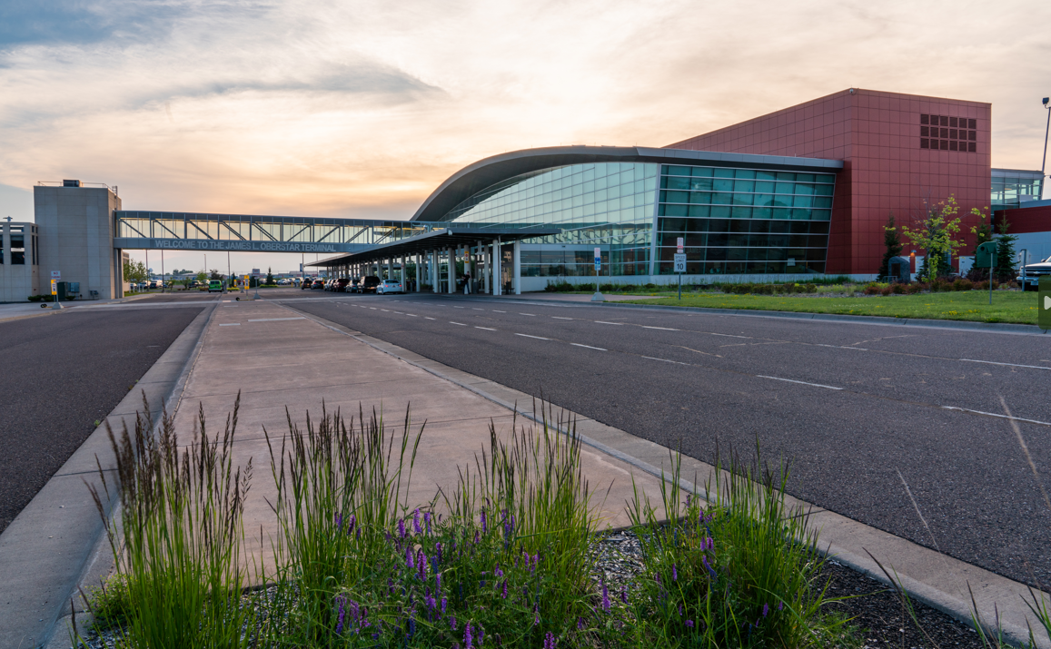
D. Resolution to Approve Master Agreement between the Duluth Airport Authority and Jamar Companies for Airport Wide Mechanical, HVAC, and Building Automatic System Coordination
Project Description –The DAA requested proposals for comprehensive Heating, Ventilation, and Cooling/Building Automated Systems (HVAC/BAS) and Facilities Services to include but not limited to boiler checks, preventative maintenance on mechanical systems, controls maintenance and customer service.
Contract term is for 5 consecutive one-year terms, beginning January 1, 2024.
Jamar Company provided a quote for $156,816.00 to perform the required project identified in the proposal.

Slide 14
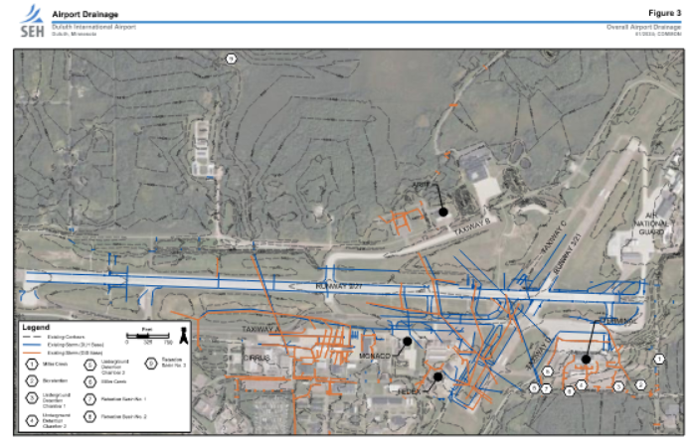
E. Resolution to Approve Work Order 2024 - 5 between the Duluth Airport Authority and Short Elliott Hendrickson, Inc for the Duluth International Airport Drainage Master Plan Study
Project Description – A stormwater management plan is a comprehensive planning tool used when planning future projects, finding potential funding sources, and identifying areas of needed infrastructure improvement.
The work order amount is $139,600.00.
The project is anticipated to be funded by FAA at 90%, MnDOT Aeronautics at 5% and the DAA at 5%.

Slide 15
F. Resolution to Accept and Award the Contract in the amount of $45,867.00 for the Plant Mitigation at the Sky Harbor Airport (DYT) between the Duluth Airport Authority and Prairie Restorations, Inc.
Project Description –The Sky Harbor Runway Relocation project included aquatic and terrestrial mitigation actions under the conditions of the permits issued by the USACE and MNDNR. Because the initial aquatic plantings completed as part of this project did not meet success criteria, a second round of plantings is required per permit commitments. This scope of services includes an additional round of aquatic plantings.
The contract amount is $45,867.00
The project is anticipated to be funded by FAA at 90%, MnDOT Aeronautics at 5% and the DAA at 5% as part of the Airport Improvement Program.

Slide 16
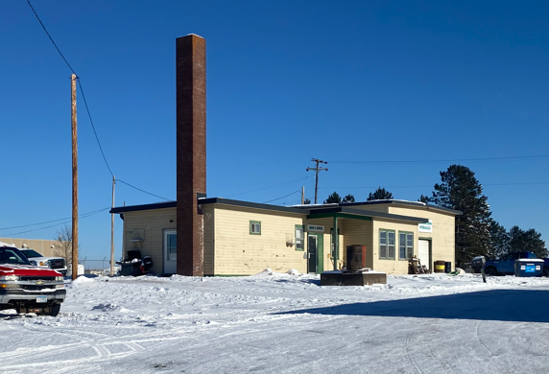
G. Resolution to Accept and Award the Contract in the amount of $233,200.01 between the Duluth Airport Authority and Urban Companies, LLC for the Demolition of Building 100.
Project Description –The existing location of Hermantown Hydraulics building is on the future Air Traffic Control Tower (ATCT) project site. Hermantown Hydraulics building will need to be demolished, removed, and the existing site will cleared for future development.
The contract for the base bid and alternate A is $233,200.01.
The project is anticipated to be funded by FAA at 95% as part of the Airport Terminal Program with the remaining 5% by MnDOT Aeronautics at 5%.

Slide 17
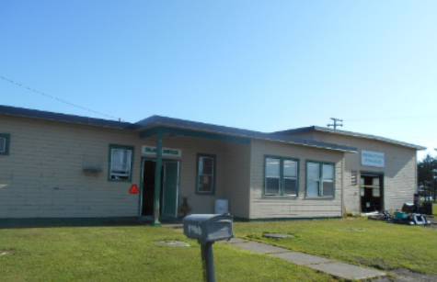
H. Resolution to Approve Work Order 2024 - 4 between the Duluth Airport Authority and Short Elliott Hendrickson, Inc for the Construction Administration of the Demolition of Building 100.
Project Description – The existing location of Hermantown Hydraulics building is on the future Air Traffic Control Tower (ATCT) project site. Hermantown Hydraulics building will need to be demolished, removed, and the existing site will need to be cleared. It is known that the existing structure contains hazardous (regulated waste) & asbestos materials that will be required to be removed.
The work order amount is $73,700.00.
The project is anticipated to be funded by the Airport Terminal Program FAA grant at 95% and MnDOT Aeronautics at 5%.

Slide 18
N. Resolution to Approve Federal Aviation Administration Non-Federal Reimbursable Agreement RA-006323 for the Design of a New Air Traffic Control Tower Project at the Duluth International Airport
Project Description –The purpose of this Agreement between the FAA and the DAA is for the FAA to perform site visits, engineering, review, and construction/installation activities in the Sponsor’s project of Airport Traffic Control Tower (ATCT) Replacement project impacting FAA National Airspace System facilities, including terminal area radar, radar displaces, communications equipment, lighting systems, weather systems, and other critical equipment fully listed in the agreement. This Agreement provides funding for the FAA to establish these services. The FAA and the Sponsor will enter into either an amendment of this agreement or a new agreement to cover the implementation of the project plans developed under this agreement.
The reimbursable agreement amount is $328,259.11.
The project is anticipated to be funded by FAA at 95%, MnDOT Aeronautics at 5% and the DAA at 0% as part of the Airport Improvement Program Airports Terminal Program grant.

