Slide 1
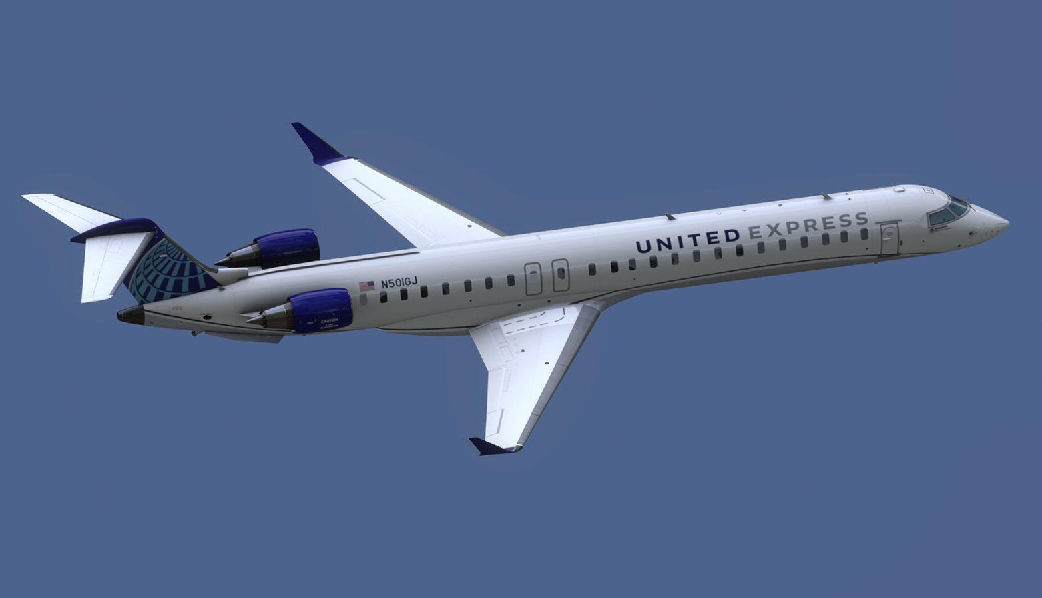
Duluth Area Chamber Foundation
United Service to Denver
February 2024

Slide 2
Potential DLH-DEN Service on UA: Where we were in 2019
With non-stop DLH-DEN service, forecasts indicated an 80% Load Factor with 1x daily CRJ service
Local DLH-DEN passengers on UA: 23 PDEWs (of 32.6 estimated market demand)
Connecting PDEWs on UA: 17 PDEWs (15% share of western region connections)
Route appeared profitable and SkyWest Airlines, flying as United Express indicated that they planned to move forward the following summer
DLH put together a $1.05 million package to support this service
Included a $750,000 Minimum Revenue Guarantee (MRG) via a SCASD Grant
DLH/community invested $255,000 in marketing support
The following slides will portray: Relative importance of economic growth/incomes as it pertains to air travel demand, the business case for DLH-DEN route, where things stand currently and needs going forward
PDEWs: Passengers Daily Each Way
SCASD: Small Community Air Service Development Grant
2
Notes:
Forecasts were done in 2018…demand further increased in 2019.

Slide 3
Enplaned Passengers per capita: U.S. average is 1.0, but airports differ due to a few factors
Enplaned passenger volumes are driven by multiple factors
Size of Economic Base
Income levels
Proximity to other airports
DLH faces multiple challenges, with proximity to MSP being the major one
RST has high incomes, but also struggles due to MSP
Isolated airports generally benefit by traffic driving to that airport (Dakotas)
Notes:
Some comments on relative outperformers: FSD (traffic driving from region, particularly Sioux City area); BIS (traffic driving from region, state capitol), RAP (traffic driving from a very broad region due to isolation, also the fact that RAP is a tourist/destination market); FAR (some drive traffic into FAR, although FAR has a high income/tech-oriented market – also with a relatively large University). GFK has leakage to FAR, but also benefits from drawing some Canadian traffic, particularly due to G4.

Slide 4
Higher incomes also generate most of air travel demand
* Sources: Woods & Poole; Consumer Expenditure Survey data from U.S. Bureau of Labor Statistics

Slide 5
Economic growth drives passenger volume growth
Notes:
There are a lot of COVID-related factors in the near-term, hence I don’t want to update this.
Left hand table illustrates that fastest growing economies through most of 2010’s had fastest enplaned passenger growth.
Right hand table shows economic growth in slower growing economies and related enplaned passenger growth.

Slide 6
DLH-DEN O&D market had been growing briskly until pilot shortages constrained supply…
10
*Source: Diio
6

Slide 7
…as had the Northern Minnesota market to DEN
10
* Northern Minnesota: DLH, BJI, INL, & HIB
*Source: Diio
7
Notes:
This is a fairly seasonal market, hence we shouldn’t be surprised if OO/UA only considers starting with seasonal service.

Slide 8
With the only regional service exclusively to “the west”, there is ample demand regionally that could use service
3
8
Notes:
I’m using 2019, as 2023 demand to many of targeted markets (such as DEN) are down 25%+ versus 2019 levels. Declines are a function of supply/capacity constraints tied largely to pilot/aircraft shortages.
I’m showing year-round demand, in addition to peak season demand, as it wouldn’t shock me if OO/UA wanted to start with seasonal service only.
The demand levels regionally are not bad. More than most airlines would think/perceive.

Slide 9
Given historical new market stimulation, DLH-DEN O&D market should generate about 50 PDEWs annually
ORD-DLH was stimulated about 315% after new service started
It would be expected that new DEN-DLH service would generate at least 25-30 PDEWs at lower stimulation sensitivities; note that N. Minnesota generated 27 PDEWs in 3Q and almost 19 year-round – with leakage of greater than 60% from region (indicating much greater demand when including traffic driving to MSP first)
*Source: Diio for market demand; fares are average one-way net of taxes
9
Notes:
Fare levels might be a bit low, but for this audience that shouldn’t factor in.

Slide 10
Baseline Forecast of about 53.7 passengers per trip or about an 83.8% load factor on a CRJ-700
3
As noted on prior slide, estimating local DEN-DLH demand at 50 PDEWs
Assuming UA would garner 70% of local market, results in a forecast of 35 PDEWs for UA in the DEN-DLH Market
At a 15% share of regional connecting PDEWs, results in a connecting PDEW forecast of about 23.7 PDEWs
In total, 58.7 PDEW forecast for DLH-DEN service on 1x daily CRJ-700 service
10
Notes:
Some comments: 1) Why 70% share of locals? DL brand loyalty, in addition with only 1 nonstop a 60%-70% share isn’t uncommon (time-of-day considerations are a major factor); 2) The market share sensitivities are an admittedly tough call. It should be noted that in most cases demand at 15% isn’t a lot different than what is flying out of DLH today. We would no doubt pick up some regional traffic due to ease of going over DEN instead of MSP and in many cases double connecting.

Slide 11
Key Point: Since 2019, the biggest change has been operating costs exploded higher (and fleet changes)…
Pilot salaries: Roughly 40% higher
Oil prices also higher
Economics result in generally larger aircraft
Even larger RJ aircraft will be more challenged
Air fares will have to go and stay higher
Retirement of 50-seat RJs
Before
11
Notes:
On next slide I summarize CRJ vs CRJ cost differential and then how much increased gauge contributed to higher costs.

Slide 12
…Operating Costs are estimated to have increased by over $3.7 million annually on the DLH-DEN route
*Note: CRJ-200 operating costs are up $1.4 million; the larger gauge increases costs another $2.3 million
12
Notes:
Before was for a CRJ-200 Aircraft. Now is a CRJ-700 Aircraft, although I summarized in footnote differences.

Slide 13
We believe that a $1.5 million MRG will be required for this route to be considered (another $750k is needed)
SkyWest has entertained similar opportunities for $1.5 million annual MRGs
They’ve done MRGs as both Delta Connections and United Express, operating CRJ-200s and CRJ-700/900s (on roughly 550-mile hauls)
Although Delta is no longer an option on CRJ-200s
With excess inventory of CRJ-200’s, SkyWest is interested in CRJ-200 flying, but at 768 miles, DLH-DEN is a bit long for a CRJ-200
My recommendation is to go with the CRJ-700/900 despite the operating cost increase
Finally, we might have to consider seasonal flying to start
13

Slide 14
Closing: Communities/states are getting much more aggressive in recruiting air service with MRGs
The States of Ohio and Indiana have annual budgets of $10+ million to support air service development
Michigan: Just came out with a $5 million package for airports statewide
Breeze: “We get offers regularly; we only accept a few”
MRGs/Financial Support packages are becoming the norm; funding is always the challenge, some more than others
We need your help
14
Notes:
Some specific examples: XWA $2 mil annually (OO-$1.5, SY - $0.5); SBN $1.5 mil with AA recently and has similar proposal to Breeze; CRW has a $2(?) million MRG with Breeze; LAN has $1.5-$3.0 mil in offers outstanding semi-regularly; MFE has done mulit-million deals with Aeromar (who is now out of business).

