Slide 1
Operations/Construction/Projects/Planning Update
Duluth International Airport:
Air Traffic Control Tower Design Update
Building 100 Demolition
Taxiway A – Phase 3 Construction
Starts May 21st, 2024
Airshow 2024 – May 18-19, 2024
Sky Harbor Airport:
New General Aviation Terminal Construction Update
New Snow Removal Equipment Building Construction Update

Slide 2
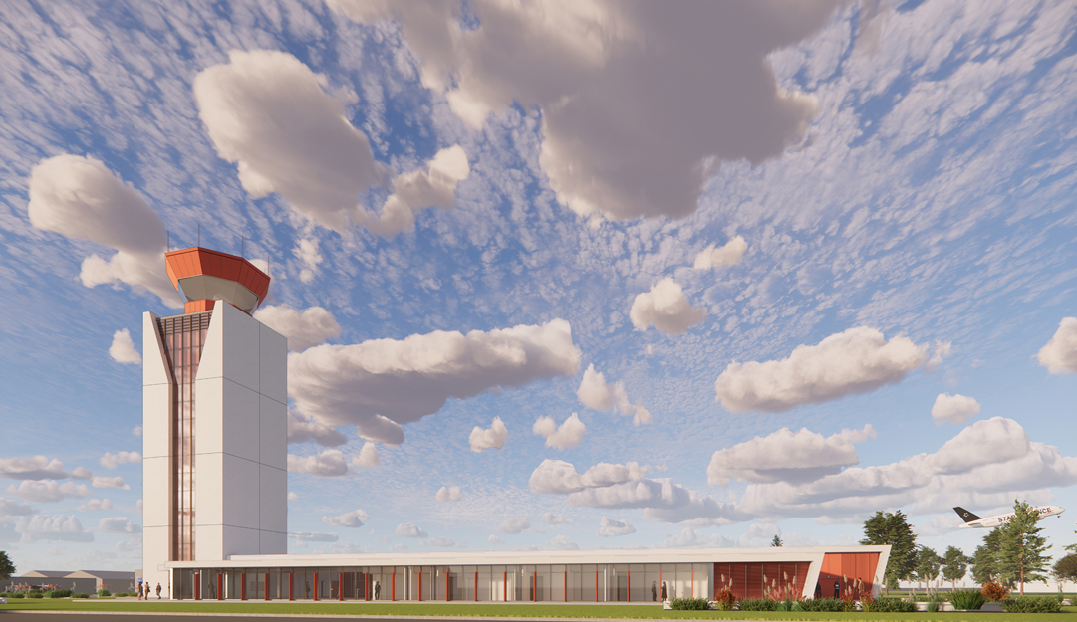
Air Traffic Control Tower Replacement

Slide 3
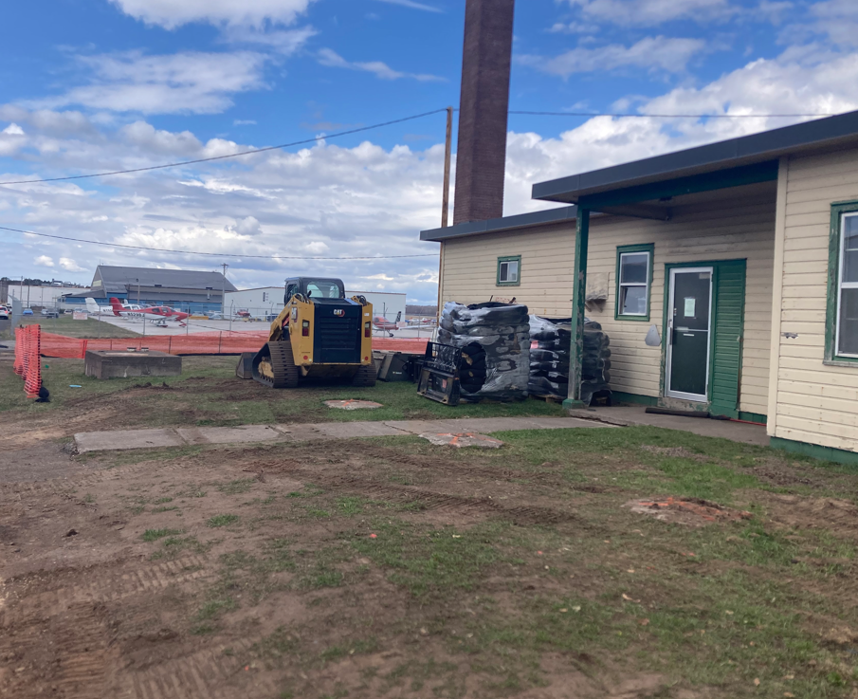
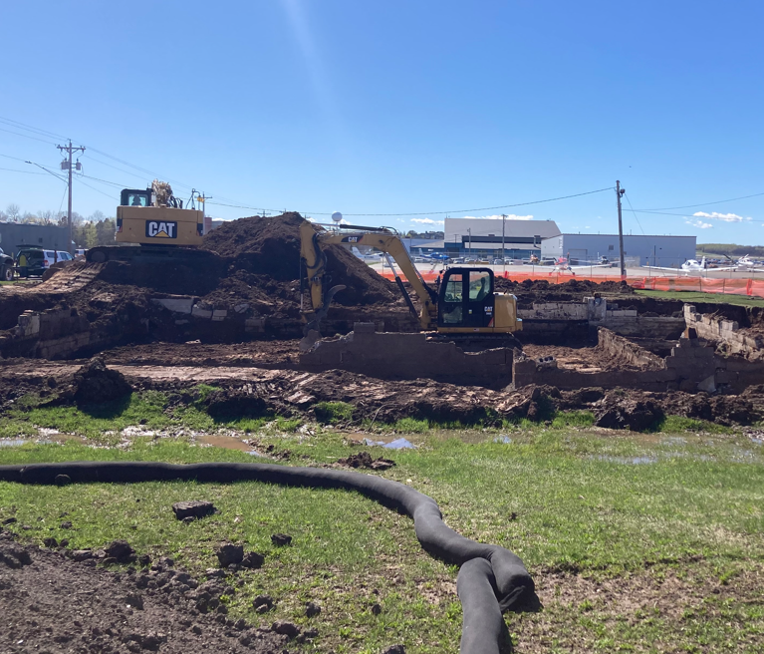
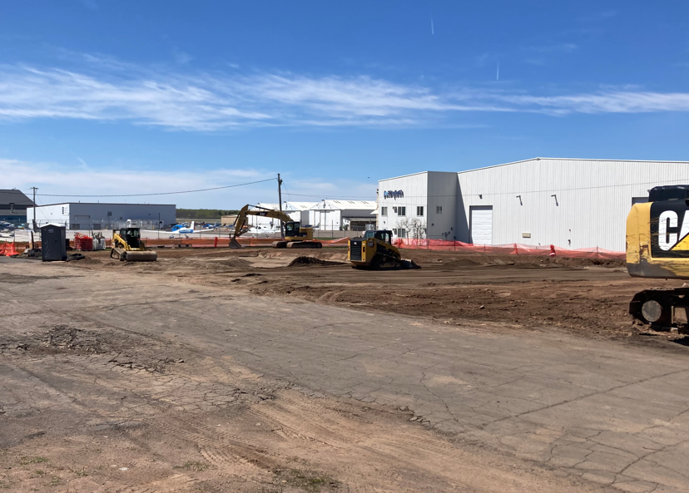
Building 100 Demolition
Before
During
After

Slide 4
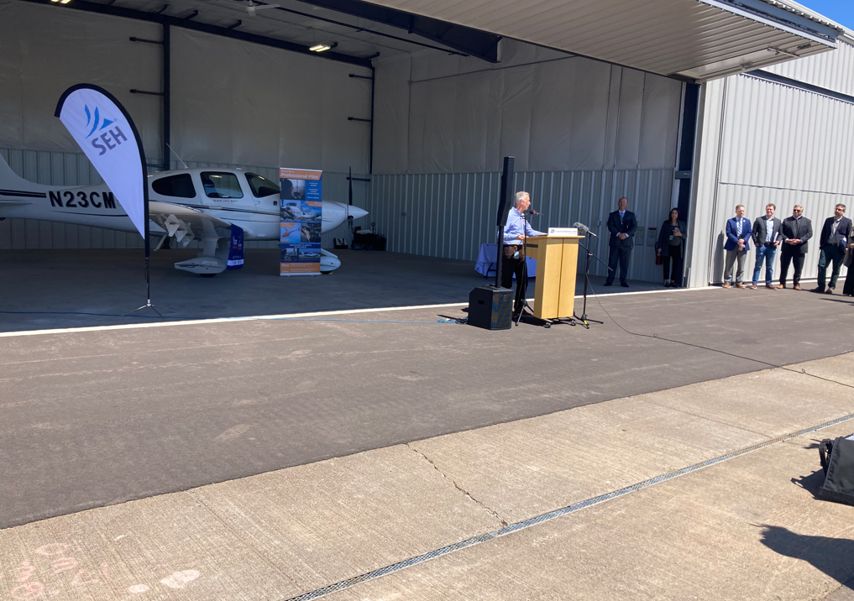
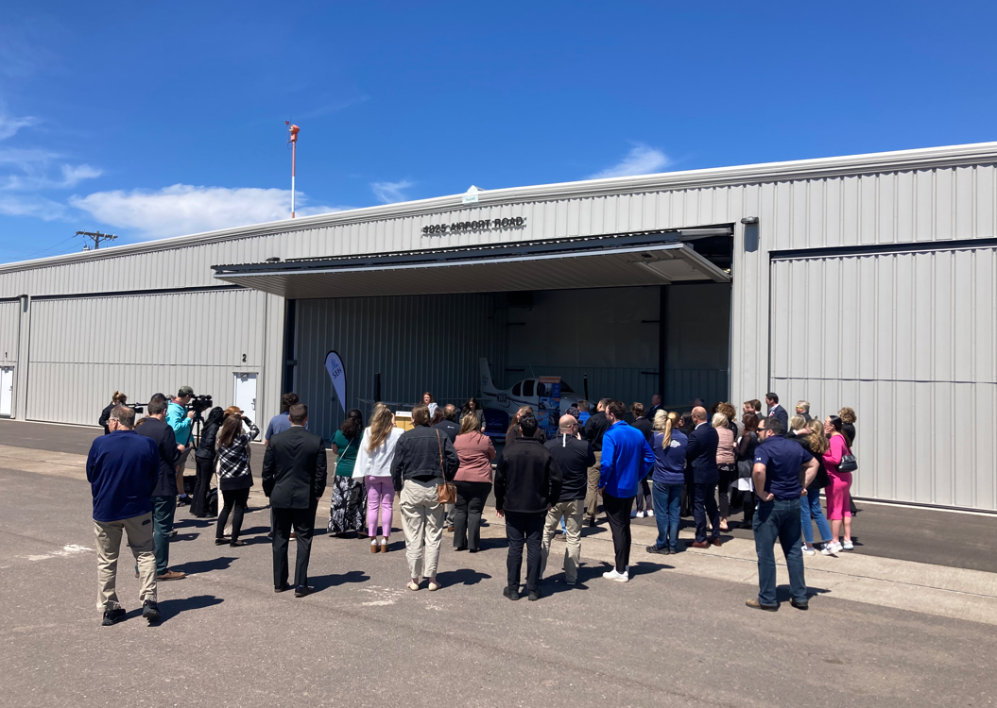
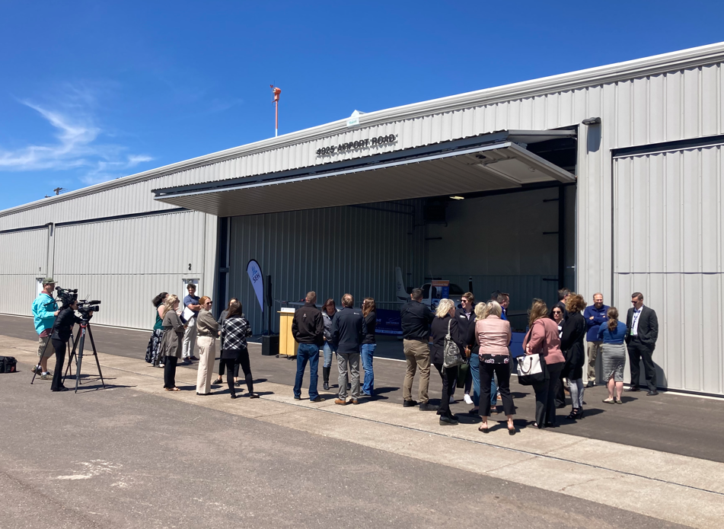
Ranch Hangar Completion - Ribbon Cutting

Slide 5
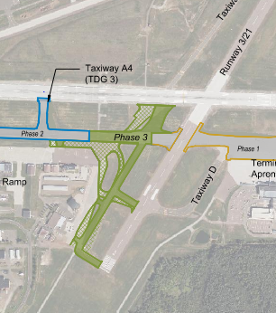
Taxiway A Phase 3 Reconstruction
Schedule: Starts Tuesday, May 21, 2024
Outreach: Completed preconstruction meeting and presentation to tenant group. Submitting weekly project email updates to stakeholders.
Coordination: Working with FAA engineering staff to coordinate work impacting FAA-owned cables, Air Traffic Control to schedule closures, and the contractor to complete work in impactful areas.

Slide 6
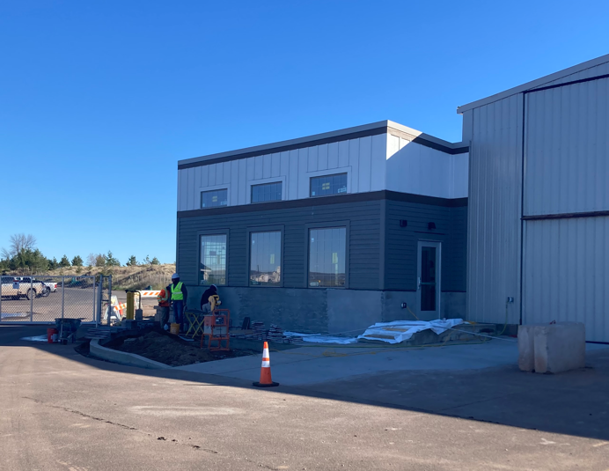
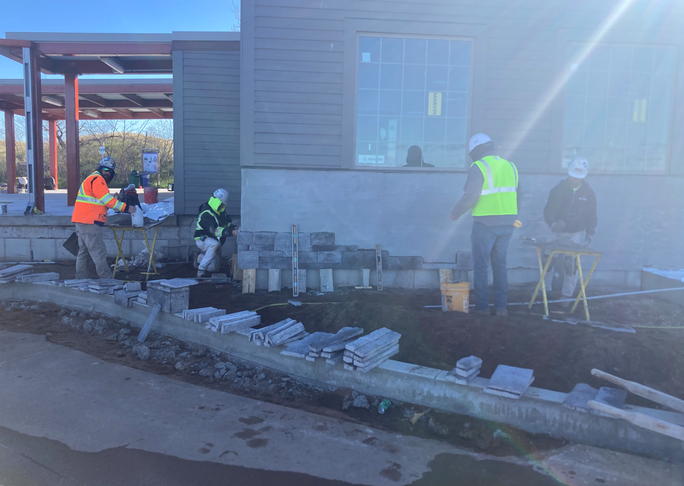
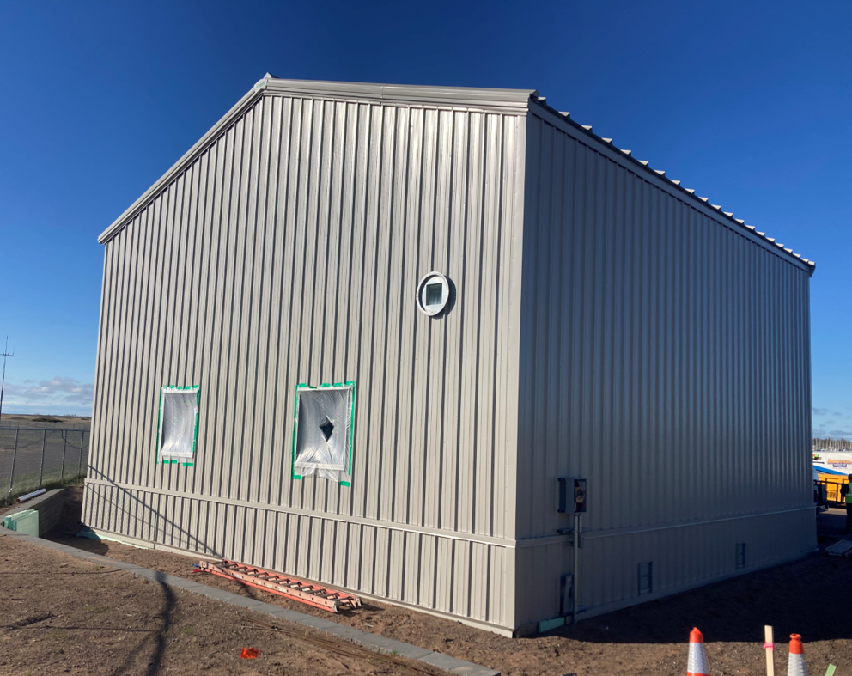
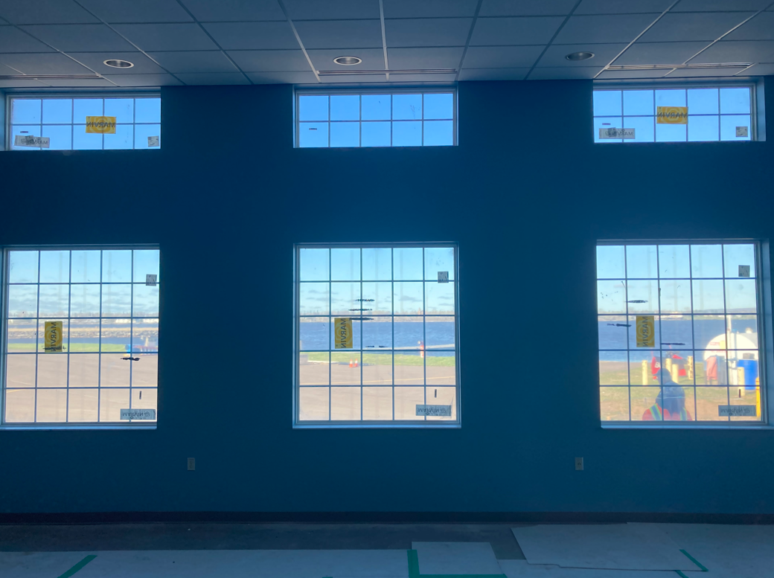
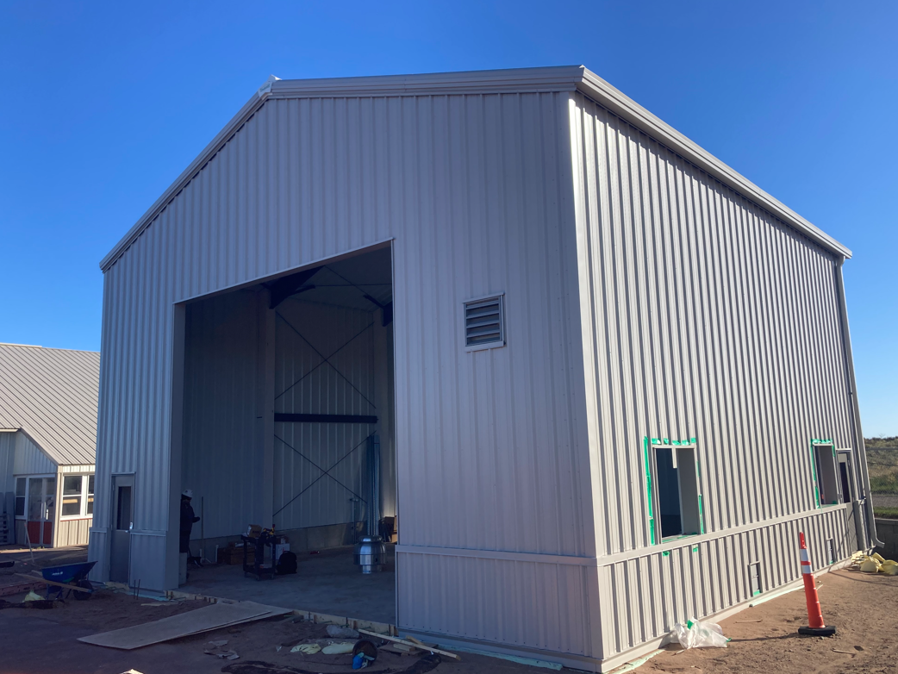
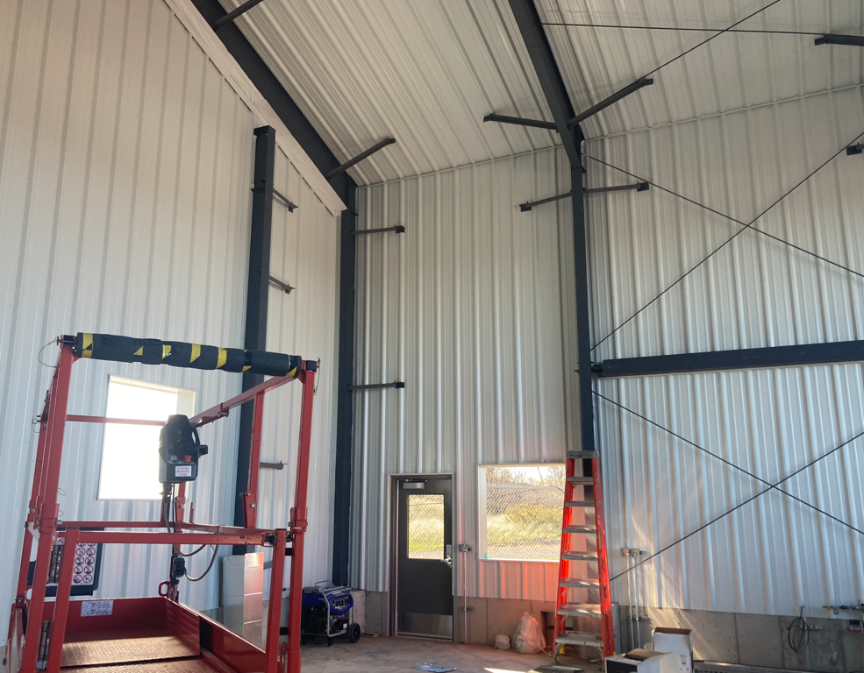
Sky Harbor – Terminal and SRE Building

Slide 7
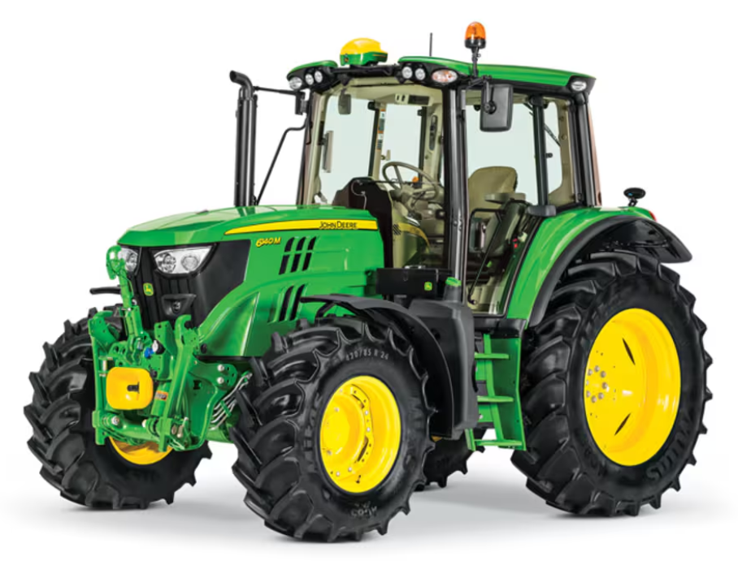
B. Resolution to Accept and Award State Grant Agreement for the 2024 Mower and Attachments Acquisition at the Sky Harbor Airport and Seaplane Base, in the amount of $280,330.00.
Agreement Overview: The state grant agreement is for acquisition of a mower and attachments. The eligible project costs are funded at 70 percent, with the terms presented as Minnesota Agreement No. 1056805 and State Project No. A6901-57 at the Sky Harbor Airport and Seaplane Base.
Financial Impact: The anticipated total cost is $280,330, with $196,230.99 (70%) being covered by MnDOT and $84,099.01 (30%) covered locally. The mower package includes a John Deere 614M Cab Tractor, snow push attachment, and flail mower. The grant covers eligible costs at 70 percent.

Slide 8
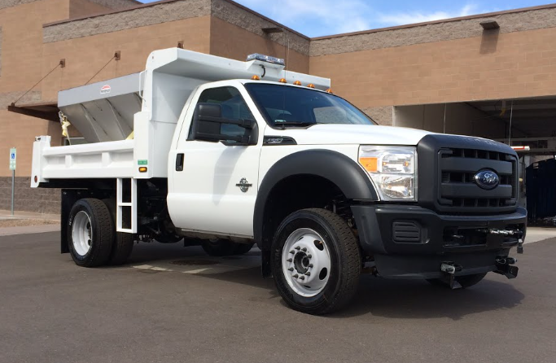
C. Resolution to Accept and Award State Grant Agreement for the 2024 Terminal Plow/Sander at the Duluth International Airport, in the amount not to exceed $153,988.61.
Agreement Overview: The state grant agreement is for acquisition of terminal plow truck with sander attachment. The eligible project costs are funded at 70 percent. The final grant agreements for State Project No. A6901-58 will be sent to the DAA over the next 30 days.
Financial Impact: The anticipated total cost is approximately $153,988.61, with $107,792.03 (70%) being covered by MnDOT and $46,196.58 (30%) covered locally. The truck package includes a Ford F550 vehicle, sander, and snowplow attachment. The grant covers eligible costs at 70 percent.

Slide 9
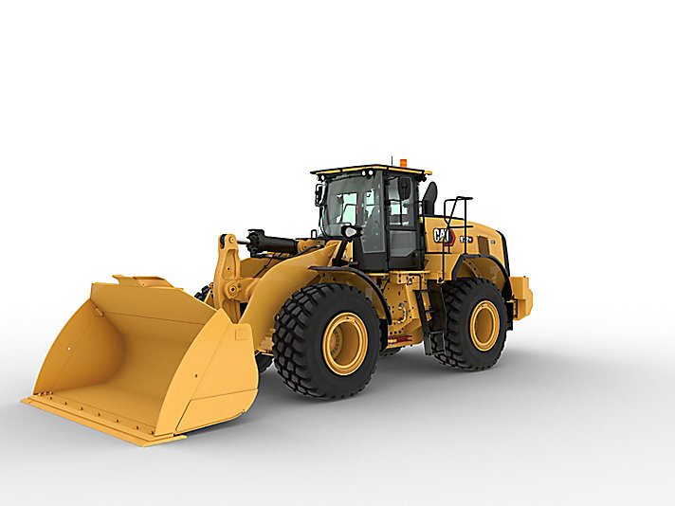
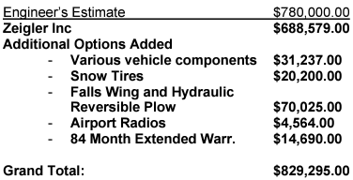
D. Resolution to Accept and Award the Contract for the Acquisition of Snow Removal Equipment – Wheel Loader at the Duluth International Airport (DLH) between the Duluth Airport Authority and Zeigler Inc. Contingent on an Approved Buy American Waiver in the amount of 829,295.00
Fiscal Impact: Proposal amount is $829,295.00. The FAA share for AIP/AIG grants is 90 percent, or $746365.50. The MnDOT State share is 5 percent, or $41,464.75, and the DAA share is 5 percent, or $41,464.75.

