Slide 1
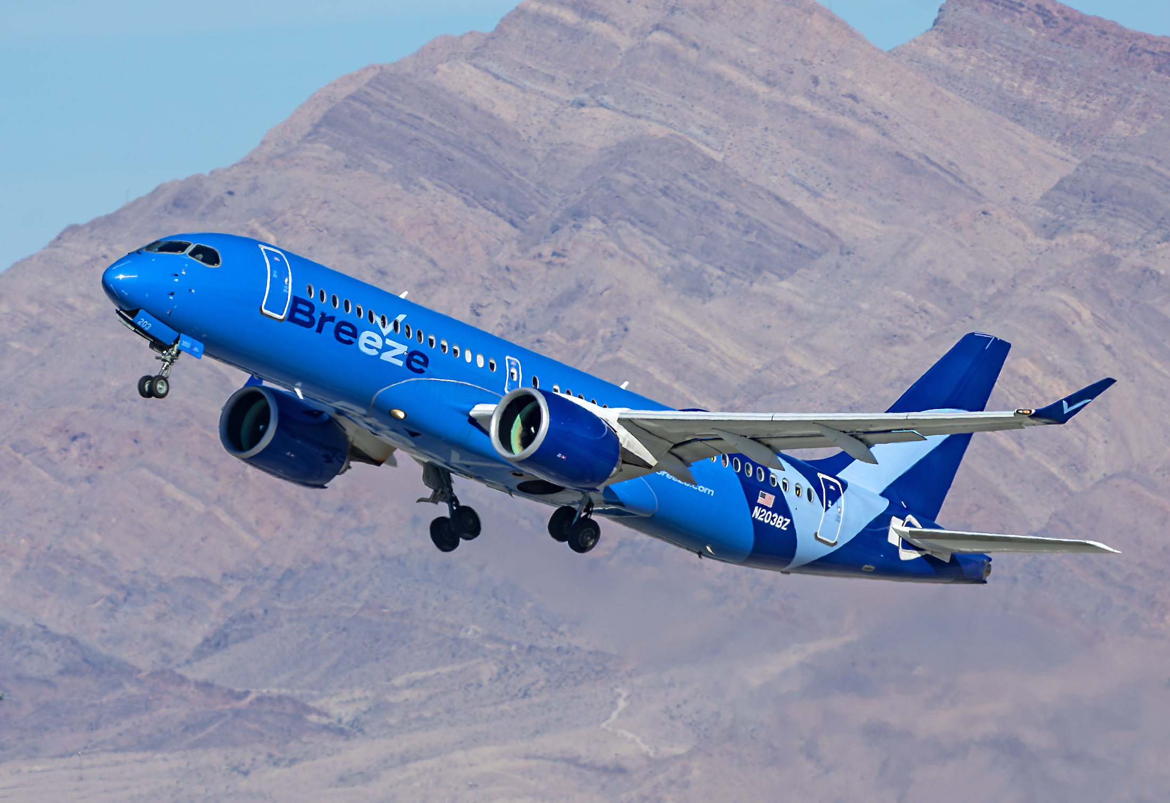
Duluth Area Chamber Foundation
Breeze Airways
July 2024

Slide 2
Presentation
Introduction to Breeze Airways.
Review of historical DLH results to Las Vegas (LAS), Phoenix (PHX) and Orlando (MCO).
Profit/Loss Range Estimates of Breeze flying these markets.
Conclusions.
2

Slide 3
Introduction to Breeze Airways
3

Slide 4
Breeze Leadership
David Neeleman: Founder and CEO
  5th start-up airline; previous start-ups have all have been extremely successful
  Morris Air, WestJet, jetBlue, Azul and now Breeze
  Because of this, Breeze has access to significant capital
Lucas Johnson: Chief Commercial Officer
  Previously was Senior VP of Network Planning at Allegiant Airlines
Trend Porter: CFO
  Previously at US Airways and Allegiant Airlines
Tom Doxey: President
  Previously at Allegiant Airlines
4
Notes:
Two key points: 1) Primarily, Neeleman’s success at launching successful airlines (known as a “serial airline entrepreneur”) – he’ll always have access to funding sources; 2) Leaders experience at Allegiant Airlines, arguably the most successful ULCC startup. As you know, besides leaders there are a lot of ex-G4 people at Breeze.
Note: Morris Air was acquired by Southwest Airlines.

Slide 5
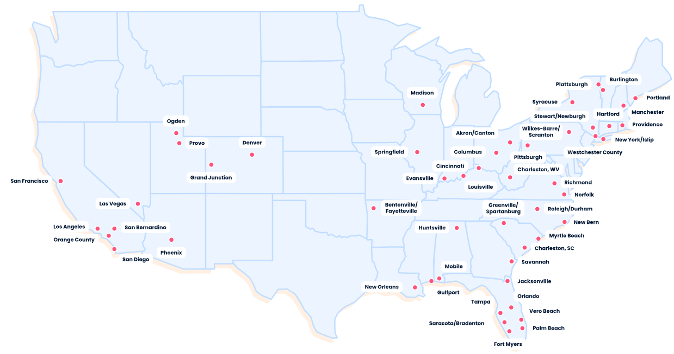
Breeze Route Map: 387 Routes as of late Spring 2024
Bases in red boxes
To-date, operations heavily focused in eastern half of U.S.
Plan is to now start growing more westward
5
Notes:
A lot of holes in the middle of the country

Slide 6
Top Breeze Markets: Heavy Eastern Region Focus
These markets comprised 82% of Breeze capacity
Red denotes a Base
* Source: Diio Mi
6
Notes:
Note that seasonally there is probably more Florida capacity than there would be on an annual basis.
MSY was one of initial bases, as was ORF, TPA, BDL and CHS. PVU was recently announced. I expect them to add a lot of capacity at PVU.
Breeze is going to be filling in the middle of the U.S.

Slide 7
Breeze Fleet: Unique Product…
A220-300: Later this year will be only scheduled service aircraft
  Seating: 137 seats in 3 classes of service (12/45/80)
  Range: 3,400 nautical miles; this aircraft can fly trans-con or NE U.S. to Europe
  Breeze is taking 1 A220-300 per month over the next few years
E-190s/E-195s: Retiring from scheduled service later this year
  E-190: 108 seats in 2 classes of service (48/60)
  E-195: 118 seats in 2 classes of service (22/96)
  But Breeze is and plans to use these aircraft for college sports teams charters (non-CFB); to-date has been very successful
* Source: Breeze Website
7
Notes:
Aircraft flexibility: Can fly Northeast U.S. to parts of Western Europe;
Classes of service: Think SkyMiles – First, Comfort & Economy, although they’re called different names.
Note that Breeze is taking A220s directly from manufacturer (Airbus), hence they’re much better positioned than other new entrants/ULCCs.
E-jets charters: There really isn’t a lot of competition for jets catering to smaller sports teams like this

Slide 8
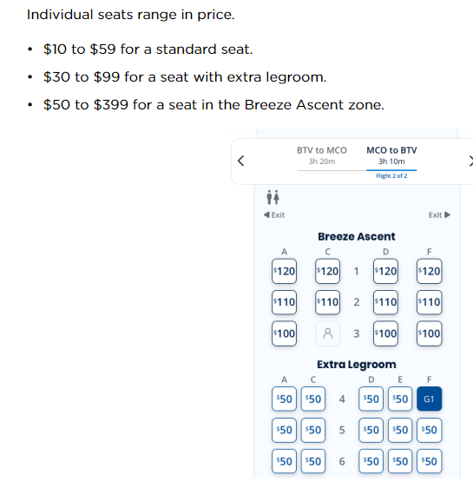
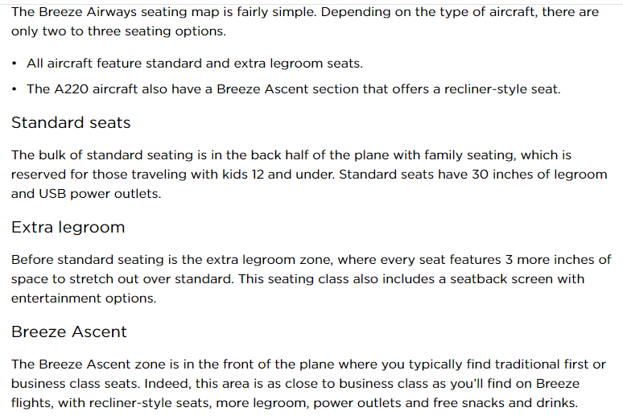
Breeze products somewhat like Delta
Notes:
Breeze products are somewhat analogous to Delta:
Standard (MX) = Main Cabin (DL)
Extra Legroom (MX) = Comfort Plus (DL)
Breeze Ascent (MX) = First Class (DL)

Slide 9
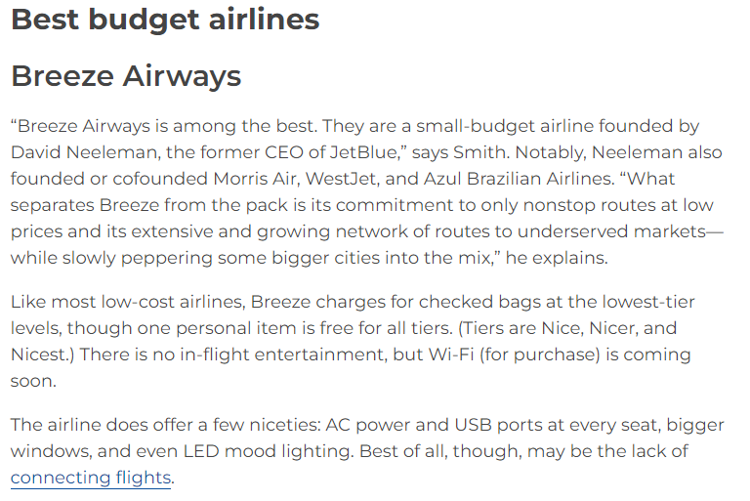
Breeze Operation: Comparable to Large, Network Airlines
On-time performance in 1Q24: 74.5%.
  Comparable to JetBlue (76.6%), United (75.9%) and Alaska 79%.
  Well ahead of other ULCCs.
  Delta was #1 at 81.0%.
Completion Factor of 99.8%.
Mishandled bags: 0.27 bags per 100.
A top 5 ‘Best U.S. Airline’ ranking in Travel + Leisure’s World’s Best.
*Source: Readers Digest
9

Slide 10
… in conjunction with low price points
Note: Does not include ancillary service pricing, which would add about 30%-40% to price points
Ancillary service: Additional $$ for better seating, check-in, etc. Consistent with other ULCCs and even some network airlines
With a 35% ancillary fees, the Provo (PVU)-Orange County (SNA) fare would increase from $159 to $214 round trip
* Source: Diio Mi; fares include taxes & PFCs
10

Slide 11
Recent Breeze News
Recently converted options on 10 A220-300s to firm orders, bringing its total firm A220-300 order to 90 aircraft, with 30 options remaining.
All aircraft are scheduled to arrive by 2028.
Breeze currently operates 22 A220-300s & will have 32 by year-end.
Expects to start flying internationally by year-end.
Breeze recently announced that it has been profitable the past 3 months.
11

Slide 12
Breeze Summary
The right aircraft: 137 seats vs 189 at ULCCs; brings many markets into play, as opposed to just the largest, leisure-oriented markets
The right product: 3 classes of service vs “cattle cars” at ULCCs
The right price point: A fraction of network airlines; while fares will be similar to ULCCs, Breeze’s service will be far superior
International Service: DLH can accommodate year-round service, unlike many smaller/mid-sized markets.
12

Slide 13
Review of Historical DLH results to LAS, PHX & MCO
Breeze Costs, P&L Estimates
Conclusions
13

Slide 14
Review of Historical Allegiant Service at DLH
Will analyze time periods that Allegiant served DLH.
Routes examined will be Las Vegas (LAS), Orlando (MCO) and Phoenix (PHX).
Will then use peak and trough revenues generated by Allegiant during these time periods and then apply to Breeze’s operating cost structure.
This will be done quarterly and annually.
14

Slide 15
Key Considerations
When Allegiant (G4) served DLH, the average aircraft size ranged from about 150 to 166 seats. During much of this time G4 operated MD88 aircraft.
Breeze operates a 137-seat A220 aircraft; in-part due to aircraft type, G4’s operating costs were materially higher than what Breeze will operate at.
Additionally, G4 typically operated a LF approximating 90% on a much bigger aircraft; due to this, for Breeze to generate comparable revenue levels will require Breeze to generate moderately higher fare levels.
Breeze: “After a consumer flies us, that same consumer typically pays 25% more the next time that they fly Breeze”.
15
Notes:
I’m relatively confident that Breeze can get good fares/yields out of DLH once the consumer understand the product better. At first, people will probably think that it is another Allegiant or Sun Country. Once flown, they’ll see the difference.

Slide 16
DLH-LAS: Historical passengers and average fare paid
10
Red: Annualized
Fairly tight range between 280-300 PWEW annually during most of service period.
Success of route dictated by fares; note sharp drop after mid-2011
*Source: Diio
**Source: Diio; includes addition of 35% for ancillary services.
16
Notes:
Maybe its just a coincidence, but LAS started to decline at the same time that AZA was added. I wonder if there was any cannibalization.

Slide 17
DLH-LAS: Historical Allegiant Revenue Trends
10
Post-2011 declines driven by:
  ULCC capacity increases at MSP which lowered MSP fares.
  Strong U.S. Dollar reduced demand from Thunder Bay.
  Vegas “burnout”.
Breeze will likely base DLH projections upon most recent results (and worst).
As fares indicated, Allegiant’s revenue fell over 20% after 2011.
*Source: Diio
17

Slide 18
DLH-PHX: Historical passengers and average fare paid
10
Very seasonal (as expected). Note relative fare in 1st Quarter.
PHX was (mostly) served with seasonal service.
*Source: Diio
**Source: Diio; includes addition of 35% for ancillary services.
18

Slide 19
DLH-PHX: Historical Allegiant Revenue Trends
10
During peak 1st Quarter, PHX results were similar to LAS.
Rest of year results were relatively weaker.
Breeze likely only considers seasonal service to PHX.
*Source: Diio
19

Slide 20
DLH-MCO: Historical passengers and average fare paid
10
MCO was served (mostly) seasonally and was sporadic.
Very seasonal (as expected). Note relative fare in 1st Quarter.
*Source: Diio
**Source: Diio; includes addition of 35% for ancillary services.
20

Slide 21
DLH-MCO: Historical Allegiant Revenue Trends
10
During peak 1st Quarter, MCO results were similar to LAS & PHX.
Rest of year results were relatively weaker.
Breeze likely only considers seasonal service to MCO – at least initially.
*Source: Diio
21

Slide 22
LAS: Can work year-round; MCO: Works in 1Q & maybe 2Q; PHX: Works in 1st Quarter only
22
Notes:
Fare: Round-trip including ancillary revenue. One-way passengers. Round-trip revenue.
DLH-MCO: In 4th quarters, G4 tried parts of 4th quarter a couple of times, hence why I didn’t show (#’s weren’t good).
DLH-PHX: G4 tried once and didn’t work, hence why Peak & Trough numbers are same; same for 3Q MCO-DLH.

Slide 23
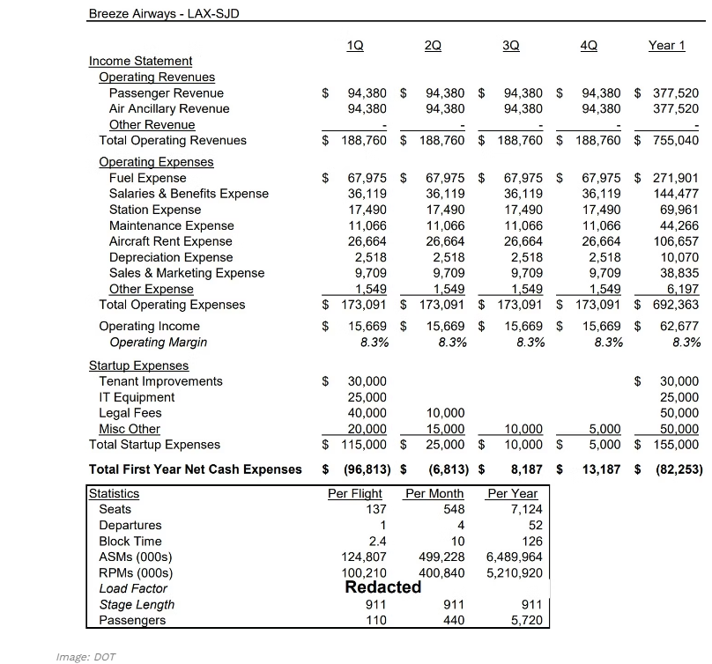
Breeze Airways: Estimated Operating Costs
23

Slide 24
Breeze P&L Estimates at Peak Demand
Demand is from:
  YE 1Q12 for LAS.
  1Q14 for PHX.
  1Q10 for MCO.
Note that G4 operating costs would have been materially higher than Breeze today.
  MD88 aircraft.
  Versus a smaller A220, much more fuel-efficient aircraft. Also, much lower maintenance costs.
Breeze’s 137 seat aircraft will require a higher air fare to generate the same revenue level as compared to G4.
* Assumes Breeze LF stays constant versus earlier Allegiant LF.
24

Slide 25
Breeze P&L estimates at recent/trough demand
During 1Q, MCO and PHX have consistent demand – not a lot of downside.
LAS demand is from YE 1Q15. LAS experienced considerable downside versus peak period(s).
Needed Breeze fare levels don’t appear excessive.
* Assumes Breeze LF stays constant versus earlier Allegiant LF.
25

Slide 26
Breeze P&L estimates at recent/trough demand --- assuming fares stay at G4 levels
If Breeze can’t increase fares, LAS likely loses $$.
This likely is somewhat what routes look like for first 6-12 months as route “ramps up”.
PHX/MCO will likely be strong in 1Q regardless, but we’ll need more than seasonal service to get Breeze’s attention.
* Assumes Breeze LF stays constant versus earlier Allegiant LF.
26

Slide 27
Where does Breeze stand on DLH?
There is some interest. Their concern is that the stage length is relatively long which drives relatively higher operating costs – particularly if fuel goes higher.
An indirect concern is the continued amount of ULCC service at MSP, although Sun Country is viewed differently than Spirit.
But there is a history. They know the market well.
A $1.5 million MRG gets immediate attention (fall/winter of 2025). A lesser amount ($500k+) gets attention, including marketing support.
27
Notes:
I realize that anything close to $1.5 million is probably not realistic. Breeze is getting a lot of $1+ million MRG proposals.

Slide 28
Final Comments
Breeze is probably the best option for DLH to grow air service. Breeze is adding a new aircraft every month through 2028 – and they know DLH.
Beyond leisure markets noted here, Breeze would likely look at adding further new service at DLH if those routes are successful (DEN & CUN to name two).
To get serious nearer-term attention, we’ll need a financial support package that includes an MRG.
After the initial ramp-up, our estimates indicate that there should be limited downside. That said, you need to assume that they’ll fully utilize any MRG.
28

