Slide 1
Operations/Construction/Projects/Planning Update
Duluth International Airport:
Air Traffic Control Tower
Round 2 ATP Funding
Latest Renderings and Cost Estimate
2024 Air Spectacular
Taxiway A – Phase 3 Construction
Customs and Boarder Protection (CBP) Federal Inspection Services Construction
Part 139 Inspection Recap
TSA Annual Inspection Recap
Sky Harbor Airport:
New General Aviation Terminal Construction Update
New Snow Removal Equipment Building Construction Update

Slide 2
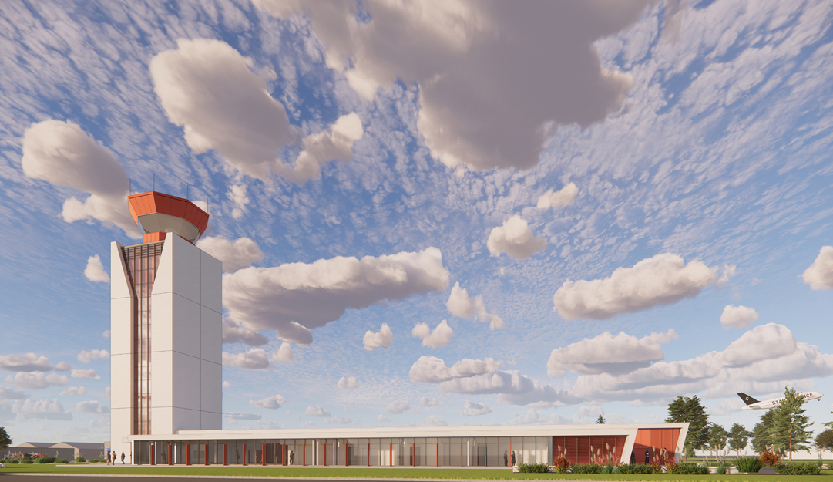
Air Traffic Control Tower Replacement

Slide 3
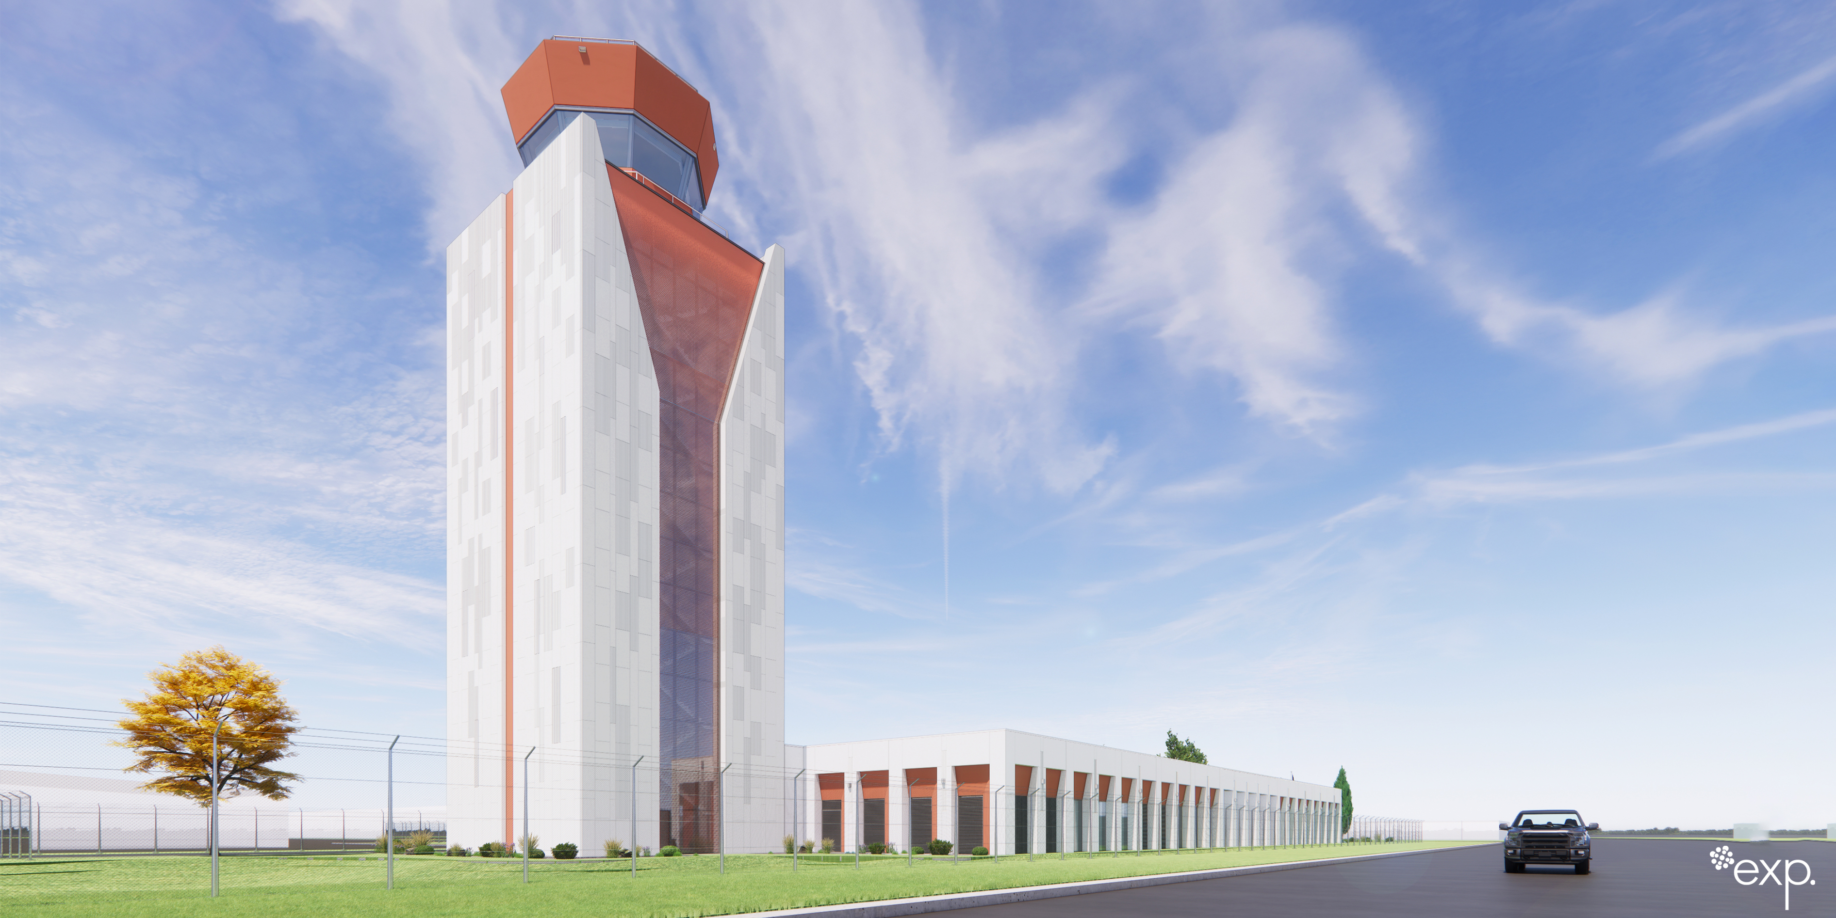

Slide 4
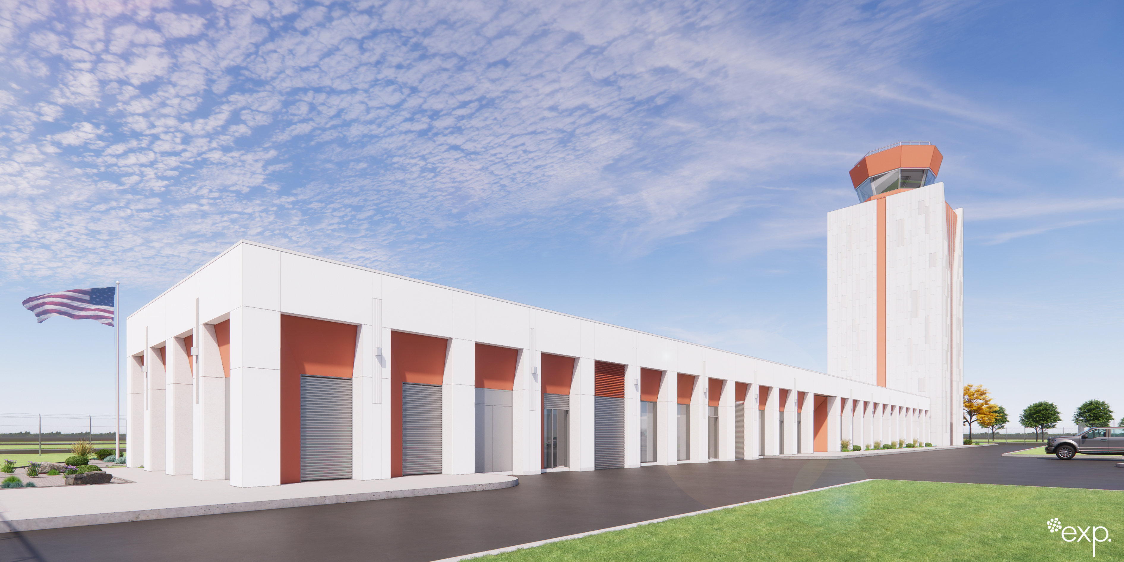

Slide 5
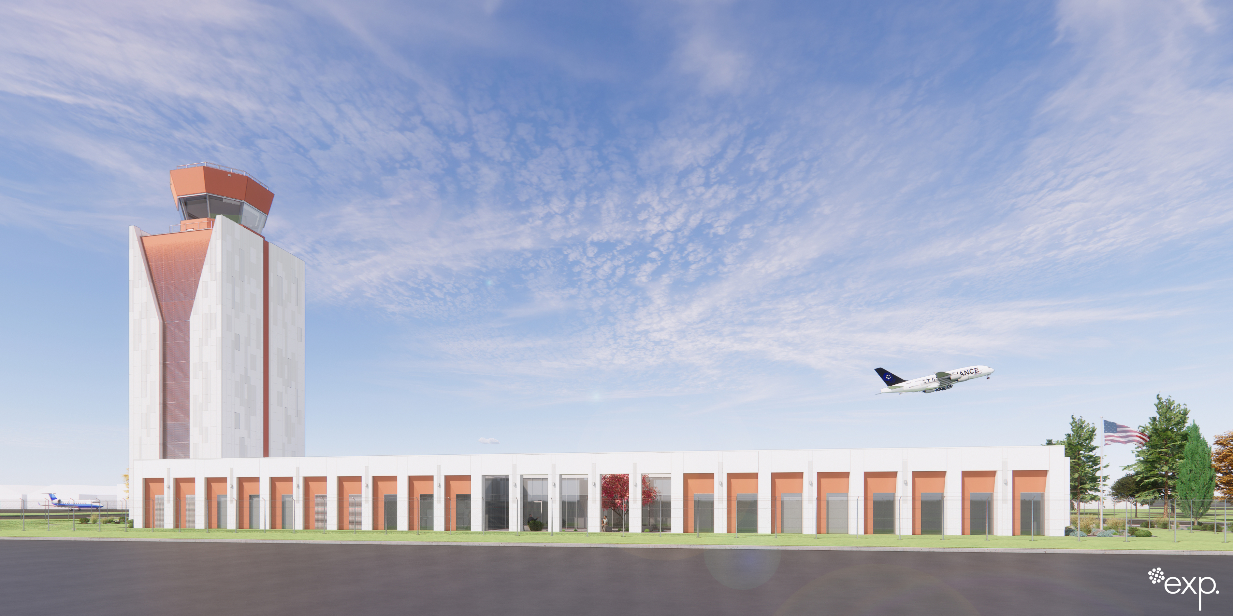

Slide 6
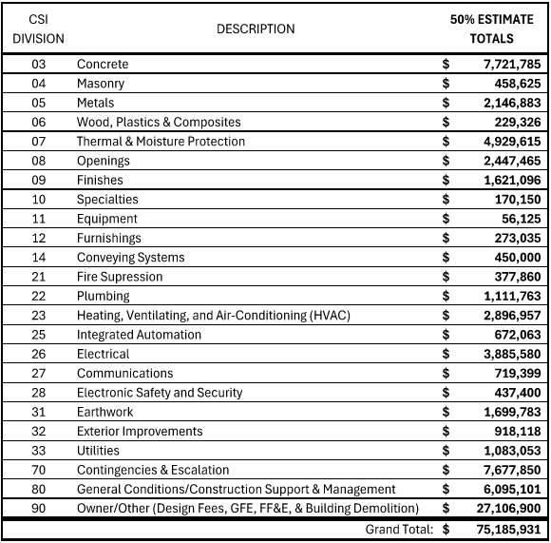
Air Traffic Control Tower Replacement – Cost Estimate

Slide 7
Operations/Construction/Projects/Planning Update
Duluth International Airport:
Air Traffic Control Tower
Round 2 ATP Funding
Latest Cost Estimate
2024 Air Spectacular
Taxiway A – Phase 3 Construction
Customs and Boarder Protection (CBP) Federal Inspection Services Construction’
Part 139 Inspection Recap
TSA Annual Inspection Recap
Sky Harbor Airport:
New General Aviation Terminal Construction Update
New Snow Removal Equipment Building Construction Update

Slide 8
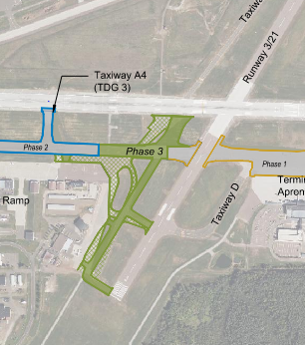
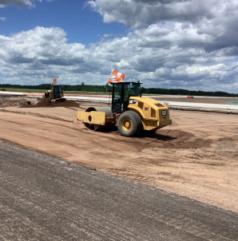
Taxiway A Phase 3 Reconstruction
Schedule: The first phase is scheduled to be complete following 60-hr closure the weekend of Aug 2-4.
Outreach: Completed tenant group updates and submitting weekly project email updates to stakeholders.
Update: Construction team is working to complete work in restrictive safety areas during nightly closures and navigating weather delays.

Slide 9
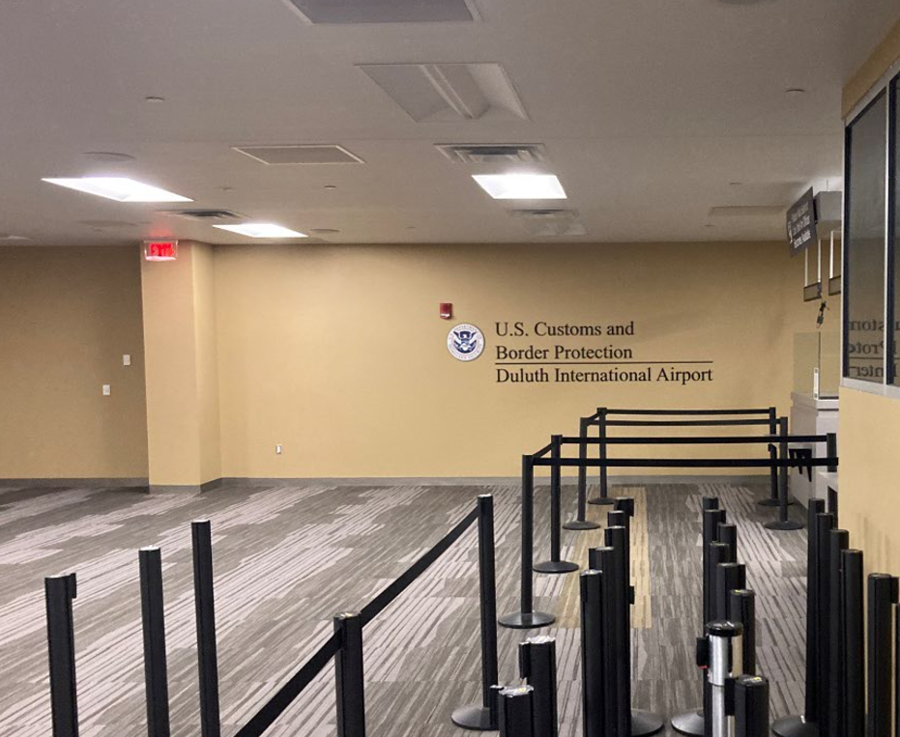
Federal Inspection Services (FIS) Facility Renovation
Issue: Customs and Border Protection (CBP) has provided an inspection report of specific items that need remediation to meet current CBP standards. A certified CPB station in required to accept international traffic at the terminal.
Scope: Proposed improvements include IT upgrades, baggage inspection flow improvements, camera replacement, and miscellaneous upgrades.
Cost: The estimated repair cost is approximately $800,000 per a design level estimate.
Next Steps: The Airport will coordinate with the City of Duluth to advertise and accept bids for the project, and then present results to the Airport Board.

Slide 10
Operations/Construction/Projects/Planning Update
Duluth International Airport:
Air Traffic Control Tower
Round 2 ATP Funding
Latest Cost Estimate
2024 Air Spectacular
Taxiway A – Phase 3 Construction
Customs and Boarder Protection (CBP) Federal Inspection Services Construction’
Part 139 Inspection Recap
TSA Annual Inspection Recap
Sky Harbor Airport:
New General Aviation Terminal Construction Update
New Snow Removal Equipment Building Construction Update

Slide 11
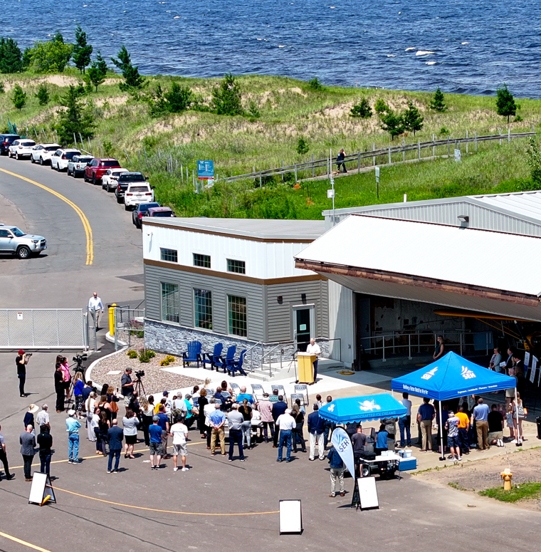
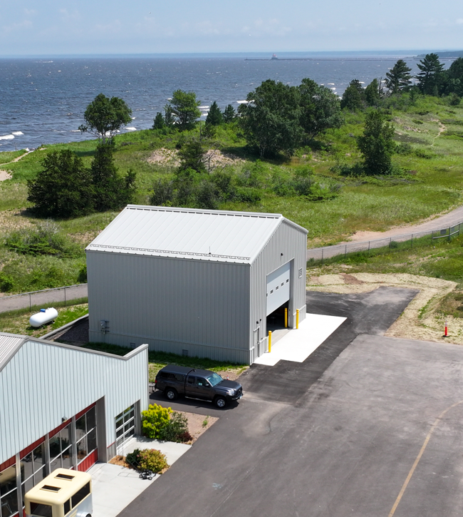
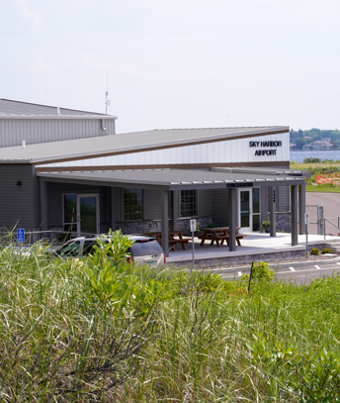
Sky Harbor – Terminal and SRE Building

Slide 12
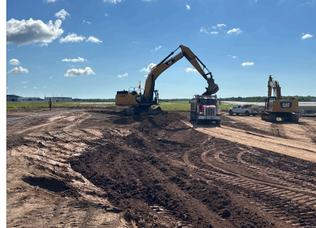
A. Resolution to Award Construction Contract in the Amount of $11,335,704.00 to Ulland Brothers, Inc. for the Construction of Taxiway A – Phase 5 and associated Alternate Schedules.
Project Description – Phase 5 of the Taxiway A Reconstruction project includes 2,600 feet of reconstruction of Taxiway A to the north of the Midfield Ramp. Taxiway A3 will be realigned to meet the current FAA design standards which includes a right-angle intersection onto a runway. This realignment is consistent with the geometrics shown in the DLH’s Master Plan. Work will also include the construction of two ramp connectors onto the Midfield Ramp. The awarded amount includes Taxiway A, Midfield Ramp, and a tank pad for deice fluid.
The contract amount is $11,335,704.00
Schedule A (FAA eligible) portions of the project are anticipated to be funded by FAA at 90%, MnDOT at 5%, and the DAA at 5% as part of the Airport Improvement Program. Schedule B is funded by the Air National Guard

Slide 13
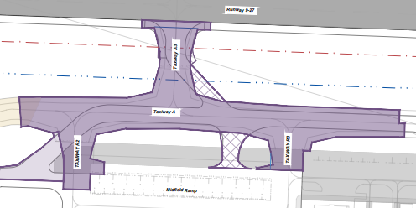
B. Resolution to Approve Work Order 2024-6 between the Duluth Airport Authority and Short Elliot Hendrickson, Inc. for the Construction Administration of Taxiway A – Phase 5.
Project Description – This scope of work includes construction administration, observation, and closeout for the FAA grant to reconstruct Taxiway A Phase 5 areas, which includes the pavement north of the SRE maintenance facility
The contract amount is $1,162,900 (Schedule A is $1,016,900 and Schedule B is $146,000)
Schedule A (FAA eligible) portions of the project are anticipated to be funded by FAA at 90%, MnDOT at 5%, and the DAA at 5% as part of the Airport Improvement Program. Schedule B is funded by the Air National Guard.

Slide 14
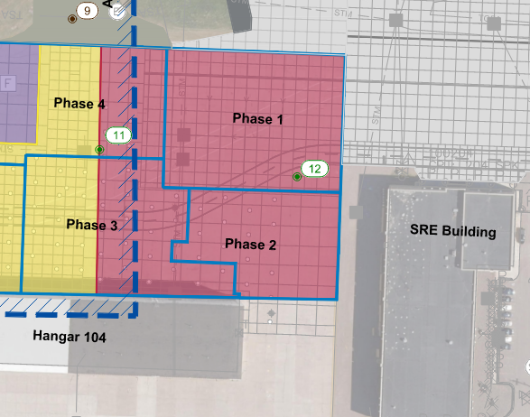
C. Resolution to Approve Work Order 2024-7 between the Duluth Airport Authority and Short Elliot Hendrickson, Inc. for the Construction Administration of Midfield Ramp – Phase 2.
Project Description – The DAA was issued a grant for the reconstruction of the Midfield Ramp. Phase 2 of the project was bid with the Taxiway A Phase 5 project with construction being completed by Ulland Contractors. This scope will enable SEH to perform construction administration of the Midfield work.
The contract amount is $148,100.
The project is anticipated to be funded by MnDOT at 70% and the DAA at 30% as part of a state grant by MnDOT Aeronautics.

Slide 15
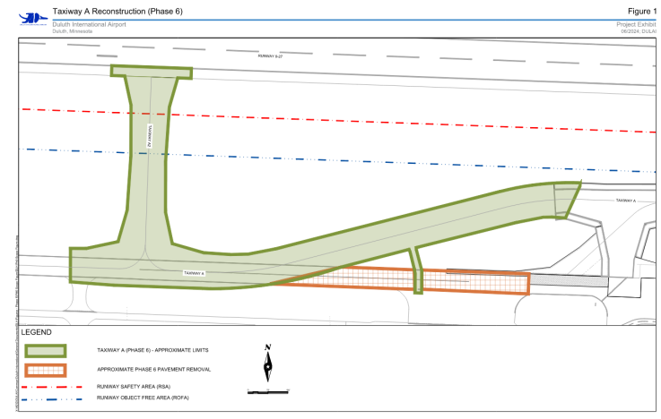
D. Resolution to Approve Work Order 2024-9 between the Duluth Airport Authority and Short Elliot Hendrickson, Inc. for the Design of Taxiway A – Phase 6
Project Description – This project includes realignment of Taxiway A north of the Cirrus Campus, with construction of 75-foot taxiways. The project will include relocation of TW A2, 20-foot shoulders and full lighting replacement,
The contract amount is $821,200 (Schedule A is $764,100 and Schedule B is $57,100)
Schedule A (FAA eligible) portions of the project are anticipated to be funded by FAA at 90%, MnDOT at 5%, and the DAA at 5% as part of the Airport Improvement Program. Schedule B is funded by the Air National Guard.

Slide 16
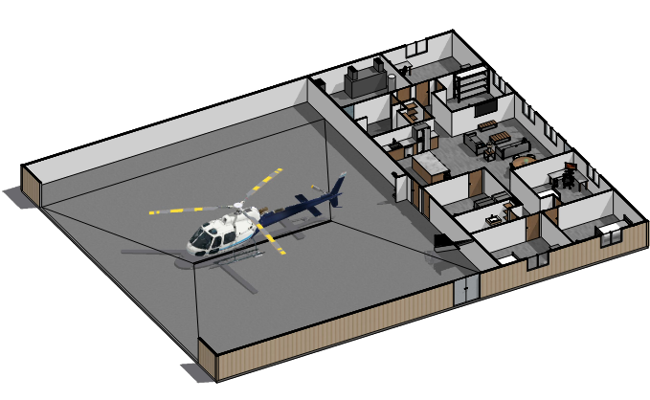
E. Resolution to Approve Amendment 1 to Work Order 2023 – 5 between the Duluth Airport Authority and Short Elliot Hendrickson, Inc. for the Design of North Business Development Hangar Construction Project at Duluth International Airport (DLH).
Amendment Overview - This amendment is for adjusted design fees for SEH and its subconsultants. The design was originally approved in March, 2023 but a delay was required to meet FAA requirements for leasing.
The amendment amount is $4,700.00.
The amendment is anticipated to be funded by FAA at 90%, MnDOT at 5%, and the DAA at 5% as part of the original grant.

