Slide 1
Operations/Construction/Projects/Planning Update
Duluth International Airport:
Air Traffic Control Tower
H&U Introduction
Groundbreaking – Spring 2026
Taxiway A – Phase 3 Construction
Building 100 Demo
Airshow 2024 – Recap
Sky Harbor Airport:
New General Aviation Terminal Construction Update
New Snow Removal Equipment Building Construction Update
Cessna 180/185 Fly-in Recap

Slide 2
July 31st over Lake Superior!

Slide 3
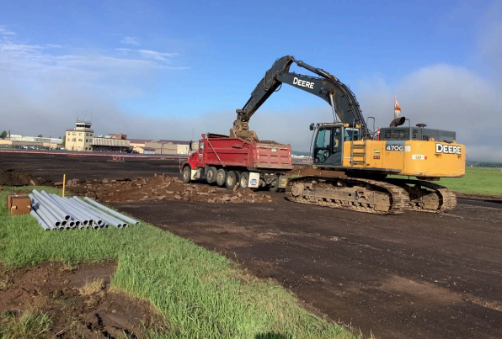
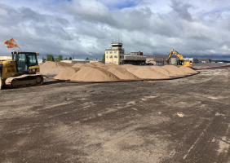
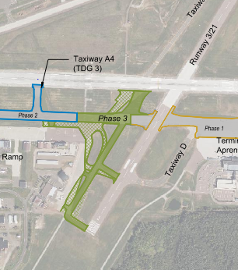
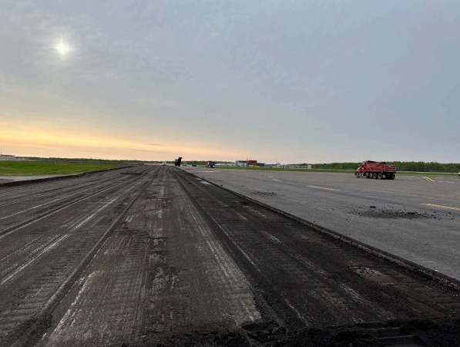
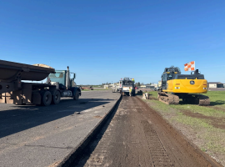
Taxiway A Phase 3 Reconstruction

Slide 4
Operations/Construction/Projects/Planning Update
Duluth International Airport:
Air Traffic Control Tower
H&U Introduction
Groundbreaking – Spring 2026
Taxiway A – Phase 3 Construction
Building 100 Demo
Airshow 2024 – Recap
Sky Harbor Airport:
New General Aviation Terminal Construction Update
New Snow Removal Equipment Building Construction Update
Cessna 180/185 Fly-in Recap

Slide 5
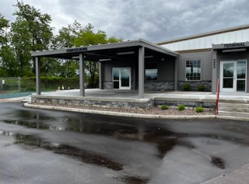
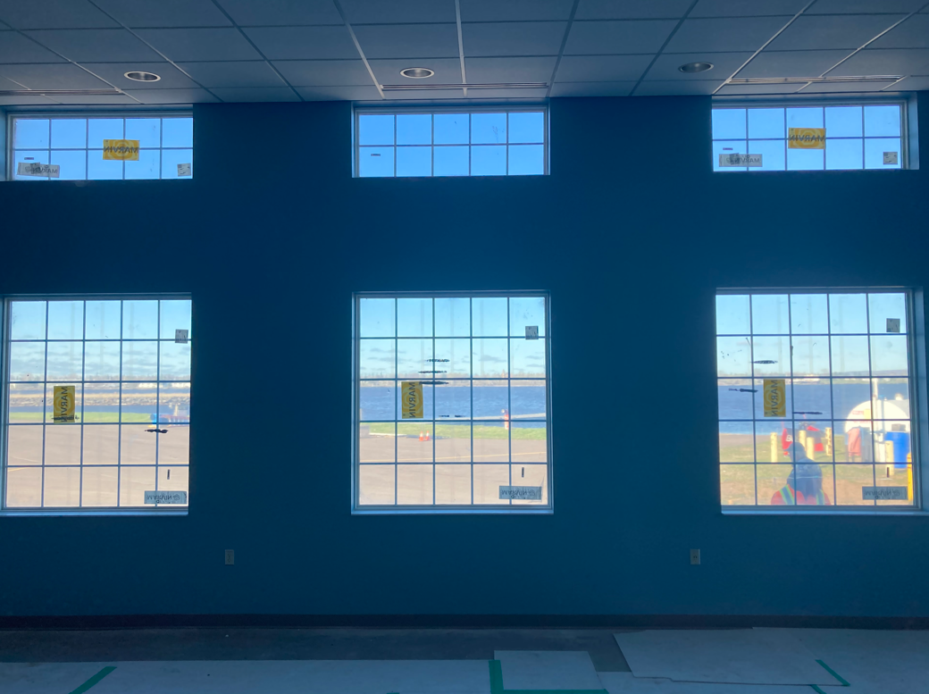
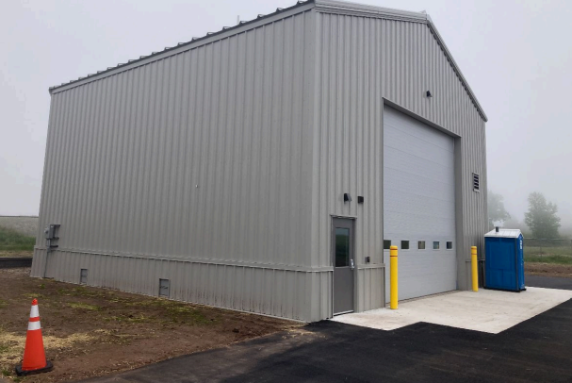
Sky Harbor – Terminal and SRE Building
Ribbon Cutting – July 10th – 1pm!

Slide 6
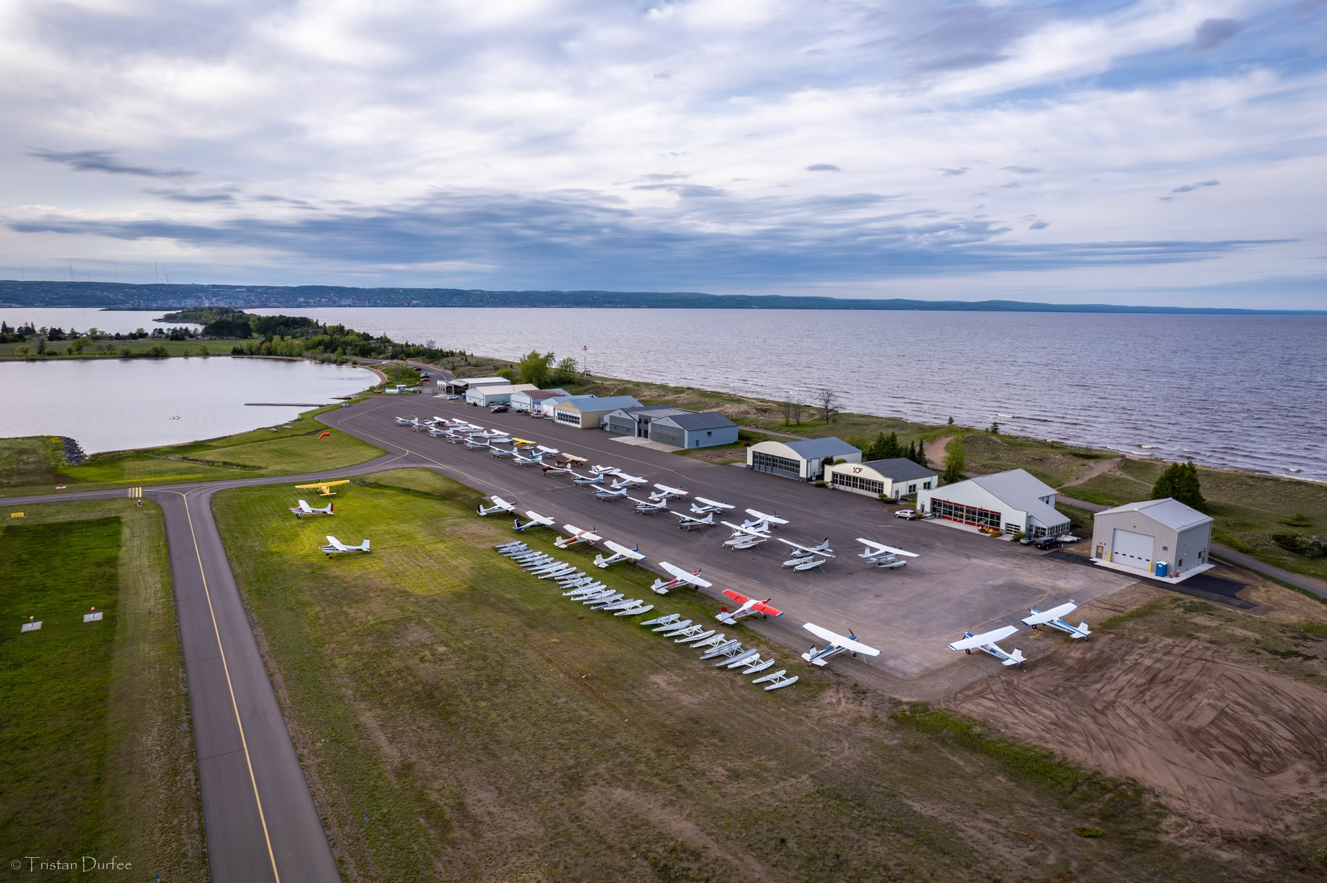
Cessna 180/185 Fly-In

Slide 7
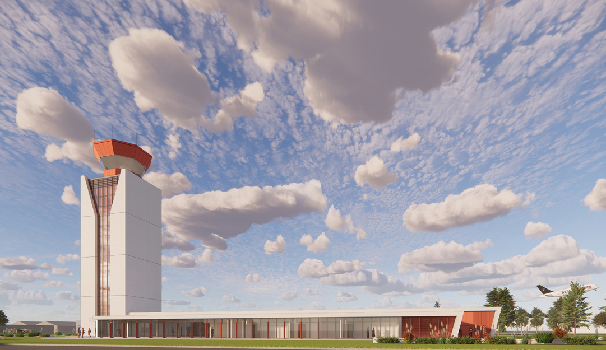
Air Traffic Control Tower Replacement

Slide 8
A. Resolution to Approve Amendment #1 between the Duluth Airport Authority and EXP, Inc, for the Design of a New Air Traffic Control Tower
Amendment #1 for $86,317.26 includes:
Additional Geotech borings
Tower elevator reconfiguration
50% submittal documentation
Additional city coordination
Funding will be provided by the ATP grant opportunity at 95%

