Slide 1
Operations/Construction/Projects/Planning Update
Duluth International Airport:
Air Traffic Control Tower
2024 Air Spectacular
Taxiway A – Phase 3 Construction
  60 Hour Closure Recap
Midfield Ramp Reconstruction – Phase 2
Customs and Boarder Protection (CBP) Federal Inspection Services Construction
Sky Harbor Airport:
New General Aviation Terminal Construction Update
New Snow Removal Equipment Building Construction Update

Slide 2
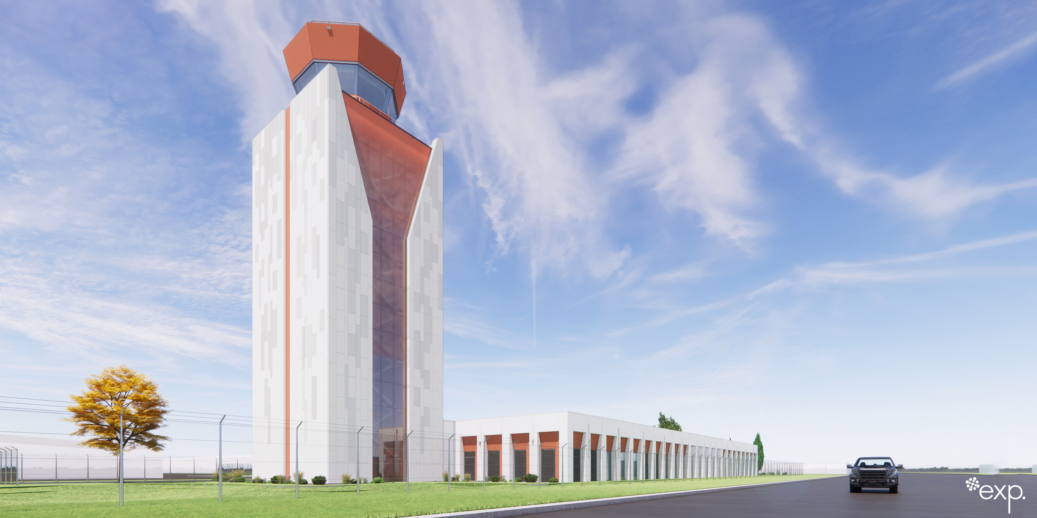

Slide 3
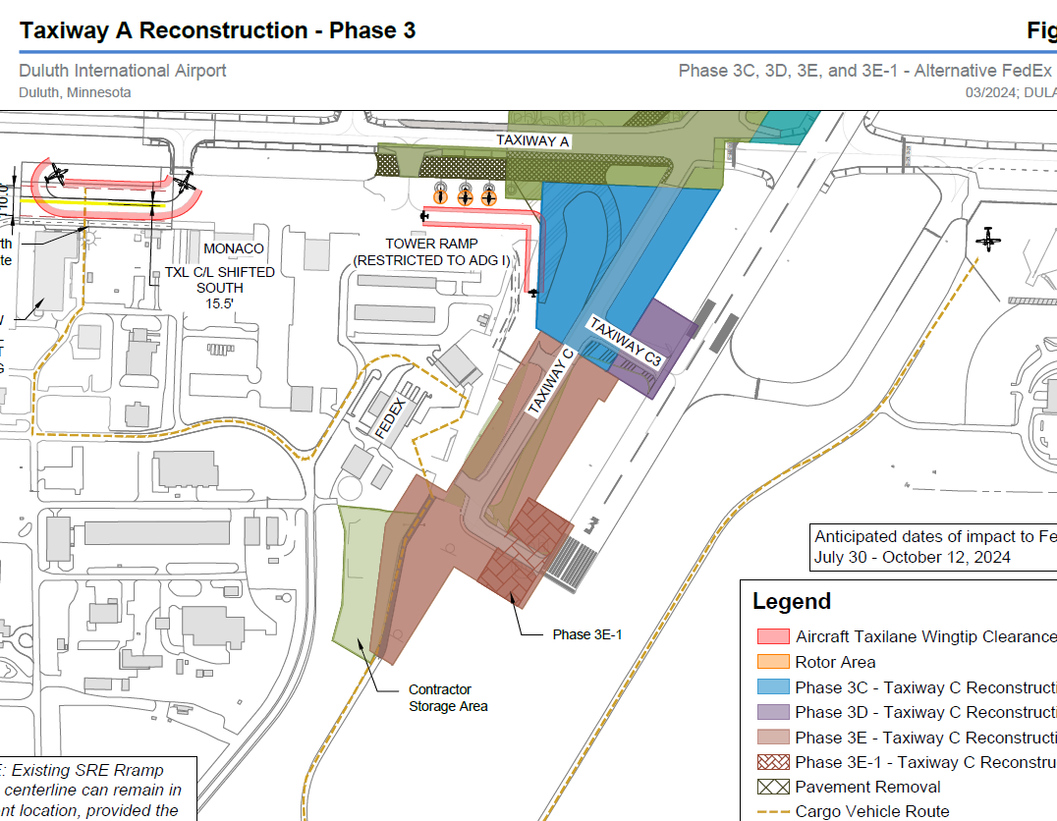

Slide 4
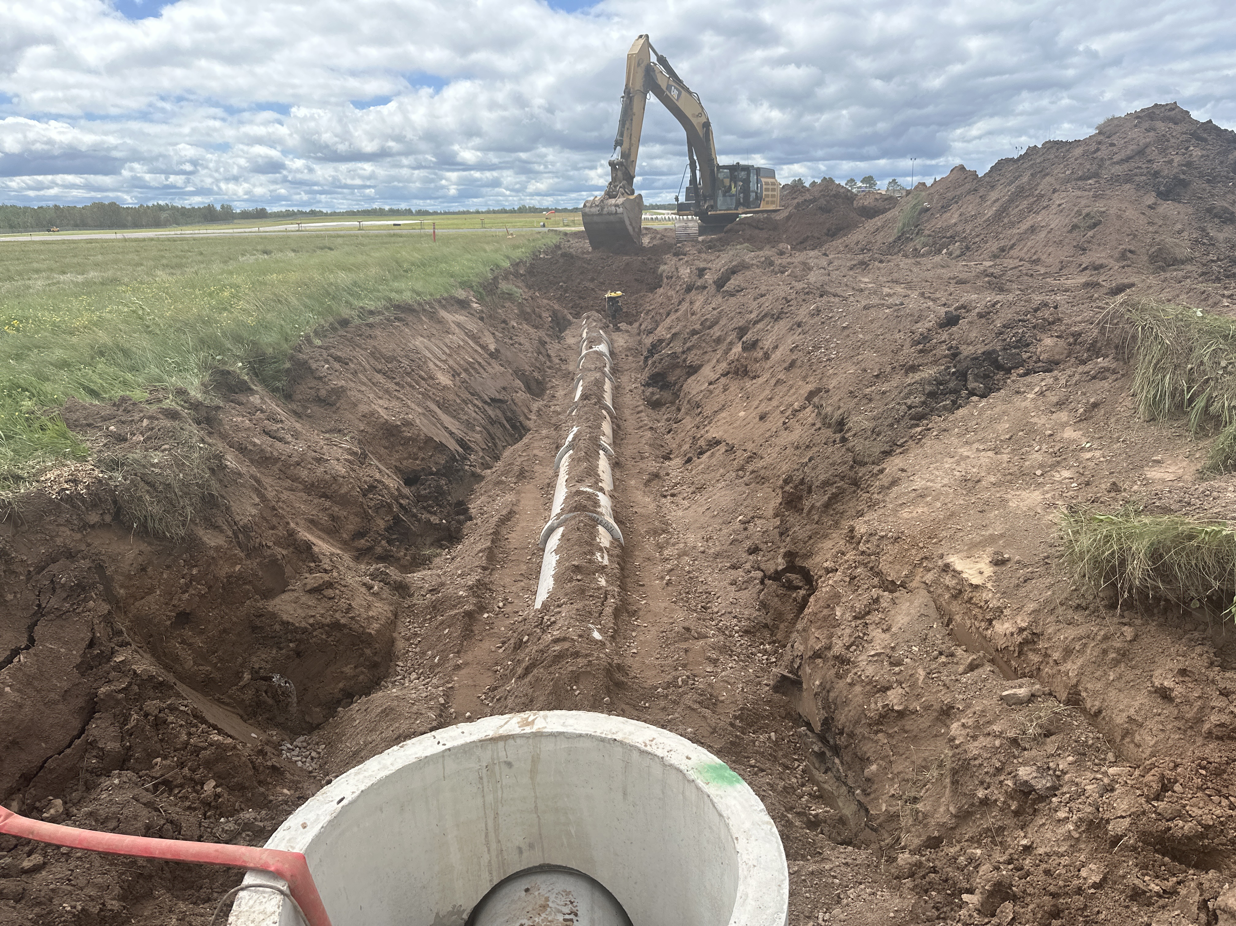

Construction Update
Taxiway A Reconstruction - Phase 3A, 3A-1, and 3B
                Existing pavement removed
                Drain tile and storm sewer installed
                New pavement section constructed (including mainline and shoulders)
              Electrical underground infrastructure installed (including FAA utility reconstruction)
              Installing new taxiway edge lighting and pulling circuitry
              Painting new pavement markings
              TWY A is scheduled to reopen on Monday, August 26
Taxiway C South Reconstruction - Phase 3C and 3C-1
                Removals have started
                Once TWY A reopens, full production will start on this phase

Slide 5
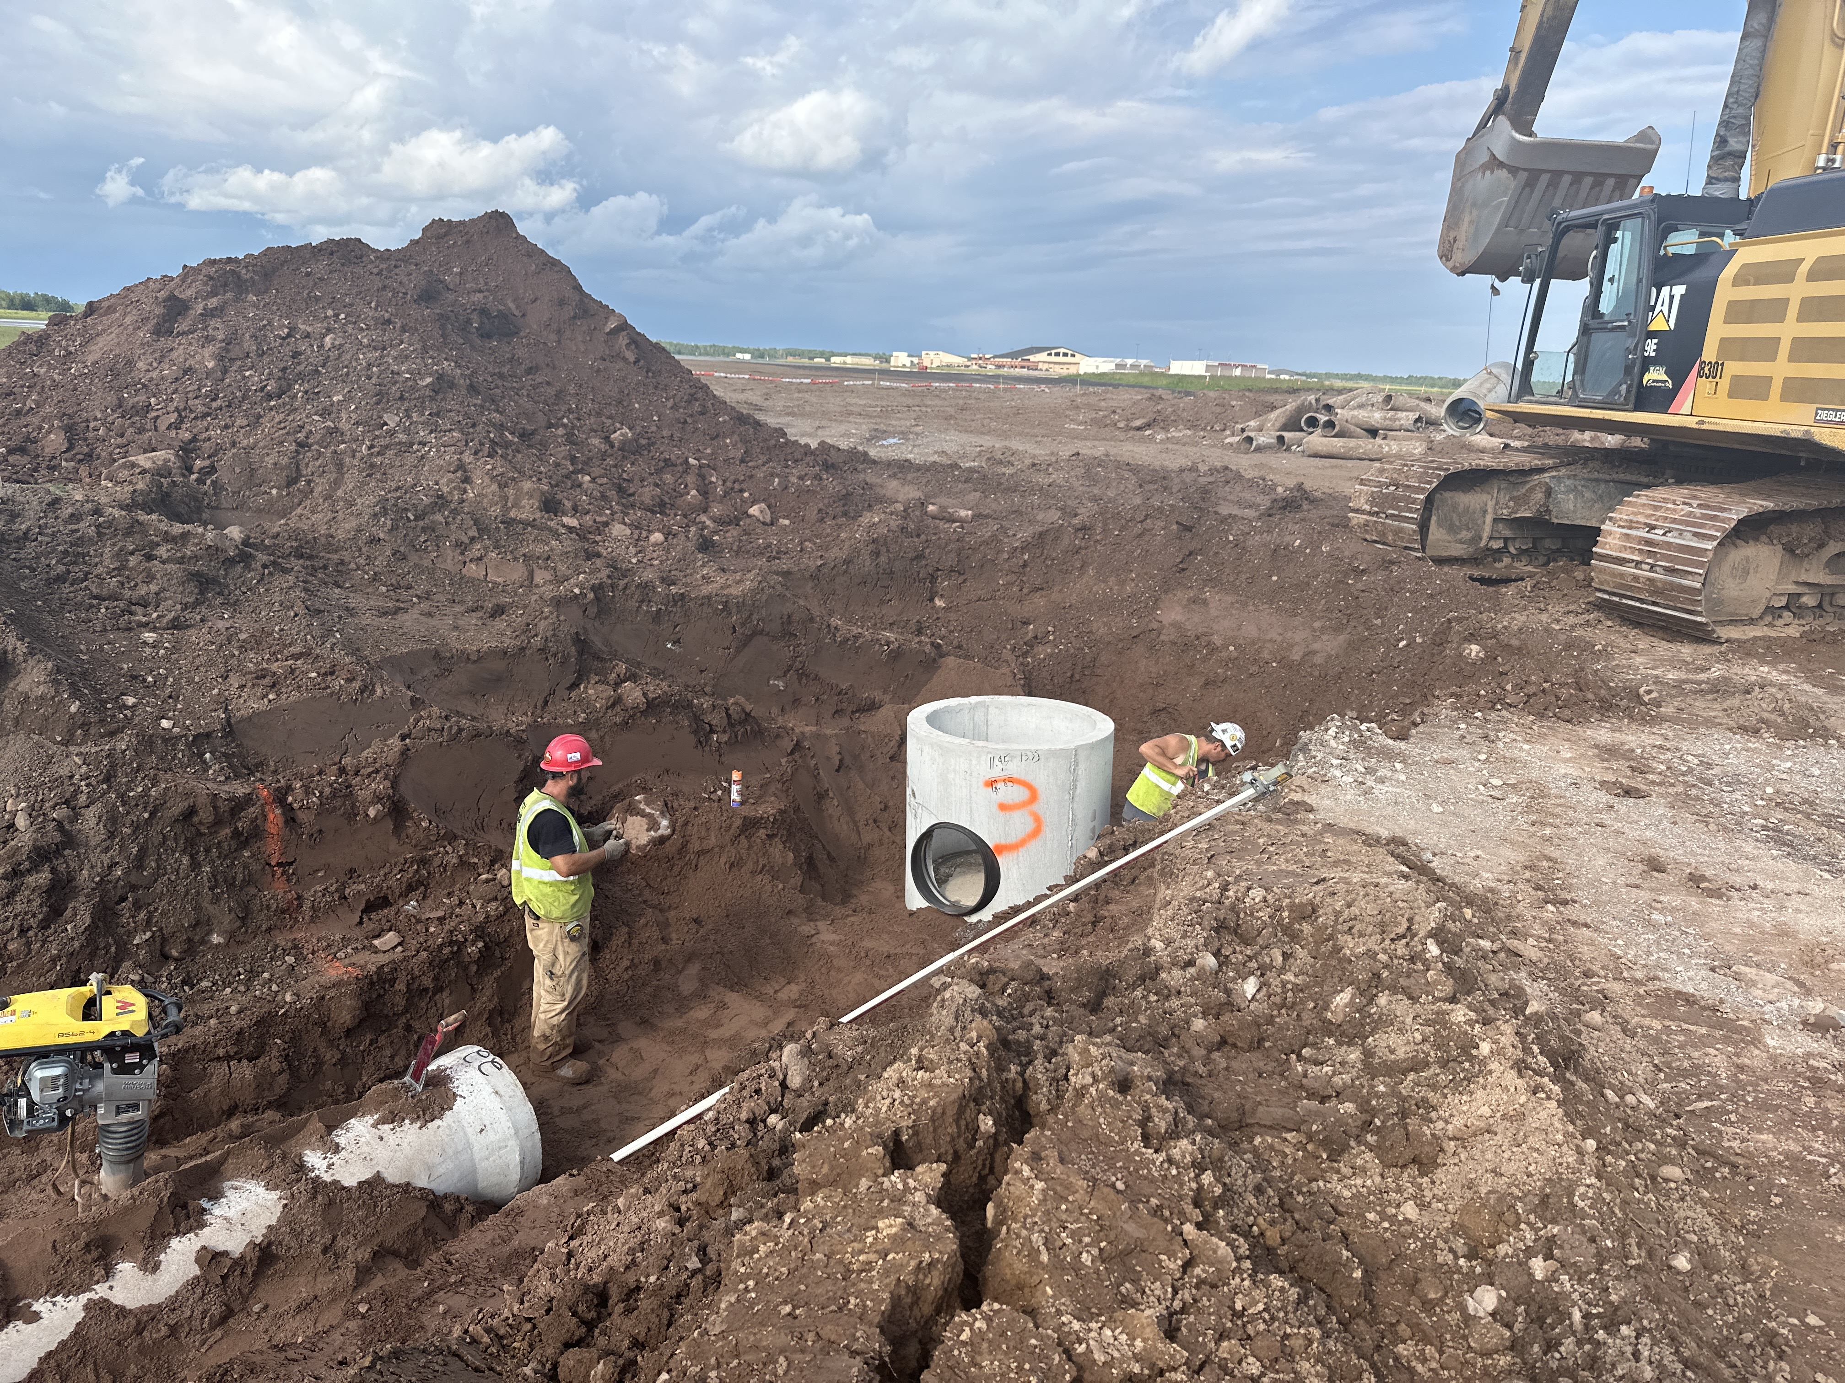
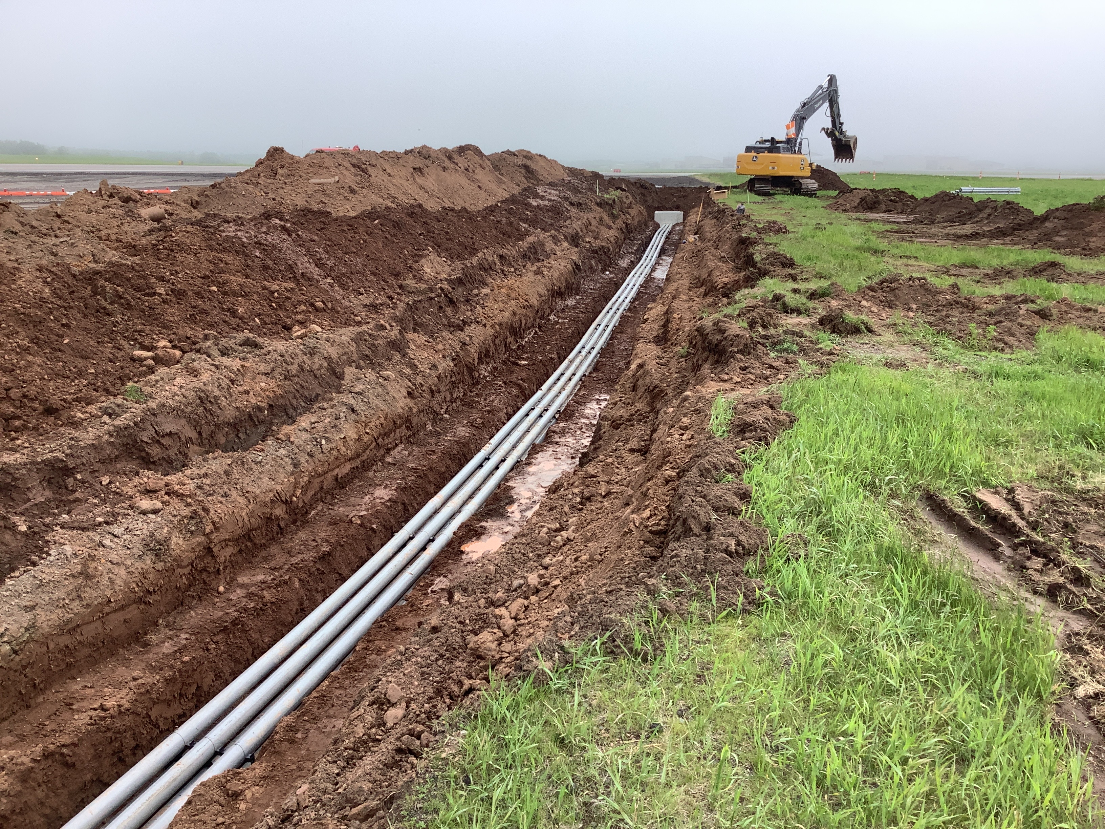
Photos
Storm Sewer Installation
Electrical Duct Bank Installation

Slide 6
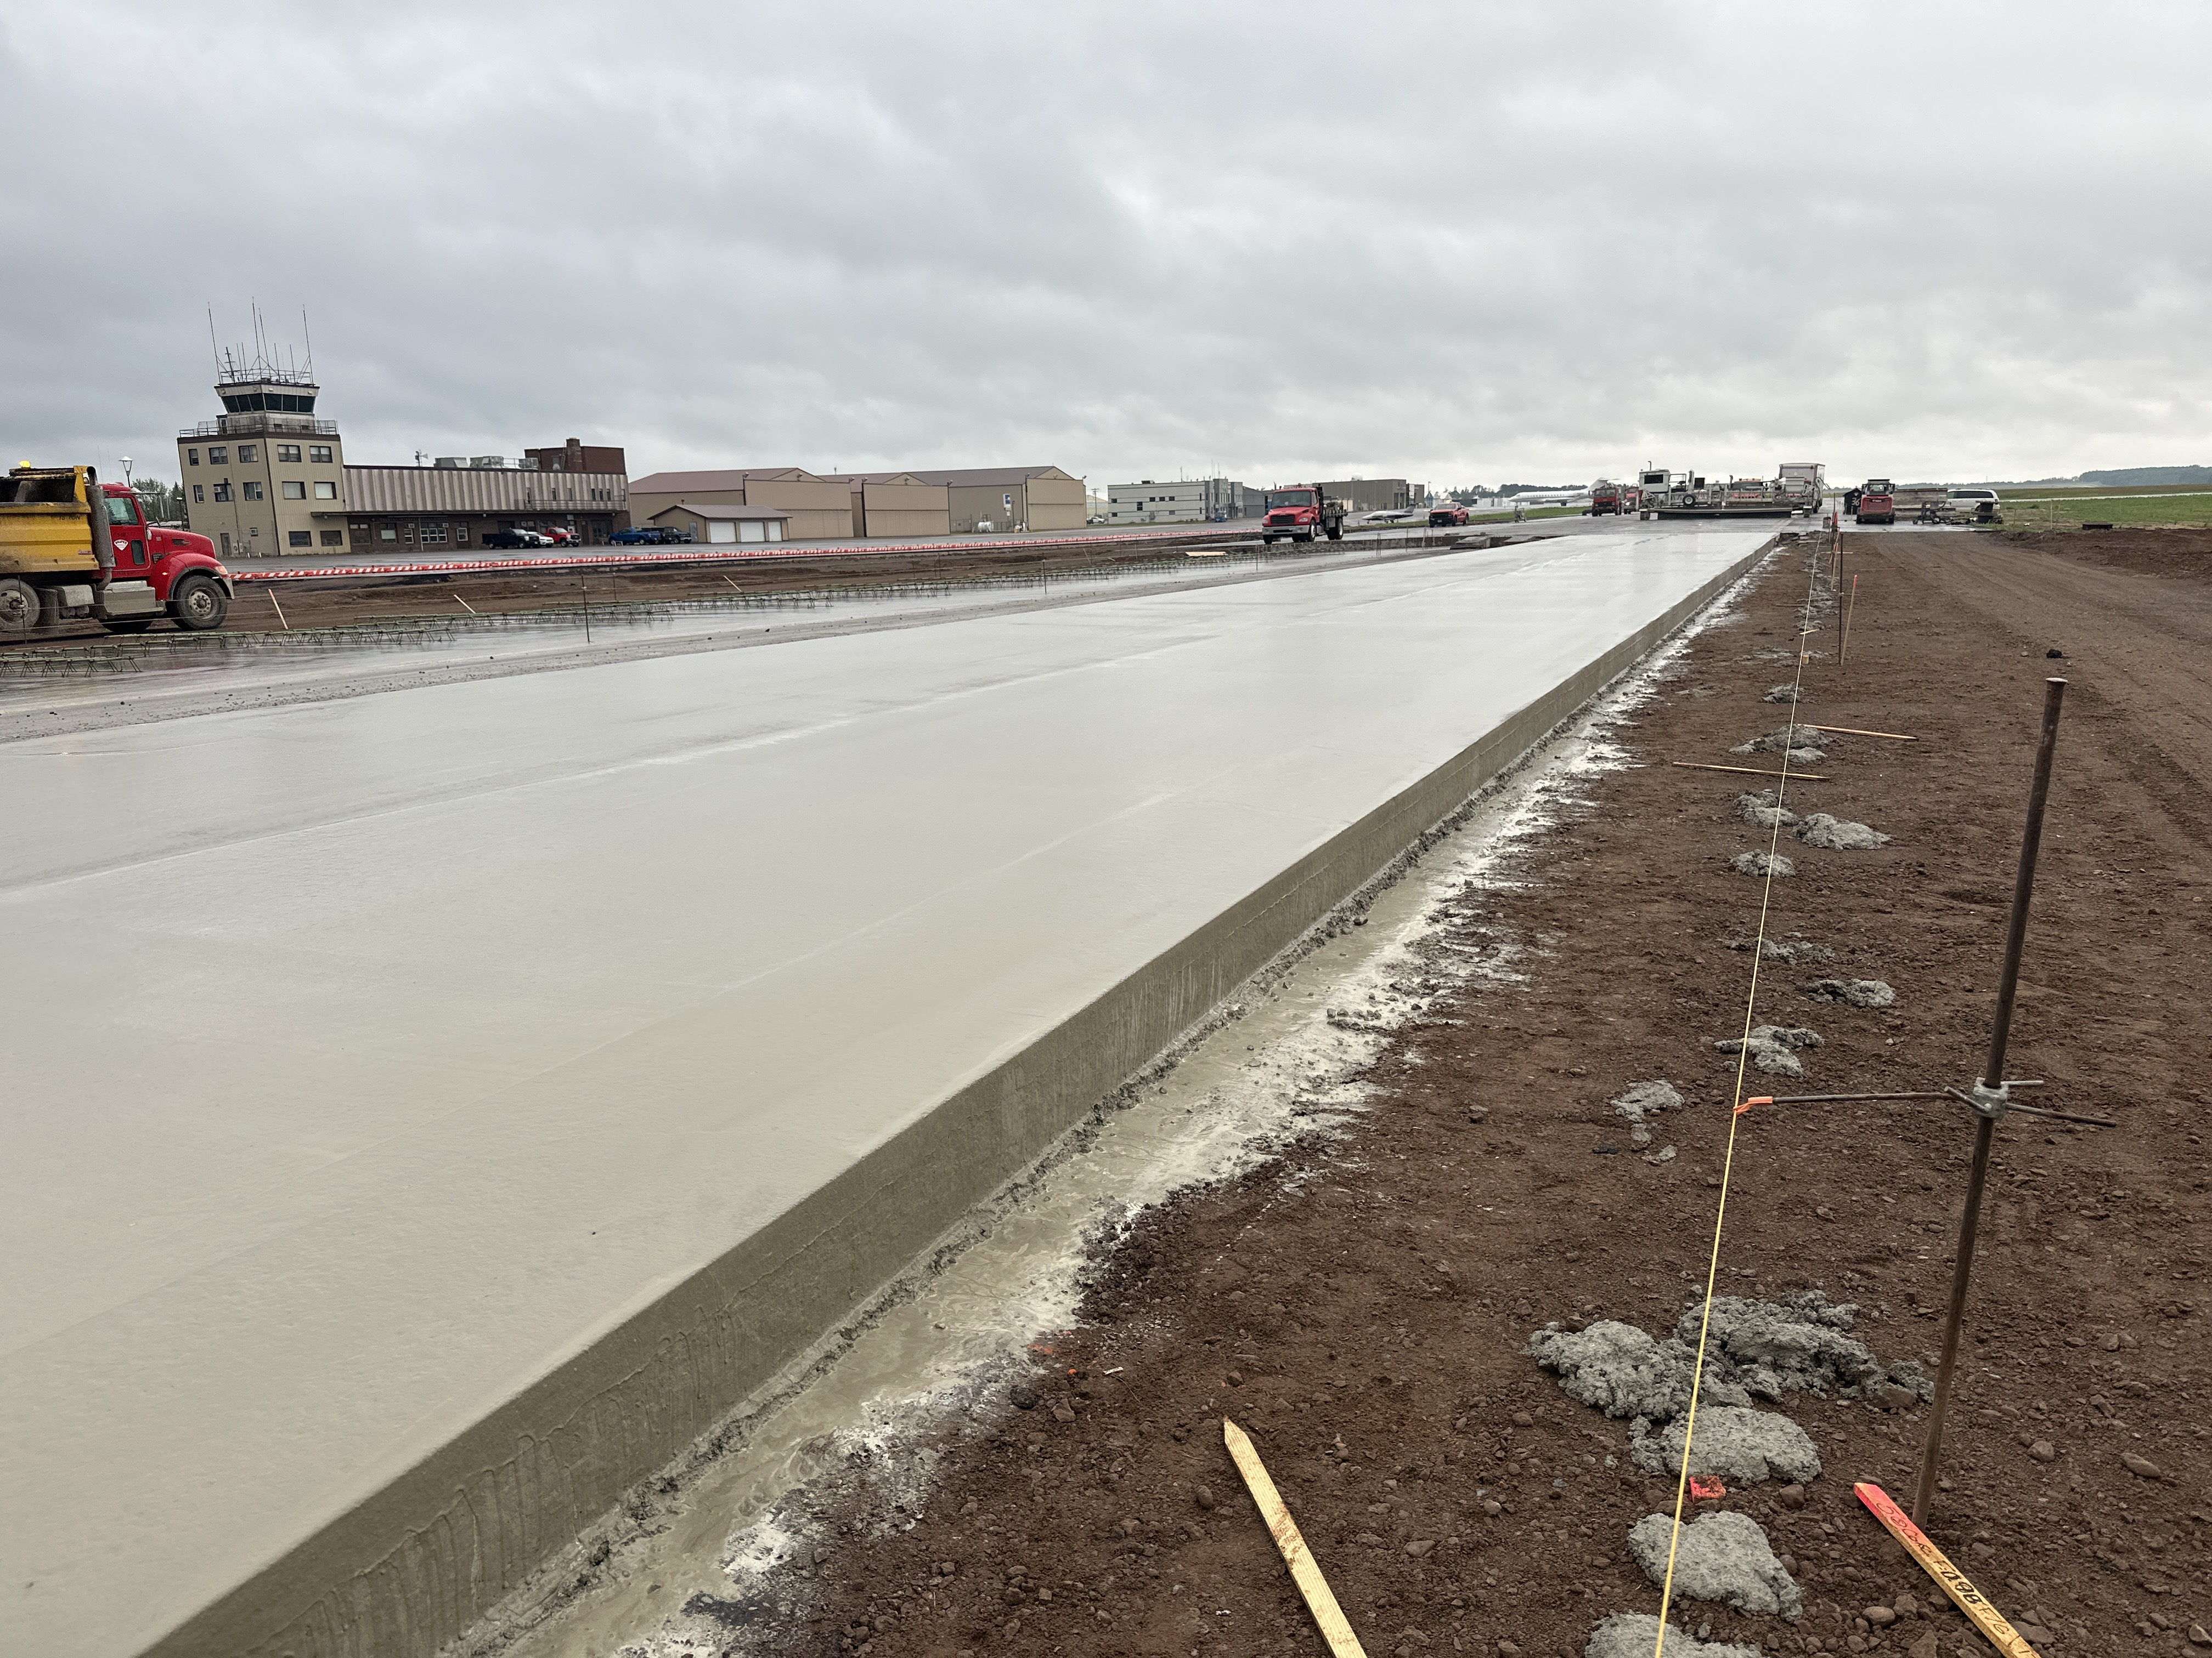
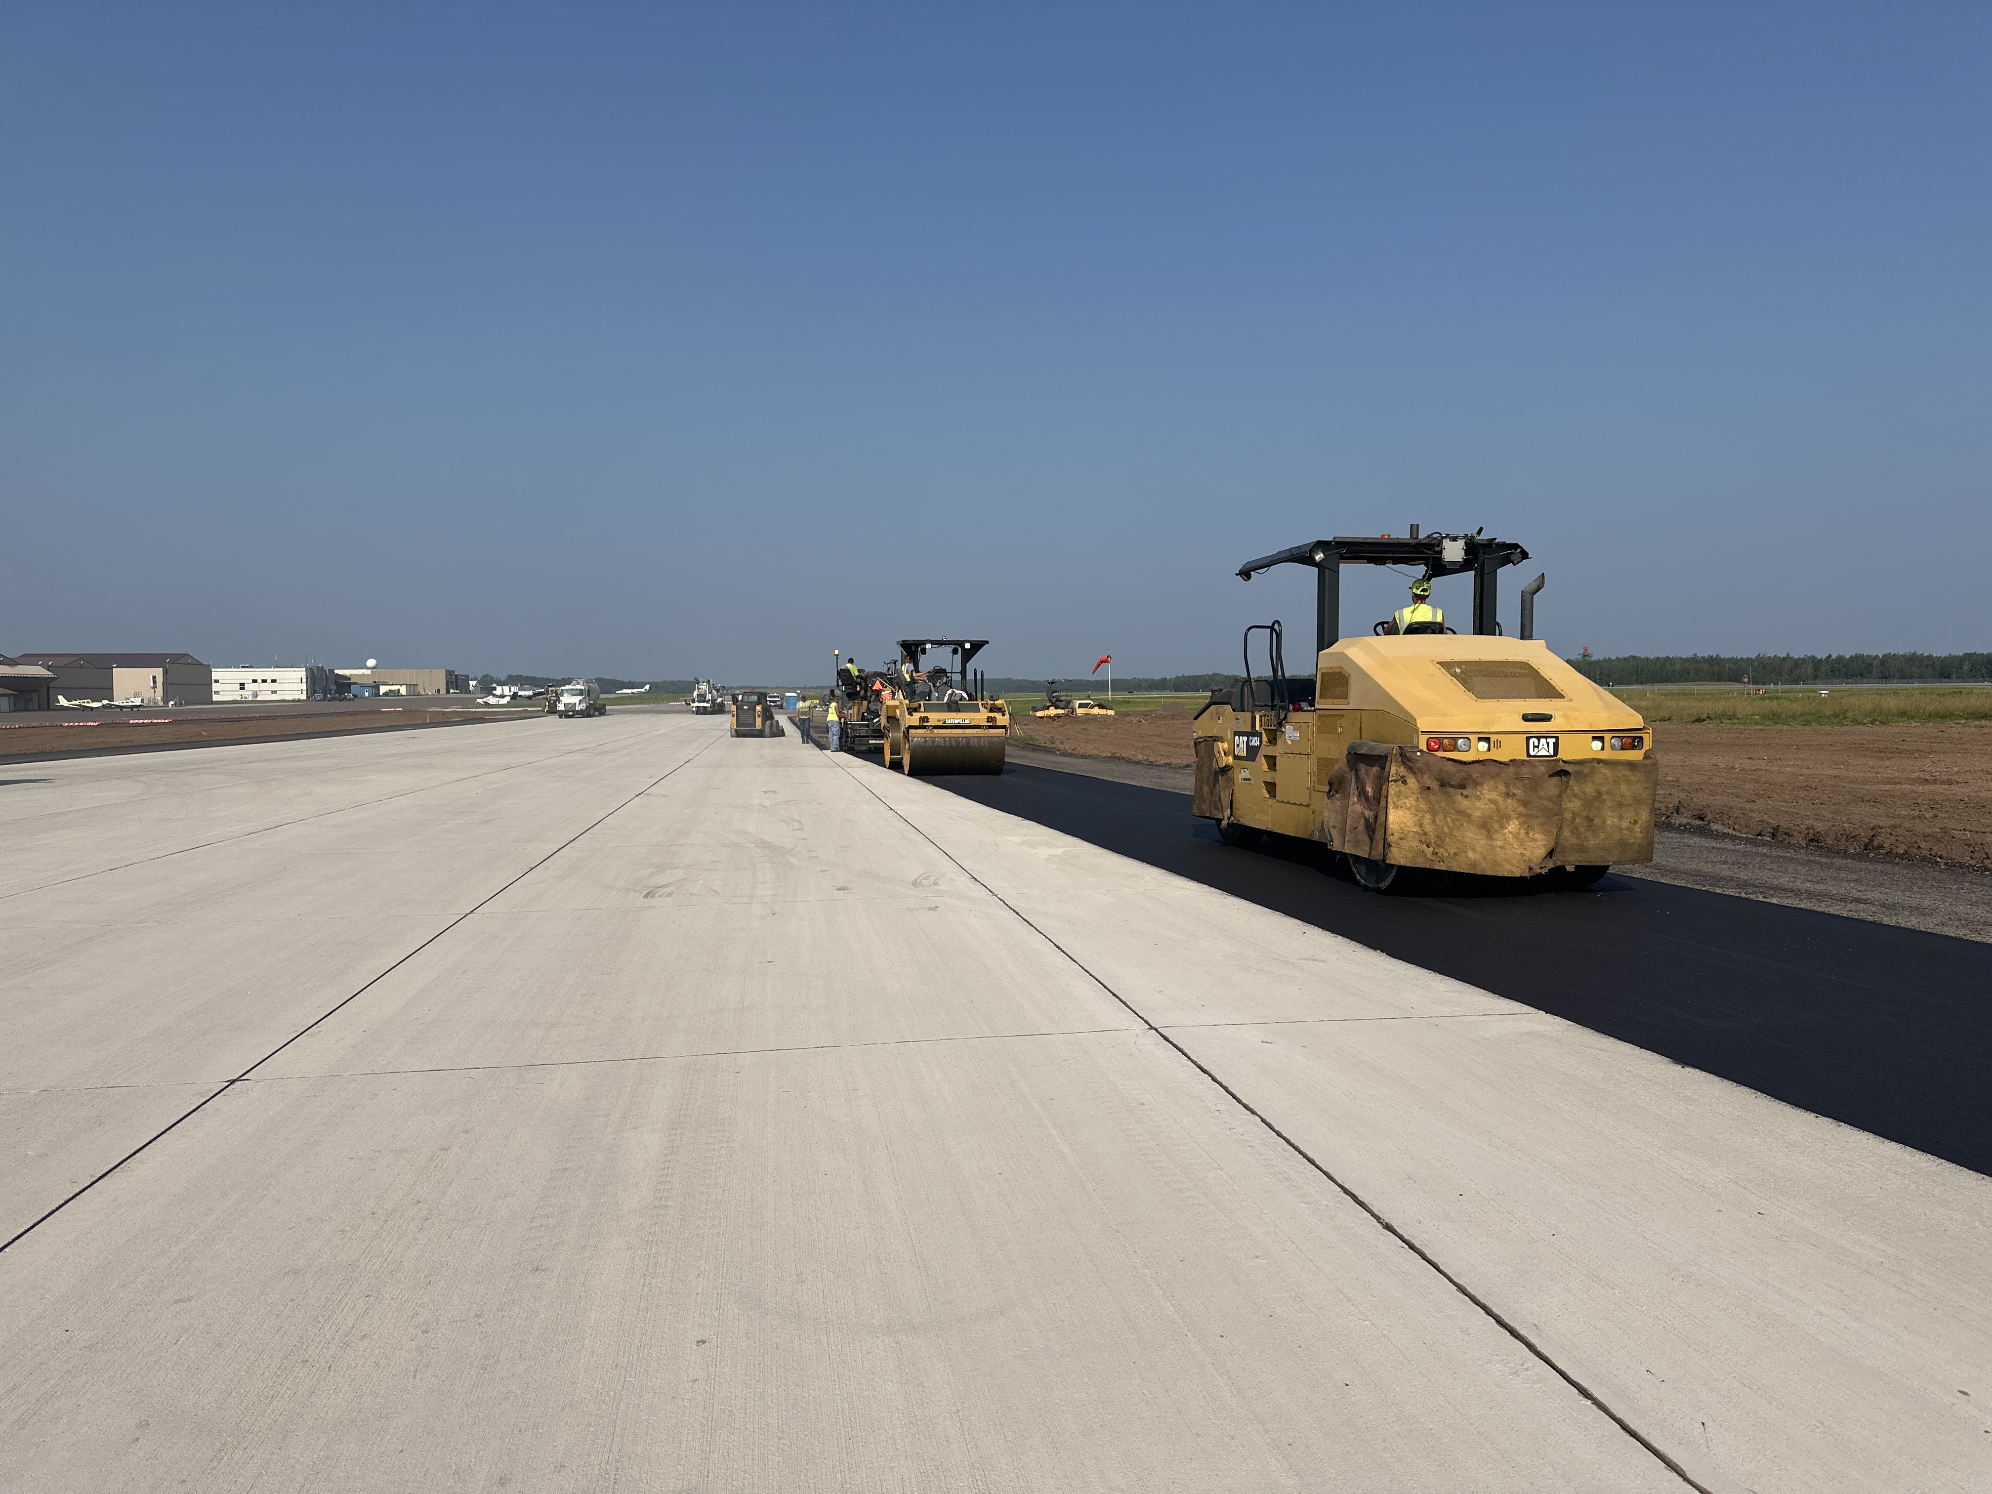
Photos
Mainline Paving - Concrete
Shoulder Paving - Bituminous

Slide 7
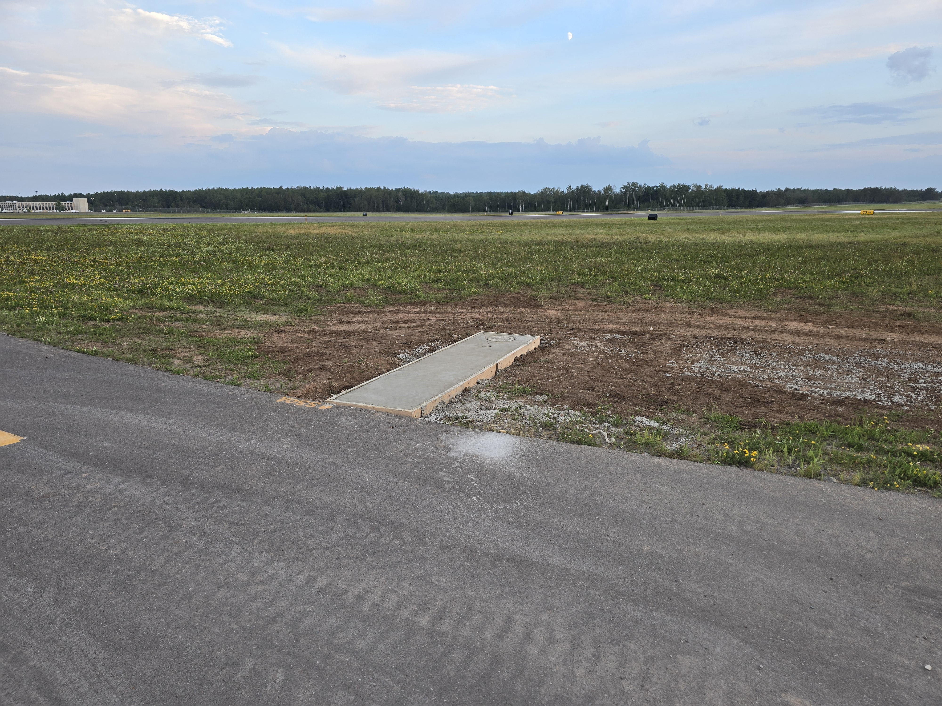
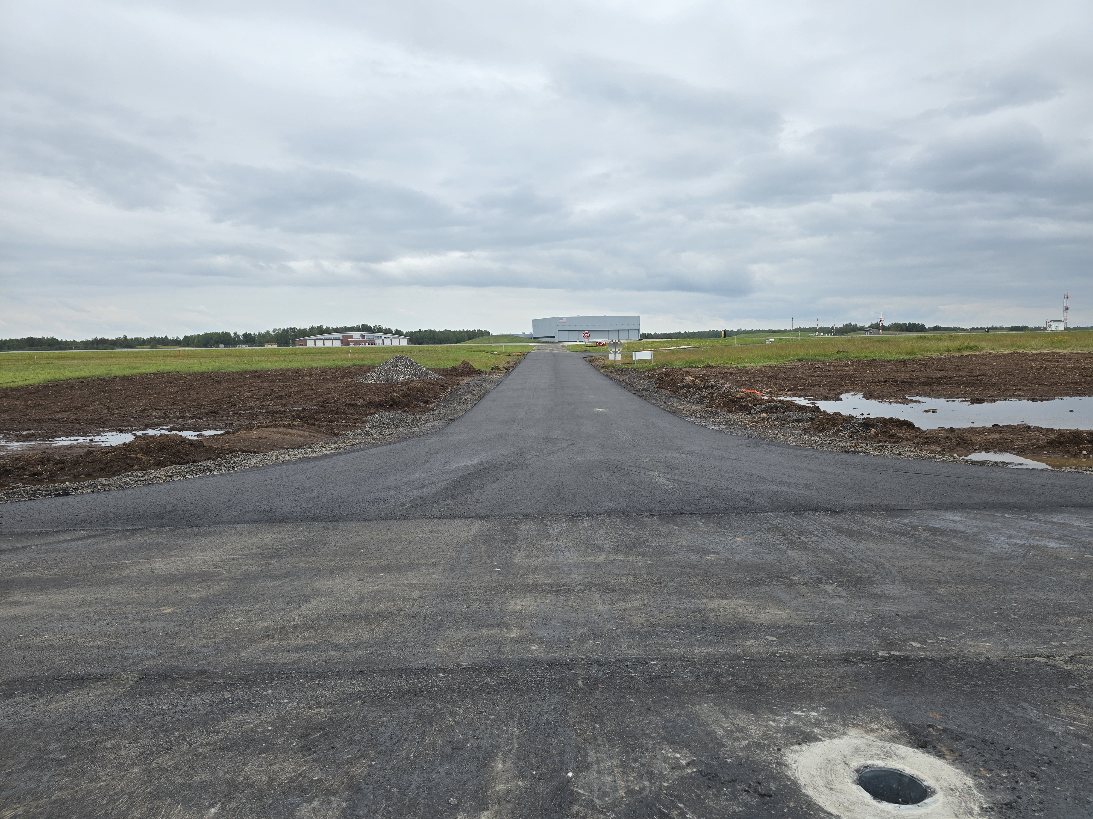
Photos
Airfield Guidance Sign
ANG Barrier Road

Slide 8
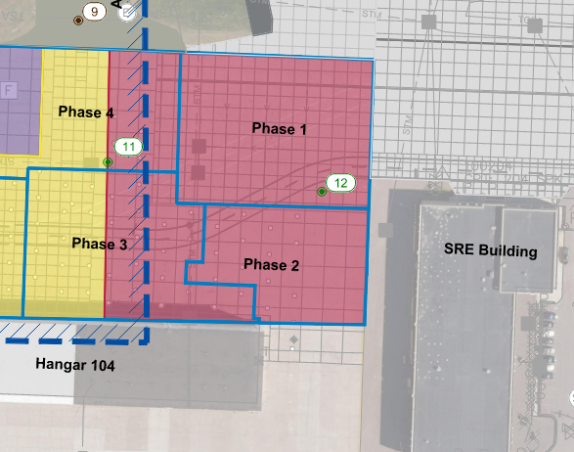
I. Resolution to Approve Work Order 2024-11 between Short Elliot Hendrickson, Inc and the Duluth Airport Authority for the Design of Midfield Ramp – Phase 3.
Project Description – This work scope includes final design, plans and specifications development, bidding documents, and bidding for the Phase 3 portion of the Midfield Ramp Repair. Portions of the pavements on the Midfield Ramp are in the poorest condition, requiring full reconstruction. The project will include drainage improvements and coordination around adjacent hangars.
The contract amount is $142,500.00
The project is projected to be funded with a MnDOT Grant at 70%, and the remaining 30% will be funded with the Passenger Facility Charge (PFC).

