Slide 1

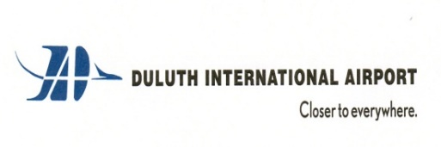
Duluth International Airport (DLH)
Airport Board Presentation | September 2024

Slide 2

Presentation
Key Industry Trends Air Service
Trends in Selected Upper Midwest markets
Essential Air Service (EAS) Program Update
State of DLH Air Service
Breeze Airways Update
UA/DEN service Update
By Airline Summary

Slide 3
Recent Key Industry Trends

Slide 4
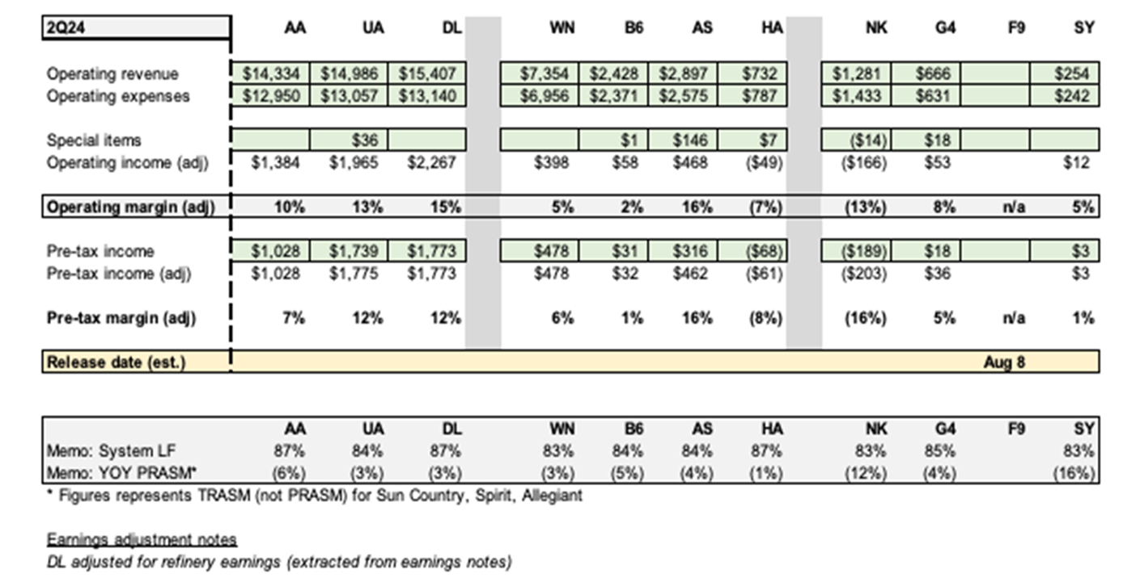
Biggest 2024 Change: Growth in premium travel relative to lower-end travel
Premium includes international travel.
UA and particularly DL benefit, while ULCCs are hurt.
DL: Main Cabin revenue flat yr/yr in 2Q24, premium revenue up 5.4%.
DL: 1/3 of revenue generated by premium cabins.
Is this a lasting trend?
Notes:
Note RASMs year/year –all down. Due to overcapacity, particularly to peak Florida destinations.
Also note extremely high BELFs – around 80% or more.

Slide 5
2024 might be remembered for airline industry operational difficulties – which is limiting capacity
Boeing, Boeing, Boeing…..
Really impacted Southwest Airlines, with other airlines also impacted. Southwest has also had some very high visibility “near misses”.
Rolls Royce engine problems have grounded a high % of specific airline fleets, particularly ULCCs Spirit and Volaris.
Even #1 airline Delta had a recent meltdown.
There were so many that we’ve probably missed some. Still, this is likely a relatively short-term series of events and won’t last long-term.

Slide 6
#1 Trend: Pilot Shortages. Improved in 2024 and a return to normalcy appears likely (18-24 months)
By October, regional airline capacity is within 11.5% of 2019 levels. This trend will continue over next 18-24 mos.
Notes:
Regional pilot shortages have improved and is believed to be behind us going forward; other factors are now impacting these trends more heavily….

Slide 7
#2 Trend: Significant airline operating cost increases – no change yr/yr, but driving larger industry trends…
Pilot salaries: Roughly 40% increase vs 2019.
Oil prices are more moderate in 2024.
Larger aircraft mix, resulting in higher trip costs.
Even larger RJ aircraft will be more challenged – bad for smaller markets
Air fares will have to go and stay higher, particularly on smaller aircraft.

Slide 8

Regional Jet dynamics serving relatively smaller markets are changing significantly
* Source: Diio Mi; Large RJs 65-76 seats, Small RJs 50 seats.
Shift to larger RJ flying is in full force.
Large RJ flying focused upon relatively longer haul flying due to economics. Only 19% of large RJ flying is on hauls >700 miles.
Notes:
Being driven by customer service and operating cost increases.

Slide 9
#3 Trend: Shifting towards larger aircraft
CAGR: 0.8%
CAGR: 1.8%
Notes:
Recently digesting some of rapid increases due to larger RJs re-entering fleet. This probably last another year or 2 and the growth continues.

Slide 10
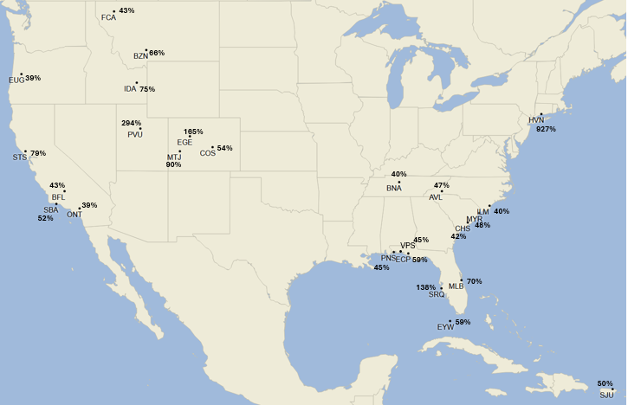
#4 Trend: Shifting of traffic to markets that are growing (migration) & generally leisure-oriented…
25 Fastest Growing U.S. Airports*
Departing Seats: 2Q24 vs 2Q19
* Of top 200 airport (seats)

Slide 11
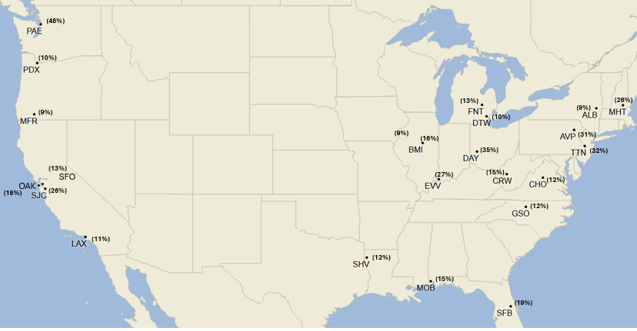
Airports with declines being impacted by various factors*
25 Airports with the largest seat capacity declines*
Departing Seats: 2Q24 vs 2Q19
* Factors
G4 Focus cities seeing reductions: PIA, FNT, SFB, although the culprits are mostly UA and AA – not G4.
SF Bay: Reduced corporate travel (which is now coming back) & appeal of SF for leisure travel.
PDX/LAX: Reduced leisure appeal, AS slower in rebuilding.
DTW. DL slow in returning regional service to DTW & MSP.
Most of rest generally in slower growing economic regions or carrier-specific growth.
PIA
* Of top 200 airport (seats)

Slide 12
Largest airports are seeing similar trends, although carrier strategic plans impacting; this is starting to change…

Slide 13
Post-COVID: Fastest growing airports now starting to normalize; tied in-part to slowing leisure demand
AA starting to bring PHL & ORD capacity back.; CLT still growing. AA & UA slowly bringing more ORD back.
Some of top growers over past few years now “digesting” some of that growth (BNA, AUS, etc.).
Notes:
This also ties to relative under-performance of ULCCs noted on 1st slide.

Slide 14
#5 Trend: Leisure demand outpacing business travel – this has evolved over the past year.
Last Year
Current
In general, while improving business travel is still 20% below 2019 levels
Large auto maker: Domestic back to 2019 levels, although international still down 20% (Europe) to 30%+ (Asia and Latin America)
Select high tech companies starting to travel again (Microsoft), while many others are still well below 2019 levels
In general, domestic travel weakening of late, although still above 2019 levels (thanks to strong leisure travel); Europe very strong of late with Asia still weak
In general, business travel is at/near 2019 levels but is “uneven”.
Same auto maker: 2024 domestic +2% vs 2019, Asia +4%, Europe +1% & Mexico +5%; 2025 expected to approximate 2024.
Select high-tech companies travel up significantly in 2024, but still uneven.
Domestic leisure travel has deteriorated throughout 2024, particularly lower-end demand (premium demand still strong). 2nd tier markets still growing, major destinations (MCO) slowing.
Notes:
Auto maker (Ford); tech commentary function of Alaska comments

Slide 15
#6 Trend: ULCCs growing much faster than network airlines; this continued earlier in year, but with ULCC margin deterioration…
Relative ULCC growth driven by first few months of 2024…
ULCCs almost exclusively cater to leisure passengers
Notes:
#3 Industry Trend (which is tied to #2 trend and is the continuation of a longer-term trend): Relative growth of ULCCs as compared to network airlines. This likely continues in long-run.
#3A Industry Trend. Network airlines shift to larger aircraft
Fastest growing airports generally benefitted from ULCC growth and/or a start-up airlines (Breeze or Avelo).

Slide 16
… this fall will see some dramatic changes in capacity

Slide 17
Summary: What Changed over the past year
Aircraft delivery problems (mostly Boeing); this has been a major problem over past 2 years - at some point this likely improves.
Relative strength of premium customers relative to lower-end consumers which subsequently benefited airlines focused upon higher-end consumer.
  Winners: Delta and to a lesser degree United; American benefited marginally.
  Losers: ULCCs, particularly those at the lowest end (Spirit).
  Will this last?
Regional Airlines have (mostly) started to put pilot & resource shortages behind them; most of this improvement will be seen over next 18-24 months.

Slide 18
Where industry is headed over next 5+ years
Air fares will likely go materially higher due to much higher airline cost structures. Airlines will either directly raise fares or cut capacity – resulting in higher air fares.
Leisure travel likely continues to outpace business travel.
While arguable, ULCCs will likely continue to grow faster relative to network airlines; also, mainline airlines will outpace regional airlines.
The big question: Will customer segmentation continue, with airlines more focused upon premium (and international) passengers?
The result will be that relatively smaller communities will likely experience constrained/reduced air service (& relatively higher air fares).

Slide 19
Regional Air Service Trends

Slide 20
Regional Airports: While still lagging U.S. growth, 2024 year/year changes were more comparable
Notes:
Wisconsin, Michigan & Minnesota have seen worsening capacity trends as compared to other regional airports and the rest of the U.S. – particularly when compared to fast growing sunbelt markets (where ULCCs are more focused, too). This is somewhat tied to DL – when ranking top 30 airports, 3 of the worst in terms of capacity declines are MSP, DTW and to a lesser degree, ATL.
Above comment from last year. While these under-performers have improved, they’re still lagging.

Slide 21
Relative capacity trends regionally are largely driven by relative ULCC changes
Notes:
ATW, DSM & GRR: Benefiting from G4 (ULCC) growth.
Negative network trends being driven by DL & UA. DLH is not alone.

Slide 22
The relative share of low-cost carriers greatly impacts air service (and fares) – very similar to last year

Slide 23
Essential Air Service (EAS) Update

Slide 24
What is Essential Air Service (EAS)?
Federally subsidized program that subsidizes air service in what are deemed “Essential” markets.
Subsidized through the U.S. Department of Transportation (DOT).
Guarantees 2 daily weekday trips.
Carriers bid, with community input weighing heavily on DOT decision.
Minnesota is one of largest EAS states, with service to 5 markets: BJI, BRD, HIB, INL and TVF.

Slide 25
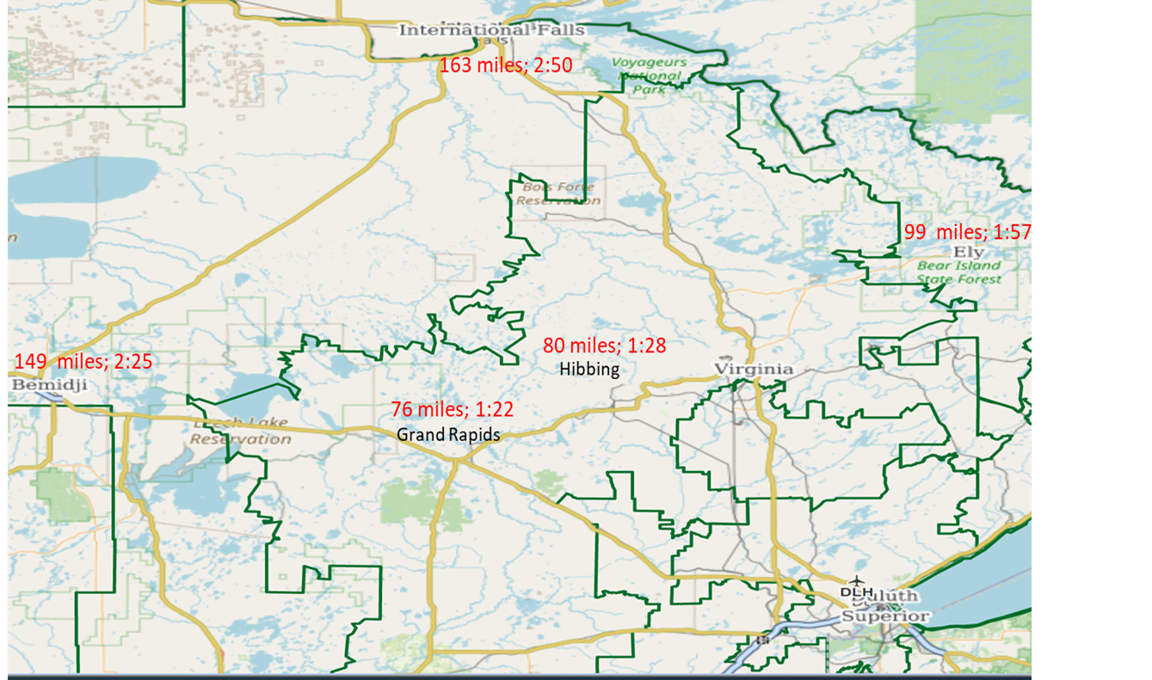
EAS is potentially important to DLH given DLH’s proximity to many of these airports
* Peak: 1998, 1999 or 2000; GPZ was not an EAS market

Slide 26
USDOT Shot Down SkyWest Plans Noted Last Year
SkyWest has/is the dominant EAS provider
  Considered by far the best regional airline in the industry
  But SkyWest will no longer bid on EAS contracts as a Part 121 airline (50-seaters)
  Instead, SkyWest will only consider flying EAS as a Part 135 carrier: 50-seat CRJ configured for 30-seats
It is far from certain that DOT will approve SkyWest flying as a Part 135 carrier
What this means for EAS regionally
  Best case: 40% less seat capacity and operating costs (subsidies) roughly doubling
  Even the best case will be a 40% reduction in seats (& it will likely be worse)
  If Part 135 airline is taken out of the equation, EAS markets will either be served by single engine, 8-seat turboprop aircraft or more likely via ground transportation (Landline)

Slide 27
EAS Update: Insanity
Regionally, DL Connection will continue operating under EAS, but with a CRJ-550 aircraft.
  CRJ-700s configured for 50 seats (to stay under Scope Clause).
  Basically, putting the cost structure of 70/76-seat planes on a 50-seat aircraft.
  Subsidies regionally will approximately double as new EAS contracts come out.
Nationally, mainline carriers are now bidding on EAS contracts.
  Sun Country (SY), American (AA), JetBlue (B6) & Breeze (MX) to name a few.
  SY flies EAU to MSP & Florida; B6 will fly from Presque, Maine (PQI) to BOS & MX from Upstate NY to IAD.
  Last PQI EAS contract was a $10.8 million annual subsidy with UA flying to EWR on a CRJ-550.
As of 2023, EAS program had subsidies totaling $411 million (not including Alaska or Puerto Rico); it is going to skyrocket going forward.

Slide 28
The State of Air Service at DLH

Slide 29
Pre-COVID: DLH passenger volumes were up almost 26% from 2017 to 2019, with early 2020 up almost 50%

Slide 30
Post-COVID: DLH 2024 seat capacity will be down about 21% vs 2019

Slide 31
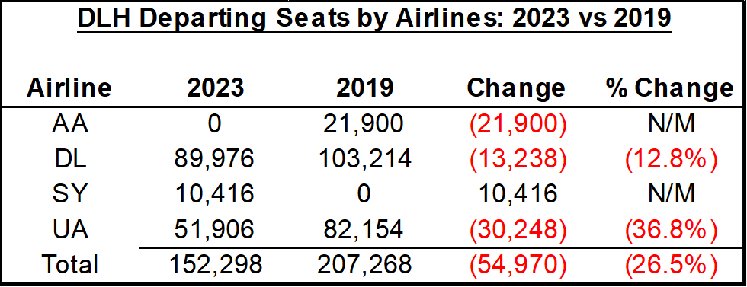
Most of declines vs 2019 are being driven by UA and AA

Slide 32
DLH LFs & Yields have generally been solid
2024 fares are down year/year
Notes:
I might change this one up

Slide 33
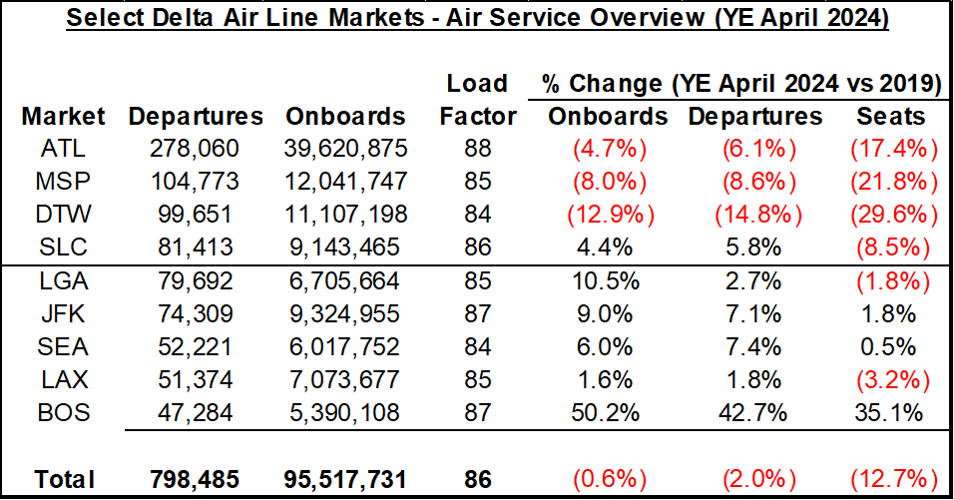
DLH has been heavily impacted by DL’s focus away from interior hubs post-COVID

Slide 34
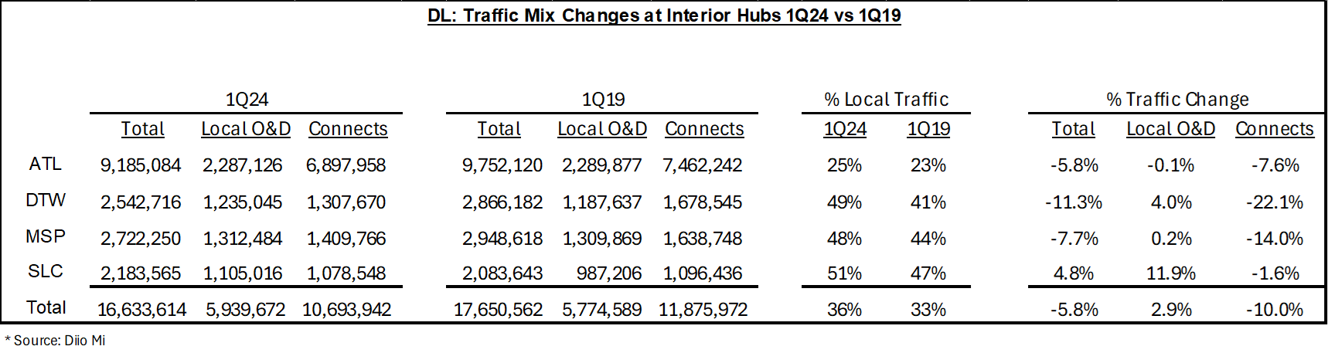
This has resulted in big connecting traffic reductions, particularly at their DTW & MSP Hubs

Slide 35
DLH is not alone for DL/MSP – big connecting traffic declines are generally across-the-board
*Source: Diio Mi; note that these include double connections – prior slide does not.

Slide 36
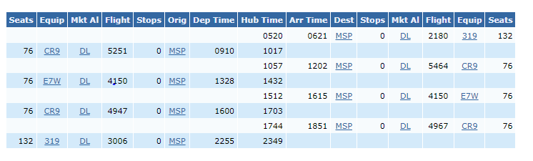
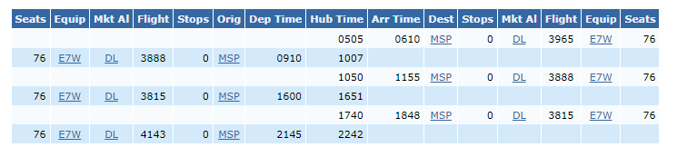
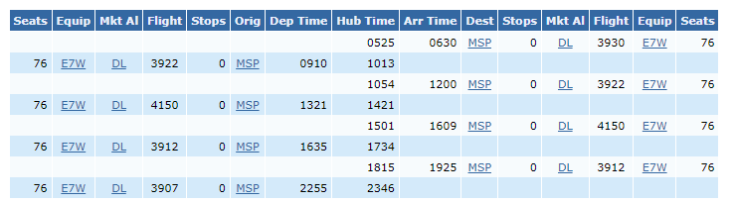
DL’s schedule during 2H24 indicates a return to normalcy is in place
August 2024
March 2024
October 2024
August 2024 seats up 7.4% vs August 2019.
October 2024 seats down 3.8% vs October 2023.
March 2024 was down 17.7% vs March 2019.

Slide 37
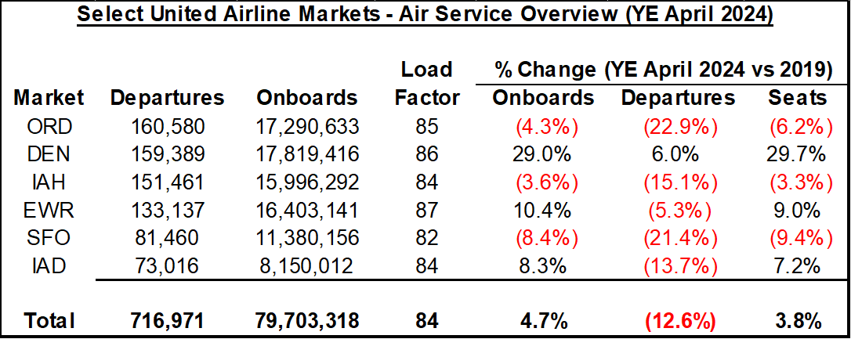
UA’s hub moves have not been as drastic as DL’s, with the exception of big growth at DEN

Slide 38
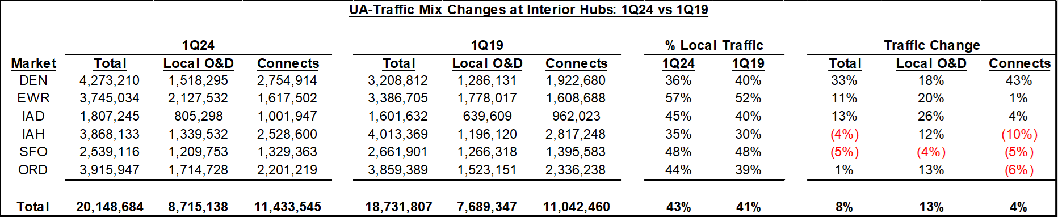
Likewise, UA connecting traffic at ORD is only down moderately

Slide 39
While overall UA’s ORD connections are only down moderately, DLH has been hard hit
*Source: Diio Mi; note that these include double connections – prior slide does not.

Slide 40
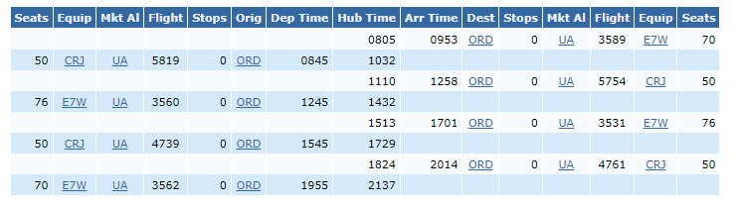
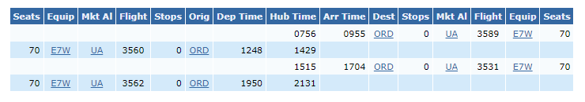
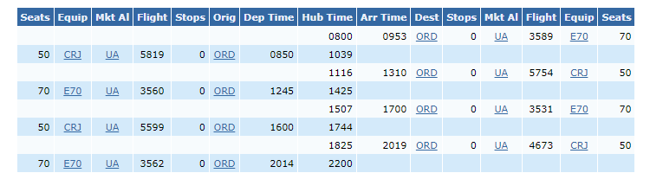
UA capacity has been improving, particularly at peak season, but has further to go at DLH
August 2024
March 2024
October 2024
August 2024 seats down 6.8% vs August 2019.
October 2024 seats down 12.6% vs October 2019.
March 2024 was down 36.3% vs March 2019. 2x service badly impacts connectivity.

Slide 41
Breeze Airways Update

Slide 42
Breeze Overview
Experienced management team, led by successful airline entrepreneur David Neeleman; key team members largely ex-Allegiant.
Has been profitable the past few months.
Offers a superior product experience at relatively low air fares.
Growing: Breeze is receiving 1 A220-300 aircraft per month through 2028. Just made a rash of new service announcements.
The right aircraft: 3 cabins with 137 seats vs 189 seats with one class for other ULCCs.

Slide 43
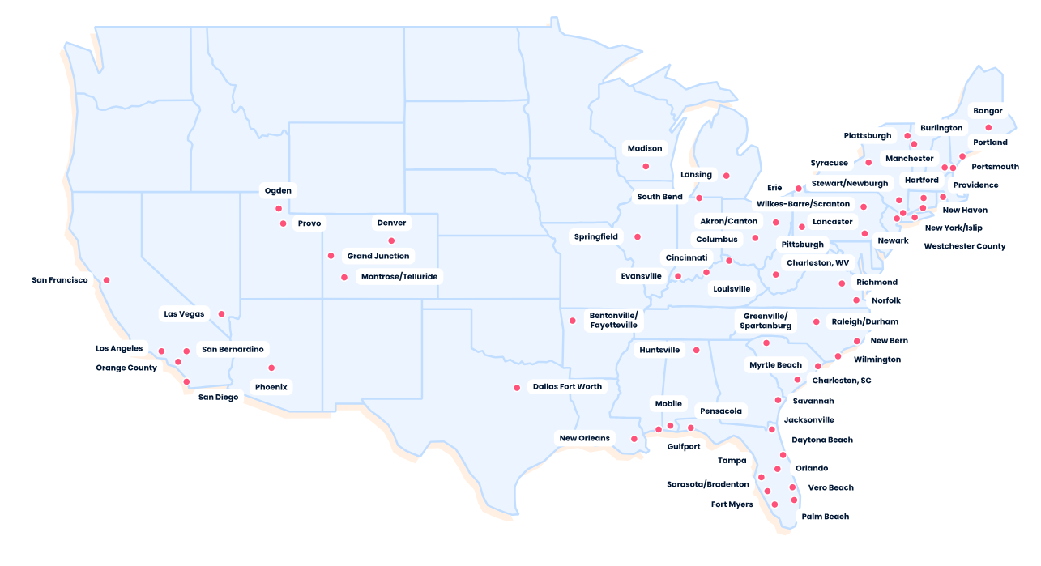
Updated Breeze Route Map: Many new markets since we last met

Slide 44
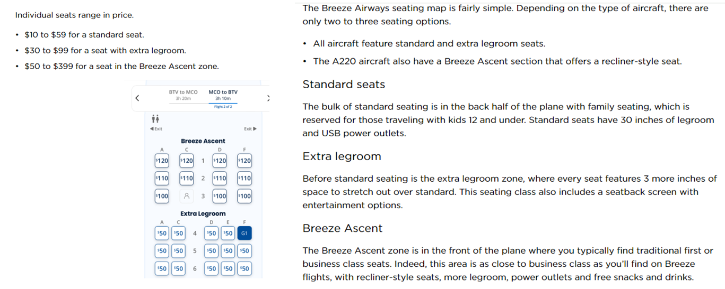
Review: Breeze product in-line with DL Offerings

Slide 45
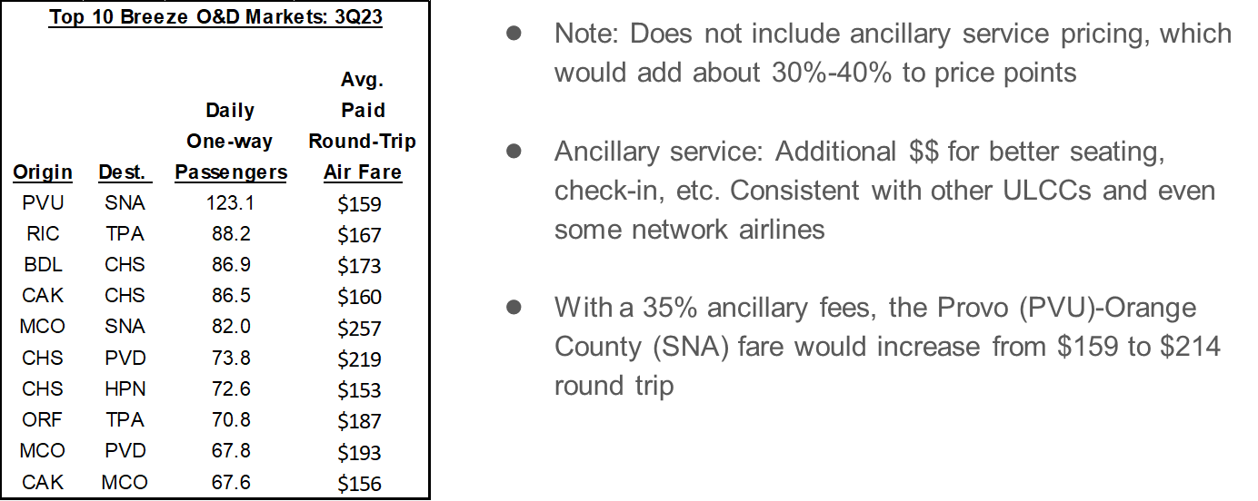
But at a much lower price point

Slide 46
Breeze P&L Estimates at historical G4 demand levels
During 1Q, MCO and PHX have consistent demand – not a lot of downside.
LAS demand is from YE 1Q15. LAS experienced considerable downside versus peak period(s).
Needed Breeze fare levels don’t appear excessive.
Should these work, Breeze could add additional markets.

Slide 47
Where does Breeze stand on DLH
There is some interest. Their concern is that the stage length is relatively long which drives relatively higher operating costs – particularly if fuel goes higher.
An indirect concern is the continued amount of ULCC service at MSP, although Sun Country is viewed differently than Spirit.
But there is a history. They know the market well.
A $1.5 million MRG gets immediate attention (fall/winter of 2025). A lesser amount ($500k+) gets attention, including marketing support.

Slide 48
United/Denver Service Update

Slide 49
With only regional service exclusively to west, there is ample demand regionally to support service

Slide 50
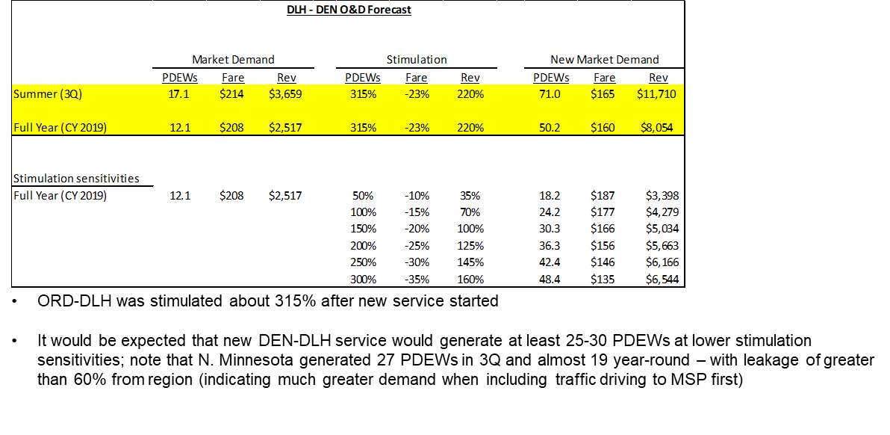
Given historical new market stimulation, DLH-DEN O&D market should generate roughly 50 PDEWs annually

Slide 51
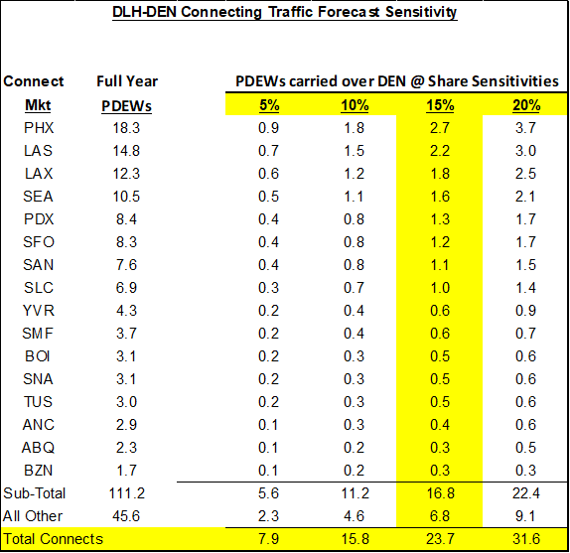
Baseline Forecast of about 53.7 passengers per trip or about an 83.8% LF on a CRJ-700
As noted on prior slide, estimating local DEN-DLH demand at 50 PDEWs
Assuming UA would garner 70% of local market, results in a forecast of 35 PDEWs for UA in the DEN-DLH Market
At a 15% share of regional connecting PDEWs, results in a connecting PDEW forecast of about 23.7 PDEWs
In total, 58.7 PDEW forecast for DLH-DEN service on 1x daily CRJ-700 service

Slide 52
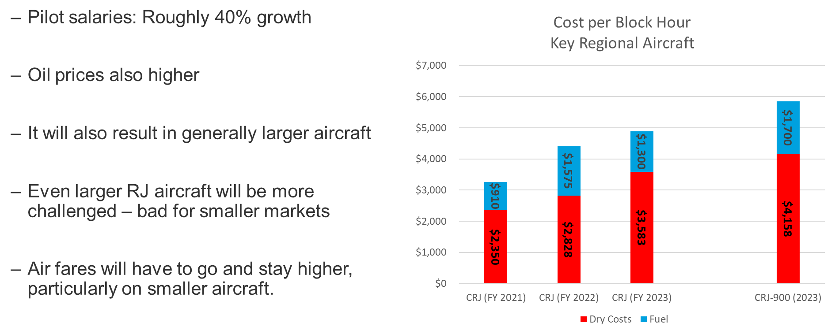
But as noted earlier, operating costs have increased significantly since UA/OO interest in route & SCASD award

Slide 53
Operating Costs are estimated to have increased by over $3.7 million annually on the DLH-DEN route
*Note: CRJ-200 operating costs are up $1.4 million; the larger gauge increases costs another $2.3 million

Slide 54
What UA/OO Needs for DEN-DLH
SkyWest has entertained similar opportunities for $1.5 million annual MRGs.
They’ve done MRGs as both Delta Connections and United Express, operating CRJ-200s and CRJ-700/900s (on roughly 550-mile hauls).
  Although Delta is no longer an option on CRJ-200s.
With excess inventory of CRJ-200’s, SkyWest is interested in CRJ-200 flying, but at 768 miles, DLH-DEN is a bit long for a CRJ-200.
My recommendation is to go with the CRJ-700/900 despite the operating cost increase.
Finally, we might have to consider seasonal flying to start.

Slide 55
DLH Air Service going forward:
Summary by Airline

Slide 56
Delta Air Lines
Delta’s recent schedules are basically back at 2019 levels at DLH as DL continues to re-build MSP (DLH is ahead of broader DL increases at MSP).
Since 2019, DL has seemed more committed to DLH and has generally backed that up with larger, multiple cabin aircraft – expect this to continue.
Likely that service is exclusively over MSP; DTW or ATL service is a long-shot.

Slide 57
United Airlines
UA has been the most impacted by pilot shortages; they’ve indicated that this is stabilizing and plans to bring some ORD capacity back in 2024.
  Update: This has occurred more slowly (at DLH & elsewhere) than expected.
  Cautiously optimistic about summer of 2025 getting back to 2019 levels.
UA: Adding a lot of mainline aircraft over next few years which likely results in downstream impacts upon smaller aircraft (meaning more growth is possible).
DEN service.
  SCASD/MRG helps support service.
  The sharp increase in operating costs makes the economics of flying RJs (even larger RJs) much more challenging on longer haul routes like DLH-DEN.

Slide 58
Sun Country Airlines
Year one (2021-22) PHX and RSW service met SY expectations.
PHX was pulled as SY re-trenched from making PHX a base.
RSW continues operating seasonally. RSW did well in 2024 operating a limited seasonal schedule.
SY initially had an interest in serving MCO and LAS after year one, although last year’s hurricane impacted results under-performed – including PHX.
SY’s future at DLH is not a given.

Slide 59
Other Airlines
Avelo Airlines: Growing start-up airline who has flown many non-traditional markets (like CWA) to leisure destinations in Florida & west coast.
Frontier Airlines: Given planned growth and their DEN hub, a secondary choice for DEN service (although a distant 2nd to what UA could provide).
American Airlines: Back-up for ORD service.
Final thought: #1 option for significant growth is likely Breeze Airways, but for business travelers, DEN-DLH on UA is probably the top choice.

Slide 60
THANK YOU!

