Slide 1
Operations/Construction/Projects/Planning Update
Duluth International Airport:
Air Traffic Control Tower
Taxiway A – Phase 3 Construction
Midfield Ramp Reconstruction – Phase 2
148th Back Stateside – 747, 747, 777, C17, C17
Customs and Boarder Protection (CBP) Federal Inspection Services Construction
Sky Harbor Airport:
General Aviation Terminal Construction – Substantial Completion
Snow Removal Equipment Building Construction - Substantial Completion

Slide 2
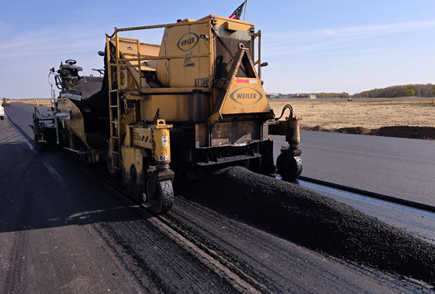
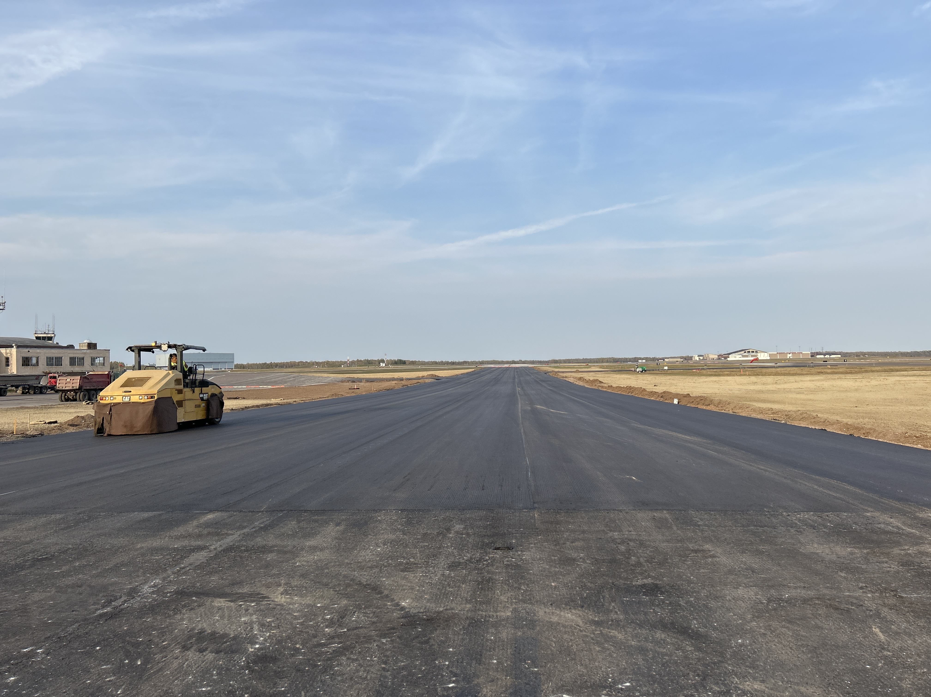

Construction Update – Taxiway C South – Finishing Up Construction

Slide 3
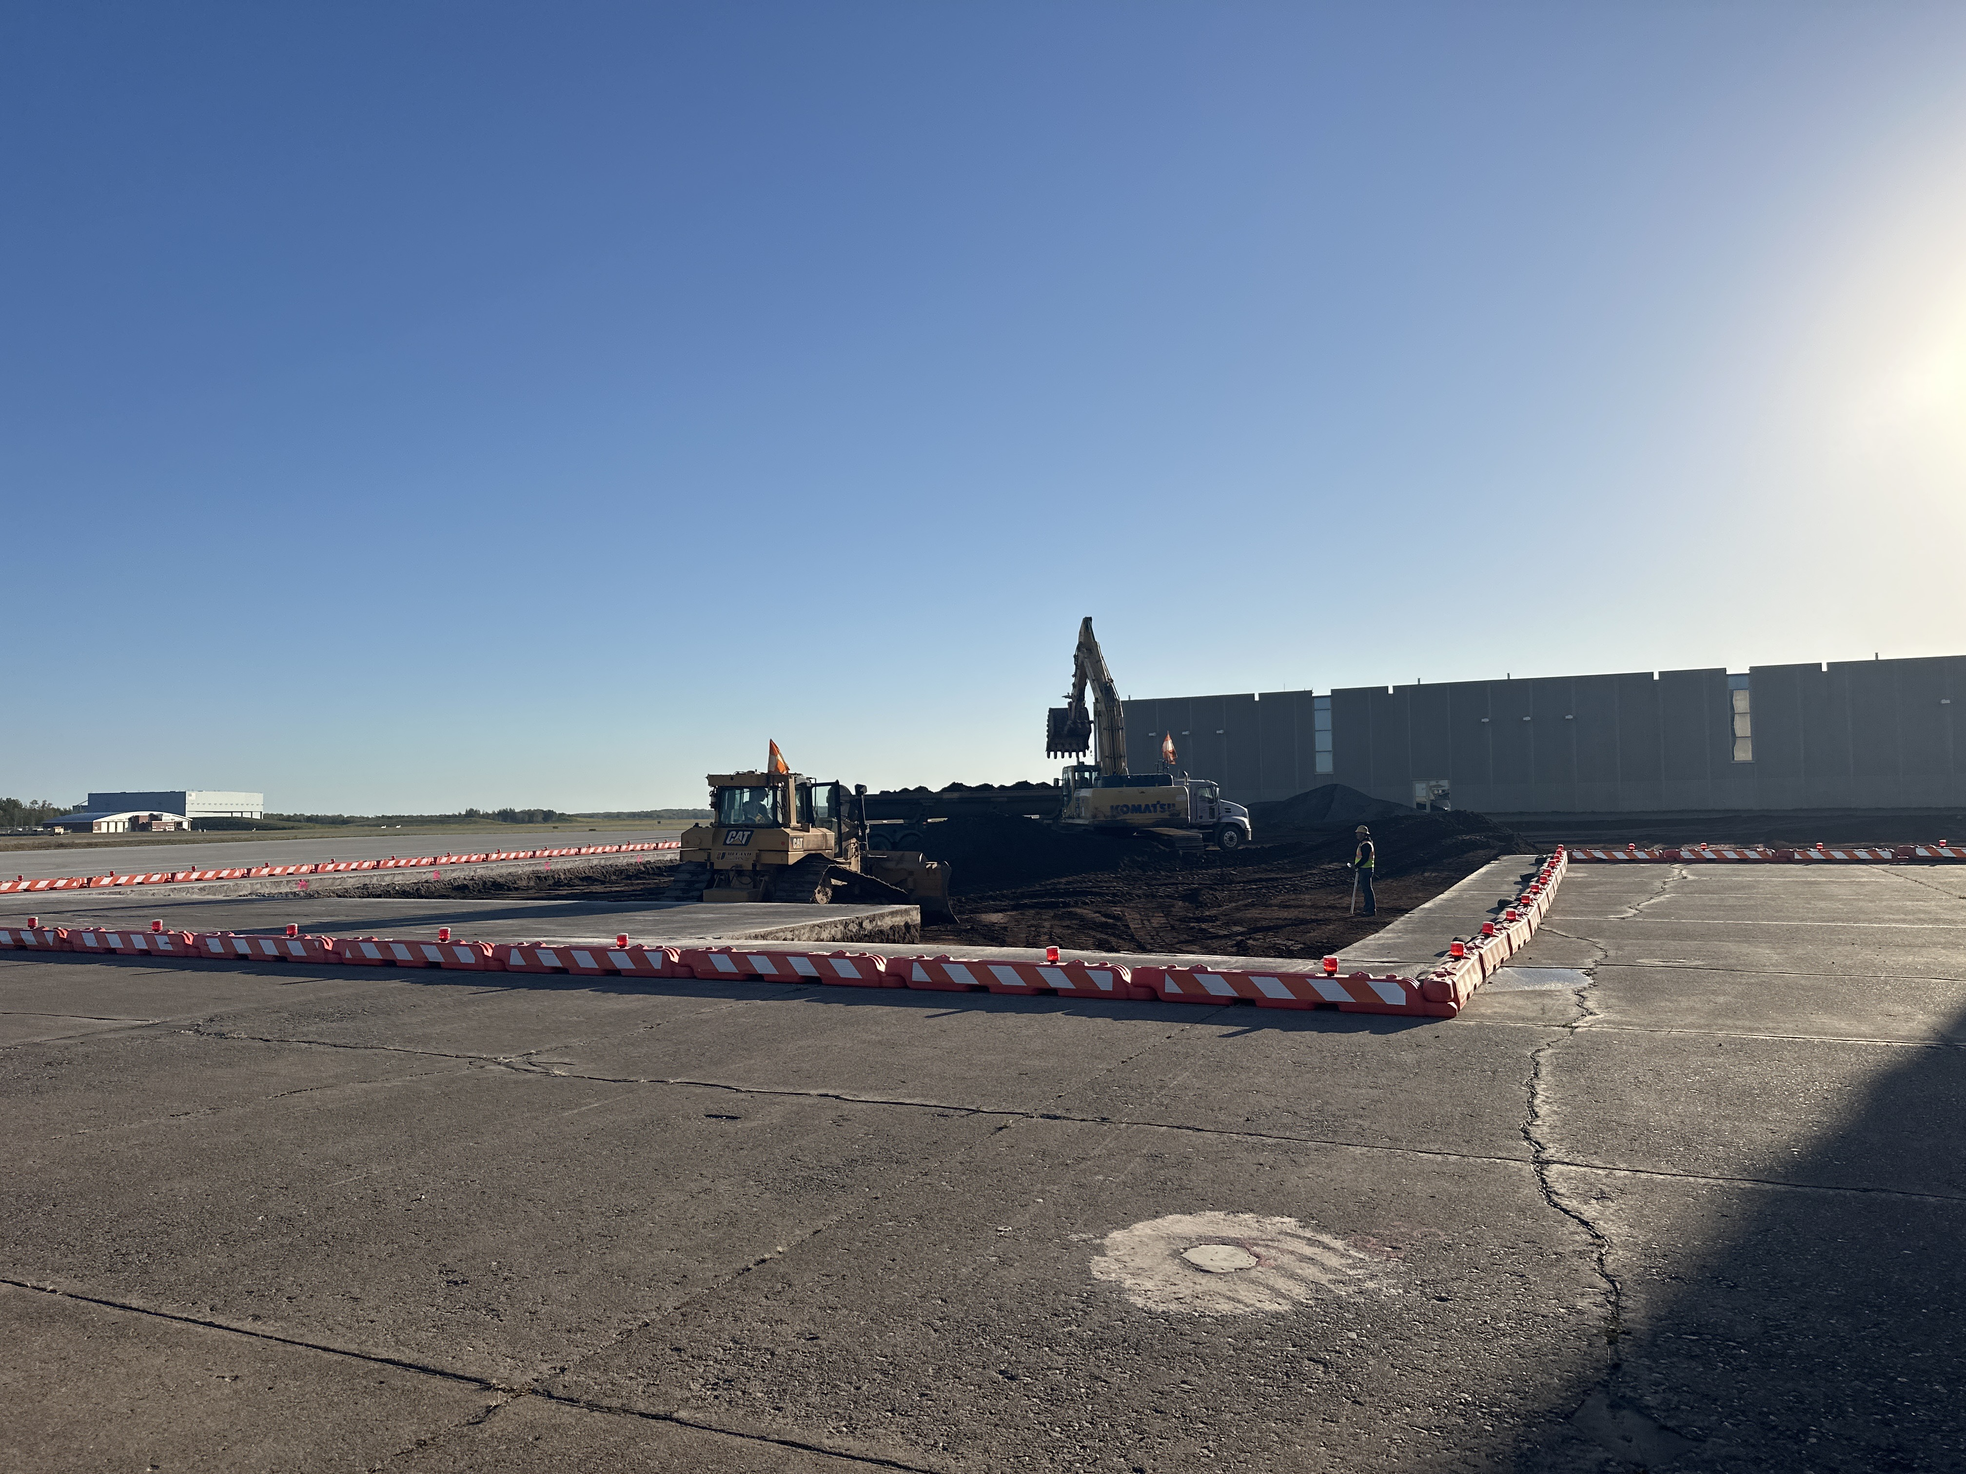
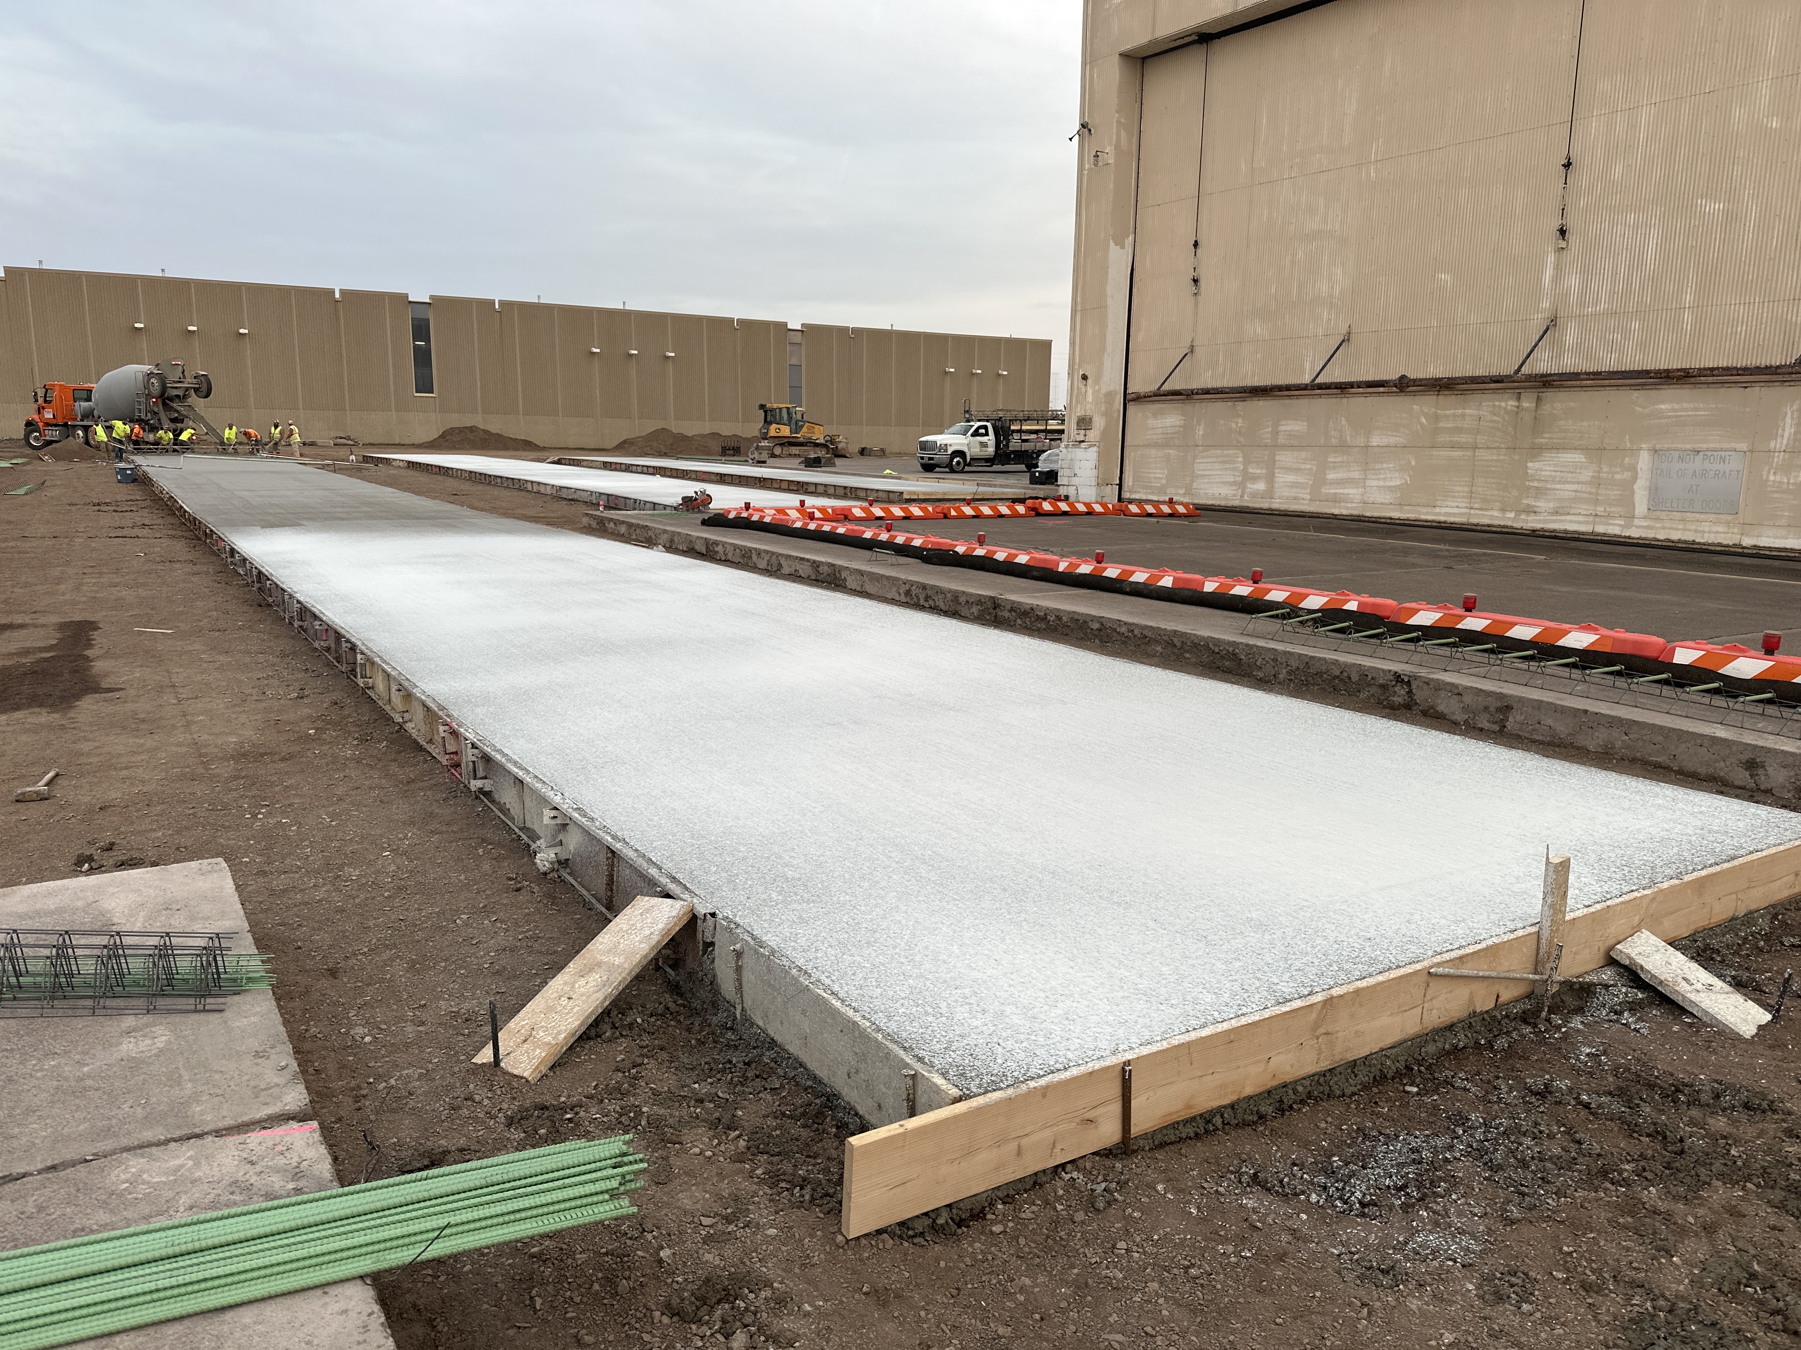
Construction Update – Midfield Ramp Phase 2 – Under Construction

