Slide 1
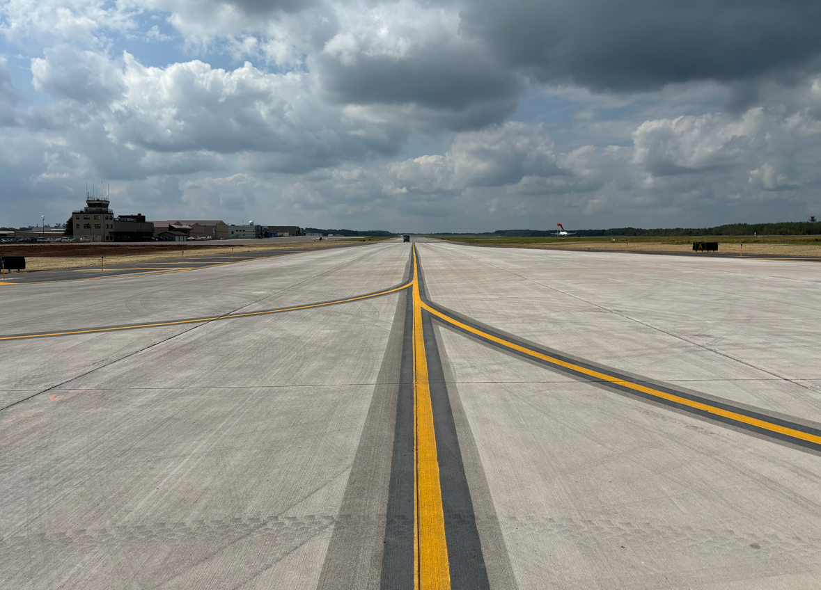
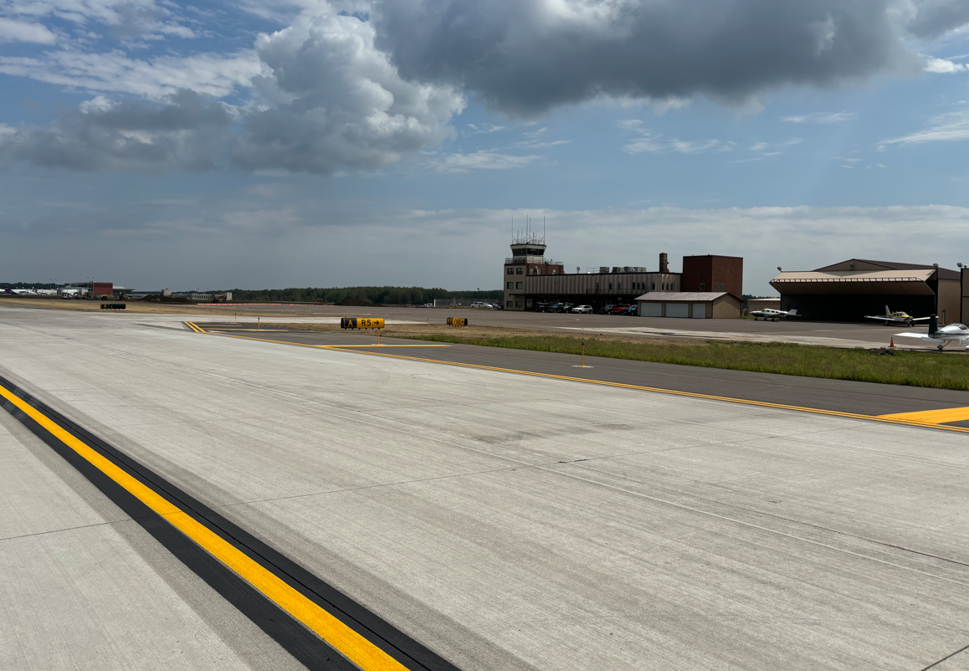

Construction Update – Taxiway A – Opened on August 26

Slide 2
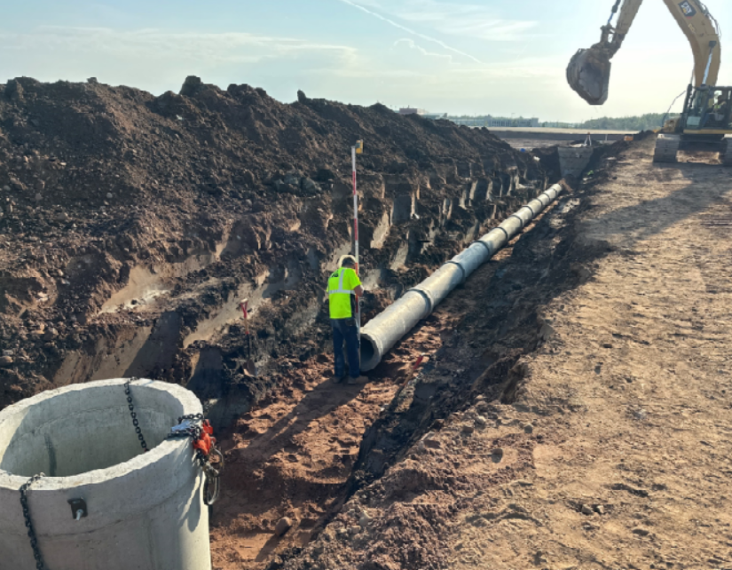
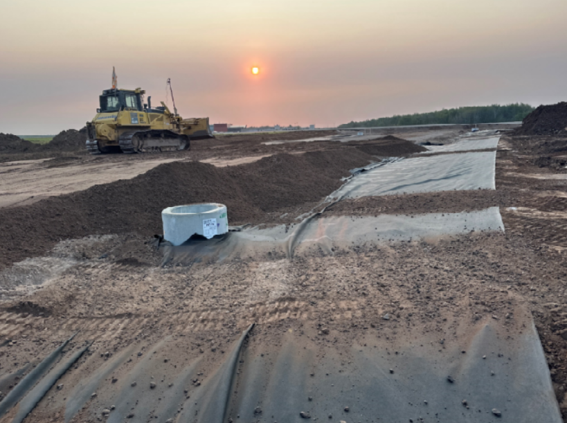
Construction Update – Taxiway C South – Under Construction

Slide 3
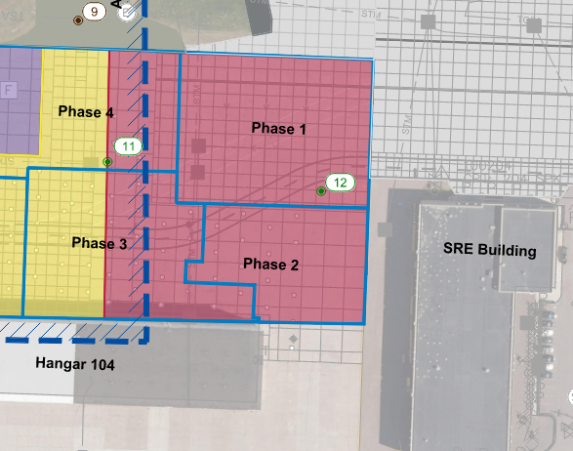
Construction Update – Midfield Ramp Ph 2 – Starting Construction
Construction starting September 23
The project will repair some of the pavement in the poorest condition on the airfield
The $1M in repairs include:
  New concrete pavement
  Surface and subsurface drainage improvements
  Pavement markings
The project is estimated to take 45 days

Slide 4
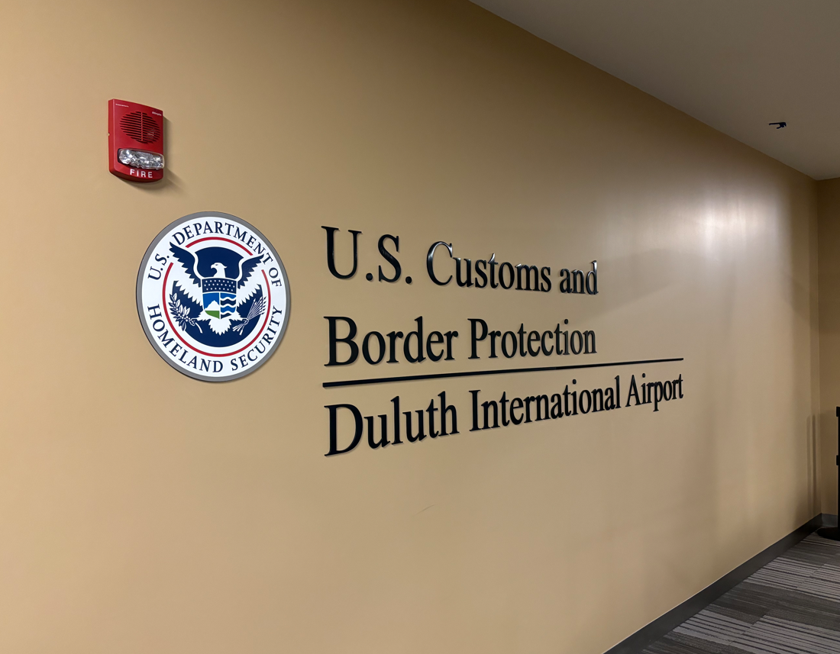
Project Update – Federal Inspection Services Renovation
Renovation of the Federal Inspection Service facility is required by CBP for the facility to be regularly used.
Project includes:
  Security enhancements
  Camera system installation
  Facility standardization
  Signage improvements
Project estimate is $800,000
The project is competitively bid through the City of Duluth, with a bid opening on Thursday, September 19 at 2pm.
Project will be considered at the October Board meeting

Slide 5
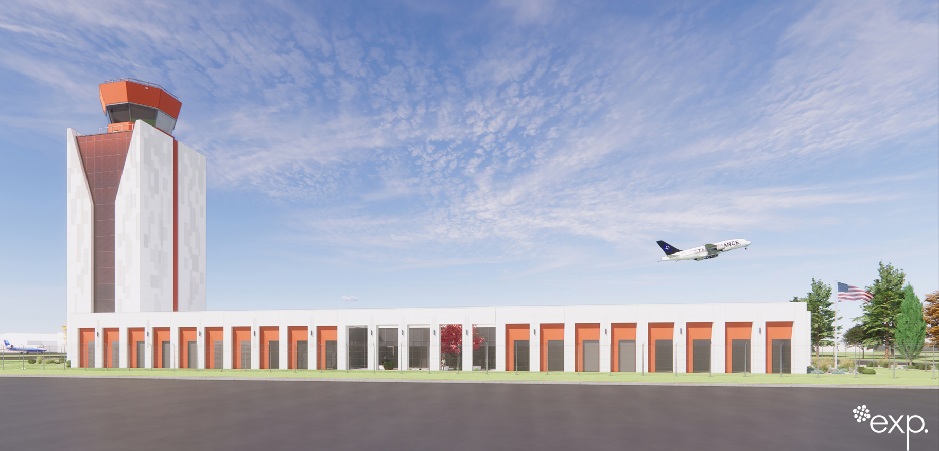
Project Update – Air Traffic Control Tower Design

