Slide 1
Operations/Construction/Projects/Planning Update
Duluth International Airport:
Air Traffic Control Tower
Taxiway A – Phase 3 Construction
Taxiway A – Phase 4 Construction Change Order
Midfield Ramp Reconstruction – Phase 2
Runway 3/21 Runway Repair
Customs and Boarder Protection (CBP) Federal Inspection Services Construction
Janitorial RFP Update
Blue Angel Winter Visit – Today

Slide 2
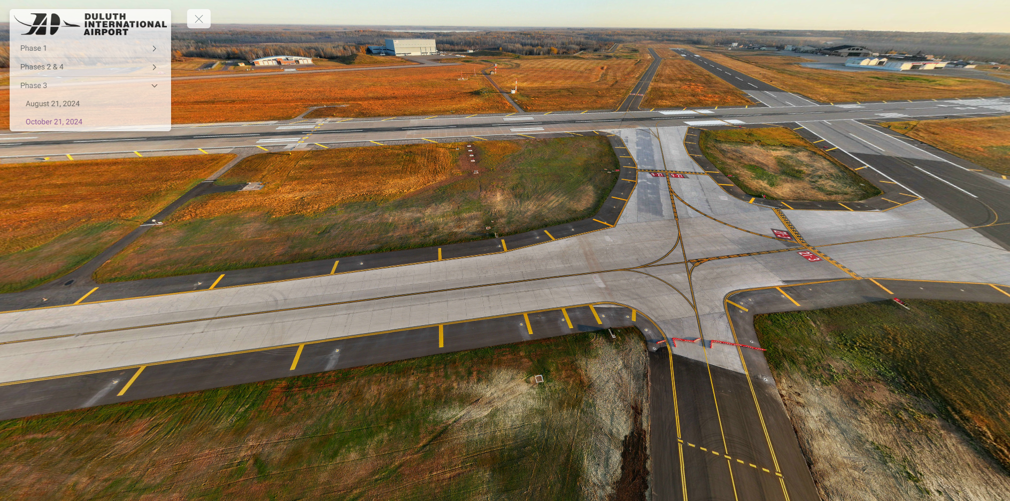
Taxiway A – Phase 3 Construction Update

Slide 3
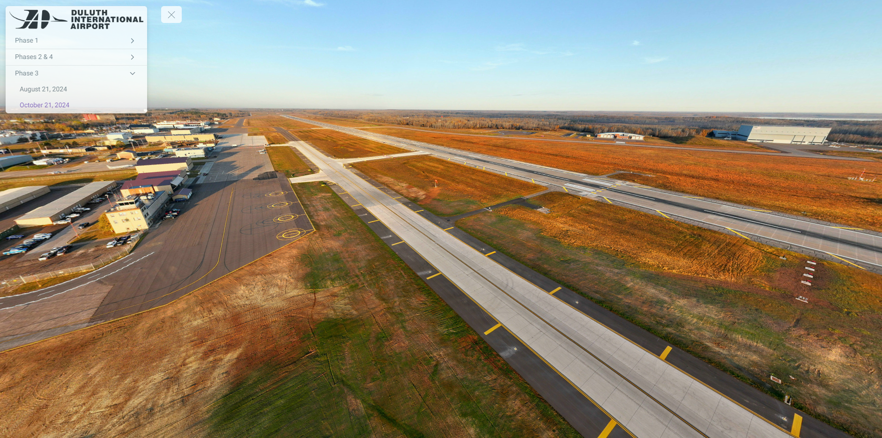
Taxiway A – Phase 3 Construction Update

Slide 4
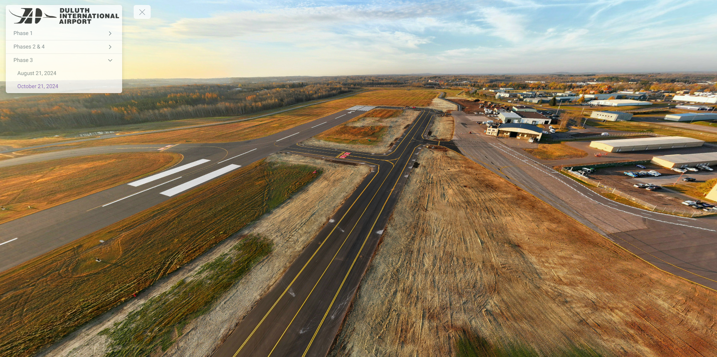
Taxiway A – Phase 3 Construction Update

Slide 5
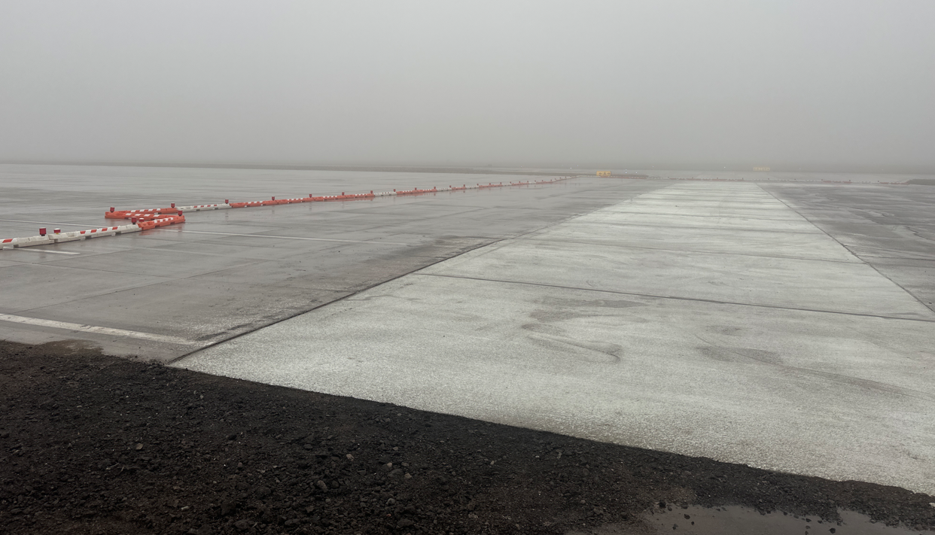
Taxiway A – Phase 4 Construction Update – Monaco Ramp Repair

Slide 6
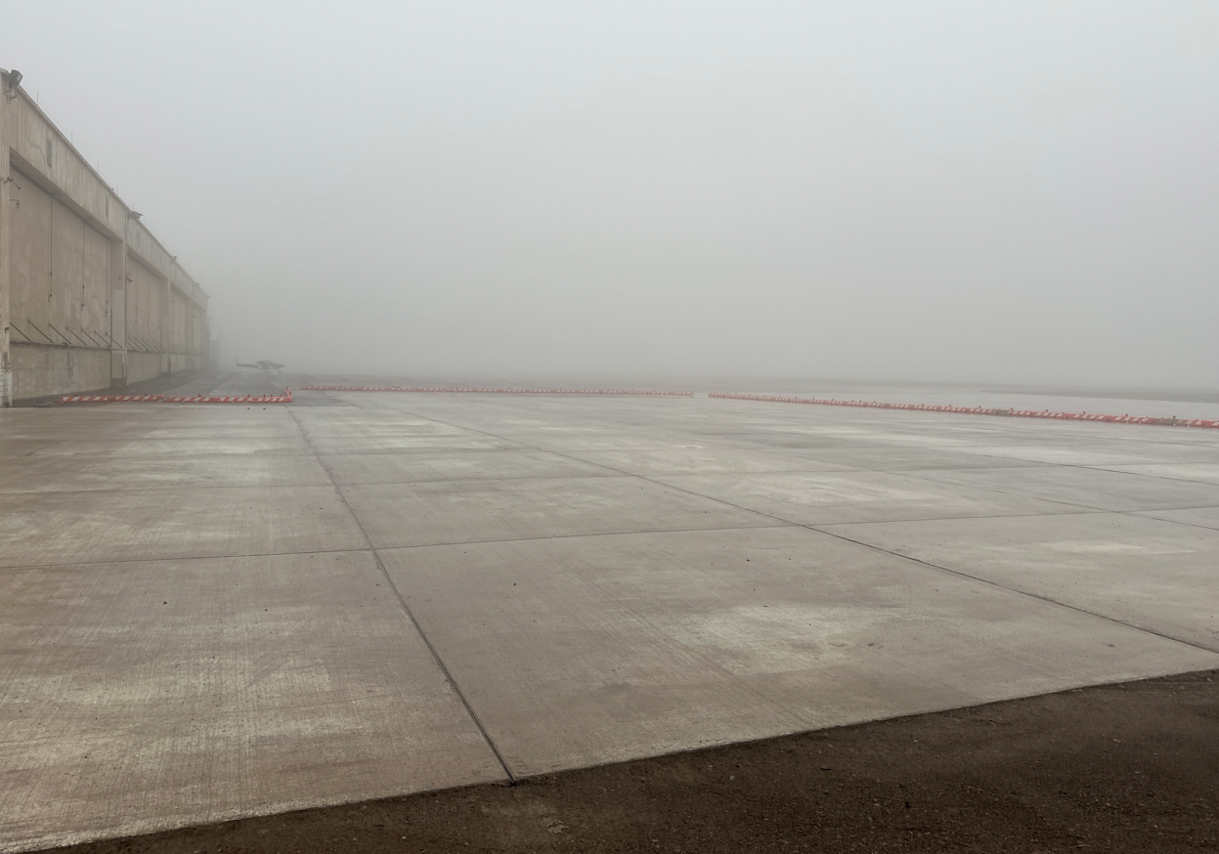
Midfield Ramp Repair – Phase 2

Slide 7
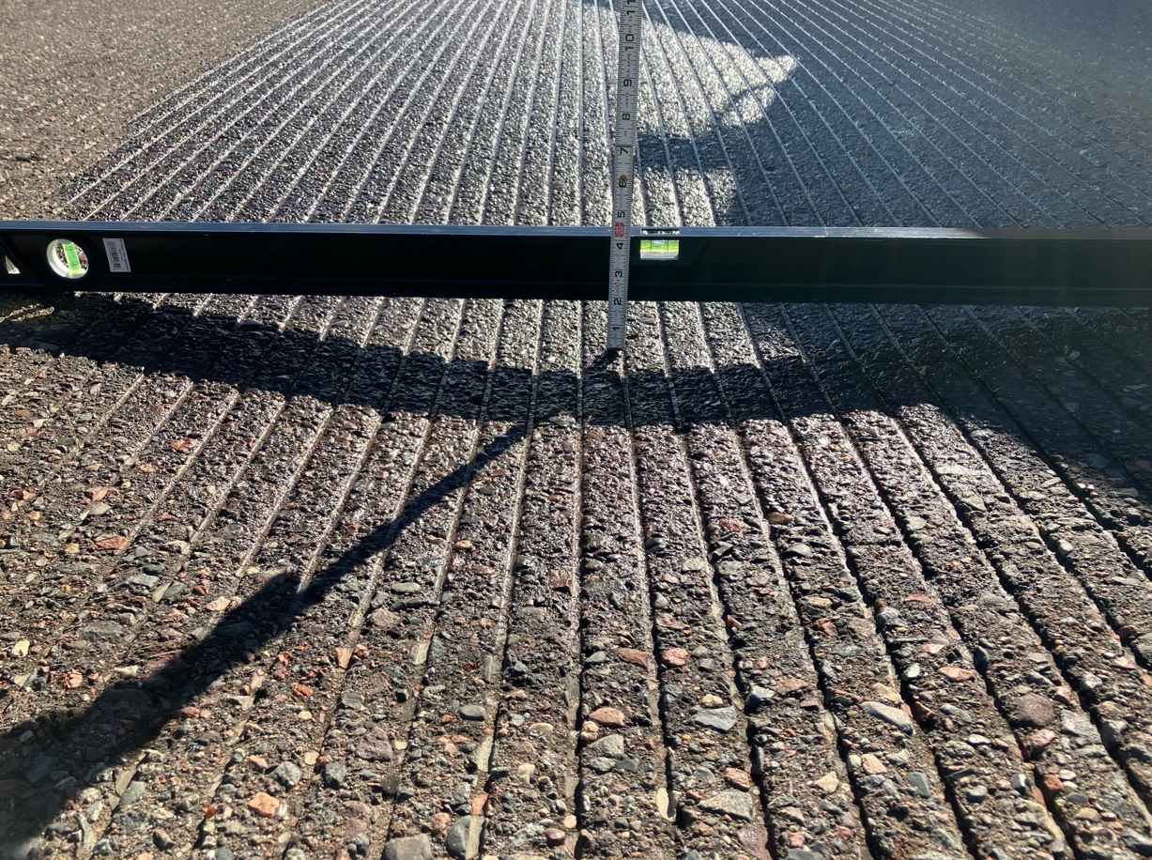
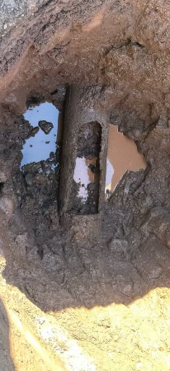
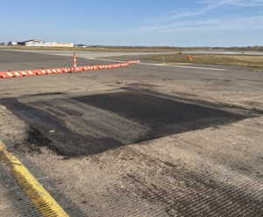
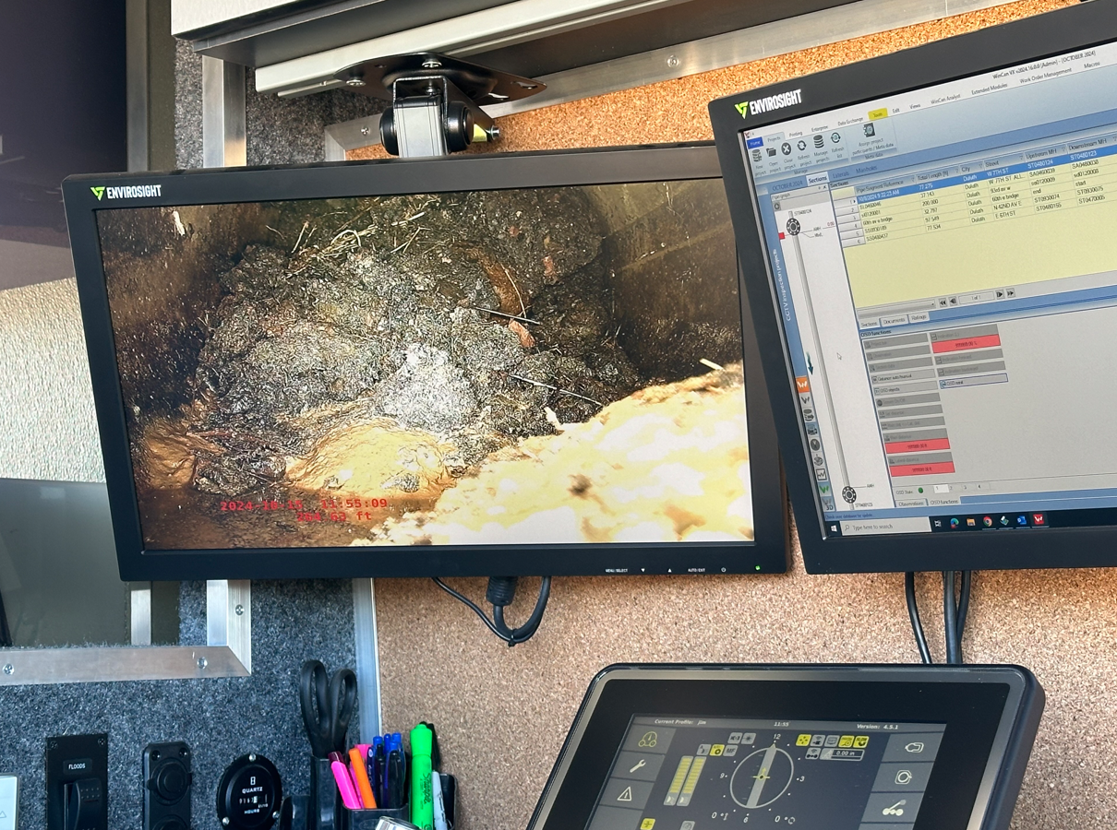
Runway 3/21 Repair

Slide 8
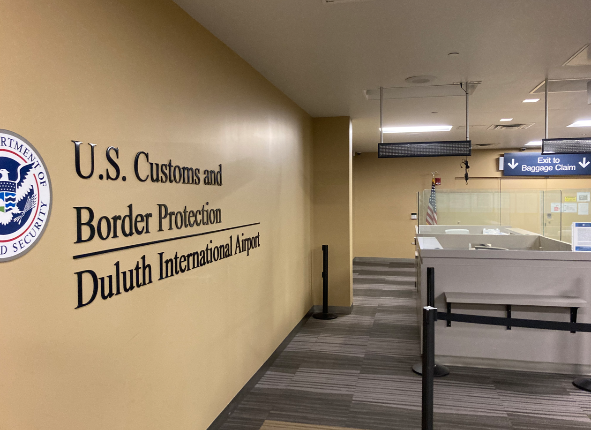
Customs and Border Protection FIS Construction Update

Slide 9
2024 Construction Statistics

Slide 10
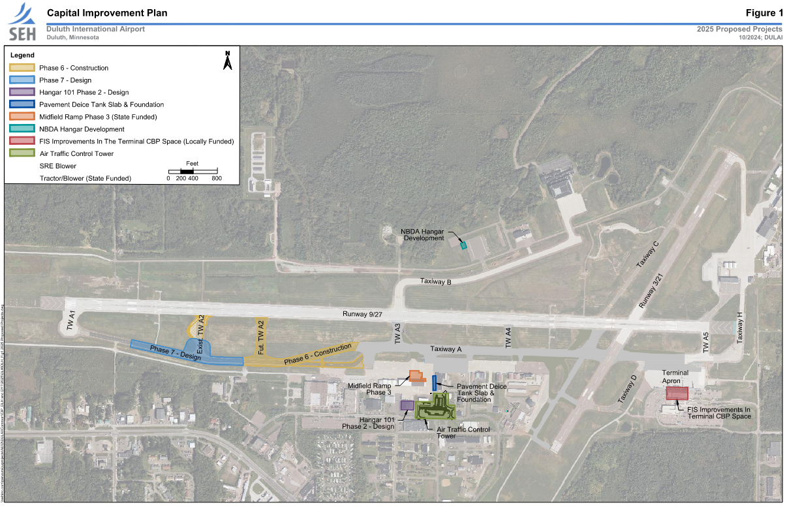
Duluth International Airport
2025 CIP

Slide 11
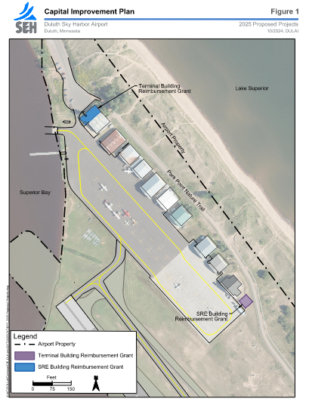
Sky Harbor 2025 CIP

Slide 12
A. Resolution to Approve the 2025 DLH and DYT Capital Improvement Plan
WHEREAS, Duluth Airport Authority (DAA) staff coordinated a Capital Improvement Plan (CIP) for Federal Fiscal Year 2025 (October 1, 2024 – September 30, 2025), and State Fiscal Year’s 2025-2026 (July 1, 2024 – June 30, 2025 and July 1, 2025 – June 30, 2026) with Federal Aviation Administration (FAA) and Minnesota Department of Transportation Aeronautics Division (MnDOT) staff;
RESOLVED, that DAA approves the 2025 Capital Improvement Plan for Duluth International Airport and Sky Harbor Airport as described and calculated in the Excel document attached hereto and incorporated by reference as Exhibit A; and
FURTHER RESOLVED, that DAA staff are authorized to execute agreements and make payments consistent with the 2025 Capital Improvement Plan for Duluth International Airport and Sky Harbor Airport as described and calculated in the Excel document attached hereto and incorporated by reference as Exhibit A.

Slide 13
B. Resolution to Authorize DAA Executive Director to Execute a Memorandum of Understanding with AFSCME Local 66 Regarding Shift Duration
RESOLVED, by the Duluth Airport Authority (DAA) that the DAA hereby authorizes DAA Executive Director to execute a memorandum of understanding (MOU) with AFSCME Local 66 regarding shift duration.
FURTHER RESOLVED, by the DAA, that the proper DAA staff will fully review the current Collective Bargaining Agreement and Employee Handbook and Personnel Policies to ensure that all impacts to the agreements and policies are well understood.
FURTHER RESOLVED, by the DAA, that the proper DAA staff will draft the MOU which includes all edits to the Collective Bargaining Agreement that are necessary to ensure proper implementation can be achieved.

